Slide 1
TEMPLE:
TEMPLate Enhancement through Knowledge Acquisition
Yolanda Gil
Jim Blythe
Jihie Kim
Surya Ramachandran
http://www.isi.edu/expect/projects/temple

Slide 2
Acquiring Planning Knowledge
Problem: SOF users need to add knowledge to the planning tools developed in AcT
  ROEs, commander’s guidance
  Plan evaluation/critiquing criteria
  Highlight the information that is important to them
  Add/extend templates
Approach: provide knowledge acquisition tools to adapt and extend pre-existing planning knowledge
  Exploit ontologies and background knowledge so users don’t have to start from scratch
  KA Scripts guide the user through multiple steps
  Users manipulate English paraphrases of internal representations
Benefits:
  Users can extend the tool’s baseline knowledge for the operation
Notes:
T]

Slide 3
Kinds of knowledge that users need to add
Factual information
  Situation-specific: the amcits are currently located at the embassy
  Persistent: The embassy is located at these lat-long coordinates
New features and classes
  Add new features: contracts have an upper limit on hotel rates
  Add new classes: security clearances, new equipment
New plan constraints and preferences
  Preferences and default values: By default, rent from Hertz
  Plan constraints (e.g. ROEs):
  all activity must be completed during hours of darkness.
New planning operators and templates
  to fly overseas, modify the “fly” template to fill in passport and visa information

Slide 4
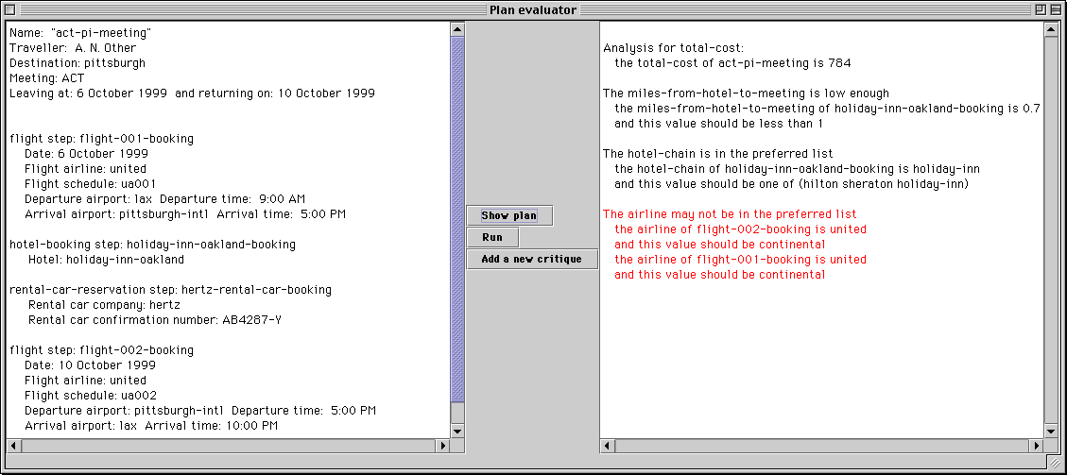
A simple application for evaluating plans

Slide 5
Acquiring plan critiques
A critique is an evaluation of a plan based on some feature
To parachute, wind speed must be less than 20 knots.
If you are visiting a military location, then by default you need a clearance.
Driving time should be less than 4 hours.
To compute driving time, find the trip distance and divide it by 55.
Choose hotels within walking distance, otherwise rent a car.

Slide 6
The range of possible critiques
To understand the nature of critiques, we look at dimensions along which they can be described.
This is useful to characterize TEMPLE’s current and future coverage.
Three features we consider:
  1. the amount of work done by the critique.
  2. the type of knowledge used.
  3. how the critique is used in other systems.

Slide 7
1. The amount of work done by the critique
“the driving time is 4 hours” provides information
“this is greater than the maximum of 3 hours”
compares the feature with a norm (can also be minimum or a set of values)
“therefore I recommend you fly instead”
suggests a correction to the plan
“prefer a route that avoids population centers unless it takes longer than 4 hours”
specifies a tradeoff between features

Slide 8
2. The type of knowledge used to make the critique
hotel
trip
contract
funds
purpose
located-in-city
...
Principle investigator
daily-rate
part-of
Start date
facilities
at
reservation
rec. max hotel rate
...
arrival-time
...
...
“hotel daily rate must be less than 120”
compares the feature with a constant
“hotel daily rate must be less than the recommended maximum for the contract under which travel is funded”
specifies how to find the value

Slide 9
Type of knowledge used (continued)
“driving time must be less than 3 hours.
To estimate driving time, find the distance (from MapQuest) and divide it by 55”
User defines a simple procedure to compute the feature
“rent a car if it costs less than using a taxi. To estimate rental car cost, multiply the rate by the length of the stay. To estimate taxi cost, add up the estimated cost for each necessary journey.”
User defines more complex procedures for the feature and the max value.

Slide 10
3. How the critique is used by other systems
Critiques can be shown directly to the user, or can be used to guide a planner.
evaluator
user
evaluator
user
plan
plan
planner
evaluator
user
critiques
plan
planner

Slide 11
TEMPLE’s approach
TEMPLE uses general knowledge about the different categories of critiques and understands how the added knowledge will be used.
Asks the user questions to identify which category of critique is being defined.
Helps break the definition of a critique into manageable pieces.
Presents a general sketch of the critique based on its category, so the user can complete the definition.
Analyzes the definition for missing or inconsistent pieces and suggests ways to address them.

Slide 12
Categories of critiques
global (assessed once)
Critique
local
(assessed on each of a set of objects)
upper bound
bounded
lower bound
Critique
inclusion (value must be one of these)
extensional
exclusion (value must not be one of these)

Slide 13
General knowledge associated with each category
To determine whether a plan satisfies a property with an upper bound:
  Estimate the value of the property for the plan
  Estimate the maximum allowed value of the property for the plan
  Check that the actual value is not greater than the maximum value

Slide 14
Evaluation and Critiquing Knowledge
Plan
ontology
(PLANET)
Submethods
for checking
plan resources
Submethods
for checking
plan structure
Ontology of
critiques
Ontology of
resources
Reused
knowledge
(ontologies
and methods)
Domain-specific
knowledge
Domain-specific
critiques
Domain-specific
plan critiquing and evaluation system
Domain-specific
submethods

Slide 15
Help with missing or inconsistent pieces
To estimate taxi cost, add the following:
  Estimate taxi cost for travel between airport and hotel
    Compute the taxi cost for a trip from the airport to the hotel
    Multiply the cost by 2
  Estimate taxi cost for travel between the hotel and the meeting
    Compute the taxi cost for a trip from the hotel to the meeting
    Multiply the cost by 2 * the number of days of the meeting
To compute the taxi cost for a trip from a location to another location:
  …
TEMPLE can notice that a meeting is not a location and help resolve the difference.

Slide 16
Components of TEMPLE’s UI
Application
KB Browser
search
Acquisition
wizard
organize
Interdependency
analyzer
Acquisition
analyzer
select method
Method editor
suggest
domain and range
suggest
class
Relation/concept editor
Instance editor
Highlights needed information from interdependencies

Slide 17
TEMPLE architecture: now
Common lisp
Java
SERVER
TEMPLE GUI
Domain
knowledge
Background
knowledge
Application
Problem
solver

Slide 18
Using the TEMPLE compiler
(initial prototype)
Common lisp
Java
SERVER
TEMPLE GUI
Domain
knowledge
Background
knowledge
Application
Java
code
compiler
Problem
solver

Slide 19
Using the TEMPLE translator
Common lisp
Java
SERVER
TEMPLE GUI
Domain
knowledge
Background
knowledge
Application
Critique
library
translator
Problem
solver

Slide 20
TEMPLE’s current scope
TEMPLE helps users to:
  Define features
  Add norms and critiques that compare features with norms
Through its editors and dependency analyzer, TEMPLE can support users to define critiques that use complex procedural knowledge.
TEMPLE defines critiques that are used by a stand-alone critiquer.

Slide 21
Planned work for the near term
Extending range of critiques supported
  Include critiques on resources (PSMTool [Blythe 2000])
Integration with other AcT software
End user evaluations for prototype system
SOF domain

Slide 22
Defining monitors
The same mechanism that TEMPLE uses to acquire critiques can be used to acquire monitors.
This requires extending TEMPLE to reason about temporal aspects of data.
Another requirement is an available source of data updates.

Slide 23
HPKB KA CCE
NL editor called by
PSM-based script
Early version of
the critique wizard

Slide 24
HPKB KA CCE results
Users could complete more tasks using the tool
Users could complete tasks faster using the tool
LEGEND:
indicates total tasks
With the tool
Without the tool
Adding small amounts
of new knowledge
2.12 ax/min
1.1 ax/min
Adding larger amounts
of new knowledge
1.26 ax/min
(unable to complete)

Slide 25
Demo

Slide 26
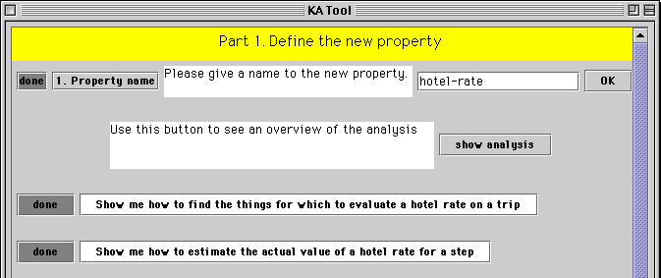
Example: hotel rate should be less than $120
TEMPLE begins with questions to help the user get started.
This example is included in the demo.

Slide 27
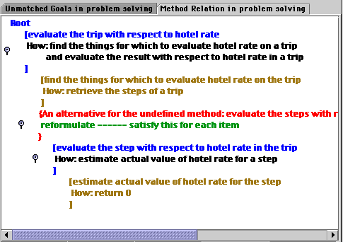
Example continued
TEMPLE shows a map of the critique definition so users can see how the new knowledge is used.

Slide 28
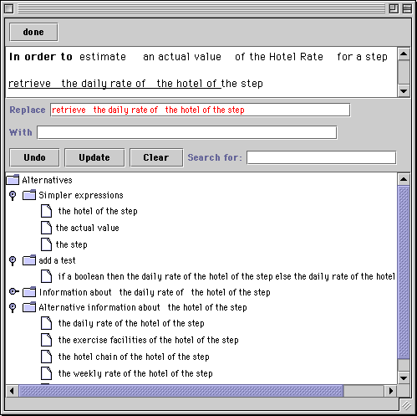
Example continued
As the user steps through the questions, TEMPLE calls an English-based editor to provide procedures

Slide 29
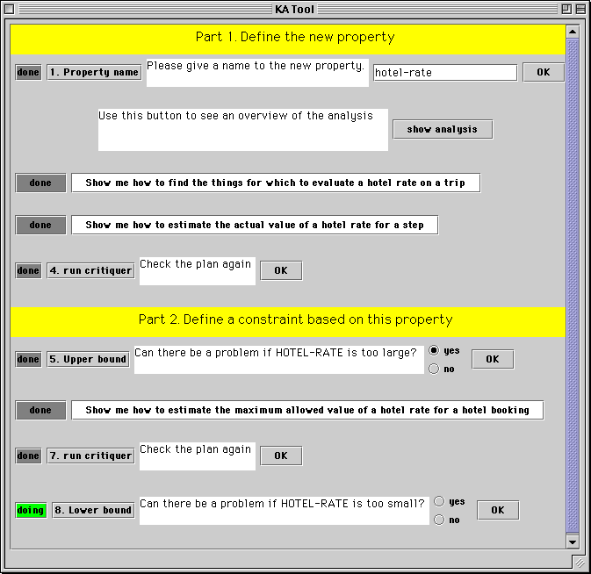
Example continued
As it identifies the critique, TEMPLE breaks its definition into manageable pieces through the questions it asks.

Slide 30
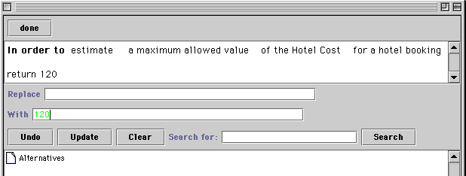
Example continued
TEMPLE’s editor is easy to use for simple critiques, but (as we will see) powerful enough for more complicated ones.

Slide 31
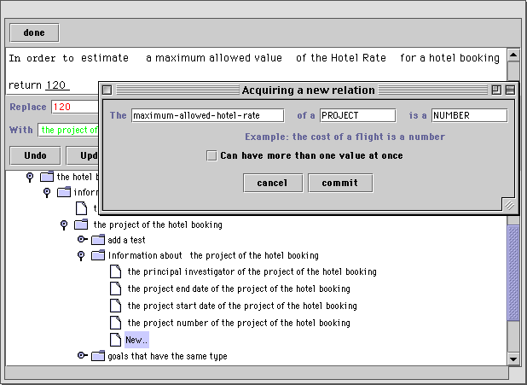
Going further: adding new slots to objects
If defining the constraint requires adding new slots to the data base, TEMPLE can provide guidance.

Slide 32
Going further: notification about needed information
TEMPLE analyzes the critique to see what information is needed, and warns the user if that information is not available. TEMPLE can provide guidance for adding that information through an editor.
(Will show a screenshot of the agenda and (next slide) the instance editor)

Slide 33
Definitions that include procedures
TEMPLE’s editor can be used to create procedures when needed
(Will show the driving time example here.)

