Slide 1

Enhancing Active Templates through Knowledge Acquisition
Jim Blythe and Yolanda Gil (PI)
Temple project
USC Information Sciences Institute
http://www.isi.edu/expect/temple

Slide 2
Why we need knowledge acquisition for constraints in active templates
Active Templates can use constraints to:
  restrict possible values for an information element,
  supply a default value,
  check consistency as templates are filled,
  link the template values to other data sources.
End users must be able to add and modify constraints in templates to suit their current needs.
  The initial constraints will not anticipate all possible situations.
  Operations often have unique constraints or use new equipment.
  Users will want to customize templates.

Slide 3
Examples of constraints
Flight time must be less than 3 hours.
The max runway landing distance at the airport must be at least the minimum required for the aircraft used.
By default choose the closest among the airfields with adequate runway length.
Compute the driving time by finding the distance from mapquest and dividing by 55.

Slide 4
The challenges of acquiring constraints for templates
End users will not be familiar with the underlying representations or the syntax for templates and constraints (and should not need to be).
Users often have difficulty following the multi-step process required to add complex constraints.
Users may need to integrate information from several different data sources to define a constraint.

Slide 5
Approach: building on knowledge acquisition techniques (Expect, HPKB and ARPI)
Constraint wizards use default constraint types to help the user define a constraint. (KA dialog scripts)
  Reduces the need for the user to know the constraint syntax.
  Helps the user through a multi-step process.
An English-based editor including an expression composer allow users to modify constraints. (NL paraphrasing)
  Further reduces the need to know the syntax.
  Constructive search capabilities help users create valid constraints.
Constraints are built from terms known to system. (Expectation-based KA)
  User can add new terms
  More recently, terms come from models of live data sources

Slide 6
Initial work (April-July 2000):
Acquiring user preferences and critiques
Developed initial version of TEMPLE that draws from several Expect tools
Application
KB Browser
search
Acquisition
wizard
organize
Interdependency
analyzer
Acquisition
analyzer
select method
Method editor
suggest
domain and range
suggest
class
Relation/concept editor
Instance editor
Highlights needed information
from interdependencies

Slide 7
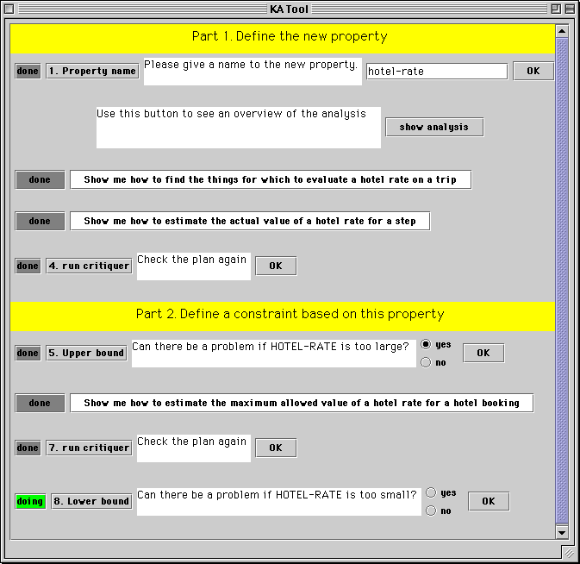
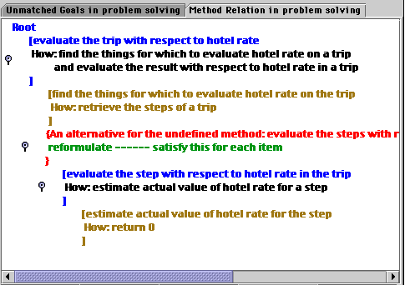
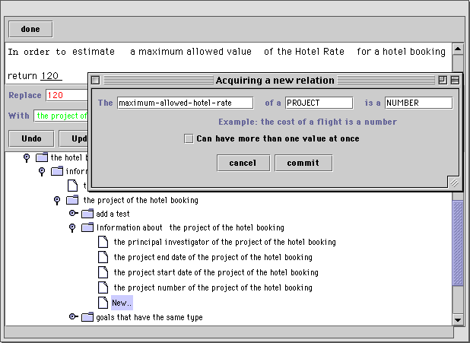
Acquiring User Preferences with TEMPLE

Slide 8
Initial version of TEMPLE: capabilities
Enables users to enter complex constraints.
  The taxi cost (distance multiplied by the local cab mileage rate) should be less than the cost of parking (daily rate multiplied by length of trip)
Designed to enter user preferences and critiques.
Tool hides underlying syntax and representation.
  Paraphrases domain ontologies and procedural knowledge
Underlying techniques tested with Army officers at Fort Leavenworth KS for the DARPA HPKB Knowledge Acquisition Critical Component Experiment, Summer 99.

Slide 9
Recent focus
Acquire constraints for active templates, not just user preferences and critiques.
  default values, restrictions on possible values, consistency checks, computing values.
Users can build constraints using terms from models of external data sources.
  Models built from XML descriptions of external sources.

Slide 10
Overview
KA system
Constraint
Wizard
Basic types
and operations
External
source
External
source
User
Models
of data
External
source
English
editor
Wrappers
Wrappers
Wrappers
Constraint
composer
Active
Templates

Slide 11
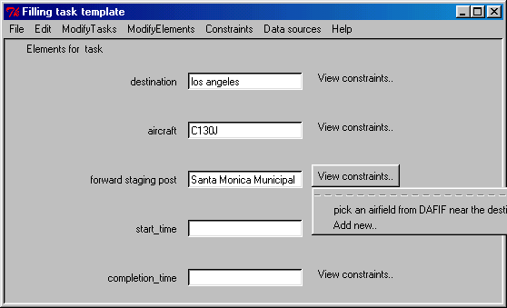
Example template

Slide 12
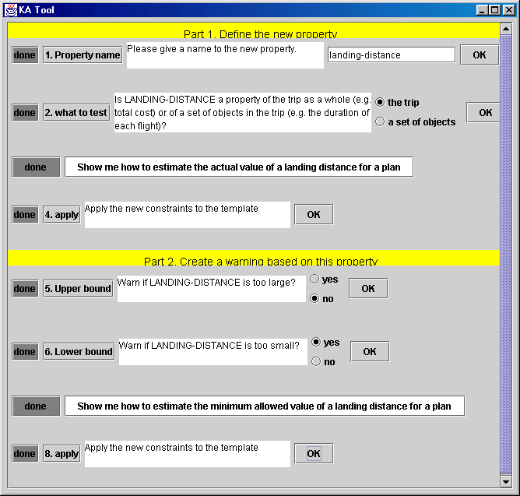
How constraint wizards help users
Provide a roadmap for defining constraints for a template’s information element.
default value
upper bound
lower bound
Invoking the editor
checking the constraints

Slide 13
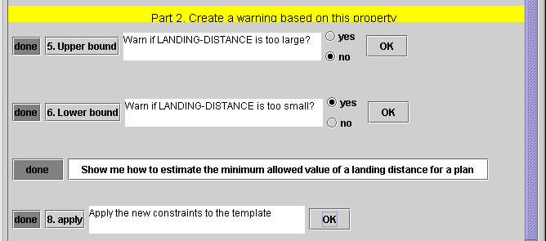
Using Constraint Wizards to add a constraint.

Slide 14
Building constraints that refer to external data sources
Users can create constraints using terms in models of external data sources.
Model contains object types, attributes, and queries.
Ex: Model for NIMA DAFIF.
Object Types: airport, runway, country, ICAO,
runway surface, ...
Available attributes for each type:
an airport has a latitude, a longitude, a set of runways,
a runway has a length, a hardness, ...
Queries:
  list all known airports.
  compute distance given latitudes and longitudes.

Slide 15
Basic data types and operations for constraints
KA tool has a small set of initial data types and operations used to compose constraints
Numbers
  add, subtract, divide, multiply, <, >, =, find max/min
Sets
  union, intersection, creation, filter with a boolean predicate, …
Booleans
  and, or, not, if-then-else
Strings
  equality, substring

Slide 16
Creating constraints with an English Editor
The constraint wizard invokes the English editor with a default definition of a constraint that the user can modify
The editor allows the user to select parts of the constraint definition and suggests alternatives for the selected part, shown as English phrases that correspond to syntactically legal expressions.
The user can also find alternatives by typing keywords, an expression composer finds syntactically legal compositions of terms that contain the keywords.

Slide 17
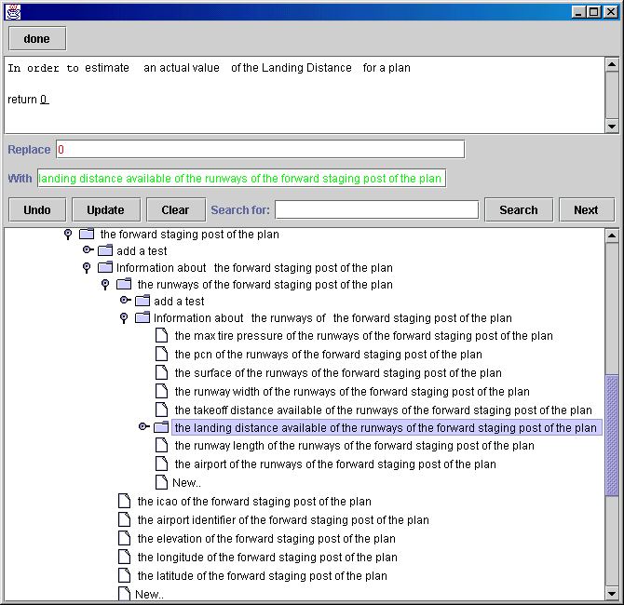

Slide 18
The expression composer
In the HPKB KA CCE, users sometimes had difficulty navigating through expressions to find the right one.
The user can type a set of terms and the expression composer creates valid expressions containing them.
Combines queries and attributes from all data sources and known functions that apply to data types.
runway
template
aircraft
use
landing distance
staging post
max speed
...
width
required landing dist
airport
hardness
max payload
latitude longitude
...
...
...

Slide 19
Using the expression composer
User types: “max staging post landing”
Tool suggests: “find the maximum of the landing distance available of the runways of the forward staging post”.
find
Function call
object
of
reformulation
maximum
landing-distance-available
Typed variable
combining queries
runways
Information element
?forward-staging-post

Slide 20
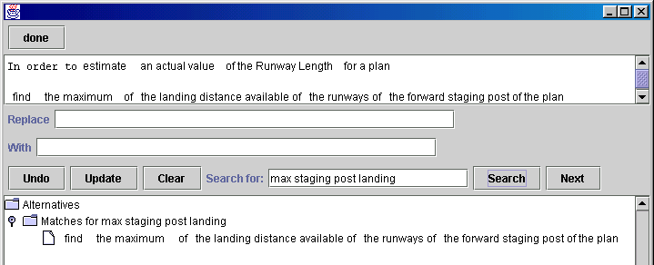
Using the English editor and constraint composer
Constraints can use any models of data sources whose objects, attributes and allowable queries are described.
For example, a user can add a constraint that the airport’s runway takeoff distance is large enough for the aircraft being used.

Slide 21
Using several data sources
We add a source of TAF weather data, which allows a query to find a TAF based on an ICAO code.
Types: TAF, ICAO, precipitation, ...
Fields: TAF has wind speed and direction, visibility, time covered, wave height, ...
Additional queries:
Can look up a TAF given an ICAO.

Slide 22
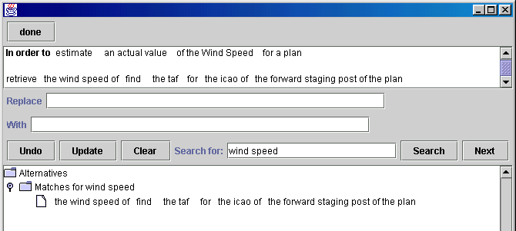
Defining constraints using several data sources
The expression composer can help a user refer to the wind speed at the forward staging post.
The composer automatically adds the step to retrieve the airport’s ICAO from the AFIF data source.

Slide 23
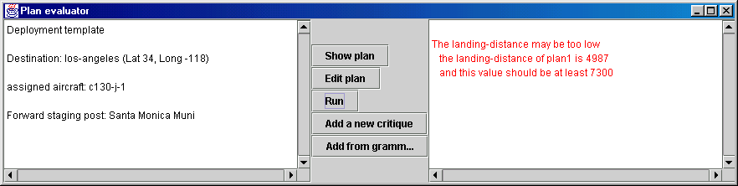
Exporting constraints
Constraints will be exported as XML to other Active Templates tools.
Constraints can be compiled to executable code.
TEMPLE’s constraint checking tool:

Slide 24
XML representation of a constraint
<constraintDescription>
<Action>Constrain
<InformationElement>force-assigned-to-clear-runway
<Template>airport-seizure-template</Template>
</InformationElement>
</Action>
<Term>
<Relation>subordinate-unit
<Term>
<InformationElement>main-force
<Template>airport-seizure-template</Template>
</InformationElement>
</Term>
</Relation>
</Term>
</constraintDescription>

Slide 25
Summary of the approach
Help users create new constraints through constraint wizards.
  Based on a default set of constraint types, the dialogs can provide a framework for the new constraint and in some cases create it automatically.
Help users define and modify constraints through a structured English editor with an expression composer.
  Reduces the need for a user to know the underlying syntax.
  Can combine different data sources and help build sequential queries.

Slide 26
Current status
Generalized the constraint wizards.
  Need better integration with information elements.
Developed expression composer used by the editor.
  User types strings, e.g. “wind speed at forward staging at arrival”
  Composer creates a valid expression which matches those strings as closely as possible.
Initial work in linking with external data sources
  Assumes a model of the linked sources: objects, attributes and queries.
  For example, constraints can link aircraft data with airport data from NIMA DAFIF and weather data from TAFs.

Slide 27
What is the scope of this tool?
The constraint language is expressive, allowing conditionals and iteration.
Users can define constraints that require a number of interacting functions.
  The interdependency analyzer catches errors and makes suggestions.
Users can also add and modify data fields and values while defining constraints.
See our demo for more details, or
[Blythe et al. Intelligent User Interfaces 2001]

Slide 28
Related work on Joint Defense Planning (JDP) for air campaigns
Plans are stated as collections of objectives and subobjectives
Objective grammars express well-formed objectives (INSPECT, ARPI and JFACC)
  Ex: defend OBJ <thing-to-defend> FROM <action> OF <redforces>
Objective editor helps users follow the grammar
Developed a grammar acquisition tool to extend objectives grammar
  Uses wizard-based dialogues to help user maintain consistency in the grammar
  Uses external data sources
    JDP DB of BattleField Objects (BFOs) includes locations, assets, …
Delivered 9/00, integrated within JDP, to be delivered to AOCs in 12/00 through GCCS
Useful technology for specifying SOF objectives

Slide 29
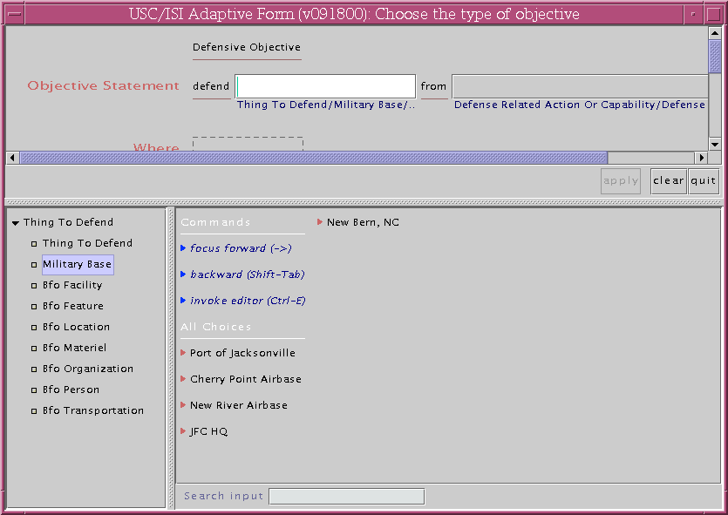
Adding an objective
The user invokes the editor to add a new term

Slide 30
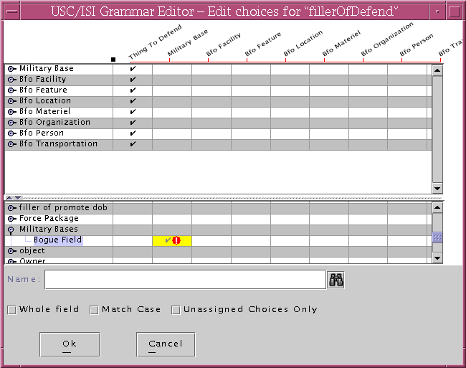
Adding a term to the grammar from the JDP database

Slide 31
Planned future work
Integrate with Active Templates tools.
  Integrate:
    constraints to information elements
    models of external data sources from other tools
  Current UI is Java.
User experiments.
  Test usability with end users by December.
Helping users define monitors.
  Investigate creating monitor wizards

