Slide 1

Phosphorus:
An Ontology-Based Agent Capability Matcher
e-Elves
Yolanda Gil
Surya Ramachandran
Jihie Kim
USC/Information Sciences Institute

Slide 2
Phosphorus:
Agent Capability Matching
Current approaches to find agents capable of performing a task will not scale up:
  one-to-one correspondence between agents and tasks
    e.g.: agent can only find routes between locations
  agents are selected and “matched” beforehand
  requests mirror agent advertisements
Approach: rich representations of capabilities
  case grammar (verb+roles), domain ontologies define terms
  fully translated to description logic and matched through classifier
  requests can be reformulated using term definitions
Benefits:
  Loose coupling between requests and advertisements
  Self-organizing index of capabilities

Slide 3
Ontology-Based Agent Capability Matching
Calculate round-trip time (RTT)
for aircraft
Find route from
location1 to location2
Calculate RTT
for transport
aircraft
Calculate RTT
for combat aircraft
Find egress route
from Ryad to Kuwait city
A) Subsumption-based match: the
request is subsumed by an agent’s capability
B) Reformulation-based match: the request can be
satisfied by combining the capabilities of two or more agents
Find route
from location1 to location2
Find addresses
of US citizens
in Kuwait
Find phone numbers
of US citizens
in Kuwait
Find route from
city1 to city2
C) Reverse subsumption-based match: an
agent can satisfy some aspect of the request
D) Partial match: an agent has a capability that
is similar/related to the original request

Slide 4
Phosphorus Overview
Teamcore
A
A
A
Phosphorus
Query
Editor
Phosphorus
Matchmaking
Service
Phosphorus
Capabilities
Editor
User’s
Capabilities
Description
Web
Browser
WWW

Slide 5
An Actual Matcher Query Issued by e-Elves
Request (breakdown (discuss (obj (spec-of coabs-project))))
Reply:
(COVERING -name ARIADNE-PROJECT
-matches KNOBLOCK MINTON LERMAN
-name PHOSPHORUS-PROJECT
-matches GIL SURYA HANS TAR
-name TEAMCORE-PROJECT
-matches COVERING (
-name PDA-PROJECT
-matches TAMBE PYNADATH LINGDEI
-name MULTIAGENT-LEARNING-PROJECT
-matches MODI TAMBE
-name ADJUSTABLE-AUTONOMY-PROJECT
-matches TAMBE SCERRI PYNADATH
-name TEAMWORK-PROJECT
-matches TAMBE PYNADATH MODI)
-name ROSETTA-PROJECT
-matches HANS TAR)
Who can present the coabs project?
Well, there are several coabs projects. Ariadne can be presented by either Craig, Kristina, or Steve. Phosphorus can be presented by Yolanda, Surya, Hans, or Tom. Teamcore is also a coabs project but there are several subprojects to it. The pda project can be presented by Milind, David, or Ling.
...
Matcher breaks down
the query
by reformulating it
using ontologies
TEAMCORE can now dynamically find team roles and agents to assign to those roles

Slide 6
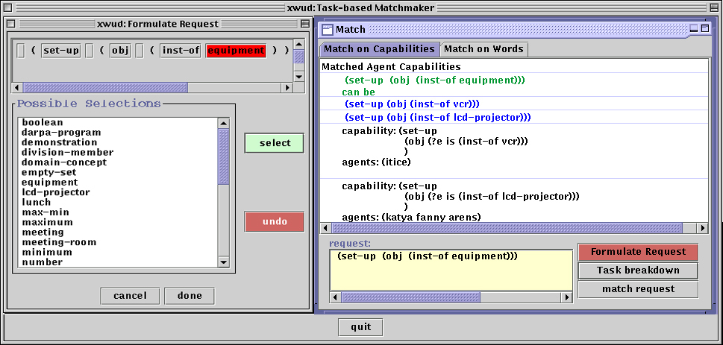
Phosphorus Query Editor

Slide 7
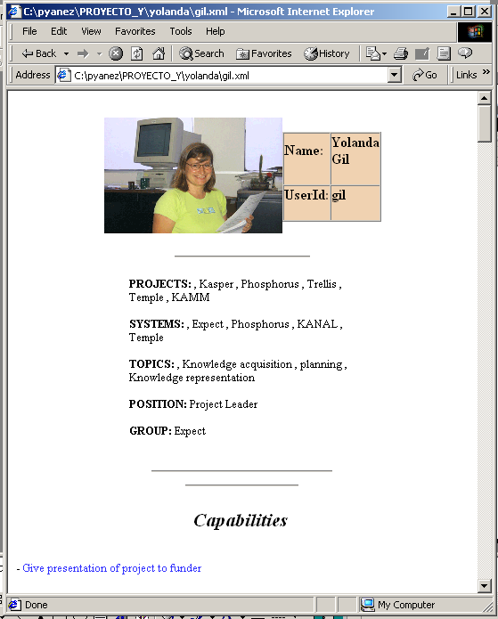
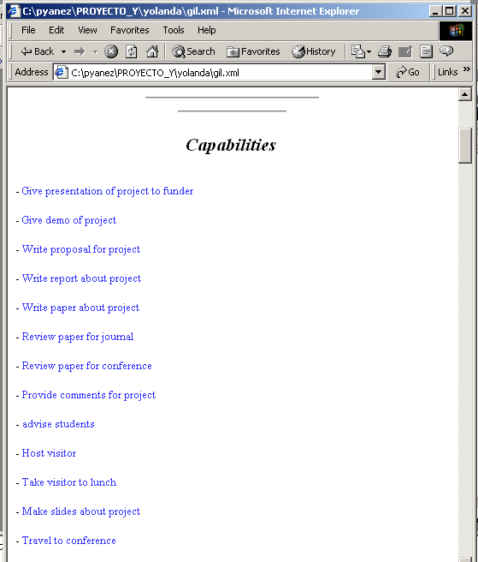
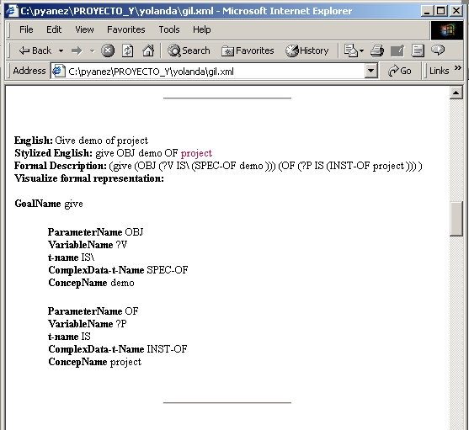
Work in Progress: User’s Capability Descriptions

Slide 8
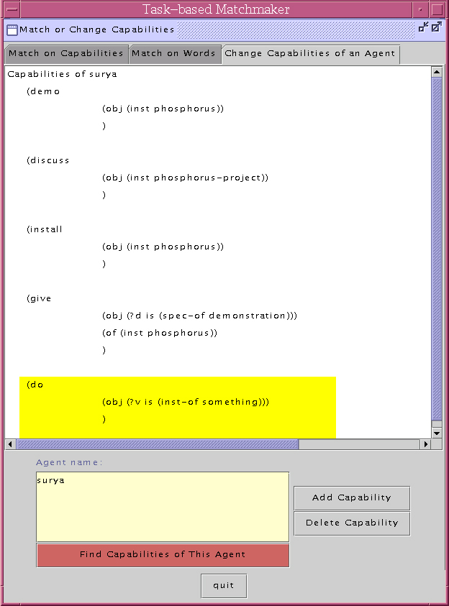
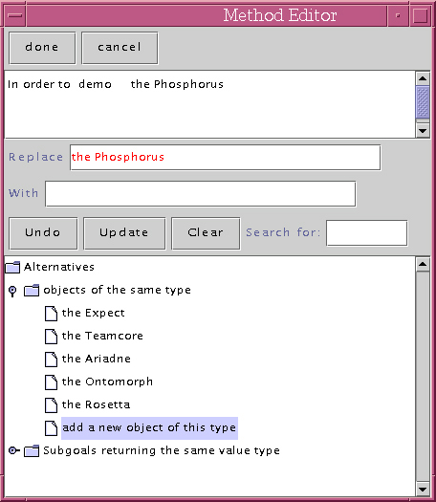
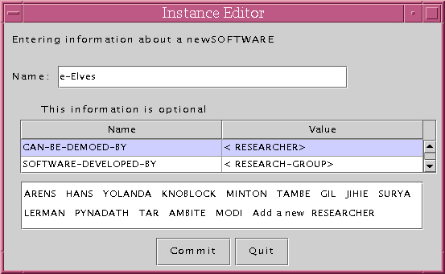
Work in Progress:
Phosphorus Capabilities Editor

Slide 9
Future Work
Extend descriptions of agent capabilities:
Further decouple agent advertisement from agent invocation
e.g.: request: find route to San Diego
  Imprecise specs: surface route? air route?
  Missing input data: from where?
  Qualification of results expected: 3ft segments? major points?
Agents that can perform a wide range of tasks (e.g. people!)
  Flexible invocation (request can mention subtasks)
Represent qualifications of agent capabilities
  Willingness (esp. for people), reliability, efficiency, expected delegations, differential properties,…
Heterogeneity

Slide 10
BACKUPS

Slide 11
Describing Agent Capabilities and Requests
Represent task descriptions more declaratively
  Case grammar: verb + roles (EXPECT’s language for problem-solving goals)
  Rich parameter language
  Terms expressed in domain ontology
Examples:
(give (obj (spec-of demonstration)) (of Teamcore))
(process (obj (spec-of reimbursement)) (for (set-of receipt)))
(demo (obj coabs-project))
        task qualification parameter
        qualifies the task to be done
        used for matching
        allows same method to be used for variety of tasks
Terms are defined in ontology
(and research-project (the funded-by coabs-program))

Slide 12
Reasoning about Agent Capabilities and Requests
Descriptions are fully translated into description logic (Loom)
(and demo
(the obj coabs-project))
Capabilities and requests are organized by Loom’s classifier, exploiting term definitions
(and demo
(the obj (and research-project (the funded-by coabs-program))))
Reformulations of requests through class partition & sets
(setup (obj (equipment)))
(setup (obj (lcd)))
(setup (obj (vcr)))
(demo (obj (Ariadne Teamcore)))
(demo (obj (Ariadne)))
(demo (obj (Teamcore)))

Slide 13
Benefits
Loose coupling
  Flexible invocation: requests do not have to mirror the agent descriptions as originally stated
  Suggests alternative formulations of requests when requests do not match exactly the capabilities of available agents
Declarative representation of task descriptions
  Not only data parameters but also task qualification parameters
  Semantics of the task and its arguments are at the core of the matching process
Automatic organization of agent capabilities
  Object and task taxonomies are basis for indexing agents

Slide 14
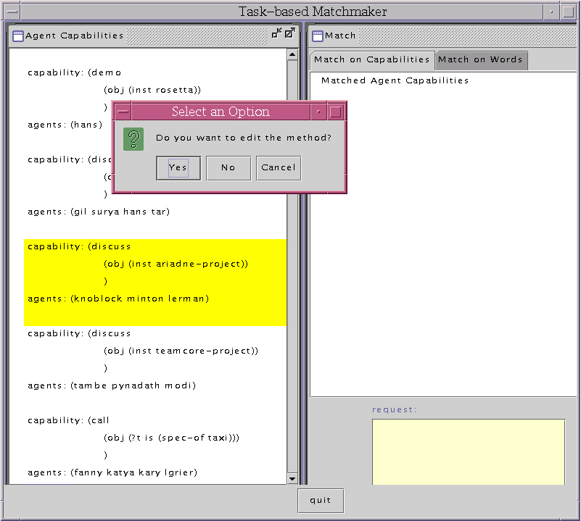
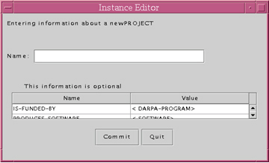
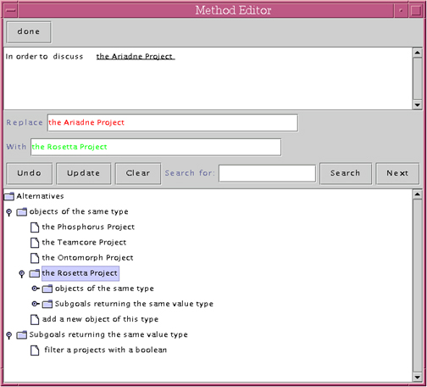
Recent Work:
Phosphorus Capabilities Editor (OLD)
Gil

