Slide 1
COA critiquing through normative simulation
COA critiquing through expected effects

Slide 2
COA critiquing through normative simulation
We focus on knowledge about actions to help critique COAs
  Examples:
    Check if the available force ratio of a given action is greater than or equal to the required-force-ratio of the action type
    Check how remaining strengths of the units change over performed actions
    Check if a given Move action can be performed based on the equipment and terrain type
    Check how unit locations change by moving actions
    …
Each action in the COA is checked by normative simulation (see next slide)
Critiquing knowledge may be modified by changing knowledge about the action types and the objects

Slide 3
KANAL: Critique based on knowledge about actions
Critiques are generated by a normative simulation that uses knowledge about actions
Simulation checks what happens before and after each step based on its background knowledge (component library)
  KANAL uses conditions and effects of each action
  Examples:
    Precondition on required force-ratio: an attack-to-destroy step has force-ratio value 2.5 but 3:1 is required
    Precondition on appropriate terrain type: tank units cannot move on Forest or Lake, “Tanks in the open ground, infantry in the woods”
    Effect on remaining strength: Remaining strength of Blue3 is still greater than 85% after the attack-to-destroy step
    Effect on location: After a move, the location of the unit changes to the destination
    Effect on time: after a step, the time changes based on its duration
    . . .
event1
event2
event3
event4

Slide 4
Example: combat power critiques
Charley’s comment: ” the elements of relative combat power would be a useful enterprise, even an essential one.”

Slide 5
Combat power critiques are challenging
Default values can be estimated based on units and equipment
  Default required force ratio for attack-to-seize is 3:1
  Default combat power of M1A2 battalion is 1.2 when baseline is M2 battalion
Defaults need to be adjusted to account for: surprise, positional advantage, deception, morale, initiative, etc.
  Examples from HPKB
    Typically require ratio of 3:1 for attack, but only 2.5:1 for attack on units in a ‘hasty defense’.
    Required force ratio is also reduced if the red forces are making a ‘mobile defense’.
    available force ratio increased if the red forces are canalized (strung out): can penetrate and only engage 1 sub-unit.

Slide 6
Combat power critiques are challenging (cont)
  More Examples:
    Battle position: If attacked unit is not in a prepared position, then need less force ratio
    If no minefields, open terrain, and good cover then higher speed and less casualties
    Morale: e.g. If all the other units are losing, your task may have more attrition
    Fatigue: e.g. If unit has already involved in more than one attacks then the attrition rate will be higher
    Combat advantage: If special equipment is available (e.g. night vision, air launched cruise missiles, commandos, special ops) then higher combat power
    Deception
    …

Slide 7
Default Knowledge about Military-Task
agent (unit-assigned)
Military-Unit
Military-Task
object (unit-acted-on)
Military-Unit
type-of-operation
required-force-ratio
agent-attrition-rate
available-force-ratio
object-attrition-rate
Number
Number
Military-Operation
Number
Number
Precondition: available-force-ratio > required-force-ratio
Effects(add/del list):
for each agent, change its remaining strength by the attrition rate
for each object, change its remaining strength by the attrition rate

Slide 8
Default Knowledge: Attack-to-Destroy
agent (unit-assigned)
Military-Unit
Destroy
object (unit-acted-on)
Military-Unit
type-of-operation
required-force-ratio
agent-attrition-rate
available-force-ratio
object-attrition-rate
3
Attack
50%
10%
Number
Precondition: available-force-ratio > 3
Effects(add/del list):
for each agent, change its remaining strength by multiplying 0.9
for each object, change its remaining strength by multiplying 0.5

Slide 9
Default Knowledge about Military Units
equipment
Military-Equipment
Military-Unit
echelon
default-combat-power
Echelon
remaining-strength
Combat-power-value
Number
value
baseline
Number
Military-Unit
Example: Blue3 (Battalion-with-M1A2AbramsTank)
equipment: M1A2Abrams
echelon: battalion
default-combat-power: ((value 1.21) (base-line M2-battalion))
remaining-strength: initially 1

Slide 10
Estimating available force ratio
available-force-ratio:
sum of agent combat power (remaining-strength * default combat power)
/
sum of object combat power (remaining-strength * default combat power)
Example: Attack-to-Fix
type-of-operation: Attack
required-force-ratio: 1
agent (unit assigned): one Battalion-with-M1A2AbramsTank (B1),
one Battalion-with-M60A3 (B2)
object (unit acted on): two Battalion-with-BattletankT64 (R1,R2)
agent-attrition-rate: 0.8
object-attrition-rate: 0.5
available-force-ratio: (1.21+0.9) / (0.5+0.5)
Precondition check: actual-force-ratio (2.11/1.0) > required-force-ratio (1) OK!
Effects(add/del list):
B1,B2: remaining-strength 0.8
R1,R2,R3: remaining strength 0.5

Slide 11
An example of COA critiquing
step ordering
Attack-to-Fix
    agent: 1st brigade
    object: 2nd tank brigade
    required-force-ratio: 1
    actual-force-ratio: 0.86
    object attrition: 20%
    agent attrition:20%
COA
sub-event
Move
next-event
Attack-to-Fix
Attack-to-Destroy
agent
object
1st brigade
2nd tank brigade

Slide 12
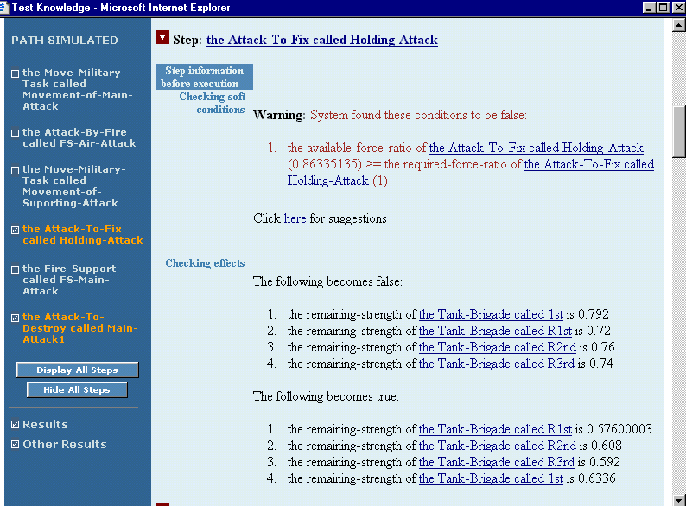
Failed condition of Attack-to-Fix

Slide 13
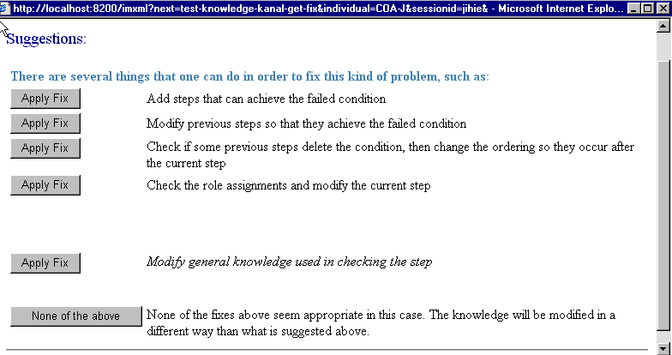
Suggested fixes
User selects this

Slide 14
COA is improved based on critique
step ordering
Attack-to-Fix
    agent: 1st brigade, cavalry squadron
    Object: 2nd tank brigade
    required-force-ratio: 1
    actual-force-ratio: 1.71
    object attrition: 20%
    agent attrition:20%
COA
sub-event
Move
next-event
Attack-to-Fix
Attack-to-Destroy
agent
object
1st brigade
2nd tank brigade
Cavalry Squadron

Slide 15
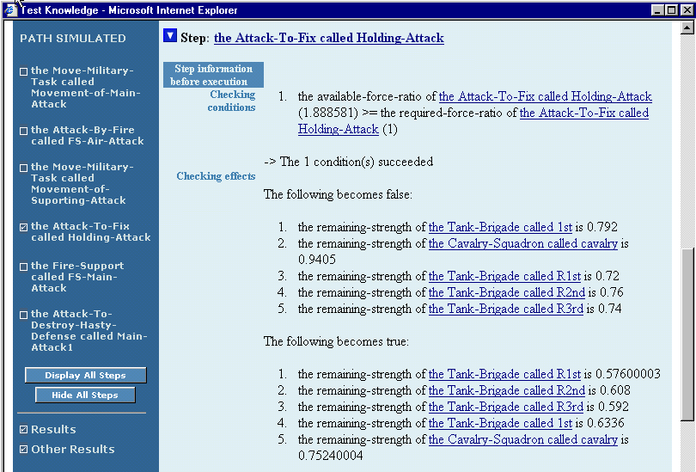
The condition is now satisfied

Slide 16
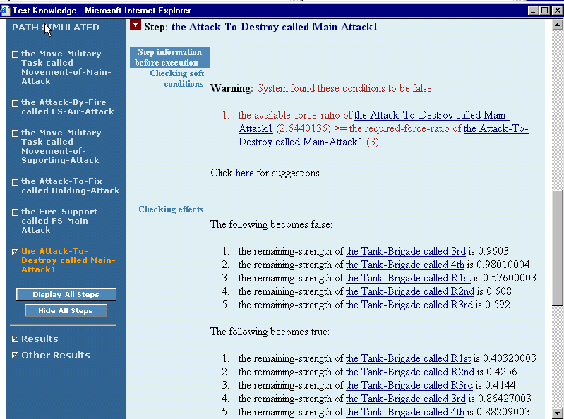
Another case of force-ratio problem:
Attack-to-Destroy

Slide 17
Using Action Editor

Slide 18
Modifying critiquing knowledge using special cases of actions
Kanal critiques a COA based on what it knows about actions
To provide new critiquing knowledge to Kanal, you can create special cases of the actions tailored to the domain
  Capture certain situations where values are different
  Tell Shaken about the essence of these situations

Slide 19
Modifying critiquing knowledge using special cases of actions
Desired modification
  If Red is not in a prepared position, a force ratio of 2.5 is sufficient for Destroy-Unit
User creates a special case of Destroy-Unit to take into account Red’s position

Slide 20
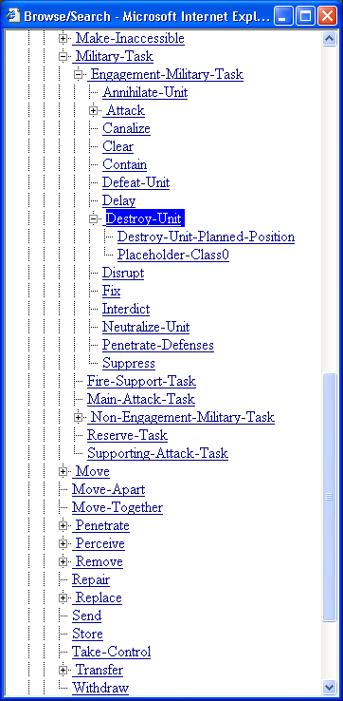
Special cases of actions
Component library contains a generic definition of Destroy-Unit that cannot be changed by users
The user can add different special cases of ‘Destroy’, shown here in a hierarchy.
The special cases of the actions represent modified default behavior.
Destroy-unit-terrain-adv
Destroy-unit-terrain-adv
Notes:
We can start from the standard Shaken class hierarchy, where the user can see the subclasses of the Destroy action that are currently defined.

Slide 21
Destroy-Unit:
  object attrition is 50%
  agent attrition is 10%
Special case of Destroy-Unit: When red has medium terrain advantage
  object attrition is 35%
Destroy-unit-terrain-adv
Notes:
The ‘triggers’ correspond to the defining elements of the subclass in KM. Here we only show the information that distinguishes an action from its parent, rather than the information distinguishing, for example, Destroy-RedTerrainAdvantage from Destroy. The full defining condition can be found as the conjunction of triggers along the path back to the root. This defining condition can then be used so that KM’s matcher can identify the appropriate action. Triggers can be shown and defined through CMAPS with the general ability to show distinguished nodes and links, as shown in the next slide.
We aim to show information to the user about an action that includes the trigger and any important properties that are different from the parent action. The boxes in this slide showing that information could be implemented using the text box that already appears when the mouse moves over an element in the hierarchy, with information about the trigger and properties automatically generated in cases where the user defines the action and there is no associated text description.

Slide 22
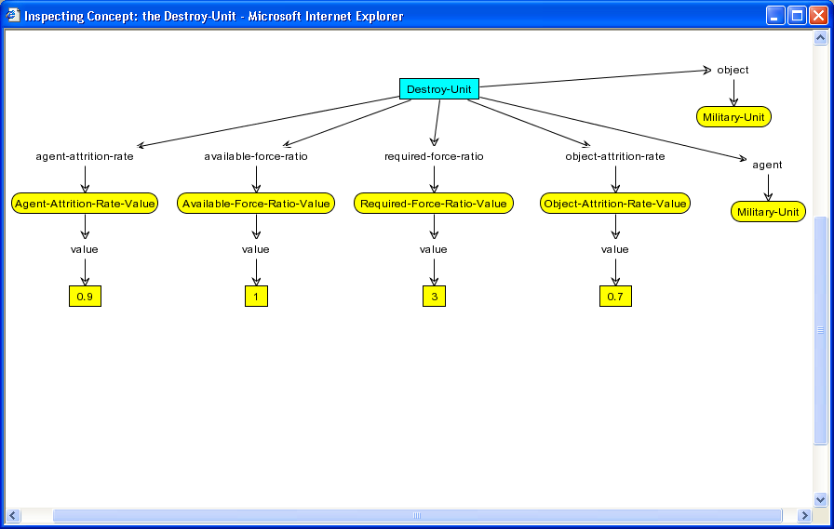
The CMAP view shows the default values for action properties
Notes:
The idea of allowing a distinguished set of nodes and/or links to be viewed and set in the CMAP has been discusses as a generally useful modification. Here it can be used to define the trigger of the action, which is created as a subclass of the parent action. In this slide, the trigger conditions are shown surrounded with a red box, but the actual mechanism doesn’t affect the way it is used here.
The two properties shown here are used in the preconditions and effects defined in pump priming on the Destroy-MilitaryUnit action. I’m using green for the property values, following Ken B’s slides.

Slide 23
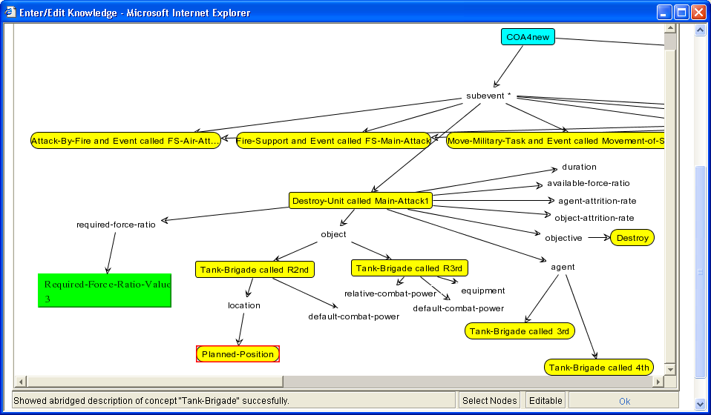
COA shows required-force-ratio value for Destroy-Unit

Slide 24
The user critiques the COA in Kanal and disagrees
Step: Destroy-Unit
  Checking conditions
  1. Available-force ratio > required force ratio (2.5 > 3) → This condition failed
  Click here to fix this
Notes:
Kanal warns the user that the preconditions are not satisfied for the attack to destroy, and offers several suggestions for fixing this. These will include finding steps to add to the COA to reduce Red’s combat power or increase Blue’s combat power, as well as creating a new specialization of the destroy action. We assume here that the user chooses this last option.

Slide 25
Proposed Fixes
Suggestions:
There are several fixes that one can do in order to fix this kind of problem, such as:
Add steps that can achieve the failed condition
Modify previous steps so that they achieve the failed condition
Check if some previous steps delete the condition, then change the ordering so they occur after the current step
Check the role assignment and modify the current step
Enter or modify knowledge that can be used for critique
None of the above
Apply Fix
Apply Fix
Apply Fix
Apply Fix
Apply Fix
Apply Fix
User selected this

Slide 26
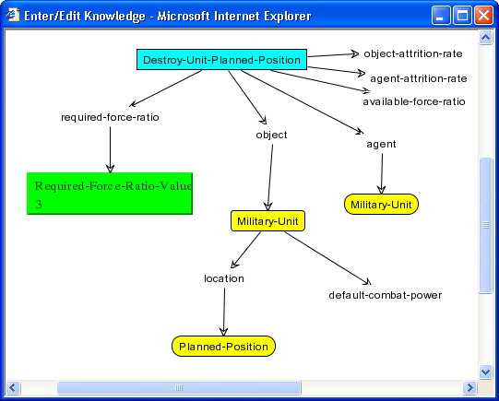
Create special case through CMap
Sketch output shows that the battle-position is planned, rather than occupied.
This defines a special case of Destroy-Unit that requires less force ratio.
First, tell Shaken that the position is planned.

Slide 27
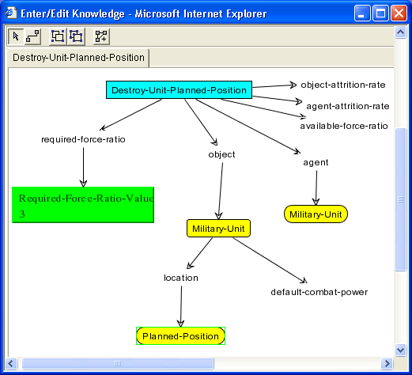
Setting the defining attributes of a special case
Next, tell Shaken that the battle position is the defining factor of this special case,
by converting it to a trigger.
(You must first make the node a group)
It shows up in green:
Notes:
The user can define a special case of this action by creating a subclass, defining its trigger and modifying the properties as needed. The trigger is used to build the defining elements of the class in KM, so Kanal and other simulators can use the KM matcher to find the appropriate action when Destroy is used in a COA.

Slide 28

Setting the functional differences of a special case
Finally, tell Shaken what other properties of the special case are different.
In this case, the required force ratio is only 2.5, not 3.
Edit the properties of the value node and select the ‘value’ tab, then edit the value.

Slide 29
The user can see the new special case in the hierarchy view
Destroy-Unit when agent is militaryUnit and object is militaryUnit
prec: force ratio >= 3:1
object attrition is 50%
  agent attrition is 10%
Destroy-Unit when red is in a planned position (not prepared)
prec: force ratio >= 2.5:1
…
Destroy-unit-terrain-adv
Destroy-Unit when red has medium terrain advantage
prec: force ratio >= 3:1
  object attrition is 35%
  agent attrition is 10%
Notes:
The new subclass can be seen in the action hierarchy along with the other subclasses that have been defined.
This approach to refining actions for specific situations using subclasses is useful because it avoids encoding the special cases in complex preconditions and conditional effects. Users typically have difficulties with such complex logical expressions. Studies have shown that users tend to describe complex logical formulae in terms of a prototypical case and exceptions (eg Pane et al 01), and the same approach is taken in ripple-down rules (eg Preston et al 94).

Slide 30
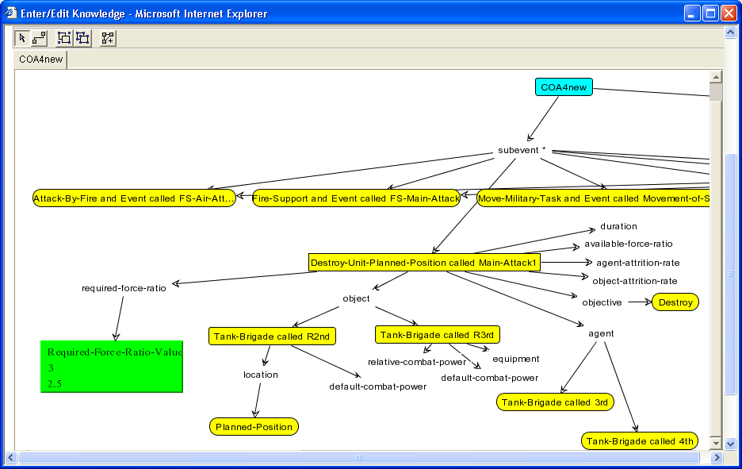
The required force ratio of the task in the plan is now correct
It changed when the special case was added, because it matches.

Slide 31
Kanal’s critique is now correct
Step: Destroy-Unit-Planned-Position
  Checking conditions
  1. There is no terrain advantage for red
  → This condition succeeded
  2. Available-force ratio > required force ratio (2.7 > 2)
  and red is in a hasty defense
  → This condition succeeded
Notes:
Kanal notes that the action preconditions are satisfied through a special case, but that the action still succeeds.

Slide 32
Adding new preconditions
This example worked because changing value of ‘required-force-ratio’ was all that was needed.
  Joe’s point that attrition rates depend on enemy’s remaining strength can be captured with a similar change, for example
In some cases a user may want to add constraints to actions that are not pre-defined
  Eg for critiquing potential red COAs rather than blue COAs
These cases can be handled in the same way as modifying action properties.
We are very interested in more examples of the need to add or modify action preconditions

Slide 33
Summary
To modify how Kanal makes a critique, you can add an action special case.
This will be called from Kanal, for now, you create a new subclass of the relevant action.
You must specify two things in the subclass:
  What are the defining criteria of the subclass (with a group node converted to a trigger)
  What other property values are different in the subclass
Shaken and Kanal will apply your new values whenever an action matches the special case in a new COA

Slide 34
More details about how normative simulation works

Slide 35
Test Knowledge (KANAL) – for COA critiquing
KANAL checks COAs based on SHAKEN’s knowledge about actions (military tasks) and their roles (such as military units) and report any problems that may arise
Simulation checks what happens before and after each step based on its background knowledge (component library)
  SHAKEN uses conditions and effects of each action
  Example:
  condition: for a given military task, the available force ratio should be greater than the required force ratio
  effect: after performing an action, change the remaining strength by multiplying its previous strength by the attrition rate

Slide 36
Conditions and Effects of Actions
agent (unit-assigned)
Destroy
object (unit-acted-on)
Military-Unit
type-of-operation
required-force-ratio
agent-attrition-rate
actual-force-ratio
object-attrition-rate
3
Attack
50%
10%
Number
Precondition: actual-force-ratio > 3
Effects(add/del list):
for each agent, change its remaining strength by multiplying 0.9
for each object, change its remaining strength by multiplying 0.5

Slide 37
Conditions and Effects of Actions (cont)
Move
agent
origin
object
destination
path
Place
Conditions:
    if origin is specified, then the object(s) are at that location
    the object(s) must not be restrained
    the path must not be blocked
Effects:
    Additions: if destination is specified, then the object is at that location.
    Deletions: if origin is specified, then the object is NOT at that location

Slide 38
KANAL Reports
checks performed that seemed ok
assumptions that seemed ok
  e.g., the location of the unit can be assumed as the place indicated by you
warnings/notes, i.e., things it wants you to take a look at so you decide for yourself whether there is a violation or not.
Warnings and notes are shown in brown
  Failed conditions (e.g., the available force ratio is less than the required force ratio)
  No effect is produced by the step
  …
  For each warning, you can ask SHAKEN to show you a list of suggestions for how to fix them.
“click here for suggestions”

Slide 39
KANAL Results: failed condition of Attack-to-Fix

Slide 40
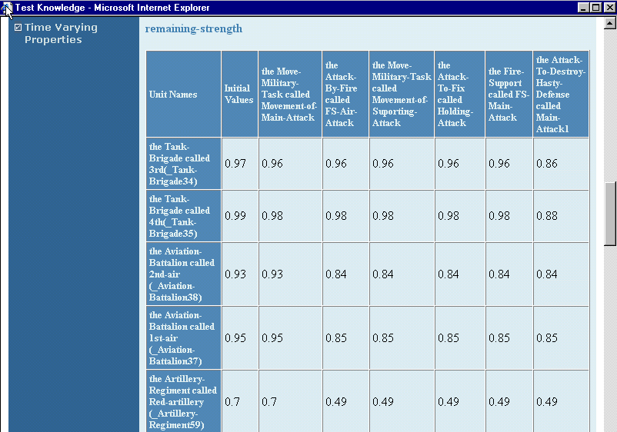
Time varying properties

Slide 41
CP spec and normative simulation

Slide 42
COA Critiques for KANAL from CP spec
Are the assigned Blue units sufficient against the Red force?
  → KANAL: For each step, check the preconditions that compare the required force ratio of the given task with the actual force ratio
Does a step achieve the Desired Results?
  → KANAL: check that an INTERMEDIATE step achieves the given expected effect
  example desired results:
  - remaining strength of Red is less than 50% ; Red is destroyed
  - the location of the Blue is now at Jayhawk
  - the location of the Red1 is not near *some-decisive-area* (keep away)
  - the task ended by 1750 hrs
  - the combat-power of the supporting effort is added to the main effort
Does the COA achieve the Desired End State? (after the final step)
  → KANAL: check that some sequence of steps in the COA achieves the given expected effect
  example desired end state:
  - Blue retains effective strength of greater than 85% (or 80,or 75)

Slide 43
Additional questions that can be answered from the simulation results
Does each encounter between a Red unit and a Blue unit results in a defeat for the Red unit?
Answer: check each encounter in each execution path and check the effects (changes in the remaining strength over the steps) to find if the Reds involved are defeated.
Does Red1 get defeated at some point in the scenario?
Answer: check each execution path and find if Red1 is defeated by some action(s) using expected effects
What is X's role in this COA? (X is any unit)
Answer: report the effect of the task assigned to X and any enabled steps by the task by checking if any produced effect is used in checking the precondition of the following steps

Slide 44
COA Critiquing through expected effects

Slide 45
Critiquing based on expected effects
Related to commander’s intent, desired end state, mission accomplishment
Two kinds:
  To check if intermediate steps achieve intended effects
  To check whether some actions achieve effects needed to reach the Desired End State and whether the overall plan (COA) achieves the mission.

Slide 46
Checking the effects of intermediate steps
Q: Does a step achieve the Desired Results?
Gen. Otstott's comments on 6/22 ".. to insure that each encounter had the desired results"
KANAL: check that an INTERMEDIATE step achieves the given expected effect
Examples:
- remaining strength of Red is less than 50% ; Red is destroyed
- the location of the Blue is now at Jayhawk
- the location of the Red1 is not near *some-decisive-area* (keep away)
- the task ends by 1750 hrs
-
- ...

Slide 47
Checking the effect of overall COA
Q: Does the COA achieve the Desired End State? (after the final step)
CP spec, "Desired End State" in page 50 and page 52
KANAL: check that some sequence of steps in the COA achieves the given expected effect (the effect after the FINAL STEP)
example expected effects:
- Blue retains effective strength of greater than 85% (or 80,or 75) in
all units
- Blue is positioned to continue the attack north (how to check the
positioning?)

Slide 48
Specifying Expected Effects
Expected effects are specified by selecting two objects and an expected relationship that should hold between the two.
  Select a step when you want to check the effects after the step (optional)
    Example: the destroy step
  Select the first object using the graph
    Example: the tank-brigade called 2nd brigade
  Select the second object using the graph
    Example: the place called Jayhawk
  Select the relationship that should hold
    Example: location
    Expected Effect:
    The location of 3rd brigade after the destroy step is Jayhawk

Slide 49
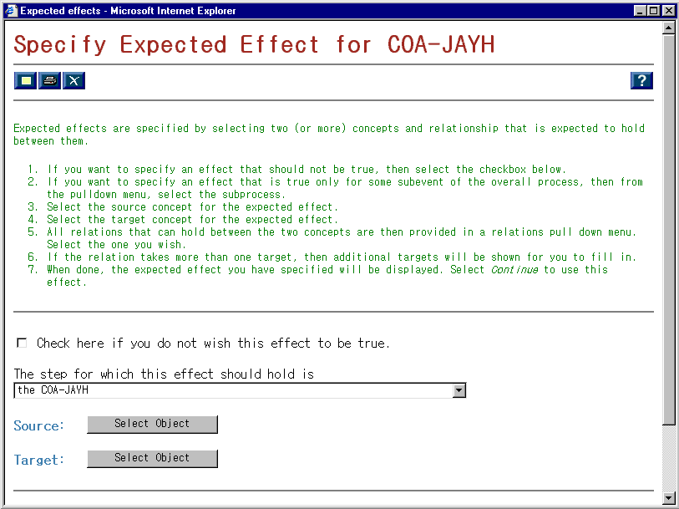

Slide 50
COA
subevent
First object
Fix
agent
Jayhawk
Move
Attack-to-Destroy
2nd brigade
Relation
location
COA
subevent
Second object
Fix
Jayhawk
Move
Attack-to-Destroy
agent
object
2nd brigade

Slide 51
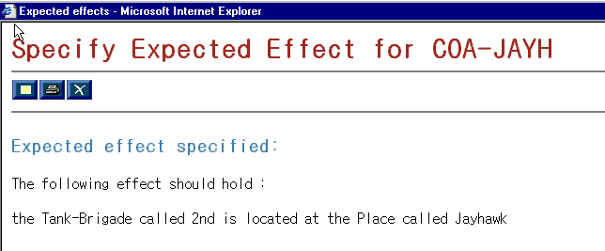

Slide 52
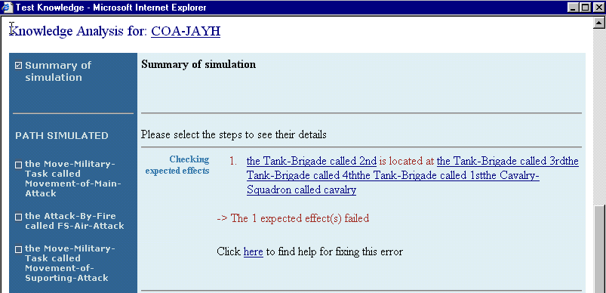
Failed Expected Effect

Slide 53
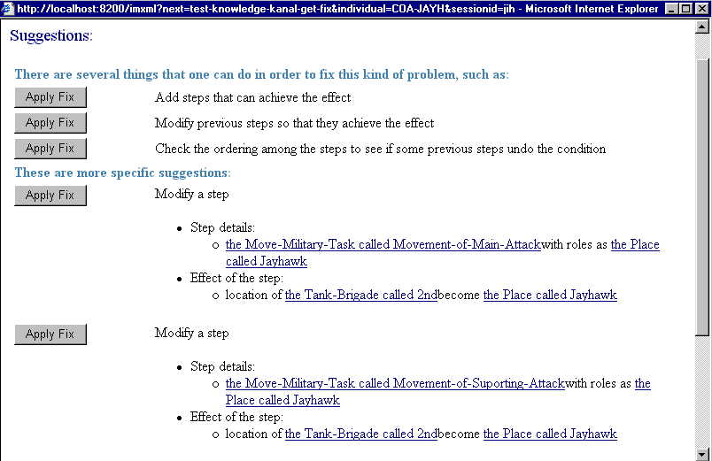
Fixes for Failed Effects

Slide 54
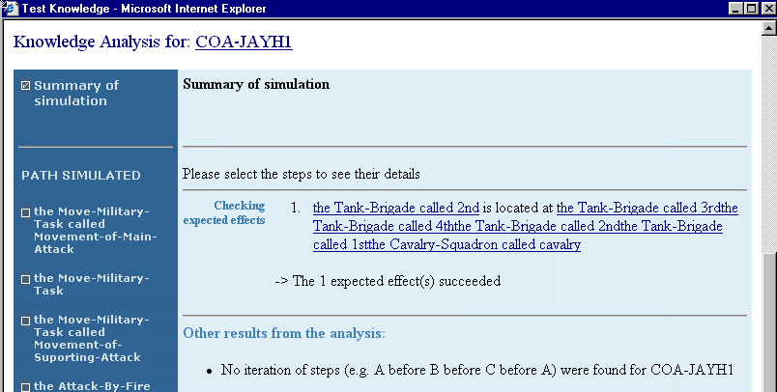
Effect achieved

Slide 55
Critique based on failed precondition
(hands on)

Slide 56
COA to critique
COA-J
sub-event
Move
next-event
Attack-to-Fix
Attack-to-Destroy
Move
next-event
Attack-by-Fire
Support-by-Fire

Slide 57
See a demo of how this works in SHAKEN
Try doing it yourself
Case 1
COA-J:
  Failed precondition of Attack-to-Fix: force ratio failure
  → assign more units (COA-JAY)
  Failed condition of Attack-to-Fix is now satisfied
Case 2
COA-JAYH
  Failed expected effect: the location of 2nd brigade (reserve) is at Jayhawk at the end
COA-JAYHAWK (with a Move of 2nd brigade):
  expected effect succeeds: the location of 2nd brigade (reserve) is at Jayhawk at the end

Slide 58
Thank you!

