Slide 1
Dialog Manager for COA entry

Slide 2
COA Entering (Now)
UI
Server
nuSketch
window
NuSketch
Server
SHAKEN
translator
KB
KANAL
Q/A

Slide 3
COA entry with Acquisition Dialogue
Server
UI
nuSketch
translator
KB
KANAL
Q/A
SHAKEN
KA dialog
Window
NuSketch
Server
Dialogue Manager
Active Acquisition goals
Acquisition
principles
…
…
State & History
…

Slide 4
Dialog Manager to guide COA entry
Show what has been done and what needs to be done based on
  Acquisition/Learning principles
  Background Knowledge (Component library)
  KANAL checks
  KA tool features (nusketch)
  User Focus
  History
  …

Slide 5
Dialog window for COA entry
(based on a SME’s wish list)
Mission: 23rd Armored Division attacks at H-hour to destroy enemy forces in the vicinity of Objective JAYHAWK
List of Friendly Forces
category task assigned MA SA FS R
1st brigade
2nd brigade
3rd brigade
4th brigade
DS Bn1
DS Bn2
GS Bn
1st Avn Bn
2nd Avn Bn
23d cavalry
Commander’s intent: I intend to attack the enemy on his weak left flank with the main attack being made on Axis Blue by 3rd and 4th brigades to rapidly envelope the enemy’s left flank and get rear to seize Obj JAYHAWK and destroy all enemy forces in the area. 1st Brigade, supported by the cavalry squadron, will make a fixing attack on Axis Green to prevent …

Slide 6
Dialog window we are planning to build
Goal : 23rd Armored Division attacks at H-hour to destroy enemy forces in the vicinity of Objective JAYHAWK
Objects involved
category task assigned grouping
1st brigade Destroy MA
2nd brigade Destroy MA
3rd brigade Fix, SA
4th brigade Follow-and-support R
DS Bn1 Attack-by-Fire FS
DS Bn2
GS Bn
1st Avn Bn
Tasks involved: I intend to attack the enemy on his weak …
Expected Effect:
remaining-strength of Red-Bridgade1 < 50%
location of 1st brigade is Jayhawk
HIGHLIGHTS
- The object of a Destroy-Unit should be Military-Unit
object of Destroy1:AXIS STRIKE (AxisOfAdvanceSupport).
- the ordering between the tasks should be known
DETAILS

Slide 7
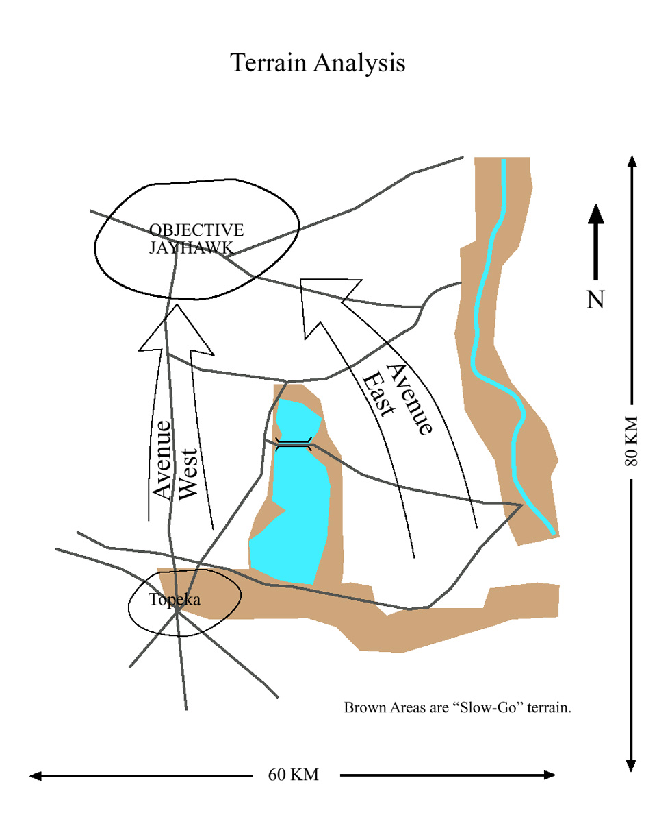
User starts COA entry (COA-1)
Goal : 23rd Armored Division attacks at H-hour to destroy enemy forces in the vicinity of Objective JAYHAWK
Objects involved
category task assigned grouping
1st brigade
2nd brigade
3rd brigade
4th brigade
DS Bn1
DS Bn2
GS Bn
1st Avn Bn
Tasks involved:
Unknown
Expected Effect: unknown
remaining-strength of
location of is
a unit
<
a number
HIGHLIGHTS
- tasks involved are not described yet
- Expected effects can be used to check COA-1
DETAILS
a unit
a place

Slide 8
User describes tasks involved and expected effects
Goal : 23rd Armored Division attacks at H-hour to destroy enemy forces in the vicinity of Objective JAYHAWK
Objects involved
category task assigned grouping
1st brigade
2nd brigade
3rd brigade
4th brigade
DS Bn1
DS Bn2
GS Bn
1st Avn Bn
Tasks involved: I intend to attack the enemy on his weak …
Expected Effect:
remaining-strength of Red-Bridgade1 < 50%
location of 1st brigade is Jayhawk
HIGHLIGHTS
- Enter tasks in COA-1
-
DETAILS

Slide 9
User enters an Attack-by-Fire
Goal : 23rd Armored Division attacks …
Objects involved
category task assigned grouping
1st brigade
2nd brigade
3rd brigade
4th brigade
DS Bn1 Attack-by-Fire FS
DS Bn2
GS Bn
1st Avn Bn
Tasks involved: I intend to attack the enemy on his weak …
Expected Effect:
remaining-strength of Red-Bridgade1 < 50%
location of 1st brigade is Jayhawk
HIGHLIGHTS
- For every Attack-by-Fire, the location of the agent should be near the its object
DS Bn1 should be near Red Brigade2
DETAILS
ignore

Slide 10
User enters a Destroy
Goal : 23rd Armored Division attacks …
Objects involved
category task assigned grouping
1st brigade Destroy MA
2nd brigade
3rd brigade
4th brigade
DS Bn1 Attack-by-Fire FS
DS Bn2
GS Bn
1st Avn Bn
Tasks involved: I intend to attack the enemy on his weak …
Expected Effect:
remaining-strength of Red-Bridgade1 < 50%
location of 1st brigade is Jayhawk
HIGHLIGHTS
- The object of a Destroy should be Military-Unit object:AXIS STRIKE (AxisOfAdvanceSupport).
- The ordering between the tasks should be known
DETAILS
ignore

Slide 11
…
User completes task assignment
Goal : 23rd Armored Division attacks …
Objects involved
category task assigned grouping
1st brigade Destroy MA
2nd brigade Destroy MA
3rd brigade Fix SA
4th brigade Follow-and-support R
DS Bn1 Attack-by-Fire FS
DS Bn2 Attack-by-Fire FS
GS Bn Support-by-Fire FS
1st Avn Bn Attack-by-Fire FS
Tasks involved: I intend to attack the enemy on his weak …
Expected Effect:
remaining-strength of Red-Bridgade1 < 50%
location of 1st brigade is Jayhawk
HIGHLIGHTS
- you can test COA-1
- expected effects can be checked
DETAILS
OK
OK

Slide 12
DETAILS
HOW DIALOGUE ITEMS ARE GENERATED?

Slide 13
Dialogue Items are computed based on Acquisition Principles [Kim&Gil 02; Gil&Kim02]
SET UP LESSON AND CHECK BACKGROUND:
  G1: Get the overall topic goal (expected effects)
ACCEPT AND RELATE NEW DEFINITIONS:
  G3: Accept new definitions
  G5: Ask the user to be complete when enumerating items in terms of the elements and in terms of the significance of the order given.
  G6: Get all the information required when existing knowledge indicates it must be provided.
    Examples
    Every COA has at least one event
    Every COA has some military-units
  G7: Make all new definitions consistent with existing knowledge
    Examples
    For Attack-by-Fire, the agent should be military-unit and the location of the agent should be near its object.
    For Destroy-Unit, the agent should be military-unit and the object should be military-unit
    For Follow-and-Support, the agent is military-unit and the base is Military-Unit whose allegiance is the same as the allegiance of the agent
  G8: Connect all new items with the topic of the lesson.
TEST AND FIX
  G9: Test the new body of knowledge and generate tests
ACHIEVE PROFICIENCY
  G16: Acquire domain terms to describe new knowledge (using lexical entries)
REACH CLOSURE
  G18: Ensure that the purpose/topics of the lesson were covered
    check if all the expected effects are achieved

Slide 14
User enters a Destroy
G8: Objects should be connected
to the scenario (assigned to tasks)
Goal : 23rd Armored Division attacks …
Objects involved
category task assigned grouping
1st brigade Destroy MA
2nd brigade
3rd brigade
4th brigade
DS Bn1 Attack-by-Fire FS
DS Bn2
GS Bn
1st Avn Bn
Tasks involved: I intend to attack the enemy on his weak …
Expected Effect:
remaining-strength of Red-Bridgade1 < 50%
location of 1st brigade is Jayhawk
G7: Make definitions consistent
with existing knowledge
HIGHLIGHTS
- The object of a Destroy should be Military-Unit object:AXIS STRIKE (AxisOfAdvanceSupport).
- The ordering between the tasks should be known
DETAILS
ignore
G5: Check the order of steps given

Slide 15
Details
DETAILS
Scenario: COA-1
  expected effects:
    remaining-strength of Red-Bridgade1 < 50%
    location of 1st brigade is Jayhawk
  First-subevent: Attack-by-Fire
  Number of times tested: 0
OBJECTS
  Attack-by-Fire
  Destroy
    object:AXIS STRIKE (AxisOfAdvanceSupport).
    It should be Military-Unit
    connected to the scenario
    domain terms used: Destroy
    more details
      Agent: object-167 (Armored-Unit)
      Object: AXIS STRIKE (AxisOfAdvanceSupport)
      …
  …

Slide 16
Details (cont)
  1st brigade (Armored-Unit)
    domain terms used: brigade
    connected to the scenario (Destroy)
    more details
  2nd brigade (Armored-Unit)
    domain terms used: brigade
    not connected to the scenario
    more details:
      Echelon: brigade
      Allegiance: Blue
  Object-179
  …
OTHER SUGGESTIONS
  Connect objects to the scenario
  Describe objects in domain terms
  add a new object
  add a new relation (e.g. agent1 is assigned to the task2)

