Slide 1
Dialog Manager for COA entry

Slide 2
COA Entering (Now)
UI
Server
nuSketch
window
NuSketch
Server
SHAKEN
translator
KB
KANAL
Q/A

Slide 3
COA entry with Acquisition Dialogue
Server
UI
nuSketch
translator
KB
KANAL
Q/A
SHAKEN
KA dialog
Window
NuSketch
Server
Dialogue Manager
Active Acquisition goals
Acquisition
principles
…
…
State & History
…

Slide 4
Dialog Manager to guide COA entry
Show what has been done and what needs to be done based on
  Acquisition/Learning principles
  Background Knowledge (Component library)
  KANAL checks
  KA tool features (nusketch)
  User Focus
  History
  …

Slide 5
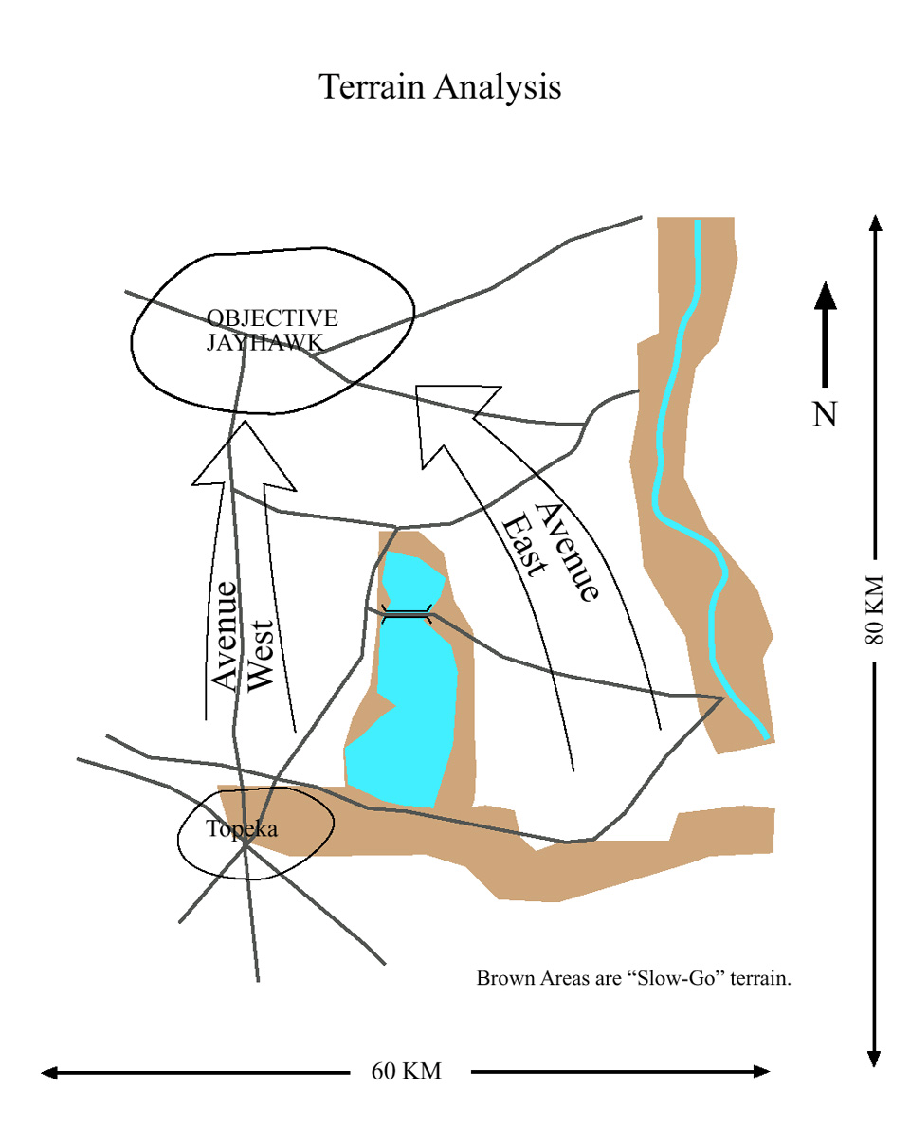
User starts COA entry
HIGHLIGHTS
  You started entering knowledge about a COA named Jayhawk-COA
suggestions:
  Intended (or expected) effects can be used to check the scenario
    Do you wan to describe them?
  Questions can be used to check the scenario
    Do you want to describe them?
DETAILS
JAYHAWK
yes
no
yes
no

Slide 6
User specifies expected effects
HIGHLIGHTS
  expected effects specified
    The location of BlueBrigade1 is at Objective Jayhawk
    The remaining strength of RedBrigade2 is less than 50%
  → resolved this: get the overall purpose of scenario
suggestions
  Every COA needs at least one action
    Do you want to enter actions?
DETAILS
dismiss

Slide 7
User enters an Attack-by-Fire
HIGHLIGHTS
  Action Attack-by-Fire entered
  → resolved this: every COA needs at least one action
suggestions
  For every Attack-by-Fire, the location of the agent should be near the its object
    Do you want to check Object-200 (Attack-by-Fire) ?
DETAILS
Check it

Slide 8
User checks the location of the agent of the Attack-by-Fire and add a Move
HIGHLIGHTS
  The location of the agent of Attack-by-Fire is checked
  → resolved this: For every Attack-by-Fire, the location of the agent should be near the its object
suggestions
  domain terms can be used to describe objects
    -- do you want to name these objects?
    Object-200 (Attack-by-Fire)
  objects needs to be connected to the scenario
    -- do you want to add new relations?
DETAILS

Slide 9
User enters a Destroy
HIGHLIGHTS
  Action Destroy entered
→ resolved this: general goal: add new actions
suggestions
  The object of a Destroy-Unit should be Military-Unit
    Do you want to check Object-192 (Destroy-Unit )?
    object :AXIS STRIKE (AxisOfAdvanceSupport).
  the ordering between the actions should be known
    Do you want to specify ordering?
    Attack-by-Fire, Destroy
DETAILS
Check it

Slide 10
… (user enter more knowledge)
User tested COA
HIGHLIGHTS
  JAYHAWK-COA tested
→ resolved this: general goal: test and fix scenario
suggestions
  expected effects can be used to check scenario:
    location of BlueBrigade1 is at Objective Jayhawk
    remaining strength of RedBrigade2 is less than 50%
DETAILS
Check it
Check it

Slide 11
DETAILS
HOW SUGGESTIONS ARE GENERATED?

Slide 12
Suggestions/questions are raised based on
Acquisition Principles [Kim&Gil 02; Gil&Kim02]
SET UP LESSON AND CHECK BACKGROUND:
  G1: Get the overall topic and purpose of the lesson.
    specify expected effect that can be used to check the scenario
    list questions you want to use to check the scenario
ACCEPT AND RELATE NEW DEFINITIONS:
  G3: Accept new definitions
    Do you want to add a new objects?
    Do you want to add a new relation between objects?
  G6: Get all the information required when existing knowledge indicates it must be provided.
    There are unfilled required slots, do you want to fill them?
  G8: Connect all new items with the topic of the scenario.
    There are objects that are not connected to the scenario. Do you want to connect them to the scenario?
ACHIEVE PROFICIENCY
  G16: Acquire domain terms to describe new knowledge (using lexical entries)
    There are objects that are not described in domain terms. Do you want to describe them using domain terms?

Slide 13
User starts COA entry
HIGHLIGHTS
  You started entering knowledge about a COA named Jayhawk-COA
suggestions:
  Intended (or expected) effects can be used to check the scenario
    Do you wan to describe them? (e.g. location of the agent1 is at Place1).
  Questions can be used to check the scenario
    Do you want to describe them?
DETAILS
JAYHAWK
yes
no
yes
no

Slide 14
User starts COA entry (cont)
DETAILS
SCENARIO: JAYHAWK-COA (COA)
  purpose of the scenario: unknown
    Expected effects: none
    Questions to ask: none
  first-subevent: unknown
  Number of times tested: 0
OBJECTS
  JAYHAWK COA (COA)
    domain terms used: COA
    needs at least one action
    needs some military-units
    I see these
      Object-165 (Armored Unit)
      Object-170 (Mechanized-Infantry-Unit)
      …
    more details
  Objective Jayhawk (Spatial-Entity)
    domain terms used: Objective
    not connected to the scenario.
    more details

Slide 15
Details (cont)
  4th brigade (Armored-Unit)
    domain terms used: brigade
    not connected to the scenario
    more details
  Object-165 (Armored-Unit)
    domain terms used: none
    not connected to the scenario
    more details:
      Echelon: brigade
      Allegiance: Red
  Object-179
  …
OTHER SUGGESTIONS
  Specify the first subevent
  Connect objects to the scenario
  Describe objects in domain terms
  add a new object
  add a new relation (e.g. agent1 is assigned to the task2)

