Slide 1

Material available from the HPKB COA challenge problem
Jim Blythe
USC Information Sciences Institute

Slide 2
Overview
Products from the HPKB year 2 challenge problem on COA critiquing include:
A formalized definition of a COA, its parts and subtasks, with a grammar, from Alphatech
Ontologies of COA pieces, tasks, some military equipment and units, from various groups
Sample COAs from Alphatech
On-line knowledge document of source materials for critiquing from Alphatech

Slide 3
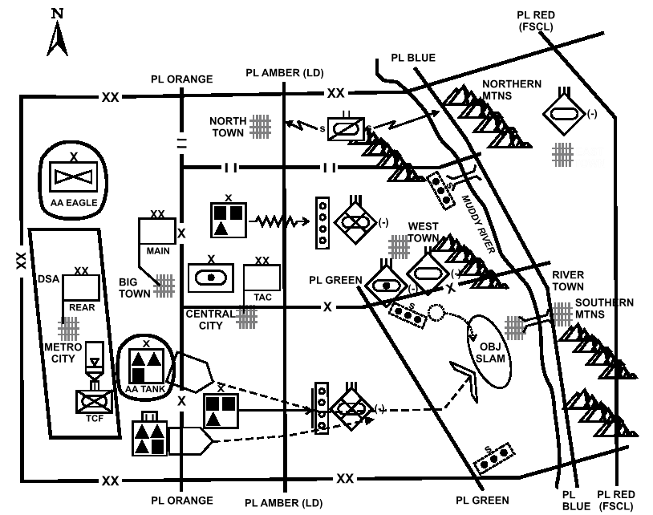
COA formalization
Example from FM-101-5
(not formalized):
At 130400 Aug XX, a mechanized division attacks to seize OBJ SLAM to protect the northern flank of the corps main effort. A mechanized brigade attacks in the north, as an economy of force, to fix enemy forces in zone denying them the ability to interfere with the main effort’s attack in the south. A mechanized brigade in the south attacks to penetrate enemy forces vicinity PL AMBER to create sufficient maneuver space to allow the main effort to pass to the east without interference from the defending enemy infantry regiment (-). A tank-heavy brigade, the main effort, passes through the southern mechanized brigade and attacks to seize the terrain vicinity of OBJ SLAM denying the enemy access to the terrain south and west of RIVER TOWN. The division reserve, a tank task force, initially follows the southern mechanized brigade prepared to contain enemy forces capable of threatening the main effort’s passage, then, if not committed west of PL GREEN, follows the main effort prepared to block enemy forces capable of threatening its movement west, ensuring the seizure of OBJ SLAM. The divisional cavalry squadron screens the division’s northern flank to provide early warning of any enemy force capable of threatening the division’s northern mechanized brigade.
Division deep operations will: 1. Initially attrit enemy artillery capable of ranging the point of penetration to prevent it from massing fires against the two southern brigades; 2. then interdict the enemy tank battalion (-) south of WEST TOWN to prevent its movement south and west towards the main effort. 3. Interdict the enemy tank regiment (-) north of EAST TOWN to prevent its movement west of the PL BLUE allowing the main effort sufficient time to seize OBJ SLAM. Division fires will: 1. Isolate the point of penetration allowing the southern mechanized brigade to conduct a penetration. 2. Prevent enemy artillery from massing fires against the two southern brigades. 3. Support deep operations to prevent uncommitted enemy forces from interfering with the initial penetration or the seizure of OBJ SLAM. A mechanized infantry team acts as the division TCF with priority of responding to any Level III threat to the division’s Class III supply point vicinity METROCITY to ensure the uninterrupted flow of Class III.

Slide 4
Formalizing the COA statement
(see HPKB-COA-1)
A COA has 1 main effort and 1 or more supporting efforts
COA should address: (FM 101-5 & HPKB-COA-1)
  Mission
  End state
  Battlefield framework
    Close (will identify the main effort)
    Reserve
    Security
    Rear
    Deep
  Fires (how they support the maneuver)
  Obstacles
  Risk (usually a fairly shallow statement)

Slide 5
Formalizing tasks
Most of the COA components consist of several task statements:
<TaskStatement> = <Resource> <TaskSpec>
<TaskSpec> = [{if, when, unless} [not] <Event> “,”]
[{on order, be prepared to}]
[<TypeOfOperationSpec> to] <Task>
[in order to <PurposeSpec>]
[and/then <TaskSpec>]
<Resource> is a military unit.

Slide 6
Task organization
<TypeOfOperation>: a broad description, eg attack, defense, movement
<Task>: more specific task, eg ambush, canalize, penetrate,..
<PurposeSpec>: enable <unit> to <taskspec>,
defeat <unit> <capability>,
prevent <unit> from <doing something>,
…

Slide 7
Sample statement
Original:
A mechanized brigade attacks in the north, as an economy of force, to fix enemy forces in zone denying them the ability to interfere with the main effort’s attack in the south.
In grammar:
A mechanized brigade (SUPPORTING EFFORT 1) attacks in the north to fix enemy forces (EF) in the area of operations of SUPPORTING EFFORT 1 in order to prevent EF from interfering with MAIN EFFORT.

Slide 8
Available ontologies
Tasks (about 80 terms)
Types of operation (about 40 terms)
Purposes (21 terms)
Units (about 180 terms)
Equipment (21 tanks, helicopters etc)
Terrain-related (areas, products of mission analysis, sketch vocab)
  Ken has best handle on this

