Slide 1
KANAL:
Knowledge ANALysis
Yolanda Gil (PI)
Jihie Kim
Jim Blythe
USC/ISI
www.isi.edu/expect/rkf/

Slide 2
Role of Knowledge Analysis
To perform checks on the knowledge entered by the user so far
To point out to the Interaction Manager what additional K needs to be acquired or what existing K needs to be modified

Slide 3
Approach: Using Interdependency Models
Relating different pieces of Knowledge among themselves and to the existing KB
  (e.g., how different pieces of knowledge are put together to generate an answer)
Successfully used in checking problem-solving K in EXPECT (Gil & Melz 96; Kim & Gil 99)

Slide 4
New Challenge: Checking Complex Process Models
Lambda Virus Invasion
…
…
Transcribe
Assemble
Enter
…
Arrive
Replicate
…
Integrate
Divide
Disintegrate
Circularize
Synthesize
Copy

Slide 5
Current Focus:
Checking Process Models
Verification checks: model is correct (e.g., no steps missing
Validation checks: model is as user intended (e.g., alert user of impossible paths)
UI
Interaction
Manager
KANAL
KM
Interaction Plans
for fixing errors

Slide 6
Describing
Process Models (Composed Concepts)
Each individual step has
  Preconditions, Add-list, Delete-list
  Assignments to the roles (e.g., Agent)
Links among the steps
  Decomposition links between steps and substeps
  Disjunctive alternatives
  Temporal links
  …

Slide 7
Checks on Process Models
All the steps are properly linked (substep, nextstep, disjunctive nextstep, conjunctive nextstep, …)
All the preconditions of each step are satisfied during the simulation
All the expected effects can be achieved
There are no unexpected effects
There are no impossible paths
. . .

Slide 8
Current Focus:
Dynamic Checks
Simulation (or symbolic execution) results show how substeps of the process model are related each other (Interdependency Model)
Perform various kinds of checks
  unachieved preconditions
  expected/unexpected effects
  disjunctive branches
  loops
  causal links
  proper execution of steps
  references to undefined objects

Slide 9
Checking unachieved preconditions
Run KM simulator with Skolem instances
  Collect unachieved preconditions of failed steps
Suggest fixes
  Add a step that can achieve the condition
  Add ordering constraint between the step and a subsequent step that asserts the condition
  Add ordering constraint between the step and a previous step that undoes the condition
  Modify the failed step

Slide 10
Example Scenario in RNA Transcription Demo
Suppose user forgets to specify that Transcribe implies a Move
Detected when KANAL checks unachieved preconditions during simulation
RNA Transcription
Failed Precondition of Detach
Polymerase at Terminator location
Proposed Fixes:
Add a Move step before Detach
Modify Make-Contact
Modify Move-Through
Modify Detach
. . .
. . .
Transcribe
Detach
Move

Slide 11
Fixing Problems: Using
Interaction Plans
Interaction Plan: describes how to proceed with the user interaction
  direct what to do next based on the results from K Analysis
KANAL’s dialogue for fixing errors is implemented with interaction plans
Will be integrated with the Interaction Manager

Slide 12
Keeping Track of Interaction History
...
Choose what to simulate
choose model: RNA-Transcription-Scenario
choose substep to test: RNA-Transcription-Scenario
Simulate model RNA-Transcription-Scenario
simulate-steps-&-find-failed-events
ask-to-fix-failed-event: (failed preconditions of Detach)
propose-fixes-for-failed-event
ask-what-to-fix-for-failed-event :
; location of Polymerase
((the location of (the major-object of Detach)) =
(the location of Detach)) ; Terminator
ask-how-to-fix-failed-event (add Move before Detach)

Slide 13
Debugging process models with KANAL
KANAL found a few errors (now fixed) in the RNA Transcription scenario developed by hand by the SRI team:
  Recognize had no effects
  Detach had no effects that applied to situation
  Break-Contact had two failed preconditions
  Recognize had no preconditions defined
KANAL will also be useful as a tool to help k engineers debug the component library and add pump-priming knowledge

Slide 14
Preliminary Evaluations
As an isolated module that checks process models
  We plan to evaluate it within the E2E system
Artificially generated test cases
  As if user had forgotten to specify some links and role assignments
  Correct process model: n links & role assigmts
  Create test cases by removing 1, 2, 3 of those at random

Slide 15
Results:
User “forgets” one link/assmt
VI LVI HPAC Total
# test cases
# errors
# errors detected
# errors w/direct fixes
total # fixes
# direct fixes
avg # fixes per error
19
19
18
16
82
17
4.56
28
28
28
26
139
31
4.96
9
9
9
8
23
8
2.56
56
56
55
50
230
56
4.18

Slide 16
Results:
User “forgets” two links/assmts
VI LVI HPAC Total
# test cases
# errors
# errors detected
# errors w/direct fixes
total # fixes
# direct fixes
avg # fixes per error
10
20
13
13
76
17
5.85
10
20
14
13
28
12
2
10
20
15
13
23
13
1.53
30
60
42
39
127
42
3.02

Slide 17
Results:
User “forgets” three links/assmts
VI LVI HPAC Total
# test cases
# errors
# errors detected
# errors w/direct fixes
total # fixes
# direct fixes
avg # fixes per error
10
30
13
12
62
14
4.77
10
30
16
16
58
16
3.63
10
30
18
15
54
15
3
30
90
47
43
174
45
3.70

Slide 18
Summary of Results
KANAL virtually always detected some error and made suggestions to user (115/116 cases)
Detecting an error impairs detecting others
  KANAL detected 98%, 70%, and 52% of the errors (1, 2, and 3 cases respectively)
  Once error was fixed, the next was always found
For 91.6% of the errors detected, KANAL’s fixes pointed directly to the source of the errors (direct fixes)

Slide 19
Future Extensions to KANAL (I):
Static Checks on Process Models
Let user pose questions about various features of the process model to test the model
KANAL will maintain test suites
  User picks from sample query templates
    How does the <slot> of <object> change during <process>?
    During <process>, does <event> occur>?
    During <process>, is it the case that <object> plays role<r>?
  User may specify the answers they expect
  User may vary the initial situations
Explanation or trace of the answer to a query shows how different pieces of K are used to generate the answer (Interdependency Model)

Slide 20
Future Extensions to KANAL (II):
New Areas
Keep track of what questions/tests were correctly answered before the user made an update
  Exploiting history and evolution of Interdependency Models (for both simulations and queries)
Using heuristics to focus K analysis as the number of errors and fixes grows
Extend KANAL to help users define concepts through composition
  Ex: “bacterial RNA”, “promoter region”

Slide 21




Grounding the Design of the Interaction Manager: ITSs
?
Intelligent
Tutoring
System
(ITS)
teaches
Intelligent
Studious
System
teaches
?

Slide 22
Structuring Student-Teacher Interaction in ITSs
Start by presenting student with a scenario and lesson overview (“advanced organizer”), end with summary
  Useful to draw prior k (can state an analogy), detect missing prior k, give context to the new k
High bandwith interfaces where students can explicate reasoning (e.g., “goal trees”)
Strategies to encourage “deep learning”
  Check that student does right thing for the right reasons
  Teach domain language, qualitative skills

Slide 23
Using EXPECT to Acquire Problem Solving Knowledge
A-7-18A: estimate the time to produce titin given a translation rate and the average number of amino acids in a protein
  Adding problem solving knowledge:
    how to estimate the size of a protein
    how to estimate the duration of a translation
  Adding roles and values needed for problem solving
    define average number of aminoacids in a protein
Blythe, Kim, Ramachandran & Gil, “An Integrated Architecture for Knowledge Acquisition”, IUI 2001: Best Paper Award

Slide 24
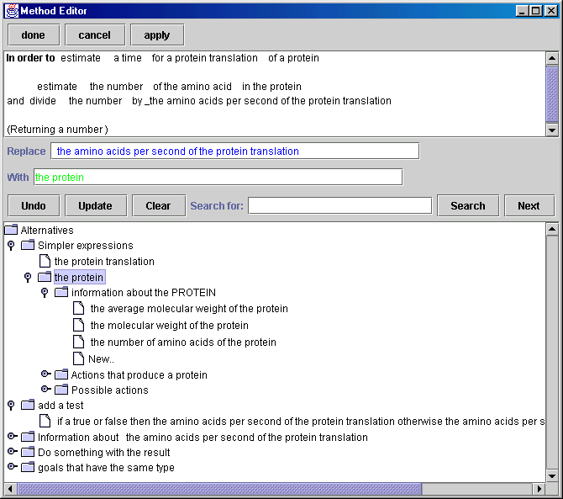
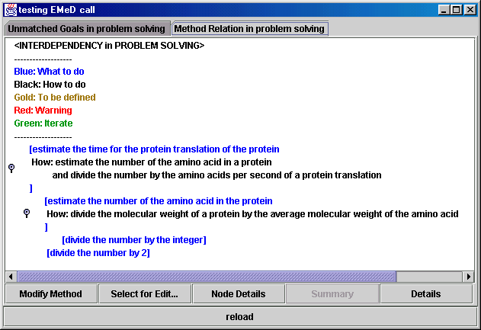
See our EXPECT demo!

