Slide 1
Knowledge Analysis
Yolanda Gil
Jihie Kim
Jim Blythe
Surya Ramachandran

Slide 2
Kinds of K Analysis
Validation
  Static and dynamic checks to detect errors
Testing with examples
  Dynamic checks, but done through execution/ground facts
Verification (comply with spec)
  showing explanations to user
  facilitating browsing and viewing
  presenting analogies

Slide 3
Validation:
Checks and Error Categories
1) Definition check
  parsing errors, if any are possible
  missing basic required parts of definitions
  (e.g., process step not linked to any others)
2) Static checks within a k unit
  undefined terms
  illegal domain/range for relation
  duplicates or overlaps with existing k unit
3) Dynamic checks (i.e., in reasoning)
  unsatisfied conditions/missing method
  invalid result
  unusable consequent/unused method
4) Clean up
  potential generalizations
  compilation
  composite definitions

Slide 4
Validation: Some Example Tools
CHIMAERA KI/KM EXPECT V&V (SEEK)
--------------------------------------------------------------------------------------------------------------------------------------------
K UNIT frame components psk rules (conj)
Definition checks
parsing errors, if interface allows them struct editor
missing basic required parts of definitions simple incompl for psk
OTHERS
Static checks within a k unit
undefined terms acronym expansion undefined c/i/r
inconsistent definition slot value/type clash unsatisfied constr invalid expr ambivalent rules
duplicates or overlaps with existing k unit redundant types psk exists redundant, subsumed
OTHERS definition cycle
Dynamic checks (i.e., in reasoning) (TRIPLE)
missing k unit missing psk unusable consequent
invalid result invalid result type
unusable k unit unused psk unsatisfiable rule
OTHERS
Clean up checks
potential generalizations abduction
compilation EBL based
composite definitions
OTHERS taxonomic analysis circularity
Example-based checks
--------------------------------------------------------------------------------------------------------------------------------------------
NOTE: REFINERY will do checks that are similar to CHIMAERA, and will include
"inferential checks" (they would be a kind of dynamic checks) and example-based
checks.
NOTE: Many other systems do similar error detection (TAQL, ASPEN).
NOTE: semantic constraints can be explicitly used to detect errors.

Slide 5
Dynamic Checks
Dynamic checks can be done with:
  views
  ps goals
  explanations
  prediction
  analogy
  ...

Slide 6
Knowledge Analysis:
Beyond Error Detection
3 main functions:
  Error detection
  Diagnosis of error source
  Suggested fixes
This means that:
  detecting errors is just the beginning
  the other 2 functions require having more context

Slide 7
Knowledge Units
an axiom, a concept, a psm, a component, a cmap, ... whatever it is
Checks can be performed by iterating bottom up
Info associated with the k units
  source info (provided by the IM)
  where & how often & how well it's been used/tested
  interdependency model:
    links to other k units
    links within a ps episode
    role mapping (e.g., for a component mapping)

Slide 8
Why Heuristics
Suppose the system generates lots of questions to the user:
  does not assume without checking
  does not generalize without checking
  double checks any possible connection, deduction, etc.
  considers it needs to know everything
Quantity not necessarily correlated with quality

Slide 9
Basic Principles to Focus Knowledge Analysis
1) Principle of practical validation (PPV)
  Invalid/incomplete statements are more likely to appear in k fragments that have not been exercised by using them to solve problems or answer questions
2) Principle of experiential context (PEC)
  Invalid/incomplete statements are more likely to appear in k fragments where limited prior knowledge (theories, components, models, etc.) can be or has been brought to bear
3) Principle of local consistency (PLOC)
  Inconsistencies are more likely to appear in k fragments that have not been defined and/or cannot be viewed in proximity (spatial, temporal, representational, or inferencial) by the user

Slide 10
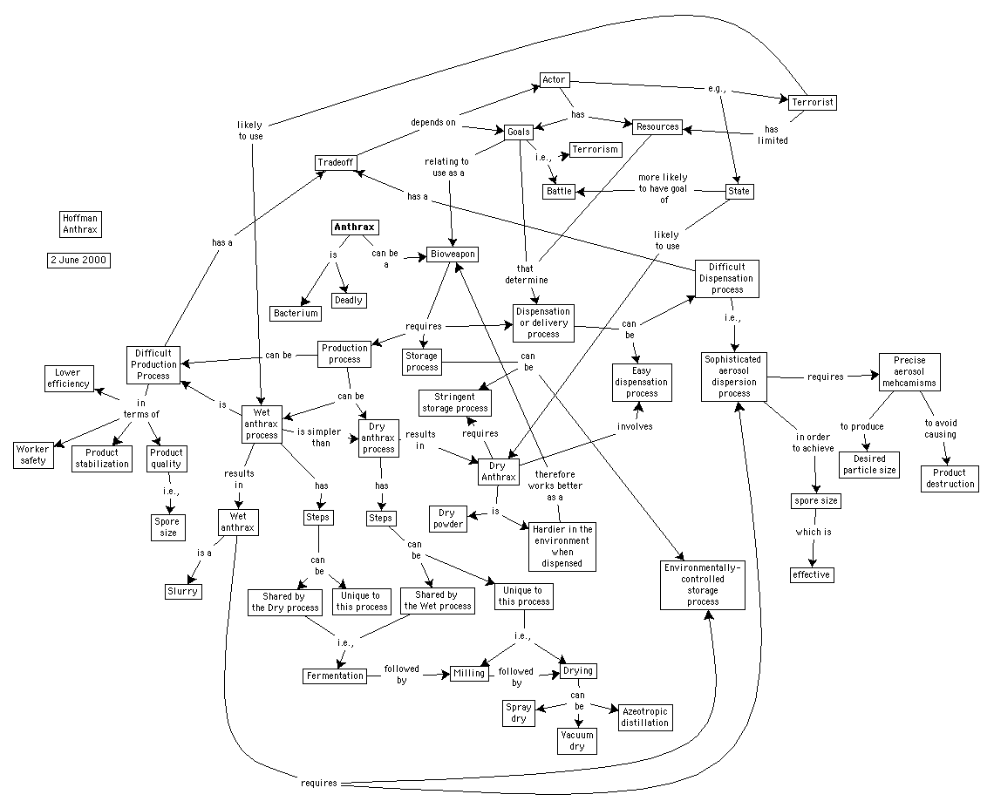

Slide 11
Entry VS Analysis Checks
Knowledge analysis will become more challenging as we strive to make knowledge entry easier
Needs to be defined in terms of capabilities of other components
Knowledge entry
Less constrained in format
Less constrained by BG K
Less constrained in structure
Knowledge analysis
More room for error
More discrepancies with KS
Less generalized/principled

Slide 12
Instrumentation: Issues
Suppose the system generates lots of questions to the user:
  does not assume without checking
  does not generalize without checking
  double checks any possible connection, deduction, etc.
  considers it needs to know everything
Quantity not necessarily correlated with quality

Slide 13
Example Inconsistencies and Knowledge Gaps [Kim&Gil, AAAI-99]
Guide the design and creation of a new KB element (e.g., a method)
  Find dependencies within the KB element based on representation language
    Ex: new method uses a role that has inadequate domain and range or is undefined
    Ex: new method has a variable with no declared type
  Find if the new method fits in principle with existing knowledge
    Ex: new method has same capability as a previously defined method
Detect missing knowledge
  Find undefined methods given the newly created ones
    Ex: the new method has a subgoal that cannot be achieved by any existing methods
  Propose initial version of new methods to add
    Ex: propose a capability and a result type based on the unmatched subgoal
Fitting pieces together
  Find user defined and yet unused methods
    Ex: method not used to achieve any subgoals
  Propose potential uses of an unused method in other methods
    Ex: new method can almost match another method’s subgoal

