Slide 1
Knowledge Analysis
Yolanda Gil
Jihie Kim
Jim Blythe
USC/Information Sciences Institute

Slide 2
Knowledge Analysis:
Overview
Functionality:
  Relates the different knowledge inputs among themselves and to the existing KB
  Helps transform knowledge into a form that is appropriate for the KS
  Detects inconsistencies
  Locates knowledge gaps (i.e., missing knowledge)
Contribution to the overall architecture:
  Guard and/or inform K Server (KS) about possibly invalid statements
  Point out to Interaction Manager what additional knowledge needs to be acquired

Slide 3




Overview of Knowledge Analysis
Established
connections
Hypotheses and
assumptions
Qualifications
Lines of reasoning
& other deductions
FRINGE OF
THE KS
Relevant background
knowledge
(((
))
())))
(defconcept
bridge ()))

Slide 4
Example Inconsistencies and Knowledge Gaps [Kim&Gil, AAAI-99]
Guide the design and creation of a new KB element (e.g., a method)
  Find dependencies within the KB element based on representation language
    Ex: new method uses a role that has inadequate domain and range or is undefined
    Ex: new method has a variable with no declared type
  Find if the new method fits in principle with existing knowledge
    Ex: new method has same capability as a previously defined method
Detect missing knowledge
  Find undefined methods given the newly created ones
    Ex: the new method has a subgoal that cannot be achieved by any existing methods
  Propose initial version of new methods to add
    Ex: propose a capability and a result type based on the unmatched subgoal
Fitting pieces together
  Find user defined and yet unused methods
    Ex: method not used to achieve any subgoals
  Propose potential uses of an unused method in other methods
    Ex: new method can almost match another method’s subgoal

Slide 5
Interaction with the KS
KS is invoked to:
  Generate deductions from certain sets of statements
    E.g., given {…} what dual-use equipment does this country own
  Solve problems or answer questions
    E.g., PQs for EKCP, component views
  Suggest relevant models/theories/principles
    E.g., could {…} fit the model of a “release process” and how?
  Seek related cases or examples of certain statements
    E.g., do you already know about any countries that seem to be capable of producing Anthrax but do not have fermentors?
  Generate explanations

Slide 6
Basic Principles to Focus Knowledge Analysis
1) Principle of practical validation (PPV)
  Invalid/incomplete statements are more likely to appear in k fragments that have not been exercised by using them to solve problems or answer questions
2) Principle of experiential context (PEC)
  Invalid/incomplete statements are more likely to appear in k fragments where limited prior knowledge (theories, components, models, etc.) can be or has been brought to bear
3) Principle of local consistency (PLOC)
  Inconsistencies are more likely to appear in k fragments that have not been defined and/or cannot be viewed in proximity (spatial, temporal, representational, or inferencial) by the user

Slide 7
Interdependency Models [AAAI-96 Gil&Melz]
Interdependency Models
derived from
problem solving context
guide KA
What process model would <actor> prefer for <agent>
TRADEOFFS
Produce
anthrax
before
Store
anthrax
RESOURCES
OBJECTIVES
FEASIBILITY
Prefer A to B
and (is eqmt of non-sh-steps B
(or (not available)
(expensive to acquire)))
(is eqmt of non-sh-steps A
(available))
alternatives
sub-step
Produce
dry anthrax
Produce
wet anthrax
sub-step
sub-step
sub-step
sub-step
Ferment
before
Milling
before
Drying
Reject P when objectives include
battlefield use and storage equipment
is environmentally controlled
store
wet anthrax
store
dry anthrax
eqmt
Does the storage eqmt for dry anthrax need to be env controlled?
Notes:
Notice that the analogy tools could be responsible for finding and bringing up the relevant parts of the wet anthrax model.

Slide 8
Basic Principles to Focus Knowledge Analysis
1) Principle of practical validation (PPV)
  Invalid/incomplete statements are more likely to appear in k fragments that have not been exercised by using them to solve problems or answer questions
2) Principle of experiential context (PEC)
  Invalid/incomplete statements are more likely to appear in k fragments where limited prior knowledge (theories, components, models, etc.) can be or has been brought to bear
3) Principle of local consistency (PLOC)
  Inconsistencies are more likely to appear in k fragments that have not been defined and/or cannot be viewed in proximity (spatial, temporal, representational, or inferencial) by the user

Slide 9
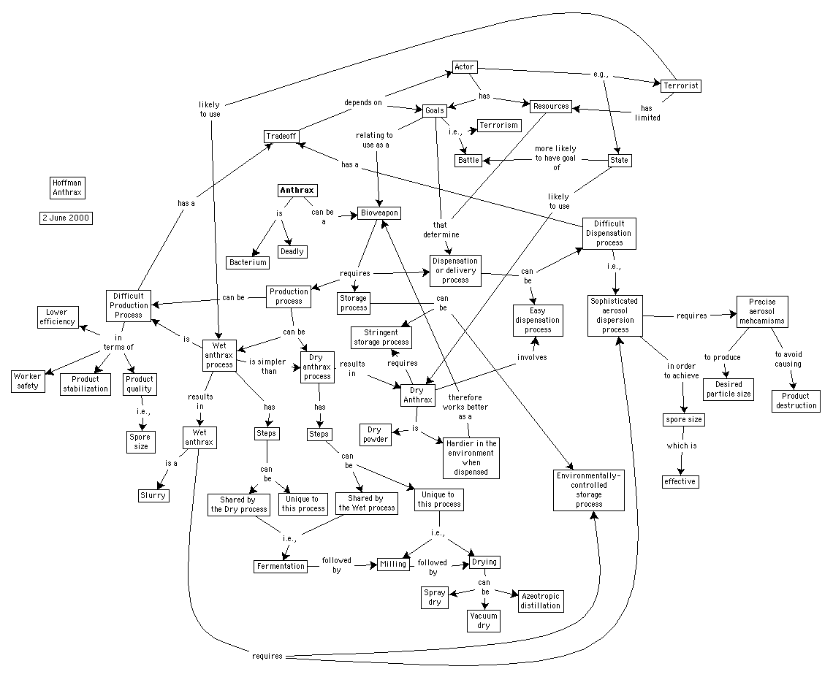

Slide 10
Providing Input to the Interaction Manager
Generating follow-up questions
  Based on inconsistencies and knowledge gaps detected
  Based on potential suggestions of applicable models/theories
  Based on plausible hypotheses and assumptions generated

Slide 11
Interaction Manager
Organizing and prioritizing follow-up questions [Gil&Tallis AAAI-97, Tallis&Gil AAAI-99]
  Coherent dialogue: Easier for user if system brings up together questions on a topic
  Adequate sequencing: The answers to some questions may help resolve others
  KA strategies: guide user through typical KA tasks such as placing a new object within a hierarchy, filling attribute/value pairs through tables, specializing a process description, etc.

