Slide 1
Test Knowledge

Slide 2
How will you know you taught SHAKEN the right things?
You can see things on the screen in front of you, but are they the right things?
SHAKEN helps you test its knowledge in two ways:
  You can ask SHAKEN to run a simulation and report any problems that may arise
    Simulation checks what happens before and after each step (e.g., checks the conditions and effects of each step)
  You can ask questions and check the answers
    Ex: During a Virus-Invades-Cell, what role does the Cell play?
      Virus-Invades-Cell, the Cell is the agent
      In Attach, the Cell’s membrane is the base
      In Move, the Cell’s nucleus is the destination

Slide 3
Using Simulation to Detect Mistakes
polymerase
DNA
Specific-Contact’s base should be promoter instead of DNA
promoter
Collide with DNA
Move-Through DNA
Recognize promoter
X
Specific-Contact to DNA → Execution Fails
Polymerase is already in contact with DNA !

Slide 4
Detecting Mistakes
Suppose you specify by mistake the enclosure of Release to be the cell membrane instead of the virus coating:
1) This problem can be detected by the simulation:
  Can the viral-nucleic-acid be released? No!
    It is not confined in the enclosure specified for “Release”(cell membrane)
2) Q: what role(s) does cell membrane play in Release?
  The viral-nucleic-acid is enclosed in the cell membrane when the acid is released ➔ unexpected answer!
Release
virus
cell
object
the-enclosure
has-part
has-part
viral-nucleic-acid
membrane

Slide 5
How Do You Know You Are Done Teaching SHAKEN?
No errors are reported when SHAKEN executes the steps (running the simulation)
You ask a few key questions and the answers are as you expected

Slide 6
SHAKEN Reports
checks performed that seemed ok
assumptions that seemed ok
errors, i.e., serious problems that you should fix.
Errors are shown in Red.
warnings/notes, i.e., things it wants you to take a look at so you decide for yourself whether there is a problem or not.
Warnings and notes are shown in Orange
For each error or warning, you can ask SHAKEN to show you a list of suggestions for how to fix them.
“click here for suggestions”

Slide 7
What Is Checked During Simulation?
1. Checking Conditions and Effects
1.1 Checking Condition
1.2 Checking Assumptions
1.3 Checking Effects
1.4 Checking Expected Effects
1.5 Checking undeletable assertions
2. Checking Step Ordering
2.1 Missing first-subevent
2.2 Missing next-event links
2.3 Loops
2.4 Unnecessary ordering
3. Other Simulation Results
3.1. Simulation paths
3.2. Steps that are never reached during simulation
3.2. Steps that enable other steps to take place

Slide 8
1. Checking Conditions and Effects
SHAKEN checks required conditions and typical effects of each step
Attach
Penetrate
Release
Move
Release
CHECKING CONDITIONS:
…
CHECKING EFFECTS:
…
Move
CHECKING CONDITIONS:
…
CHECKING EFFECTS:
…
Attach
CHECKING CONDITIONS:
…
CHECKING EFFECTS:
…
Penetrate:
CHECKING CONDITIONS (checking if the step is necessary)
Can the viral nucleic acid be released from protein coat? OK
- the acid is confined to the protein coat.
CHECKING EFFECTS:
Is the virus no longer confined? OK
- The state Be-confined is no longer true

Slide 9
Conditions and Effects of Actions
Move, Move-Through, Move-Out-Of, …
  Conditions:
    if origin is specified, then the object(s) are at that location
    the object(s) must not be restrained
    the path must not be blocked
  Effects:
    Additions: if destination is specified, then the object is at that location.
    Deletions: if origin is specified, then the object is NOT at that location

Slide 10
Conditions and Effects of Actions (cont)
Make-Contact
  Conditions: the object and the base musnt be touching
  Additions:the object and the base in Touch
Break-Contact
  deletions: the object and the base is no longer in Touch
Confine
  Conditions: the object must be inside the base
  Additions: the object is confined to the base
Release
  Conditions: the object is confined with the base
  Deletions: the confined state

Slide 11
How to find Conditions and Effects of an action
Browse
Select an Action (e.g., Make-Contact)
Select ‘description’ mode

Slide 12
1.1 Checking Condition
polymerase
DNA
promoter
Collide with DNA
Move-Through DNA
Recognize promoter
X
Specific-Contact to DNA → Execution Fails
Polymerase is already in contact with DNA !

Slide 13
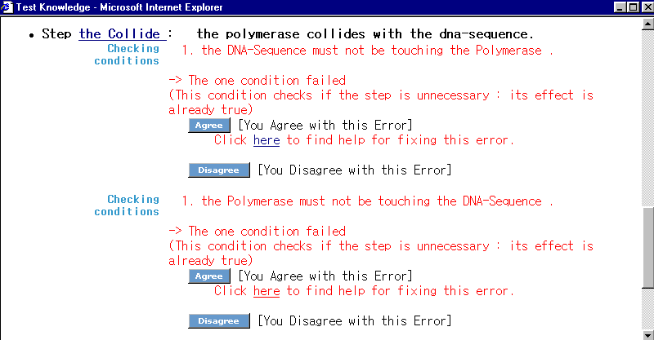
Failed Condition
(checking unnecessary step)
Test-two-collides

Slide 14
Handling Problems
Agree: you agree with the error message and the need to fix it
Disagree: you don’t think there is an error in your process
  Please indicate why you don’t think there should be an error reported here
Ignore (for notes only): you agree with the note but there is no need to fix your process

Slide 15
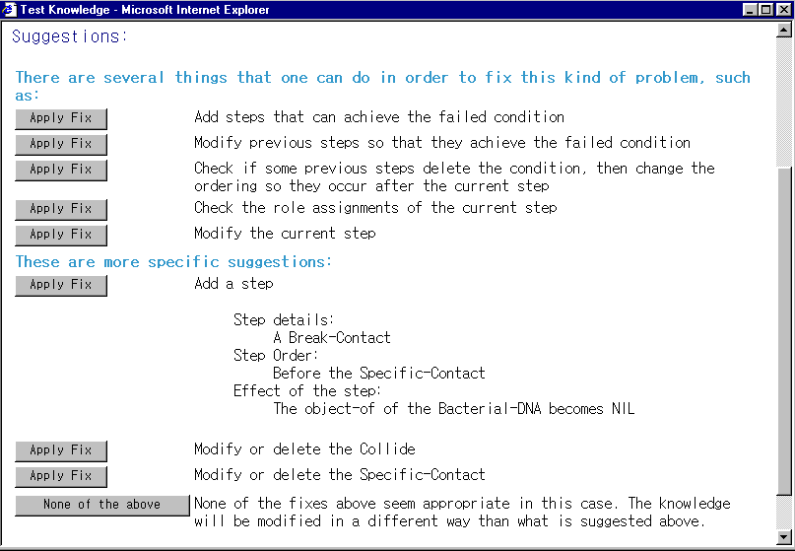
Example: Suggested Fixes for Failed Condition

Slide 16
1.2 Checking Assumptions
Checks correctness of assumptions (esp. initial conditions)
Attach
Penetrate
Release
Move
CHECKING CONDITIONS OF RELEASE:
the viral-nucleic-acid must be confined
by the protein coat?
- Ok to assume that the viral-nucleic-acid can be confined
CHECKING EFFECTS OF RELEASE:
Is the virus no longer confined? OK
- The state Be-confined is no longer true
No facts about confinement
are mentioned, so SHAKEN
assumes they are OK
Suggested fixes are similar

Slide 17
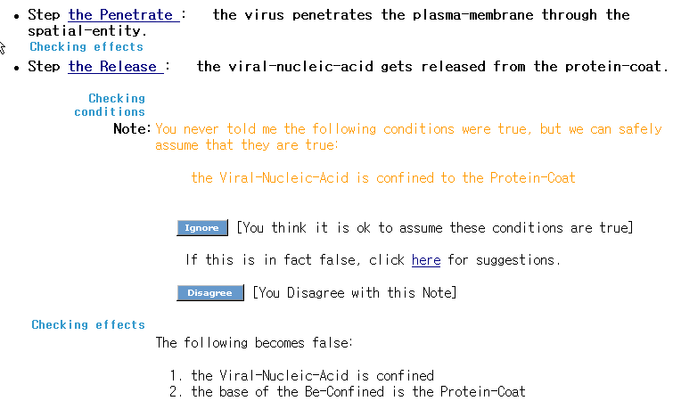
Example: Assumptions of Release
Indicates assumptions made

Slide 18
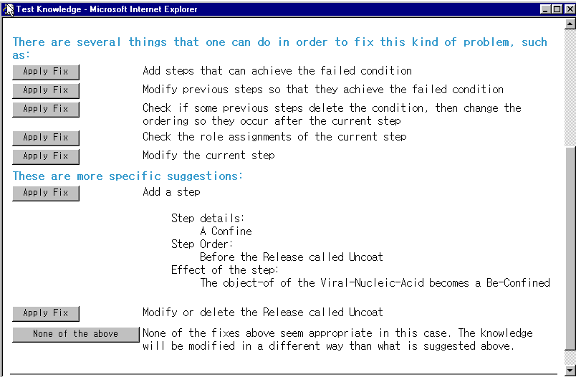
Fixing a Wrong Assumption

Slide 19
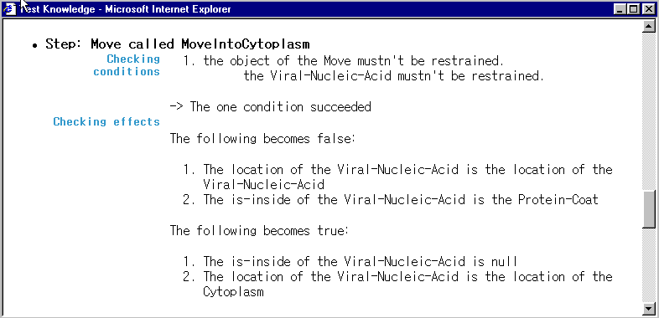
1.3 Checking Effects
Check what happens after each step is executed in terms of what effects are added (things that become true) and deleted (things that become false).

Slide 20
1.4 Checking Expected Effects
You need to tell SHAKEN what you expect to be the case after the overall process happens
  Ex: plasma membrane is broken
  Ex: viral nucleic acid is inside the cell
SHAKEN will check that these things are true at the end of the simulation

Slide 21
Specifying Expected Effects
Expected effects are specified by selecting two objects and an expected relationship that should hold between the two.
  Select the first object using the graph
    Example: the viral-nucleic-acid of the virus
  Select the second object using the graph
    Example: the cell
  Select the relationship that should hold
    Example: is-inside

Slide 22
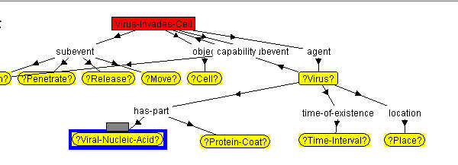
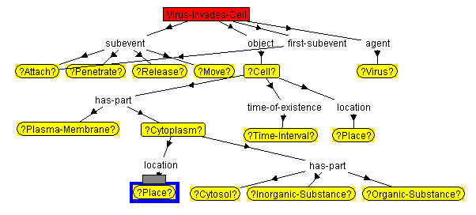
First object
Relation
is-inside
Second object

Slide 23
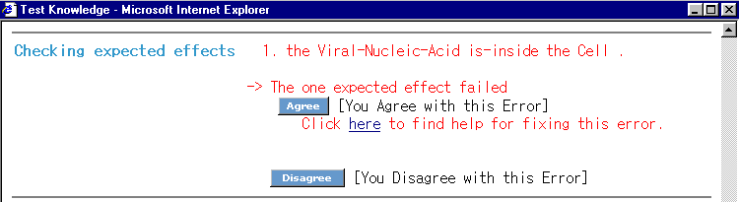
Failed Expected Effect

Slide 24
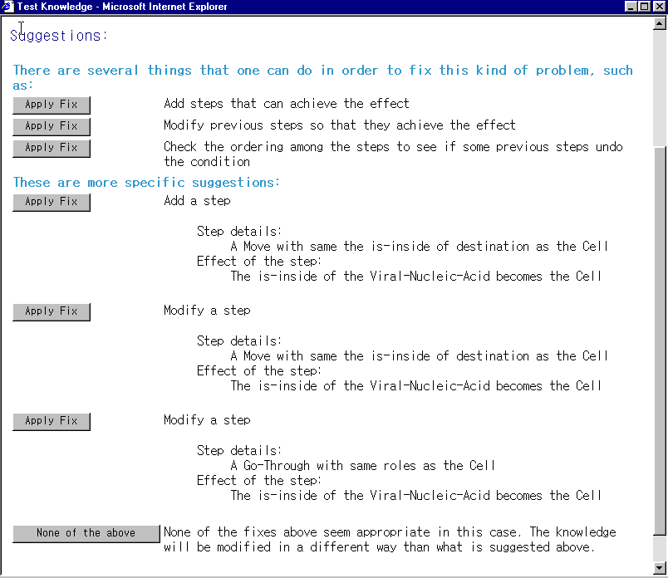
Fixes for Failed Effects
Fixes
for
Failed
Expected
Effect

Slide 25
1.5 Checking undeletable assertions
A step’s effect negate something that is not true in the first place
Fixes:
  Add a previous step that asserts the condition
  Modify the role assignments of the failed step
  Modify previous steps to assert the condition

Slide 26
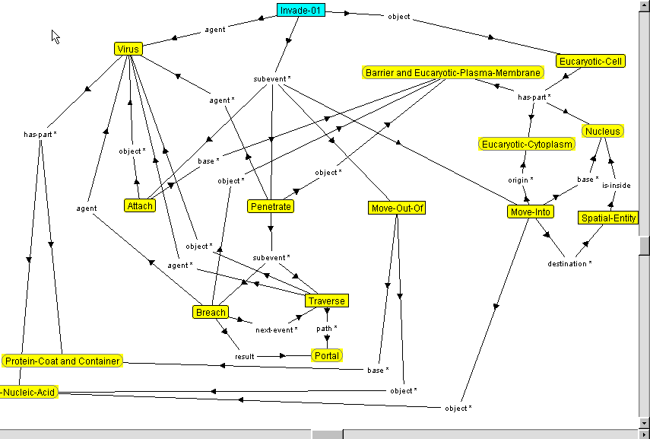
2.Checking Step Ordering
How quickly can you spot the mistakes here?

Slide 27
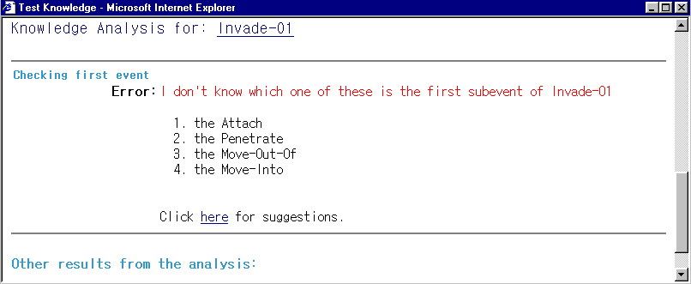
2.1 Missing first-subevent
Suggested Fixes:
- Specify the first-subevent of the event.

Slide 28
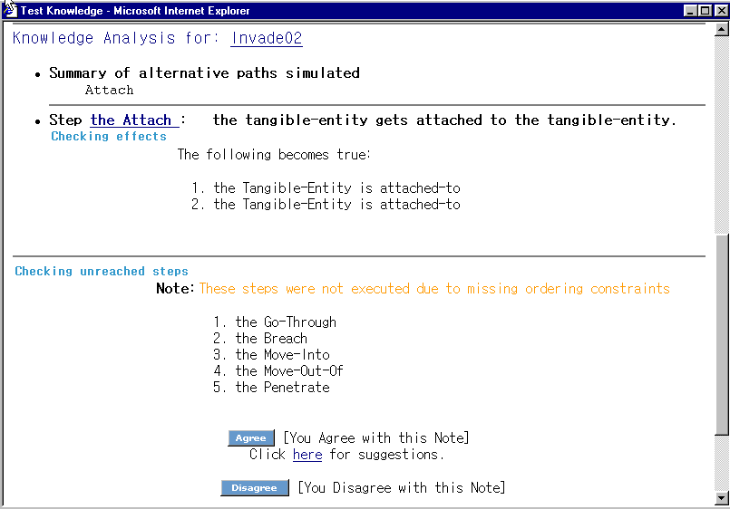
2.2 Missing next-event links
You can see that many of the steps specified were not simulated
SHAKEN also warns you about the steps that were not simulated
Suggested Fixes: Specify the next-event links

Slide 29
2.3 Loops
checks if there are any loops among subevents, and warns you if it finds any so you can confirm that they were intended.
Suggested fixes:
  Modify or delete next-event links among the steps involved in the loops.

Slide 30
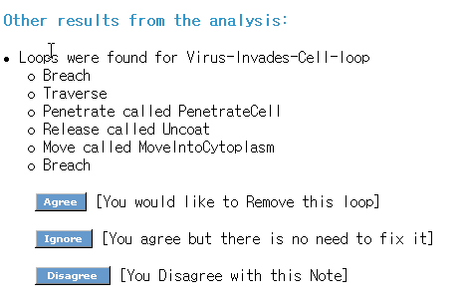
When there is a Loop

Slide 31
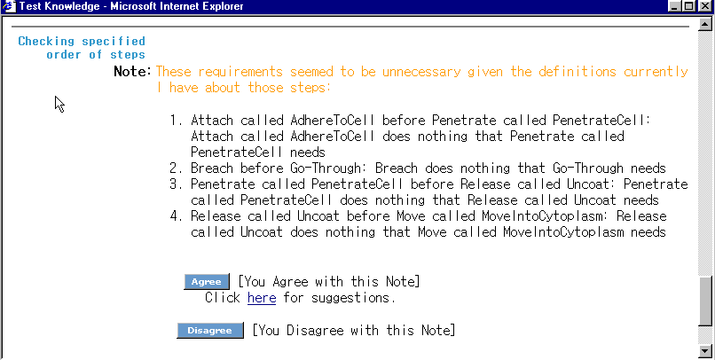
2.4 Unnecessary ordering
check if a step achieves something needed by some steps indicated to happen later (with next-event links)
Suggested fixes:Modify or delete next-event links

Slide 32
3. Other Simulation Results
Steps that enable other steps to take place:check and show what steps cause effects that enable other steps to happen.

Slide 33
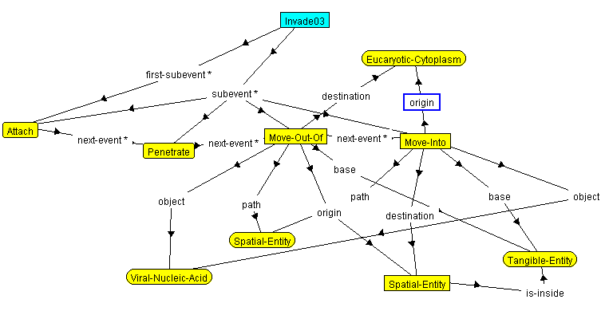
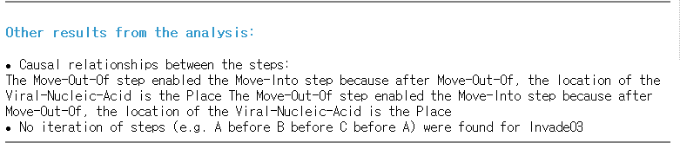
Move-Out-Of enables Move-Into

Slide 34
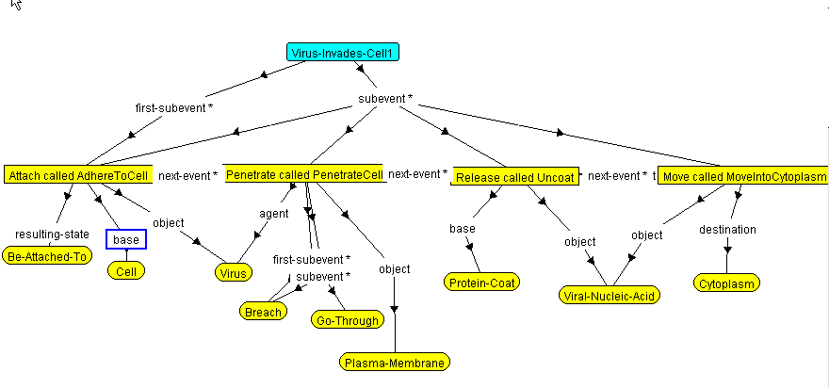
Virus Invades Cell scenario

Slide 35
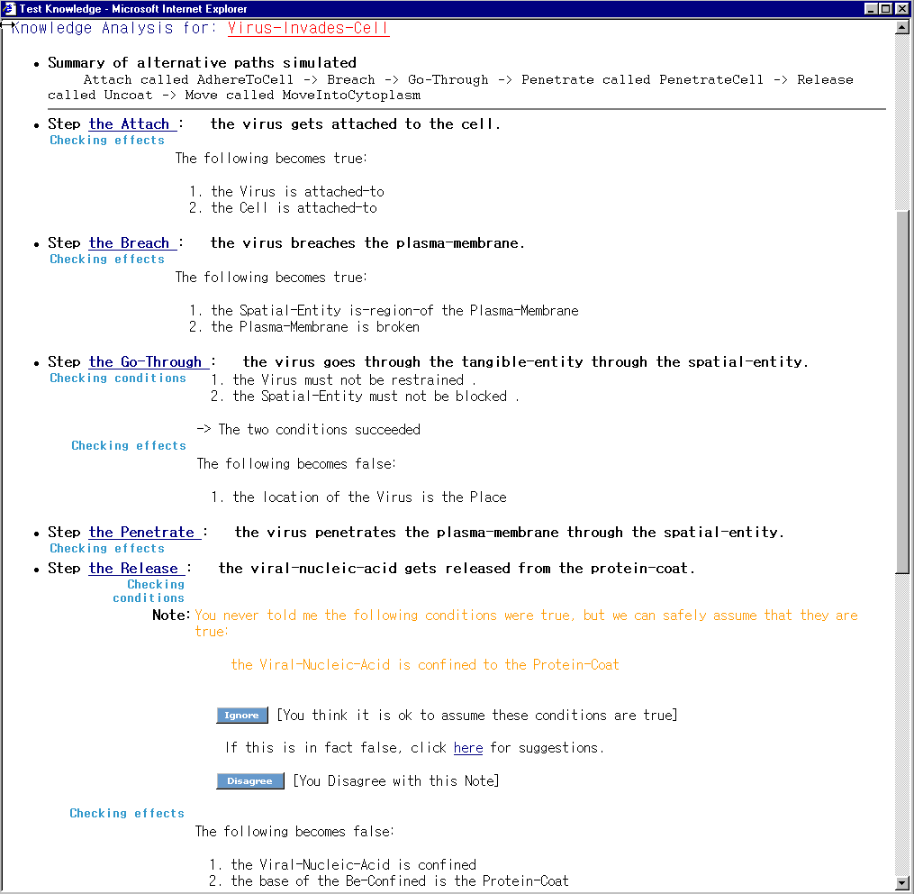
Summary:
Reports for
Virus Invades Cell
Executes
low-level steps
(e.g., Breach and Go-Through)
before higher-level steps (e.g. Penetrate)
Indicate assumptions made

Slide 36
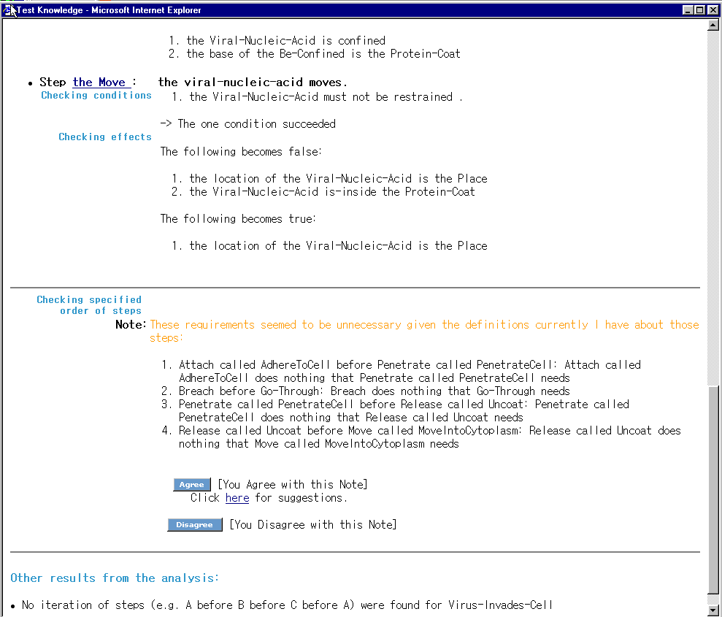
Test
results
(cont)

Slide 37
Summary: What Is Checked During Simulation?
1. Checking Conditions and Effects
1.1 Checking Condition
  e.g.: before executing a Move step, check if viral-nucleic-acid is not restrained
1.2 Checking Assumptions
  e.g.: no facts about confinement are mentioned, so SHAKEN assumes viral-nucleic-acid is confined by the protein coat
1.3 Checking Effects
  e.g.: after Breach the plasma membrane of the cell is broken
1.4 Checking Overall Expected Effects
  e.g.: after virus-invade-cell, viral-nucleic-acid is located in the cytoplasm
1.5 Checking undeletable assertions

Slide 38
Summary: What Is Checked During Simulation? (cont)
2. Checking Step Ordering
2.1 Missing first-subevent
2.2 Missing next-event links
2.3 Loops
2.4 Unnecessary ordering
3. Other Simulation Results
3.1. Simulation paths
3.2. Steps that are never reached during simulation
3.3. Steps that enable other steps to take place

Slide 39
You should look at the results of these checks and see that they are as you expected!

Slide 40
Hints
Run the simulation to check and test any process model you define
Fix errors whenever you can
  If you can’t understand what the problem is:
    Go back and ask more questions about the steps that are causing problems, see if any answers are wrong
    Check the connections of each step (first-event, next-event, and role assignments)
If you can’t figure out how to fix an error, it’s ok
  it means SHAKEN did not learn a perfect model
  yet, be assured it did learn a lot about that process!
Express your judgment (Agree, Disagree, Ignore)

Slide 41
Practical session I
Test the following expected effect with Virus-Invades-Cell:
  After the process is completed, the viral nucleic acid is in the cytoplasm
    Select ‘Viral-Nucleic-Acid’
    Select ‘Place: the location of Cytoplasm’
    Select ‘location’

Slide 42
Practical session II
Test your version of virus invasion
Check errors and notes
Handle Errors
Check suggested fixes
Modify virus invasion & test again

