Slide 1
Testing Transcription Concept built by a SME
Jihie Kim
7/30/01

Slide 2
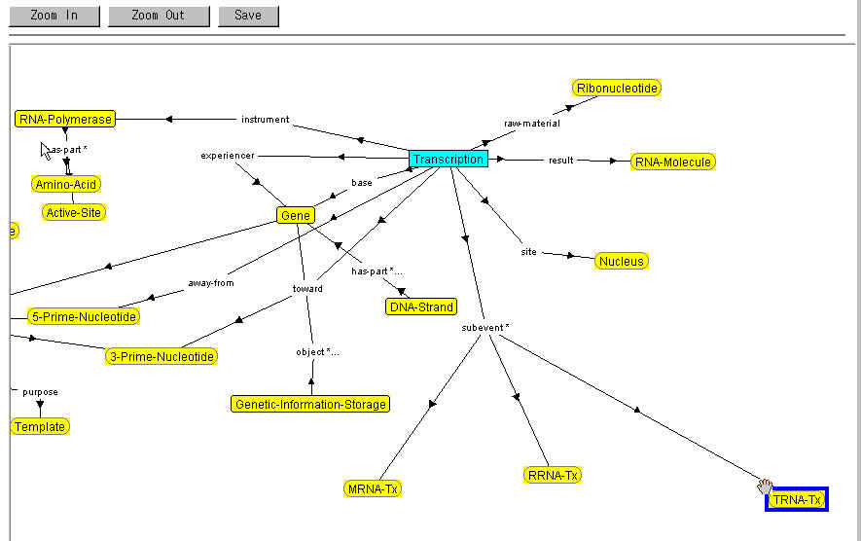
View Concept: Transcription

Slide 3
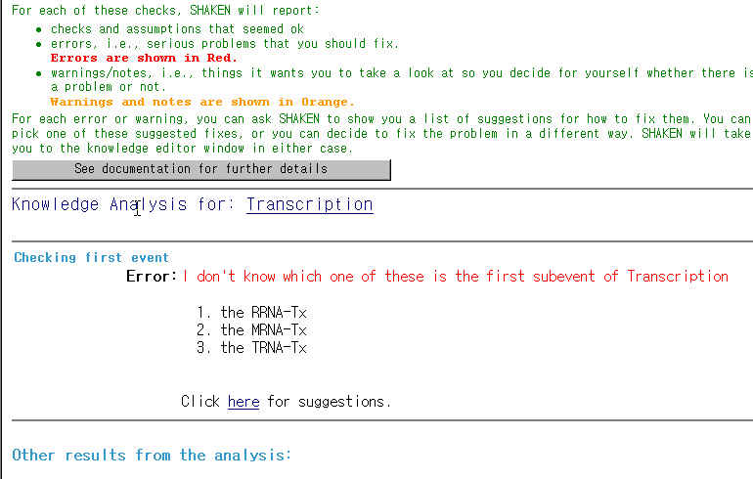
Test Concept: Transcription

Slide 4
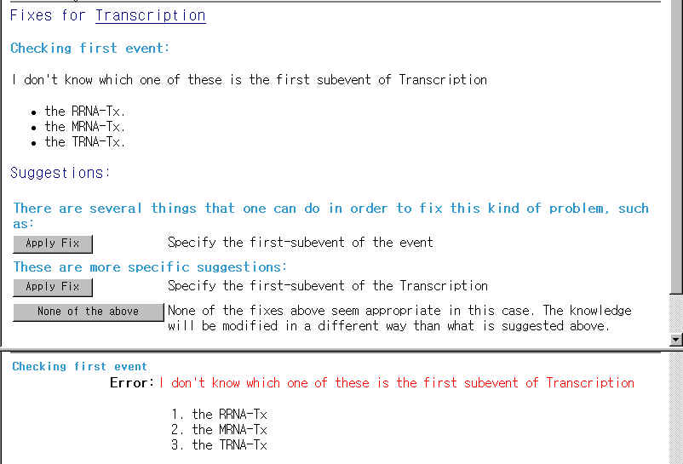
Get fixes for missing first-subevent

Slide 5
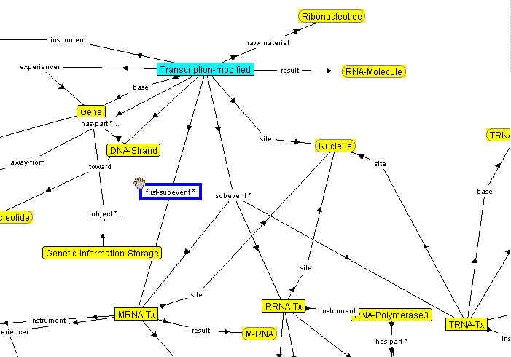
Modify Concept: Transcription and saved as Transcription-modified

Slide 6
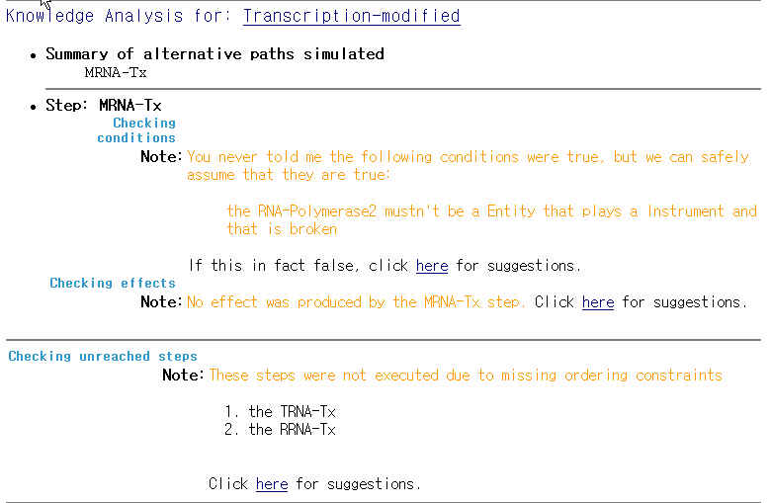
Test Concept: Transcription-modified

Slide 7
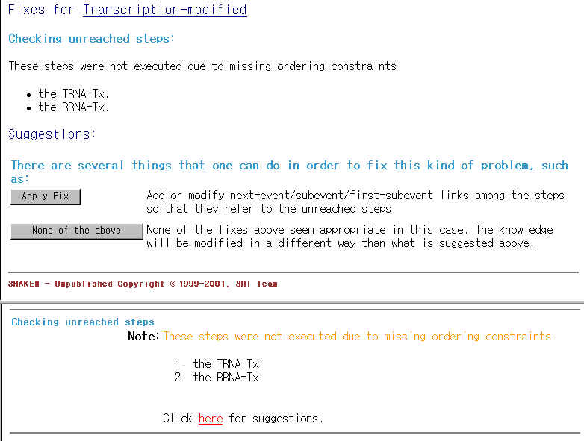
Get fixes for unreached steps

Slide 8
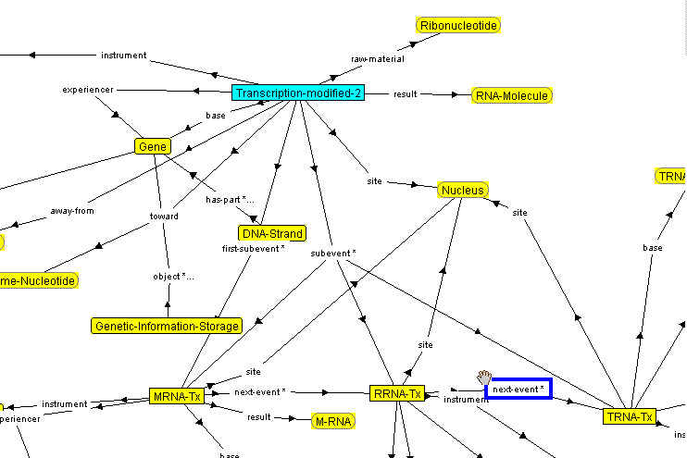
Modify Concept: Transcription and saved as Transcription-modfied-2

Slide 9
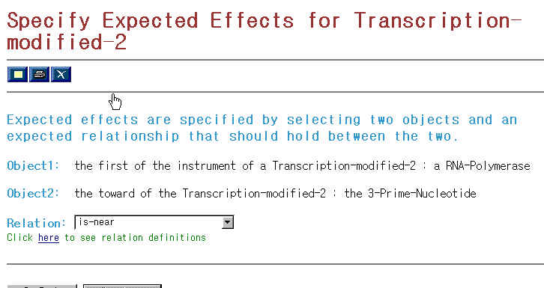
Specify Expected Effect

Slide 10
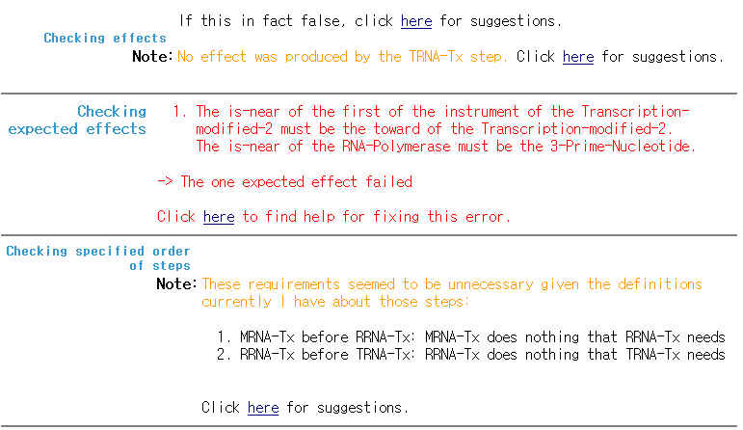
Test Concept with Expected Effect

Slide 11
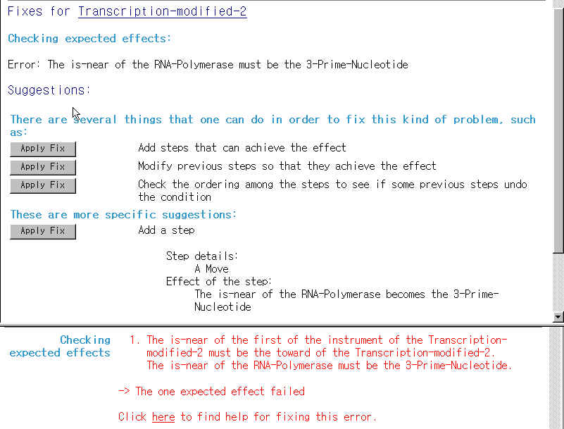
Get fixes for the unachieved effect

