Slide 1

Action Editor Storyboard
Please use the “Notes Page View” for details
Jim Blythe
Jihie Kim
Yolanda Gil
USC Information Sciences Institute
June 14th, 2002

Slide 2
Adding critiquing knowledge in Shaken
The component library is the primary source of background information used in critiquing.
Some critiquing knowledge will be added by specializing concepts from the component library or adding new concepts to extend it.
Kanal uses knowledge about actions -- preconditions and effects. We can add critiquing knowledge for Kanal by adding new situation-dependent specializations of the actions.
  This does not modify the component library, but extends it.

Slide 3
Example: a specialized version of ‘destroy’ when the attack is on the flank
We assume the action ‘destroy’ has a domain-independent definition in the component library
Initially, (through pump-priming) the KB has a special case of ‘destroy’ for military units in which the agent needs a 3:1 force ratio to be successful
(e.g. to achieve the expected effect: attrition rate > 40%)
However, in a SME-generated COA, a 2.5:1 ratio is sufficient because the attack is in the Red flank.
The SME will create a new special case of the ‘destroy’ action so that normative simulation can test mission accomplishment.
Notes:
To check mission accomplishment, a normative simulation would check that all the actions are possible and that they combine to achieve the plan’s desired effects. Here we consider an example where the tool believes the action is not possible because it has an over-constrained model of the preconditions.

Slide 4
Initial critique of mission accomplishment
From KANAL:
Step: Attack to destroy red forces
  Checking conditions
  1. There is no terrain advantage for red
  → This condition succeeded
  2. Force ratio >= 3:1
  → This condition failed
  Click here to find help for fixing this
  Checking expected effects from this step
1. Red forces are destroyed
→ the expected effect failed
attrition rate < 40%
Click here to find help for fixing this
Notes:
Kanal warns the user that the preconditions are not satisfied for the attack to destroy, and offers several suggestions for fixing this. These will include finding steps to add to the COA to reduce Red’s combat power or increase Blue’s combat power, as well as creating a new specialization of the destroy action. We assume here that the user chooses this last option.

Slide 5
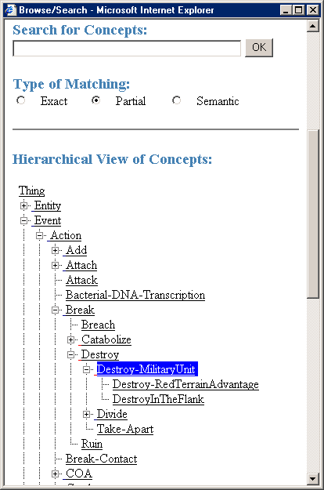
Viewing the subclasses of the ‘destroy’ action
The user can see the different subclasses of ‘Destroy’ in Shaken’s hierarchy view.
The subclasses represent special cases of the actions, with modified behavior in specific cases.
Initially the differences can be implemented using KM properties that influence generally defined effects and preconditions, e.g. ‘required-force-ratio’
Notes:
We can start from the standard Shaken class hierarchy, where the user can see the subclasses of the Destroy action that are currently defined.

Slide 6
trigger: agent is militaryUnit and object is militaryUnit
if: force ratio >= 3:1
and object does not have terrain advantage
  object attrition is 50%
  agent attrition is 10%
trigger: red has medium terrain advantage
  object attrition is 35%
Notes:
The ‘triggers’ correspond to the defining elements of the subclass in KM. Here we only show the information that distinguishes an action from its parent, rather than the information distinguishing, for example, Destroy-RedTerrainAdvantage from Destroy. The full defining condition can be found as the conjunction of triggers along the path back to the root. This defining condition can then be used so that KM’s matcher can identify the appropriate action. Triggers can be shown and defined through CMAPS with the general ability to show distinguished nodes and links, as shown in the next slide.
We aim to show information to the user about an action that includes the trigger and any important properties that are different from the parent action. The boxes in this slide showing that information could be implemented using the text box that already appears when the mouse moves over an element in the hierarchy, with information about the trigger and properties automatically generated in cases where the user defines the action and there is no associated text description.

Slide 7
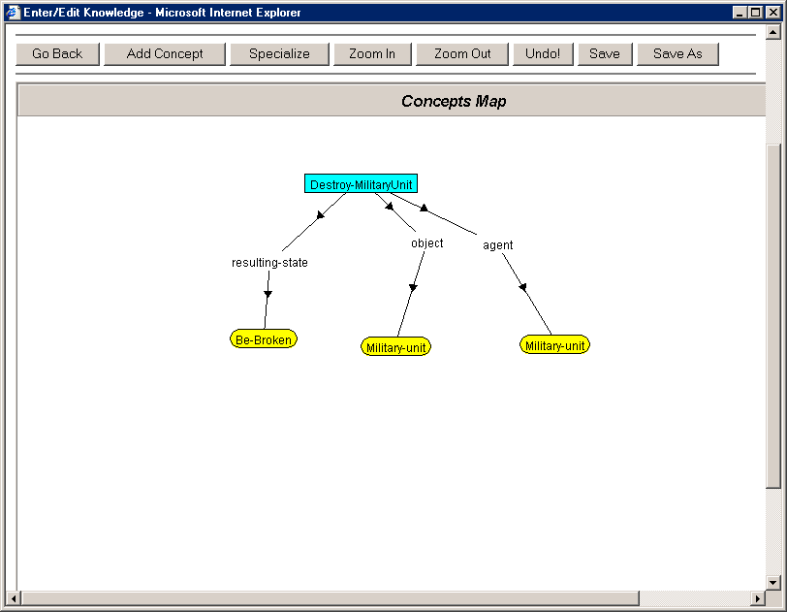
The CMAP view shows the trigger as a distinguished set of features
required-force-ratio
attrition
3
Trigger
50%
Notes:
The idea of allowing a distinguished set of nodes and/or links to be viewed and set in the CMAP has been discusses as a generally useful modification. Here it can be used to define the trigger of the action, which is created as a subclass of the parent action. In this slide, the trigger conditions are shown surrounded with a red box, but the actual mechanism doesn’t affect the way it is used here.
The two properties shown here are used in the preconditions and effects defined in pump priming on the Destroy-MilitaryUnit action. I’m using green for the property values, following Ken B’s slides.

Slide 8
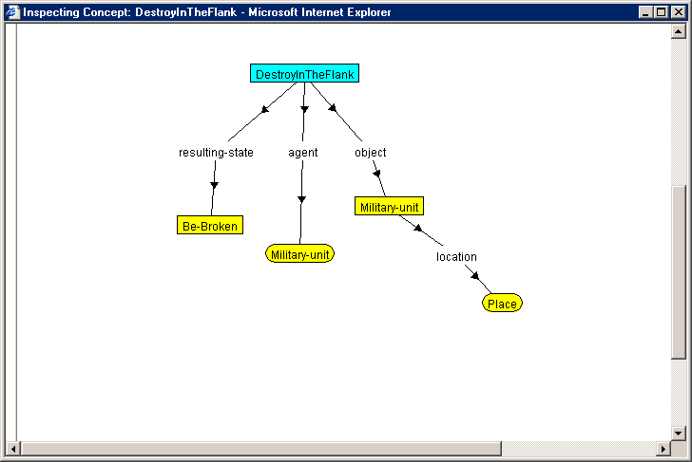
Define the new special case by its trigger and essential differences from the parent (Destroy-MilitaryUnit)
Trigger
required-force-ratio
point-of-attack
flank
2.5
Notes:
The user can define a special case of this action by creating a subclass, defining its trigger and modifying the properties as needed. The trigger is used to build the defining elements of the class in KM, so Kanal and other simulators can use the KM matcher to find the appropriate action when Destroy is used in a COA.

Slide 9
The user can see the new special case in the hierarchy view
trigger: agent is militaryUnit and object is militaryUnit
if: force ratio >= 3:1
and object does not have terrain advantage
  object attrition is 50%
  agent attrition is 10%
trigger: red has medium terrain advantage
  object attrition is 35%
trigger: point of attack is the flank of the object
if: force ratio >= 2.5:1
and object does not have terrain advantage
Notes:
The new subclass can be seen in the action hierarchy along with the other subclasses that have been defined.
This approach to refining actions for specific situations using subclasses is useful because it avoids encoding the special cases in complex preconditions and conditional effects. Users typically have difficulties with such complex logical expressions. Studies have shown that users tend to describe complex logical formulae in terms of a prototypical case and exceptions (eg Pane et al 01), and the same approach is taken in ripple-down rules (eg Preston et al 94).

Slide 10
Revised critique of mission accomplishment
KANAL is able to use the appropriate action using KM’s matcher
Step: Attack to destroy red forces
  Checking conditions
  1. There is no terrain advantage for red
  → This condition succeeded
  2. Force ratio >= 2.5:1
  and the point of attack is the flank of the object
  → This condition succeeded
  Checking expected effects from this step
1. Red forces are destroyed
→ the expected effect succeeded
Notes:
Kanal notes that the action preconditions are satisfied through a special case, but that the action still succeeds.

Slide 11
Examples requiring this capability
Our previous HPKB work on estimating force ratios in COA critiquing demonstrates this requirement.
Our previous HPKB work on estimating length of time to repair damage to bridges also demonstrates it.
Also previous experience in real-world planning KBs (for oil-spill domain, machining, …)
In the above cases, KA was done by KE.

Slide 12
From HPKB experience estimating force ratios
Typically require ratio of 3:1 for attack, but only 2.5:1 for attack on units in a ‘hasty defense’.
Required force ratio is also reduced if the red forces are making a ‘mobile defense’.
Also actual force ratio increased if the red forces are canalized (strung out): can penetrate and only engage 1 sub-unit.

Slide 13
From HPKB experience estimating length of time to repair a bridge
This was accomplished through normative simulation of alternative plans to repair damage using different equipment.
Main difference: we needed to use an AI planning system.
Preconditions on using floating bridges depend on the amount of ‘extra’ gap on river beyond length of bridge
Same for fixed (non-floating) bridges, but in a different way

