Slide 1

Notes on the expression composer
Jim Blythe
USC Information Sciences Institute
http://www.isi.edu/expect/temple

Slide 2
The need for the expression composer
In the HPKB KA CCE, users sometimes had difficulty navigating through the space of possible expressions to find the one they wanted.
For example, a user wanted to talk about “the units”, but the KB only talks about the units attached to specific sides and the user needed to specify a side.
We saw many examples of the same difficulties experienced by SMEs in the RKF year 1 summer trials.

Slide 3
What the expression composer does
The user can type a sequence of words and the expression composer creates valid expressions containing them.
Combines queries and attributes from all data sources and known functions that apply to data types.
runway
template
aircraft
use
landing distance
staging post
max speed
...
width
required landing dist
airport
hardness
max payload
latitude longitude
...
...
...

Slide 4
An example of using the expression composer
User types: “max staging post landing”
Tool suggests: “find the maximum of the landing distance available of the runways of the forward staging post”.
find
Function call
object
of
reformulation
maximum
landing-distance-available
Typed variable
combining queries
runways
Information element
?forward-staging-post

Slide 5
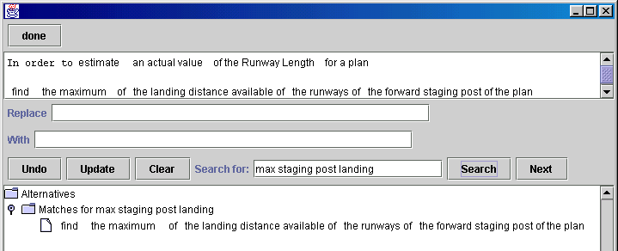
Using the English editor and constraint composer
Constraints can use any models of data sources whose objects, attributes and allowable queries are described.
For example, a user can add a constraint that the airport’s runway takeoff distance is large enough for the aircraft being used.

Slide 6
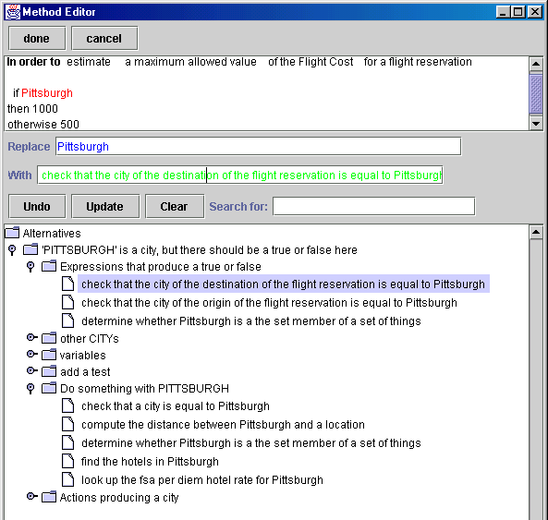
Suggesting Fixes Based on Expectations
Expression composer constructs compound terms in KB that include user terms and have desired type
Anytime breadth-first search through space of terms

Slide 7
One successful search path
(check-that (obj <thing>) (is-equal-to <thing>))
(check-that (obj <city>) (is-equal-to pittsburgh))
(r-city <location>)
(r-city (r-destination <flight>))
(r-city (r-destination ?flight))

Slide 8
Using several data sources
The composer is very useful when different pieces of knowledge are combined, and a user may not be familiar with all of them.
For example, we add a source of TAF weather data, which allows a query to find a TAF based on an ICAO code.
Types: TAF, ICAO, precipitation, ...
Fields: TAF has wind speed and direction, visibility, time covered, wave height, ...
Additional queries:
Can look up a TAF given an ICAO.
Next slide has composer example..

Slide 9
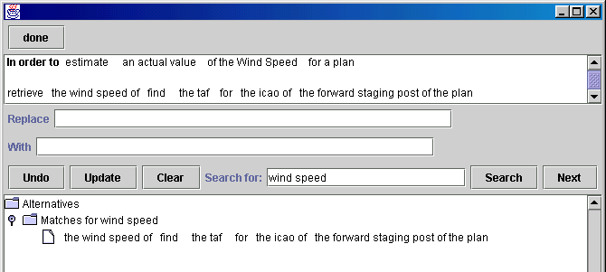
Defining constraints using several data sources
The expression composer can help a user refer to the wind speed at the forward staging post.
The composer automatically adds the step to retrieve the airport’s ICAO from the NIMA AFIF data source.

Slide 10
Summary of the approach
Help users define and modify constraints through a structured English editor with an expression composer.
  Reduces the need for a user to know the underlying syntax.
  Can help disambiguate user-entered statements that do not correspond exactly to formal syntax.
  Can combine different data sources and help build sequential queries.

