Slide 1

Detailed notes on the demo
Jim Blythe
USC Information Sciences Institute
http://www.isi.edu/expect/temple

Slide 2
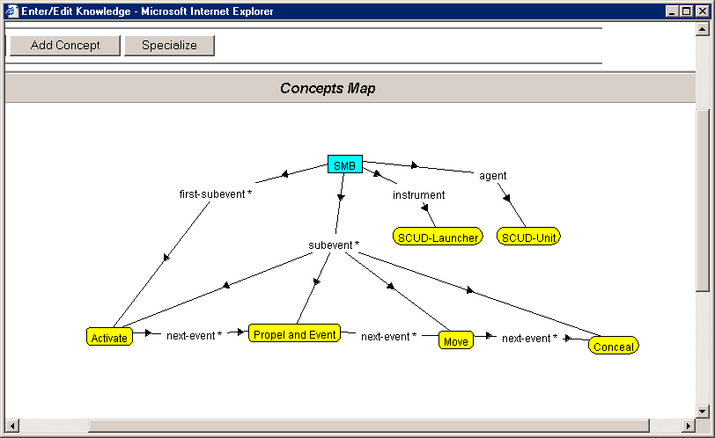
Initial CMAP should look something like this
Notes:
The CMAP name will be different, Active should be ‘load’ which is not in my database and hopefully ‘propel’ will already be an event.

Slide 3
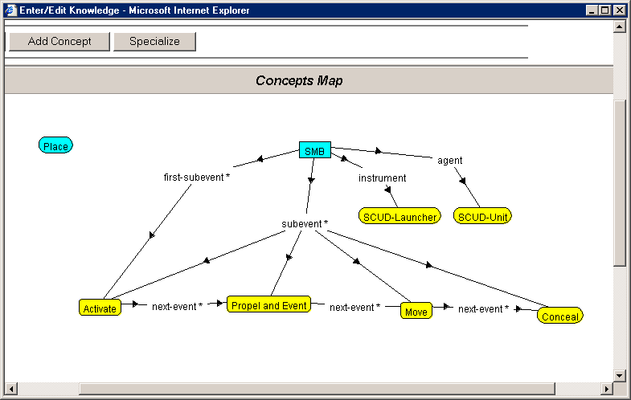
1. Add Place to the SCUD-Attack CMAP.
Notes:
Click the ‘add concept’ button shown. In the concept search window, type ‘Place’ in the text box, hit return. Click the line ‘Place’ from the two matching concepts shown below the text box. The new object is added to the CMAP as shown.

Slide 4
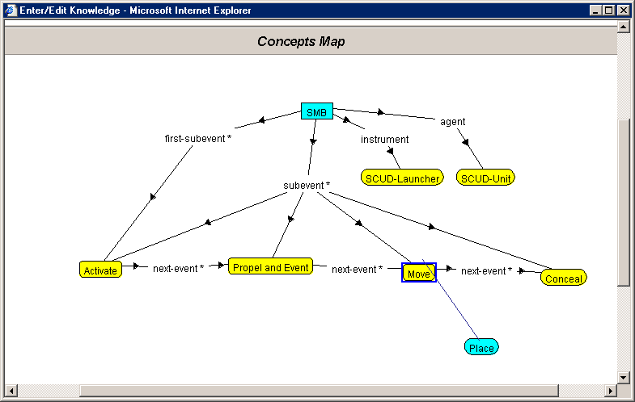
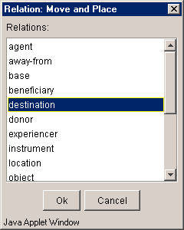
2. Hook the Place up as the destination of the Move.
Notes:
Drag the Place object to below the Move object as show. Click the Move object and a small gray box appears over its box. Drag from this box and you will sweep out a line. Drag the line to the Place box, release the mouse button and the menu of relations appears as shown. Select ‘destination’.

Slide 5
3. Save the CMAP and quit the window.
Right-click the background of the CMAP to get a main menu
Select ‘save’.
Click the ‘X’ button below the line ‘Enter/Edit knowledge’ at the top of the CMAP window.

Slide 6
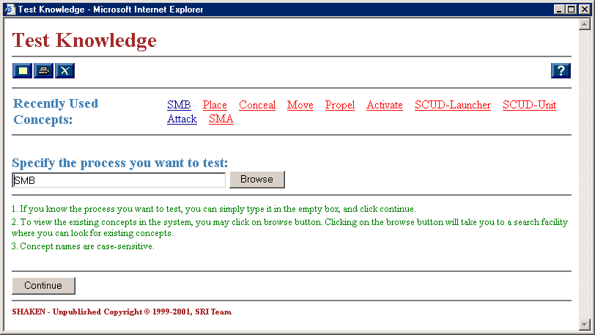
4. Select 'Test Knowledge' from the main window. Choose to test the new SCUD-Attack process.
Notes:
Click ‘Test Knowledge’ on the main window. On the ‘test knowledge’ window, click ‘Browse’ to specify the process to test’. In the search box of the next window, type ‘SKUD-Attack’, or whatever is the name of the process in the demo and hit return. When the proper name appears in the list of matches, click it. The search concept window will disappear and the ‘test knowledge’ window will look like this. Click ‘continue’.

Slide 7
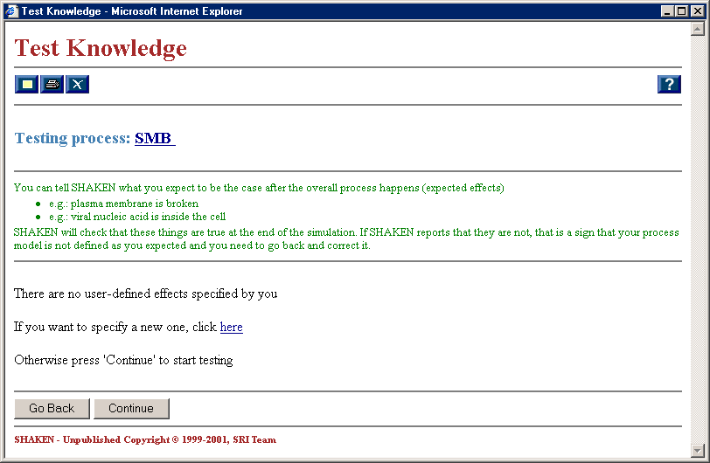
5. Choose to specify a new expected effect.
Notes:
Click on the ‘If you want to specify a new one, click here’.

Slide 8
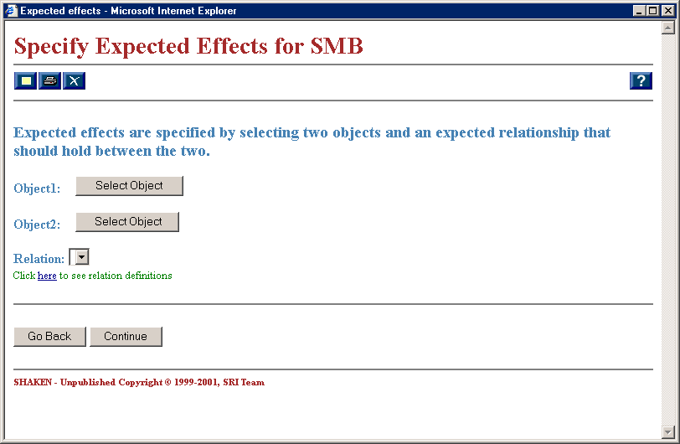
6a. Click 'select object' by Object1:.

Slide 9
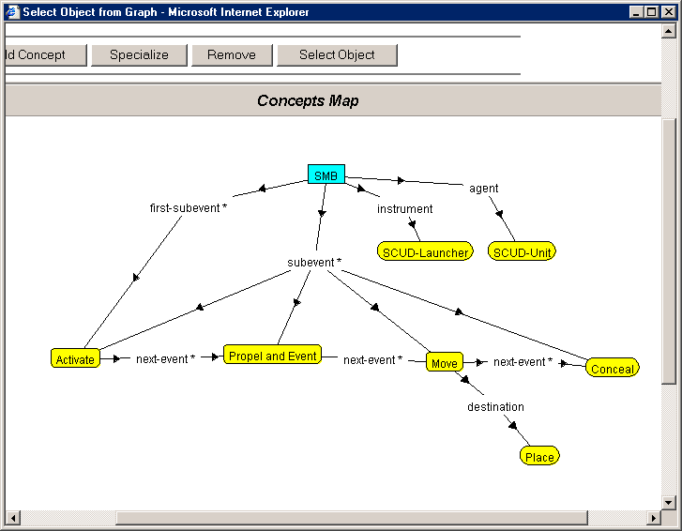
6b. In the CMAP window that comes up, click the SCUD-Unit and click 'select object'.

Slide 10
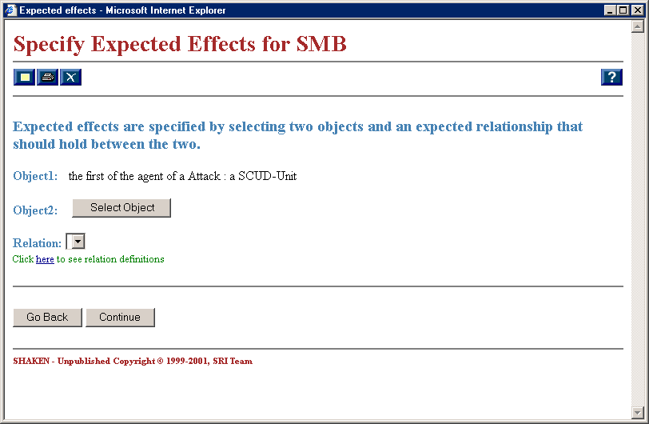
6c. The expected effect window now looks like this:

Slide 11
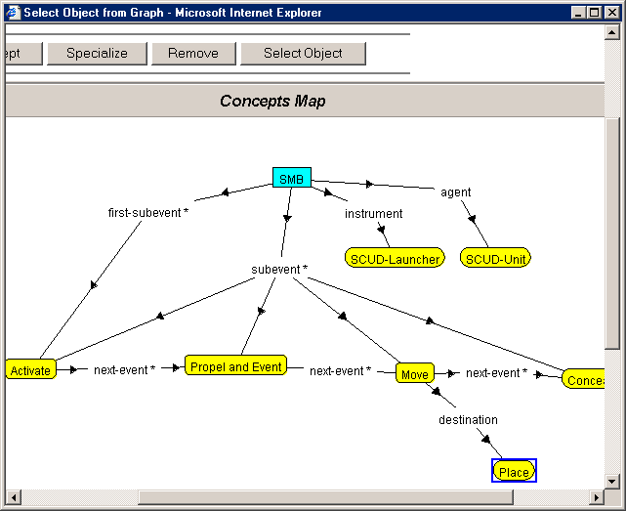
7. Select object2 as the Place in the Move

Slide 12
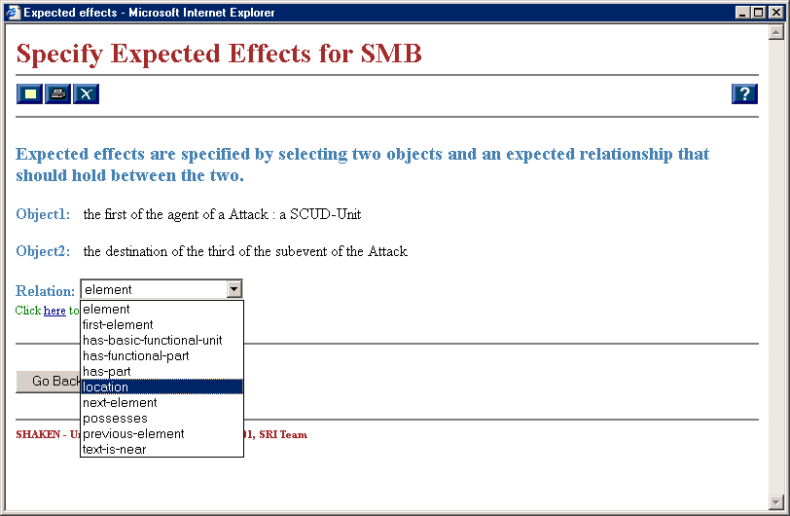
8. Choose 'location' for the relation and click continue.

Slide 13
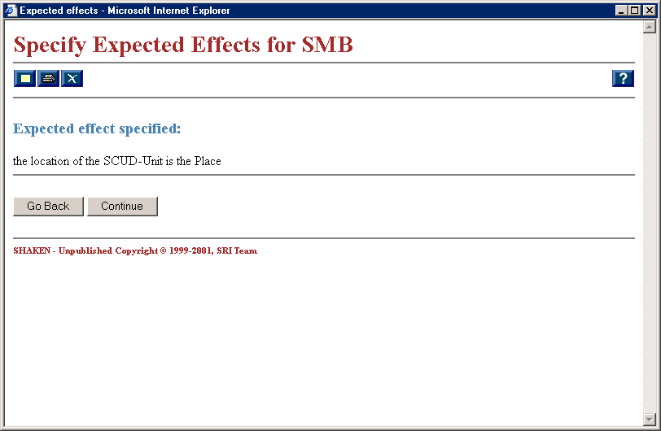
9. Click continue to go back to the 'test knowledge' screen.

Slide 14
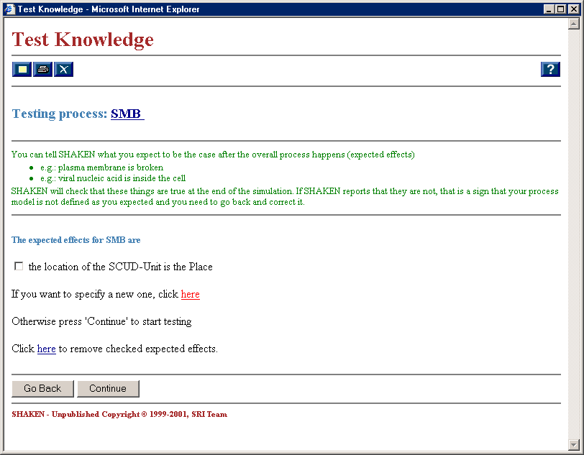
10a. Click continue to test the process

Slide 15
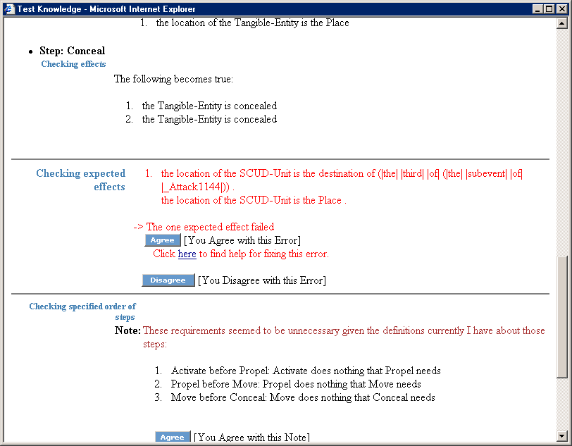
11. click 'click here for help fixing this error' below the message about the expect effect.
Notes:
The result from Kanal should look like this. The expected effect is not achieved.

Slide 16
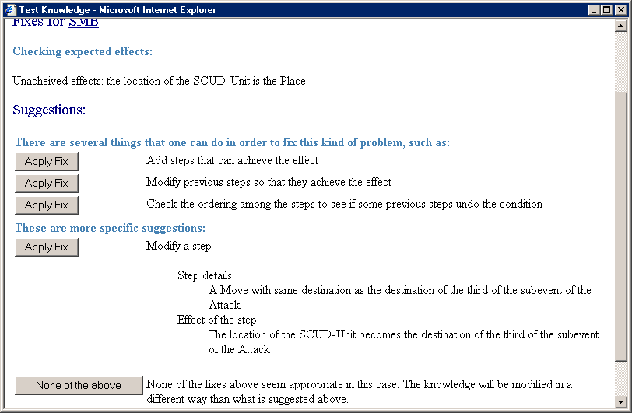
12. Click 'apply fix' next to the detailed 'modify step' fix.
Notes:
Kanal has picked the right step to change although it doesn’t say to make the SCUD-Unit the object of the Move.
Clicking the ‘apply fix’ will bring up the CMAP.

Slide 17
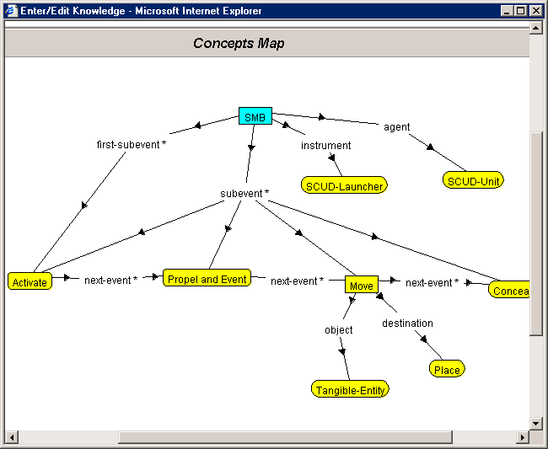
13. In the CMAP, right-click the Move event and select 'Show complete description'.
Notes:
The link 'object->Tangible-Entity' appears.

Slide 18
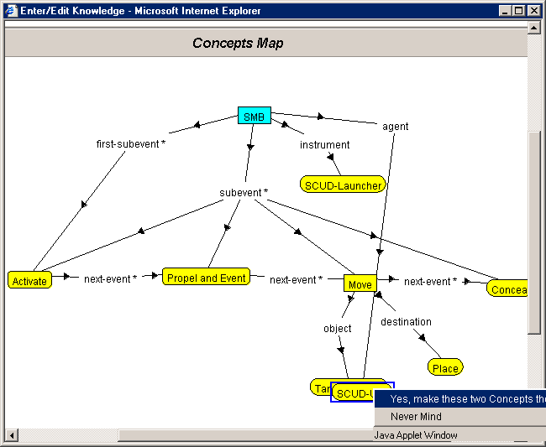
14a. Unify the Tangible-Entity with the SCUD-Unit.
Notes:
Drag the SCUD-Unit box over the newly displayed Tangible-Entity box. From the resulting menu select ‘Yes, make these two Concepts the same’.
Right-click the CMAP background and select ‘save’.
Click the ‘X’ under Enter/Edit knowledge to remove the CMAP window.

Slide 19
14b. Quit the fix window
Click the ‘x’ button near the top of the window.

Slide 20
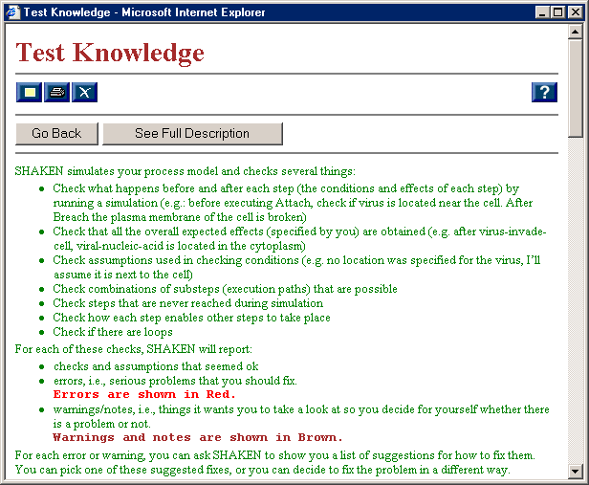
15a. Choose 'go back' in the 'test knowledge' window so that you can run Kanal again.

Slide 21
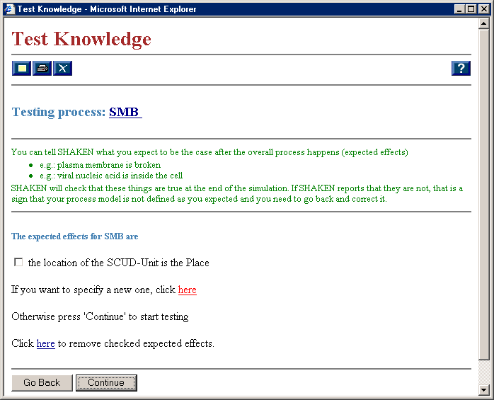
15b. Choose ‘continue’ to re-test

Slide 22
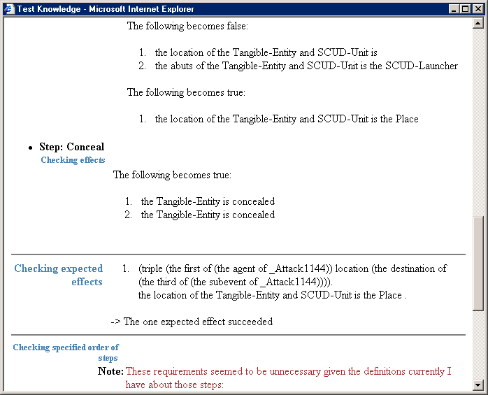
15c. The expected effect is now satisfied
Notes:
You can quit the windows in the same way as before.

