Slide 1
Next Step #2:
Acquisition Dialogue
Jihie Kim
Yolanda Gil
www.isi.edu/expect/projects/rkf/y2plan.html

Slide 2
Feedback from Summer-01 Evaluations
User’s comments on SHAKEN:
    “The system had to be taken by the hand”
    "I do not really know whether there is a possibility of standardizing the entire [KA] process. But it would be better to document some of the [KA] processes which you think are standardized".
Proposed solution: Extend SHAKEN with proactive dialogue capabilities

Slide 3



An Analogy with Robotics
Tele-operated
Robot
passive
not autonomous
can’t handle failure
1970s
…
…
…
Autonomous
Robot
proactive
planning
reactive
Today

Slide 4
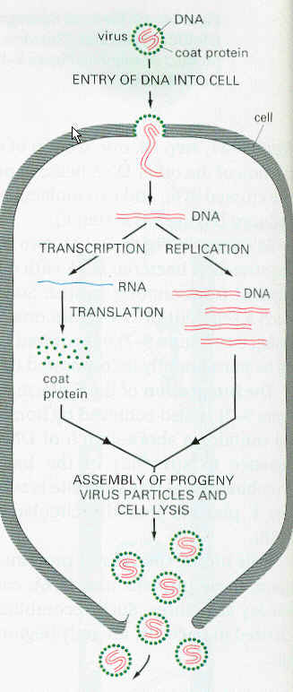

Our Goal for SHAKEN
SHAKEN’01
passive
no feedback
WYGIWYI
Today
…
…
…
SHAKEN’02
Proactive
Plan and suggest
Ask for help
Highlight what
was/wasn’t understood
May’02

Slide 5
Related Work
  Tutorial Strategies
    Known strategies by best teachers [Collins & Stevens 82;Lepper et al 93; Graesser et al 95; Moore 99]
    Human Tutorial Dialog Project [Fox 93]
  Dialog Systems
    Dialog Planners [Allen et al 01; Larsson & Traum 00; Chu-Carroll & Carberry 95]
    Collaborative Discourse theory [Sidner & Rich 01; Ortiz & Grosz 00]
    Discourse management in Intelligent Tutoring Systems [Woolf & McDonald 84; Wenger 87; Freedman 00; Rose 00]
  KA dialogs
    Elicitation techniques[Cooke 94]
    KA script [Tallis 99]
    KA wizard [Blythe 00]

Slide 6
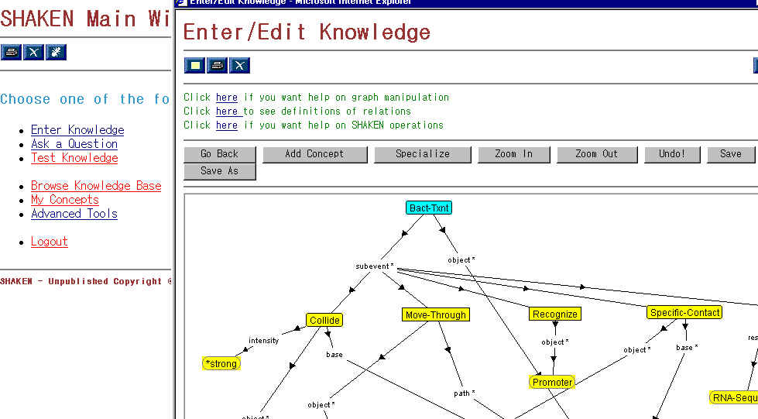
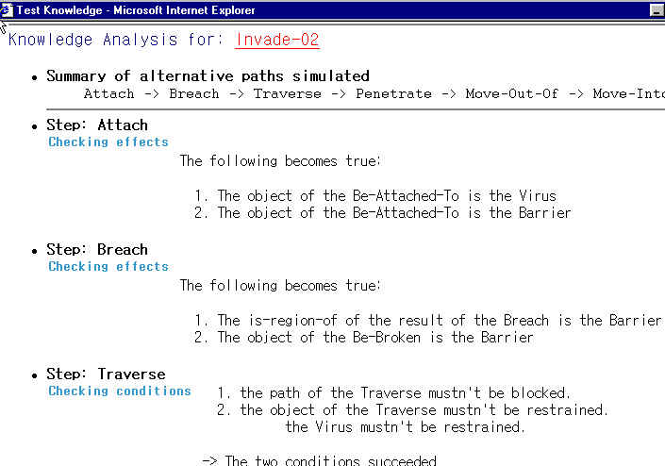
SHAKEN’01
UI (SHAKEN client)
SHAKEN server
KB
KANAL
Q/A
User command logs

Slide 7
Acquisition Dialogues in SHAKEN’02
SHAKEN server
UI (SHAKEN client)
Dialogue Manager
KB
Active Acquisition strategy
KANAL
Acquisition
Strategies
KA dialog
Window
…
Q/A
…
…
State & History
User command logs

Slide 8
KA strategy: accepting K
When the user wants to enter knowledge:
  Ask first for the purpose of the lesson
  Ask for sample test questions and answers
  Explore what the system knows about the given topic (let the teacher explore the competency of the student): relevant existing terms
  Highlight new terms to be defined
For each new term, user needs to 1) define it, 2) define its role in the overall process
For each relevant existing term, user is expected to use it in definitions and/or roles
Test knowledge, fix if needed
Summarize to the user what was learned & end lesson

Slide 9
KA (sub)strategy: Testing and fixing KB
When the user is ready to diagnose a concept, test the concept and inform the errors found
  Suggest fixes based on priorities (e.g., simple fixes before complex fixes)
When the user changes the concept inform of the implications of the change
  Inform what was fixed
  Inform if there are new problems

Slide 10
KA Dialog Window
A high bandwidth user interface for meta-level KA process:
Users can see/checkmark the KA strategy currently active and overwrite it
Users can indicate/see progress in completing each part and to-do items
Exploits dialogue context (i.e., what user has done) and status to help users

Slide 11
Draft KA dialog window (I)
Initiate lesson
Lesson goal: “Describe Lambda virus invasion of
a cell with induction on cell chromosome”
Proposed test questions for the lesson:
  Q: “What is the location of the viral nucleic acid after the invasion?” A: “cell’s nucleus”
  Q: “what are the components of the cell chromosome after invasion?” A: “cell’s genetic material and viral nucleic acid”
  Terms to be defined:
  Lambda virus
  Lambda virus invasion
  induction
Relevant known terms:
  cell
  chromosome
  virus invasion
  For each new term define it and define its role in the process
View previous lessons

Slide 12
Draft KA dialog window (II)
Initiate lesson
For each new term define it and
define its role in the process
  Define Lambda virus
  Describe the role of Lambda virus in Lambda virus invasion
  Define induction
  Describe the function of induction in Lambda virus invasion
…
For each relevant existing term, define how to
use it in definitions and/or roles
Test knowledge, fix if needed
Summarize to the user and end lesson
View previous lessons
Recent lessons (history)
Defined virus invasion
Defined chromosome

Slide 13
Research Issues
Designing the acquisition strategies
  We are already looking into ITS, spoken dialogue, adaptive interfaces, etc.
Flexible interaction: imposing an order in executing steps in the strategy vs not
Fixed scripted macro-strategies vs dynamic planning w/ smaller subdialogs
Selecting among relevant strategies

Slide 14
Research Plan
First version (Dec 01):
  Rigid guidance: user must follow steps in stated order
  Small set of KA strategies
  Standalone KA dialog manager (use SHAKEN files)
Second version (Feb 02):
  Semi-flexible guidance: user can change order of steps
  Integrate with logs/history and state in SHAKEN
  Preliminary tests with SMEs
Third version (May 02 and beyond):
  More flexible guidance: towards plan recognition in dialog
  Extensive KA strategies

