Slide 1

Proactive Acquisition Dialogues
Jihie Kim
Yolanda Gil
www.isi.edu/expect/projects/rkf/

Slide 2
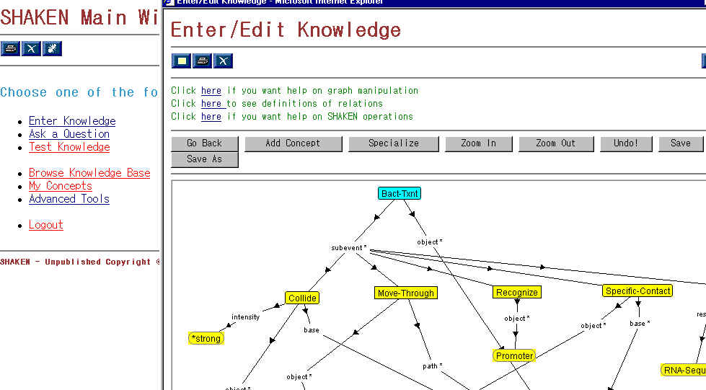
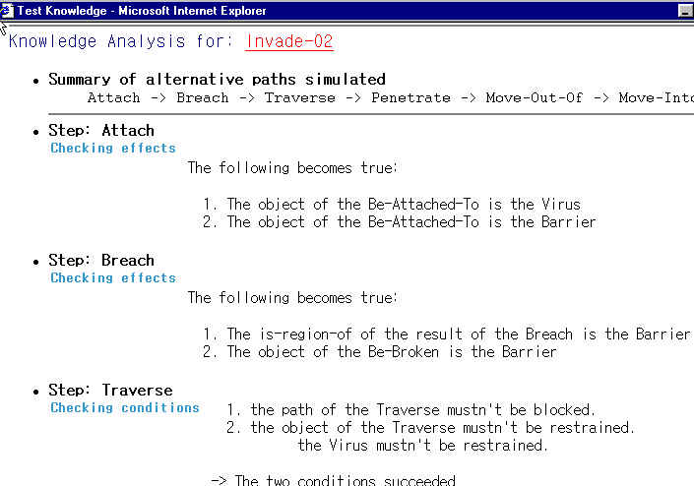
Acquisition Dialogues in SHAKEN’02
SHAKEN server
UI (SHAKEN client)
Dialogue Manager
KB
Active Acquisition strategy
KANAL
Acquisition
Strategies
KA dialog
Window
…
Q/A
…
…
State & History
User command logs

Slide 3
Bacterial Transcription: A process model in biology
Scenario called Bact-Txn1
subevent
first-subevent
Collide
next
Move-Through
next
Recognize
next
Make-Contact
next
DNA-Melting
path
object
base
object
object
base
object
object
Tangible-Entity
Base-Pair
Base-Pair
Bacterial-Polymerase
structural-part-of
Bacterial-DNA
Promoter

Slide 4
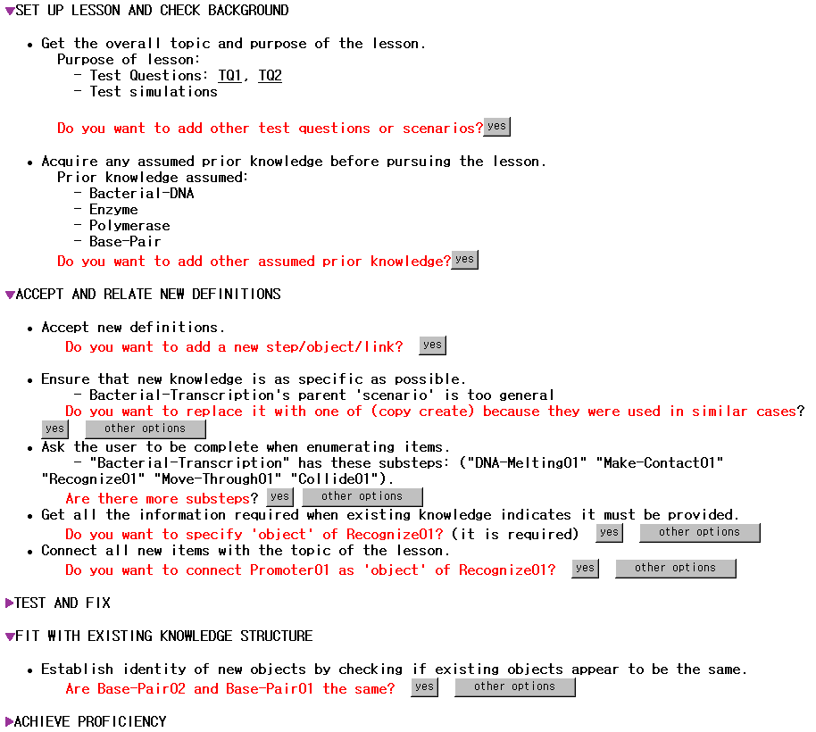

Slide 5
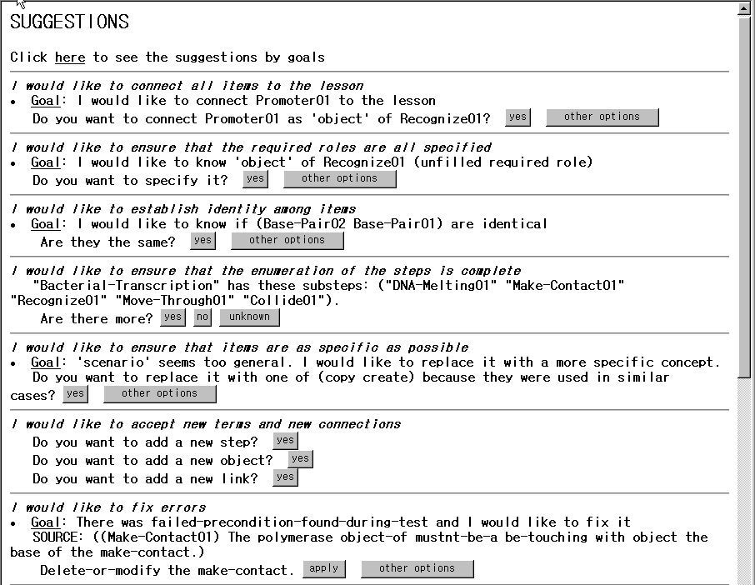
Gral acquisition principle
Specific acquisition goal
Educated guesses

Slide 6
Awareness Annotations
1) Annotations to the new body of knowledge:
  For each lesson: purpose, assumed background, sub-lessons, overall competence and confidence
  For each k item: connection to lesson, relation to other items, identity wrt other items, possible analogies and generalizations, domain terminology details, competence, confidence
  For each axiom of a k item: required information, generality, completeness, confidence
2) Annotations to the dialogue history:
  For each user action: changes to the annotations to the new knowledge, acquisition goals achieved and/or activated, possible future KA strategies

Slide 7
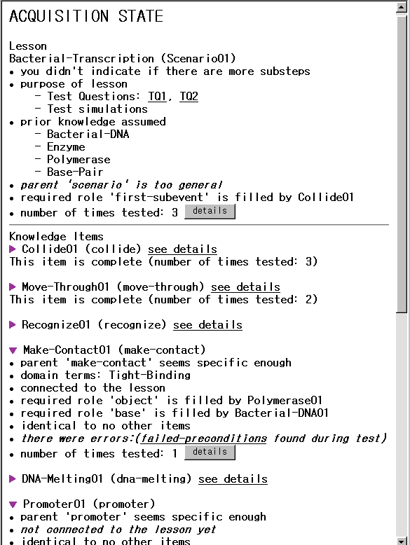
Awareness
Annotations:
1) State

Slide 8
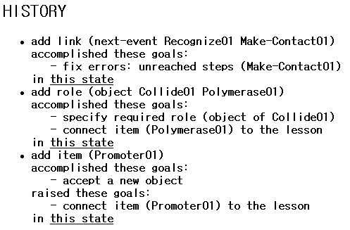
Awareness Annotations:
2) History
Shows user’s actions
and their effects in
accomplishing
acquisition goals
or raising new ones
User can view changes
to the state

