Slide 1
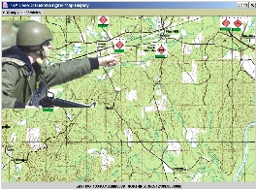
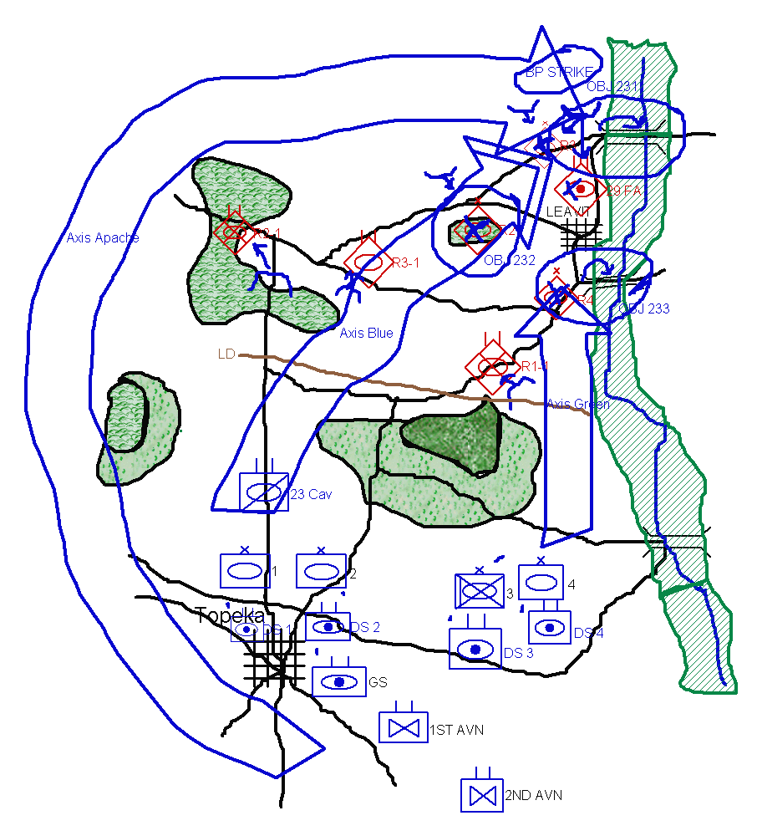
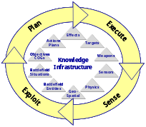
RKF Program
Project Name: KASPER
Prime contractor: SRI International
Subcontractor(s): Information Sciences Instutute/ University of Southern California
Program Manager: Yolanda Gil
Presenter: Jihie Kim
27 June 2003
Upper
Ontology
Upper
Ontology
Upper
Ontology
Core Theories
Core Theories
Core Theories
Domain-Specific Theories
Domain-Specific Theories
Domain-Specific Theories
Facts
Facts
Facts
Notes:
foo

Slide 2
Prior Major Accomplishments
(from start of project through 5/31/03)
Development of two modules (in SHAKEN) that help users author sound plans and refine the action knowledge used to check plans.
  Knowledge Analysis (KANAL): a module that checks the plans or process models entered by a user, reports possible errors in an accessible format and provides specific suggestions to the users about how to fix those errors.
  Action Editor: a module that lets users enter special cases of actions that address different behavior of actions in a given situation.
  These modules have been successfully used for checking biological process models and COAs.
  Papers
    Jihie Kim and Jim Blythe, Supporting Plan Authoring and Analysis, International Conference on Intelligent User Interfaces, 2003.
    Jihie Kim and Yolanda Gil, Knowledge Analysis on Process Models, International Joint Conference on Artificial Intelligence, 2000.
    Ken Barker et al, A Knowledge Acquisition Tool for Course of Action Analysis, Innovative Applications of Artificial Intelligence Conference, 2003.
Development of a process language for KM, SADL (Shaken Action Description Language) that supports conditionals and loops within KM's situation mechanism.

Slide 3
Accomplishments (cont)
Development of a new acquisition dialogue tool called SLICK (Skills for Learning to Interactively Capture Knowledge).
    A set of principles that KA systems can use based on
    the strategies good learners pursue during a tutoring dialogue.
    A prototype dialogue system for nuSketch output (COAs)
  Papers
    Jihie Kim and Yolanda Gil, Proactive Acquisition from Tutoring and Learning Principles, International Conference on AI in Education, 2003.
    Jihie Kim and Yolanda Gil, Deriving Acquisition Principles from Tutoring Principles, Intelligent Tutoring Systems Conference, 2002.
An analysis of interactive KA tools from the viewpoint of their learning skills.
  Papers
    Yolanda Gil and Jihie Kim, Interactive Knowledge Acquisition Tools:
    A Tutoring Perspective, 24th Annual Meeting of the Cognitive Science Society, 2002.

Slide 4
Accomplishments (cont)
Led team In-house Trials with SMEs for RKF yr1 evaluation, Spring 2001
    Prepared the training material and conducted tests at SRI
    Trial materials are available at http://www.isi.edu/~gil/rkf/evals/t1/
Participation in the RKF evaluations
  Biology Textbook Knowledge Challenge Problem, Summer 2001 and Spring 2002.
  Army Course Of Action Challenge Problem, Fall 2002.
Assessment of SME entered knowledge based on general principles for checking processes and plans (IET’s Expert Panel)
  Analyzed SME entered process models in biology, 2002
  Analyzed SME entered process-related COA critiquing knowledge, 2003
  Papers
    Mike Pool et al, Evaluating SME-Authored COA Critiquing Knowledge, 2003 (submitted for publication)

Slide 5
Remaining Funding
Contract funds remaining as of 6/1/03: Funds pretty much depleted
Spending plan from 6/1/03 through contractual end date
  Remaining funds will cover travel to present KANAL and SLICK papers at conferences
  Support SRI

Slide 6
Remaining Tasks
(from 6/1/03 through contractual end date)
Contractual end date: 02/04/04
Tasks planned for 6/1/03 through contractual end date
  Technical paper presentations
  Support SRI

Slide 7
Major Deliverables and Their Data Rights* to Government (due by contractual end date)
All have been delivered to SRI
  Reports
    Technical publications in conferences (see above)
    SADL: http://www.isi.edu/expect/projects/rkf/sadl/index.html
    In-house trial report: http://www.isi.edu/~gil/rkf/evals/t1/
    Report from SME interviews after RKF yr1 evaluation: http://www.isi.edu/~gil/rkf/evals/final/
    RKF yr2 evaluation material and report: http://www.ai.sri.com/~rkf/private/E2E/eval02/
  Software
    SHAKEN/KANAL
    SHAKEN/Action Editor
  Knowledge bases
    SHAKEN KBs
      Special cases of actions for COA critiquing
      Process models in molecular biology domain
  Documentation
    KANAL: http://www.isi.edu/expect/projects/rkf/KANAL/KANAL-documentation-7-18-00.htm
SLICK software prototype available

Slide 8
Issues with Remaining
Tasks, Deliverables, and/or Funding
Further work would require additional funds.
  Full Integration of SLICK with SHAKEN
  Adapt KANAL/Action Editor to KB extensions (a more comprehensive representation of military tasks, military equipment, terrain,etc.)
  Extend KANAL Action Editor to handle concurrent COA tasks
    Force ratios are computed by finding the maximal cooperating set for Blue combat power.
    Incorporate multipliers in combat power calculation based on Gen. Otstott’s suggestions.

Slide 9
KANAL: verifying plans and process models entered by user
Action Editor: acquiring special cases of actions that address different behavior of actions in a given situation
SLICK: KA dialogue Tool

Slide 10
KANAL: Knowledge ANALysis of Plans and Process Models [Kim&Gil IJCAI-01]
  Approach: Use Interdependency Models to acquire process knowledge from users
    1) Derive interdependencies by analyzing how knowledge is used
      Example: Step A has effect X that is needed by Step B
    2) Use the interdependencies to detect inconsistencies and missing knowledge
      Example: Detect missing steps by checking preconditions of other steps
    3) Based on the context provided by the models, guide users in fixing problems
      Example: Propose to add a step that can achieve the failed condition

Slide 11
KANAL for COA critiquing
Critiques are generated by a normative simulation that uses knowledge about actions
Simulation checks what happens before and after each step based on its background knowledge
  KANAL uses conditions and effects of each action
  Examples:
    Precondition on required force-ratio: an attack-to-destroy step has force-ratio value 2.5 but 3:1 is required
    Precondition on appropriate terrain type: tank units cannot move on Forest or Lake
    Effect on remaining strength: Remaining strength of Blue3 is still greater than 85% after the attack-to-destroy step
    Effect on location: After a move, the location of the unit changes to the destination
    Effect on time: after a step, the time changes based on its duration
    . . .
event1
event2
event3
event4

Slide 12
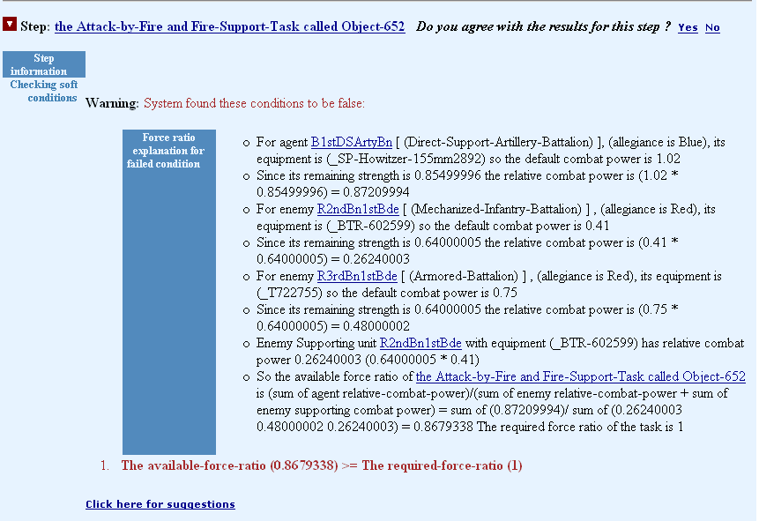
KANAL Results: failed condition of Attack-by-Fire

Slide 13
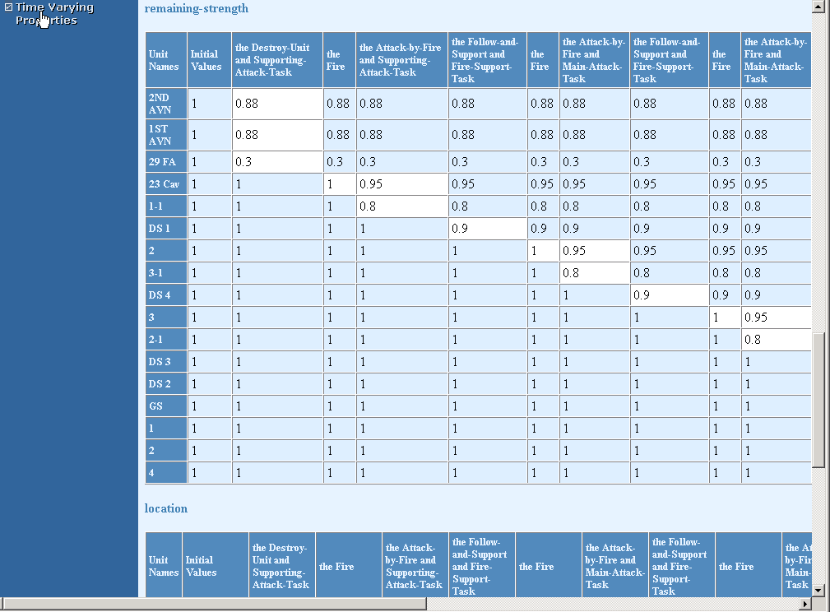
KANAL unit timeline
Summary of state transition
  generating a table for each property that changes over time in order to visualize changes made to objects in a plan
Allows user-specified expected effects

Slide 14
Action Editor: Adding New Knowledge for Plan Analysis
The KB contains general knowledge about actions
General descriptions need to be extended with variations that account for action behavior in different situations: special cases of the actions
User adds this knowledge by specializing concepts from the KB
KANAL uses knowledge about actions – preconditions and effects. It will use newly defined situation-dependent specializations of the actions.
Non-programmers find this type of knowledge easier to understand (Pane et al 2001)
Needed in building various KBs: biology process models, military courses of actions (COAs)

Slide 15
Example (in checking COAs): a specialized case of ‘attack-by-fire’ when the agent is artillery
‘Attack’ has a domain-independent definition
‘Attack-by-Fire’ for military units: the agent needs a 1:1 force ratio to be successful
However, in a user-generated COA (course of action), a 1:2 ratio is sufficient for artillery.
The user creates a new special case of the ‘Attack-by-Fire’ action
  With a use-when: the agent is artillery
  With a different precondition: required force ratio 1:2
KANAL uses the new knowledge in the simulation
Notes:
To check mission accomplishment, a normative simulation would check that all the actions are possible and that they combine to achieve the plan’s desired effects. Here we consider an example where the tool believes the action is not possible because it has an over-constrained model of the preconditions.

Slide 16
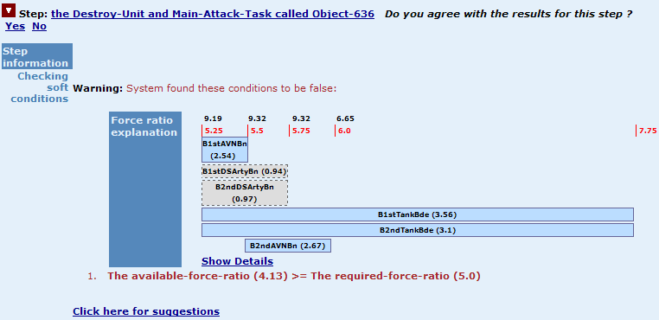
Handling Concurrent Tasks in COAs
Handling cooperating tasks in COAs:
Two tasks will cooperate if they overlap in time and share a common enemy.
Combat power for a set of mutually cooperating tasks is the sum of the combat power of all tasks involved.
Use a maximal set of mutually cooperating tasks for combat power.

Slide 17
Action Editor /KANAL usage for COA critiquing
Results | September 2002 | October 2002
Number of special cases created | 4 | 13
Average number of times applied | 1 | 5.4
Number of times KANAL was run | 32 | 42
Number of plans tested | 9 | 8
Total number of warnings/errors | 85 | 345
Number of times agreed | N/A | 29
Number of times disagreed | N/A | 43
User Comments: “It is interesting how it interprets this.”,
“surprisingly good” when special actions were applied

Slide 18
SLICK: Proactive Acquisition Dialogues
Users remain largely responsible for the acquisition process
  Decide where, what, when, how, why to enter knowledge
  System checks errors, may have some short-term acquisition goals
Ideally, these tools should have good learning skills:
  Formulate and pursue learning goals
  Keep track of lessons and progress
  Assess how much they are learning and how useful k is
  If teacher is not so great, still capable of learning

Slide 19
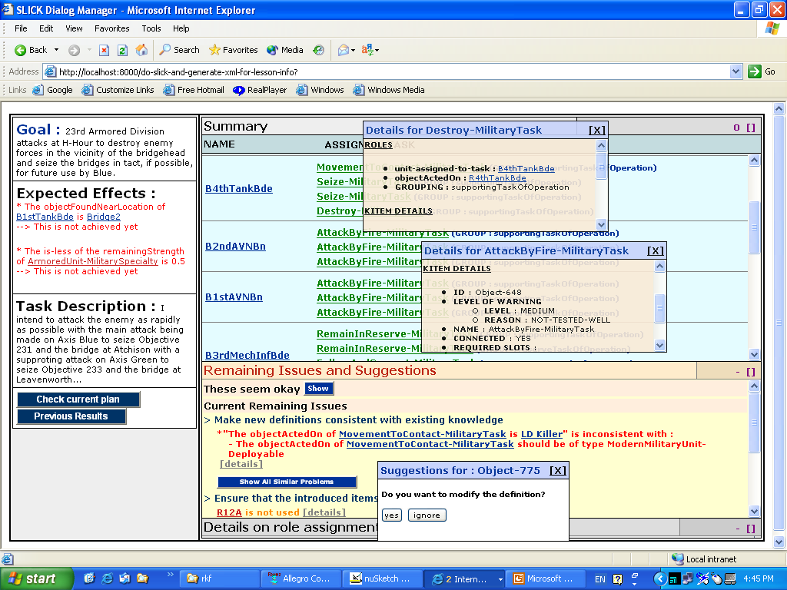
A SLICK prototype: Supporting COA Entry
  User can inspect how system is assimilating the new knowledge and its confidence in it
  User dialogue is structured around instructional goals and topics
  System can summarize what it has learned at each point in time
  System justifies its questions and sets priorities
  System makes educated guesses to provide useful suggestions

Slide 20
Dialogue Items are derived from Acquisition Principles
SET UP LESSON AND CHECK BACKGROUND:
  G1: Get the overall topic goal (expected effects)
ACCEPT AND RELATE NEW DEFINITIONS:
  G4: Ensure that new knowledge is as specific as possible
  G5: Ask the user to be complete when enumerating items in terms of the elements and in terms of the significance of the order given.
  G6: Get all the information required when existing knowledge indicates it must be provided.
    Examples
    Every COA has mainTask, supportingTask, reserveTask, FireTask
    Each task has assigned units
  G7: Make all new definitions consistent with existing knowledge
    Examples
    For MovementToContact, the object should be militaryUnit
    For Follow-and-Support, the agent is military-unit and the base is Military-Unit whose allegiance is the same as the allegiance of the agent
  G8: Connect all new items with the topic of the lesson.
TEST AND FIX
  G9: Test the new body of knowledge and generate tests
FIT WITH EXISTING KNOWLEDGE STRUCTURE
  G13: Establish identity of new objects by checking existing objects
ACHIEVE PROFICIENCY
  G15: Acquire domain terms to describe new knowledge (using lexical entries)
REACH CLOSURE
  G17: Ensure that the purpose/topics of the lesson were covered
    check if all the expected effects are achieved

