Slide 1
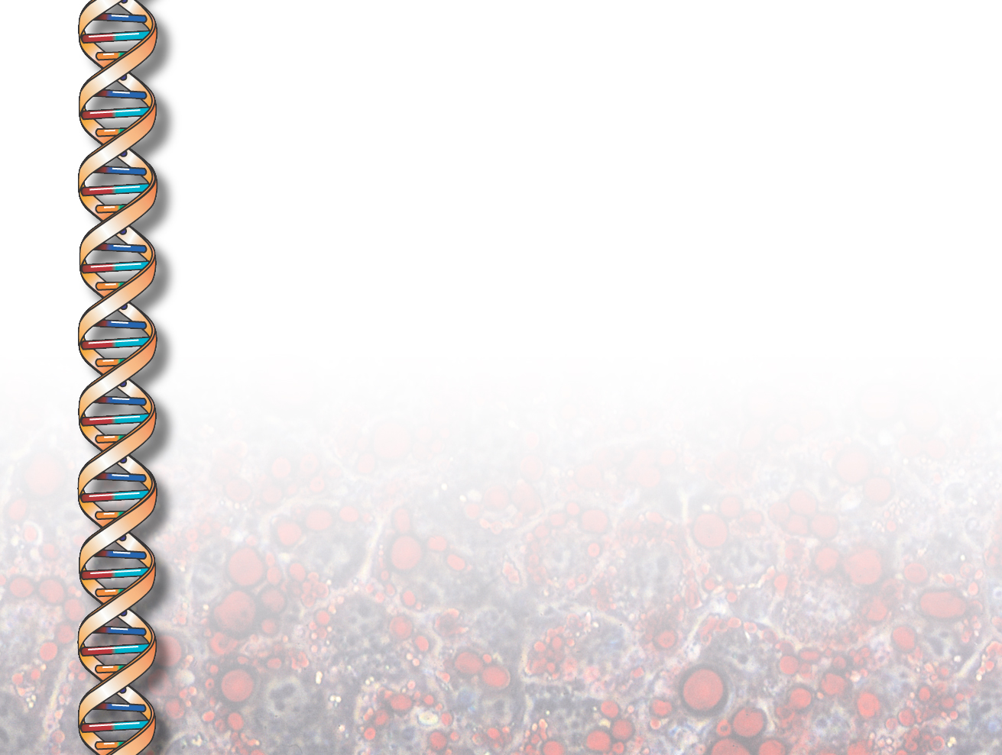
KANAL
(Knowledge ANALysis)
Jihie Kim
Jim Blythe
Yolanda Gil
www.isi.edu/expect/projects/KANAL/

Slide 2
Problem Addressed: Helping users specify complete and consistent process models
Models need to contain detailed information:
  Substeps of a given step, temporal and causal links between substeps
  Each step modeled as an event type in the component lib
  Each event type defines roles that are filled by
  objects (e.g., agent, destination, etc.)
Users need help in defining process models:
  May forget important details
  May define inconsistent steps or links among steps
  Even when an inconsistency or gap is detected, user may not know how to fix it

Slide 3
Approach: Interdependency Models
Interdependency Models relate different pieces of Knowledge among themselves and to the existing KB [Swartout & Gil 95; Kim and Gil 99]
  1) Derive interdependencies by analyzing how knowledge is used
  2) Use the interdependencies to detect inconsistencies and missing knowledge
  3) Based on the context provided by the models, guide users in fixing the inconsistencies and gaps
Successfully used in acquiring and checking problem-solving K in EMeD/EXPECT from end users [Kim & Gil 00]

Slide 4
KANAL: Helping Users through
Interdependency Models (IMs)
KANAL derives IMs through the dynamic analysis (simulation) of steps and static analysis of the event ontology
  Starting with initial state, iterate through steps (and alt. paths):
    Check preconditions in current state
    Apply step by asserting effects
    Check effects
KANAL uses the resulting IMs to check if:
  All steps are properly linked, all step preconditions are satisfied, all expected effects are achieved, etc.
  User sees a report of serious errors (to be fixed) as well as warnings for potential problems (can be fixed or dismissed by user)
KANAL exploits the IMs to suggest fixes for these problems
  Finding steps that can assert unachieved effects, adding missing links, changing ordering constraints to reinstate conditions, etc.

Slide 5
KANAL’s Checks on Process Models
  Unachieved preconditions
  Expected effects
  Enabling relationships
  Unnecessary or missing links
  Undoable step/ useless step
  Disjunctive branches
  Loops

Slide 6
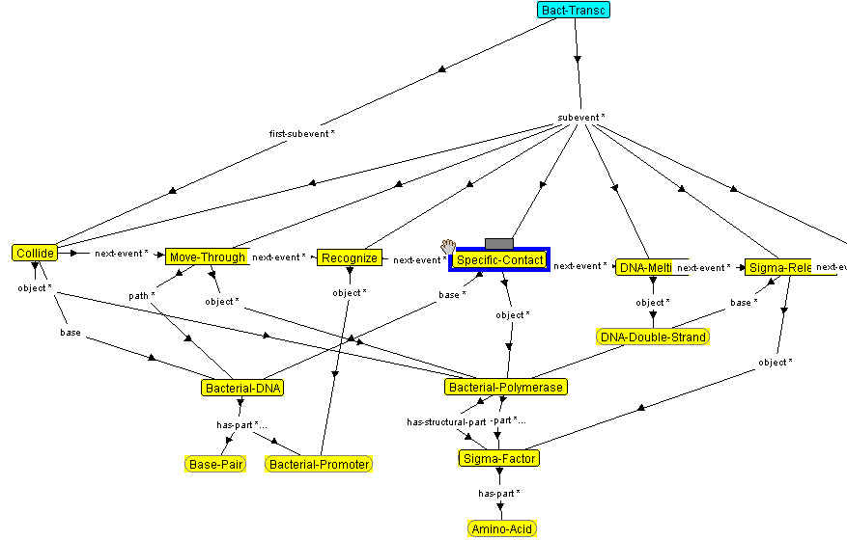
Iflu’s mistake: Specific-Contact’s base should be the Promoter

Slide 7
KANAL helps users detect and fix the errors
polymerase
DNA
promoter
Collide with DNA
Move-Through DNA
Recognize promoter
X
Specific-Contact to DNA → Execution Fails
Polymerase is already in contact with DNA !
. . .
Proposed
Solutions:
A. Add a Break-Contact step
B. Modify the Collide step
User
picks C
X
C.
Specific-Contact to DNA
Promoter

Slide 8
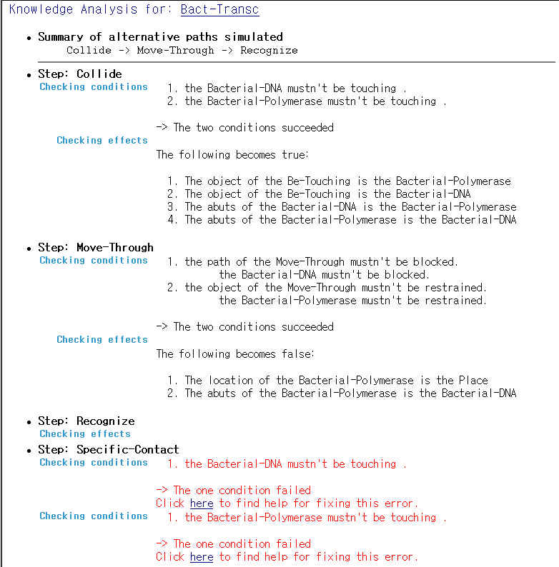
Test
Bacterial
Transcription

Slide 9
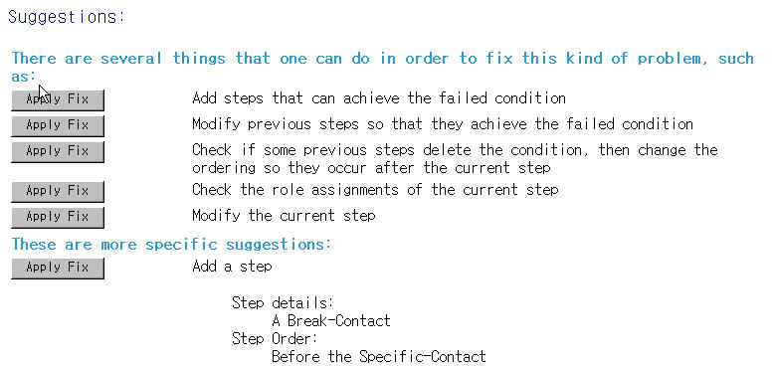
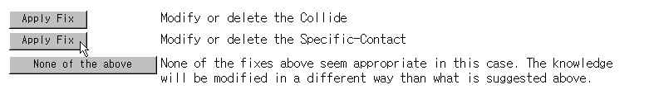
Suggested Fixes

Slide 10
KANAL in SHAKEN
KANAL
Dynamic
Analyzer
Error Detector
KM
Static
Analyzer
Fix Proposer
Component
Library
UI
Q/A
…

Slide 11
Errors & Warnings shown during TKCP
Error type
# errors/
warnings
Missing first-event, subevent, next-event
37
Unreached events
55
Unnecessary ordering
105
Loop
1
Failed conditions
133
Failed execution of step
30
Effectless step
139
Failed expected effect
7
Total invocations of KANAL: 144

Slide 12
Fixing Problems: Using
Interaction Plans
Interaction Plan: describes how to proceed with the user interaction
  direct what to do next based on the results from K Analysis
KANAL’s dialogue for fixing errors is implemented with KANAL interaction plans
Will be integrated with the KA Dialog Manager

Slide 13
Keeping Track of
Interaction History
...
Choose what to simulate
choose model: VirusInvadesCell
choose substep to test: VirusInvadesCell
Simulate model VirusInvadesCell
simulate-steps-&-find-failed-events
ask-to-fix-failed-event: (failed preconditions of Enter)
propose-fixes-for-failed-event
ask-what-to-fix-for-failed-event :
((the location of (the patient of Enter)) =
(the space-near of (the agent of Enter)))
ask-how-to-fix-failed-event (add Arrive before Enter)

