Slide 1



DARPA
DARPA
Knowledge Acquisition
Critical Component Experiment
The EXPECT Project
USC/Information Sciences Institute
Yolanda Gil
Jihie Kim Jim Blythe
Marcelo Tallis Surya Ramachandran
Held August 24-27, 1999
Battle Command Battle Lab
Ft Leavenworth, KS

Slide 2
EXPECT: A User-Centered Framework for Developing KBSs
EXPECT
Ontologies and
Method libraries
Knowledge Base
Method
instantiator
COA
ontologies
Domain
ontologies
and factual
knowledge
CYC/Sensus
Upper
Problem
solving
methods
Plans
(PLANET)
Evaluations and
Critiques
Domain
dependent
KBS
Resources
(OZONE)
Evaluation
PSMs
KA tools
KBS
compiler
Interdependency
Model (IM)
EMeD
PSMTool
KA Strategies
KA Scripts
Knowledge-Based
System
Instrumentation

Slide 3
Background
Subjects extended the KB of the EXPECT COA Critiquer
The EXPECT COA critiquer provides an analysis of COA structure and resource use
Functionality of our tools: help users enter problem solving fragments
  “In order to estimate the force ration for a task in a COA, compare the combat power of all Red units performing the task with the combat power of all the Red units involved”
Knowledge acquired: EXPECT’s fine-grained problem-solving methods, which contain procedural constructs such as conditional statements and iteration)

Slide 4
EXPECT’s Approach to Knowledge Acquisition
Key idea: Tool can understand how different pieces of knowledge are related, and guides user to provide knowledge needed to make them work together
EXPECT forms expectations about what knowledge it needs to acquire
EXPECT exploits many sources of expectations:
  Existing domain knowledge
  General principles and middle-level theories
  How problem solving works
  Typical acquisition strategies

Slide 5
EXPECT’s Support for KA:
Key Technologies
1) How do I know I am adding the right thing?
  System derives and uses model of knowledge interdependencies to understand how different pieces of knowledge are related
    Guides users to add the facts needed for problem solving
2) I don’t know the computer language…
  An English-based editor
    Users modify the English paraphrase of the internal, more formal representation
3) KA takes many steps; users will be lost…
  Script-Based Knowledge Acquisition
    Capture typical sequences of changes that users make
4) Where do I start?
  Capture general principles, core theories (e.g. plan evaluation)
    Can be adapted by user with specific domain knowledge

Slide 6
Our participation in the KA CCE
Our claims and hypotheses centered on:
  Tool helps users enter knowledge faster because they have X
  Tool using X enables users to enter certain kinds of knowledge that they cannot enter without X
Our methodology is described in [Tallis, Kim, and Gil 99]
Within-subject ablation experiments:
  Subjects enter knowledge using a KA tool with a useful feature X
  Same subjects enter knowledge (different but comparable size task) using the KA tool without the feature (i.e., some capabilities are disabled)

Slide 7
Pre-tests with Wide Range of Subjects
[Kim & Gil IUI-2000] (EMeD version 1.0)
As users are more naïve:
KA tool saves more time
More time to train them
They need more help
We extended tools accordingly

Slide 8
Schedule for the Experiment
Given initial system with knowledge about COA critiquing, participants were asked to add new knowledge using different KA tools (ablated and non-ablated versions in different orders)
Day 1
  session 1: tutorial of EXPECT and overview of EXPECT COA critiquer
  session 2: tutorial of EMeD tool and practice
Day 2
  session 1: add new knowledge using a version of EMeD
  session 2: add new knowledge using another version of EMeD
  session 3: short overview and experiment with two advanced features (PSMTool)

Slide 9
Experiments with EXPECT’s Interdependency Model (Jihie Kim)
Hypothesis: The use of a detailed Interdependency Model (see next slide) decreases the time to add new knowledge because the interdependencies point out to the user what new knowledge needs to be acquired.
KA tasks: four additions and modifications to the EXPECT COA critiquer (two simpler tasks, two more complex tasks)
Tool ablation experiment: four tasks done using Interdependency Model, four tasks done without
Subjects: Four Army officers, previously trained on EXPECT’s language for a day

Slide 10
EMeD (EXPECT Method Developer):
Guidance through Interdependency Models
Effective KA tools guide users with expectations derived from interdependencies among components in KBS
    User: Add Havana as a new seaport
    System: Tell me about the berths of Havana because I need to know how to dock ships
EMeD [Kim & Gil 99, Kim & Gil 00] exploits several kinds of interdependencies to acquire problem-solving knowledge:
    Guide the design and creation of a new KB element (e.g., a method)
      Find dependencies within the KB element
      Find if the new method fits in principle with existing knowledge
    Detect missing knowledge
      Find undefined methods given the newly created ones
      Propose initial version of new methods to add (e.g., propose a result type)
    Fitting pieces together
      Find user defined and yet unused methods
      Propose potential uses of an unused method in other methods

Slide 11
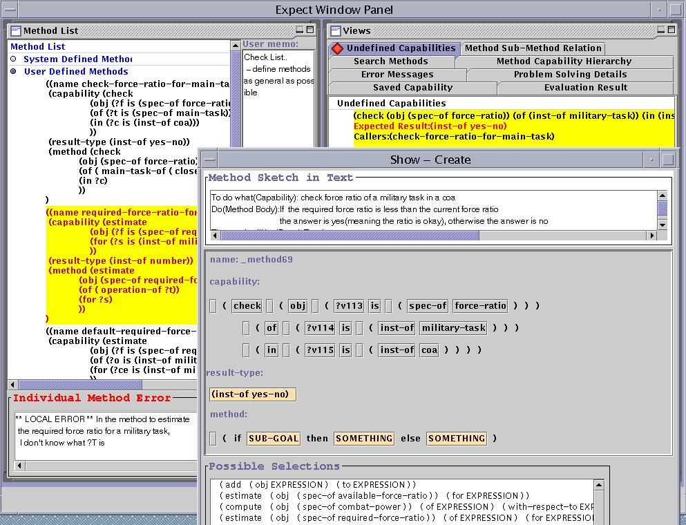
Snapshot of EMeD interface
Errors in
interdependencies
Point out missing
knowledge
Proposed initial sketch
of new method
Structured
editor

Slide 12
An Example of EMeD’s Interaction with Users
User adds a new method
  “In order to evaluate the force-ratio for a military task, check if the required ratio for the task is less than the available ratio for the task”.
System points out that it is missing problem solving knowledge
  EMeD has analyzed interdependencies between the new method and its sub-methods (for computing required ratio and for computing available ratio) and found that the user has to add a new method for computing available ratio.
System proposes an initial sketch of missing knowledge
  EMeD predicts what the missing sub-method has to do and proposes a capability : the new method should compute available ratio for a given military task
  EMeD predicts the output of the missing sub-methods, and proposes a result type : the new method should return a number (force ratio) to be compared with another number (required force ratio)

Slide 13
Sample Tasks Given to Subjects
Easier task 1: Change the combat power value of an M1A2 battalion
Easier task 2: Generalize the existing methods for computing combat power for battalions for any military unit in general
More complex task 1: Add new knowledge for checking the force ratio of a task, given some methods for computing required ratio and available ratio
More complex task 2: Add details to the combat power computation to take attrition into account
(Four other comparable tasks were also used)

Slide 14
Experimental Results
Average time to complete tasks

Slide 15
Experimental Results
Tasks completed
LEGEND:
indicates total tasks

Slide 16
Qualitative Results
Predicting what pieces are interrelated and how was easier with EMeD’s help
  Visualizing super/sub method relations was useful
Detecting missing knowledge and adding it was easier with EMeD’s hints
  Highlighting missing problem-solving methods and creating initial sketch based on interdependencies were very useful
Fixing errors was easier with EMeD
  EMeD categorizes different error types and helps the subjects fix them in an appropriate order
Structured editor provided very useful guidance for less experienced users

Slide 17
Experiments with the EXPECT PSM-Based KA Scripts and NL Editor (Jim Blythe)
These experiments test a KA tool that uses:
PSM-based KA Scripts [Blythe & Gil 99] that use background knowledge about plan evaluation and critiquing (a Problem-Solving Method + ontologies) to guide the dialog with a user about a new critique to be added
An English-based editor [Blythe & Ramachandran 99] that lets the user add or modify problem-solving knowledge by manipulating its English paraphrase, without having to see or understand the internal formal representation

Slide 18
PSM-Based KA Scripts
Helps the user add new critiques by using a background theory (PSM) of plan evaluation and critiquing.
KA Scripts guide the dialog with the user about the new critique (wizard-type interaction).
The tool creates some of the needed methods for the critiques, helps the user to create new ones (by suggesting initial templates), and ensures consistency with existing knowledge.

Slide 19
English-Based Editor
Generates automatically English paraphrases of
problem-solving fragments, and presents alternative
text to replace parts of
the paraphrase based
on the ontologies and
background knowledge
NL description of
method
Alternatives for
selected text fragment

Slide 20
Snapshot of User Interface
NL editor called by
PSM-based script
PSM-based
KA Script

Slide 21
First experiment: An ablation test on the PSM-Based KA Scripts
Hypothesis: the PSM-Based KA Scripts significantly reduce the expertise and the effort required to add a new critique to the knowledge base.
KA tasks: add two new critiques to the EXPECT COA critiquer (a completeness check and a resource check)
Knowledge (and tool) ablation experiment: Two tasks done using PSM-Based KA Scripts, two tasks done without
Subjects: four Army officers, previously trained on EXPECT’s language for a day

Slide 22
Sample Tasks Given to Subjects
Simple critique: Add a critique to check if the COA has a security statement.
Complex critique: Add a critique to check if each task in the COA has sufficient force ratio.
To compute force ratio, divide the sum of combat powers of the Blue units assigned to the task by the sum of combat powers of the Red units acted on by the task.
(Two other comparable tasks were also used)

Slide 23
Quantitative results: what users could do
Users could complete more tasks using the PSM-based KA scripts
LEGEND:
indicates total tasks

Slide 24
Quantitative results: speed improvements
Time reduction using the PSM-based KA Scripts
Time in
minutes

Slide 25
Axiom acquisition rates:
Experiment with PSM-Based KA Scripts
with PSM-Based
KA Scripts
with ablated version
Adding small amounts
of new knowledge
2.12 ax/min
1.1 ax/min
Adding larger amounts
of new knowledge
N/A (users were not
able to do tasks)
1.26 ax/min

Slide 26
Summary
Using the PSM-Based KA Scripts significantly reduced the time taken to add a critique
Using the PSM-Based KA Scripts, all four subjects successfully added simple critiques to the EXPECT critiquer; three of them successfully added more complex critiques.
Without the PSM-Based KA Scripts, three out of four subjects successfully added simple critiques and two added more complex critiques.
Comments on the tool usability were positive in all cases.

Slide 27
Second experiment with PSM-Based KA Scripts and English-Based Editor
Hypothesis: the combination of the PSM-Based KA Scripts and English-based editor allows a user with very little training to add new critiques.
Single subject usability test: A subject was briefed in COA critiquer and the KA interface (but not about EXPECT) for 20min and asked to add two critiques using the tool
KA tasks: add two new critiques to the EXPECT COA critiquer (a completeness check and a resource check), same used in the previous experiment
Subject: an Army officer with no EXPECT training

Slide 28
Results
The subject was able to add two new critiques of both low and medium complexity.
The time taken was comparable to that for the other four subjects that had previous training in Expect:
Time in
minutes

Slide 29
Golden Nuggets
Within-subject experiments are useful when there is a limited number of subjects
Ablation experiments provide better support for the claims
Detailed instrumentation of tools (including editors) was very useful for analyzing the results
Lumps of coal:
Overall time savings is not a good measure
  Tool only helps with a subset of all the KA activities
Individual differences are important (and hard!) to control

Slide 30
Conclusions
Domain experts were able to use our KA tools to enter new COA critiques and adapt existing ones
Our experiments show that
  our KA techniques (interdependency models, PSM-based KA scripts, English-based editor) broaden the range of knowledge that domain experts can enter
    problem-solving knowledge (including procedural constructs)
  our KA techniques help users enter knowledge faster
A subject with practically no training was able to add new COA critiques
  KA tool uses background knowledge, NL-based interface, and acquisition scripts
We are developing a good methodology to evaluate KA tools

Slide 31
Limitations and Future Work
Domain experts entered new knowledge but:
  most domain experts
  controlled acquisition scenarios
Need to support users in all aspects of KA process
  only added problem solving k, ontologies were pre-defined
Reduce time to enter new knowledge
  improve tool’s help by creating wider range of expectations
  exploiting wider range of background knowledge
Reduce training time further
  easy to use interfaces (NL and other)

