Slide 1

Integrating Expectations from Different Sources to Help End Users Acquire Procedural Knowledge
Jim Blythe
(blythe@isi.edu)
www.isi.edu/expect

Slide 2
Presentation outline
Why integrate expectations?
Expectations from problem-solving methods in Constable
Expectations from interdependency models in Constable
How tools in Constable benefit by sharing expectations
Initial experimental results

Slide 3
Acquiring knowledge for intelligent systems
Each user can have unique requirements of a system
Their requirements will change over time, perhaps frequently
  In travel planning, may be different for each trip
Users need to be able to modify intelligent systems to address their needs

Slide 4
Example: adding knowledge to a travel assistant
An travel assistant tool makes judgments about travel itineraries:
  e.g., Use United for flights to DC, otherwise use American,
  e.g., the hotel should be within walking distance, unless I am renting a car.
A user should be able to tell the system to make a new kind of judgment:
“If the flight arrives after 9pm, the hotel should be near the airport, otherwise it should be near the meeting.”

Slide 5
Related work
Learning procedural knowledge automatically
  [Mitchell et al. 88, Rosenbloom et al. 93]
Case-based approaches
  [Veloso 94, Garland et al 01]
Semi-automated/KA from examples
  [Tecuci et al 00]
Problem-solving methods
  [Breuker & Van de Velde 94, Eriksson et al. 95,
  Marcus & McDermott 89]
Interdependency models
  [Gil & Swartout 95, Kim & Gil 99]

Slide 6
Some difficulties that users encounter defining procedural knowledge
Don’t know where to get started to modify a large system
Can get lost when the modification requires several steps
Don’t know the formal procedural language
Can easily make syntax errors

Slide 7
Problem-solving methods
Problem-solving method (PSM): an explicit, domain-independent description of the problem-solving process. [Breuker & Van de Velde 94]
  an ontology of task-related concepts
  generic procedural knowledge for each task type
Helps a user get started and follow several related steps.
  PSM provides structure for the interaction
No help in defining novel procedural knowledge.

Slide 8
Interdependency models
An Interdependency Model records how components of the KB interact in the intelligent system.
[Swartout & Gil 95, Kim & Gil 99]
Provides constraints on the components
  e.g. missing knowledge, input-output specifications
  Can identify missing procedural knowledge as well as declarative knowledge
Helpful to check syntax errors and identify knowledge needs

Slide 9
Combining information from different sources
Aim: combine information from PSMs and interdependency models throughout the KA process
An expectation is a belief about the knowledge being entered that can help interpret it, or diagnose problems and offer assistance [Kim & Gil 99]
Our approach: view PSMs and interdependency models as different sources of expectations which can be shared by interacting tools

Slide 10
Constable KA System
Based on EXPECT and makes use of its procedural language and interdependency models
[Gil & Swartout 95, Kim & Gil 99]
Builds systems for plan evaluation using a problem-solving method
Includes several KA tools that interact and share expectations from interdependency models and problem-solving methods
  e.g., KA Wizard, method editor, instance editor.

Slide 11
Presentation outline
Why integrate expectations?
Expectations from problem-solving methods in Constable
Expectations from interdependency models in Constable
How tools in Constable benefit by sharing expectations
Initial experimental results

Slide 12
Expectations from problem-solving methods
The problem-solving method includes
  an ontology of task-related concepts
  generic procedural knowledge for each task type
Expectations when a user adds new knowledge:
  Task will be classifiable in ontology
  Initial input-output specification of required procedures

Slide 13
Problem-solving method for plan evaluation
A hierarchy of generic types of plan evaluation task with default procedural knowledge
judgment
global judgment
local judgment
bounds check
extensional check
completeness
judgment
upper bound
lower bound
positive
negative
Question: “Warn if the value is too large?”
flight cost
judgment
Generic procedural knowledge:
Executable: check that the value is less than the maximum value
To define: compute a maximum value for each object

Slide 14
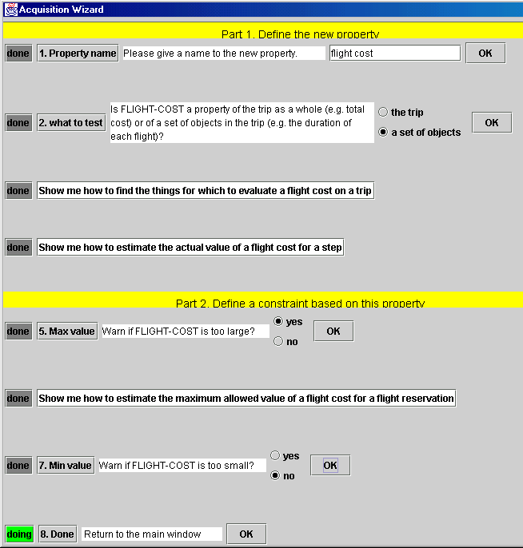
Acquisition wizard identifies and refines a task
Dialog with user structures the process.
Questions are dynamically planned from PSM ontology

Slide 15
Expectations From Interdependency Models
The Interdependency Model records how components of the KB interact in the intelligent system.
[Gil & Swartout 95, Kim & Gil 99].
Expectations:
  Missing knowledge that needs to be defined (procedural or factual)
  Result type of procedures (e.g. “compute maximum” should produce a number), range of relations
  Syntactic expectations, e.g.
  “if <boolean> then <r1> else <r2>”

Slide 16
The Method Editor: Constructing Procedures by Replacing Text
Automatically generates an English paraphrase using Expect’s clause grammar representation for procedures [Blythe & Ramachandran 99; Swartout, Paris & Moore 91]
User selects a subsequence to change and the editor generates alternatives, also in English paraphrase.
User does not need to know formal syntax; the editor ensures that the syntax is correct.

Slide 17
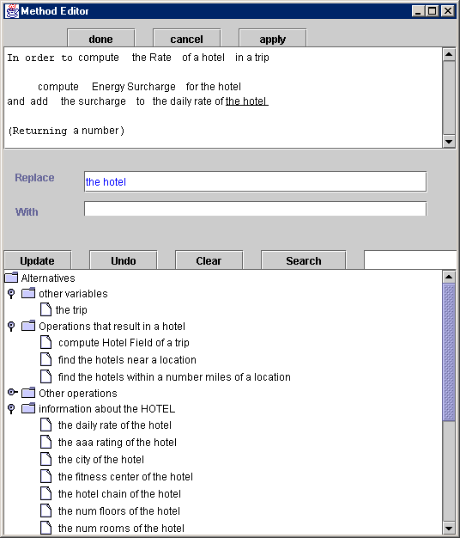
NL description of
procedure
(add
(obj (compute (obj ..) (for ?hotel))
(to (r-daily-rate ?hotel)))
Alternatives generated
at run-time from KB
Notes:
Should be a better procedure being edited.

Slide 18
Using Expectations From Interdependency Models
The method editor enforces correct syntax by presenting a dynamically built set of alternatives
It finds type violations and suggests expressions that will resolve them based on the knowledge base

Slide 19
Hard and Soft Expectations
Hard expectation: the editor does not allow a procedure to be expressed if it violates a hard expectation.
  e.g., “If <condition> else ..”,
  using a procedure with incorrect arguments.
Soft expectation: the editor allows violations to be expressed, but will show a warning and offer fixes
  e.g. Violating expected type of an expression
Tool allows:
But warns:
If Pittsburgh
Then 500
Otherwise 1000
Pittsburgh is a city, but there should be
a true-or-false here

Slide 20
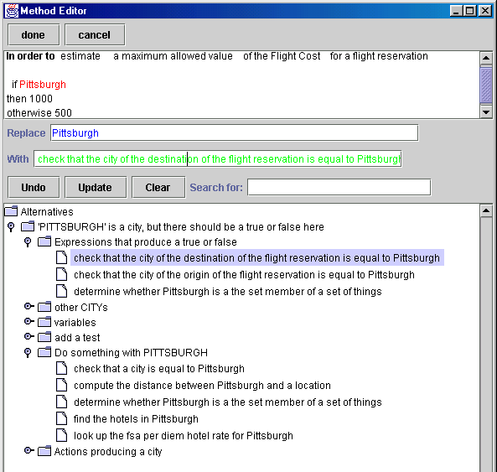
Suggesting Fixes Based on Expectations
Constructs compound terms in KB that include user terms and have desired type
Anytime breadth-first search through space of terms

Slide 21
One successful search path
(check-that (obj <thing>) (is-equal-to <thing>))
(check-that (obj <city>) (is-equal-to pittsburgh))
(r-city <location>)
(r-city (r-destination <flight>))
(r-city (r-destination ?flight))

Slide 22
Presentation outline
Why integrate expectations?
Expectations from problem-solving methods in Constable
Expectations from interdependency models in Constable
How tools in Constable benefit by sharing expectations
Initial experimental results

Slide 23
Sharing expectations
Expectations from both sources can be specifications of knowledge to be defined or refined.
  e.g., input and output type specifications for procedures
This provides a common language for tools to share expectations
Both the Acquisition Wizard and the Method Editor benefit from expectations they share

Slide 24
Integrating expectations in the Acquisition Wizard:
Text questions come from the PSM ontology
Procedure specification from the PSM is passed to the method editor
  The flight cost for a reservation is a thing
A refined specification from the editor improves the identification in the PSM ontology
  The result is a number: check for threshold tests

Slide 25
bounds check
upper bound
lower bound
“Warn if the value is too large?”

Slide 26
Initial experiments
Six subjects, who had no programming background, were asked to add and modify critiques in the travel planning domain.
Training: follow written instructions to modify three critiques and add one. Average time: 1 hour.
Testing: add and modify up to six critiques from a written list. Subjects spent an average of 30 minutes

Slide 27
Example training critique
Check that the hotel is no more than twice the distance of the closest hotel.
Subjects define maximum value as follows using Constable:
(multiply (obj (find (obj (spec-of minimum))
(of (compute (obj (spec-of distance))
(between (find (obj (set-of (spec-of hotel)))
(in (r-city (r-hotel ?t)))))
(and (r-meeting (r-trip ?t)))))))
(by 2))

Slide 28
Example test critique
If the city of the hotel is Pittsburgh, then the maximum hotel cost should be $70, otherwise it should be $120.
4 of the 6 subjects successfully added this rule and the critique that used it.
Task Average steps completed
  Modify const max value 1 / 1
  Max value conditional on city 0.67 / 1
  Complex new upper bound 1.4 / 3
  Complex new upper bound 2 1 / 3

Slide 29
Summary
Sharing expectations helps Constable support end users across several tasks involved in adding procedural knowledge to a system
Both the KA Wizard and Method editor are improved by sharing expectations
  See [Blythe et al IUI 01 for benefits to other tools]
Distinguish strong and weak expectations
Use the KB to construct expressions that can resolve type violations

Slide 30
Future work
Apply to more complex problems, e.g. military movements
  More constraints than in travel planning
  More thorough evaluation of solutions
Apply to problems other than plan evaluation
Improve the set of alternatives generated in the Method Editor
Improve efficiency of expression composer using a dynamic programming approach
Use a dialog component to manage the interaction with the tools

Slide 32
Back-up slides

Slide 33
Procedural knowledge in EXPECT
Check that the value of an upper-bounded-property is less than the maximum value:
Capability: (determine-whether
(obj (?t is (inst-of thing)))
(satisfies (?bc is (inst-of upper-bounded-property)))))
Result-type: (inst-of boolean))
Body: (check-that
(obj (estimate (obj actual-value) (of ?bc) (for ?t)))
(is-less-than-or-equal-to
(estimate (obj maximum-allowed-value) (of ?bc) (for ?t)))))

Slide 34
Different kinds of knowledge need to be acquired.
Specific instances or constants
  the traveller’s home city is Boston
Object classes
  New classes: beaches
  New information about classes: hotels sometimes allow pets
Procedural knowledge
  The hotel can cost up to 50% more than the cheapest hotel from the top 50 chains
Our focus

