Slide 1
Adding SLICK interfaces to SHAKEN

Slide 2
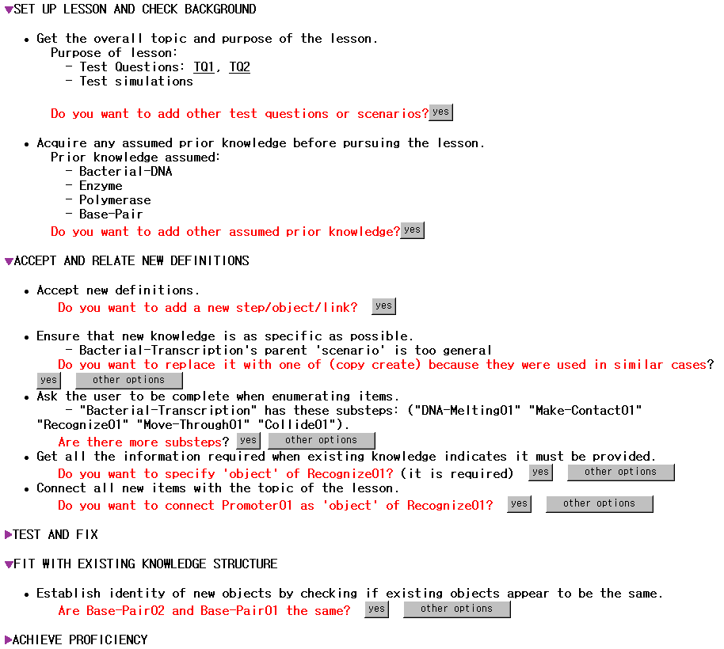
Dialogue is structured
as a thematic lesson
Gral acquisition principle
Specific acquisition goal
Educated guesses

Slide 3
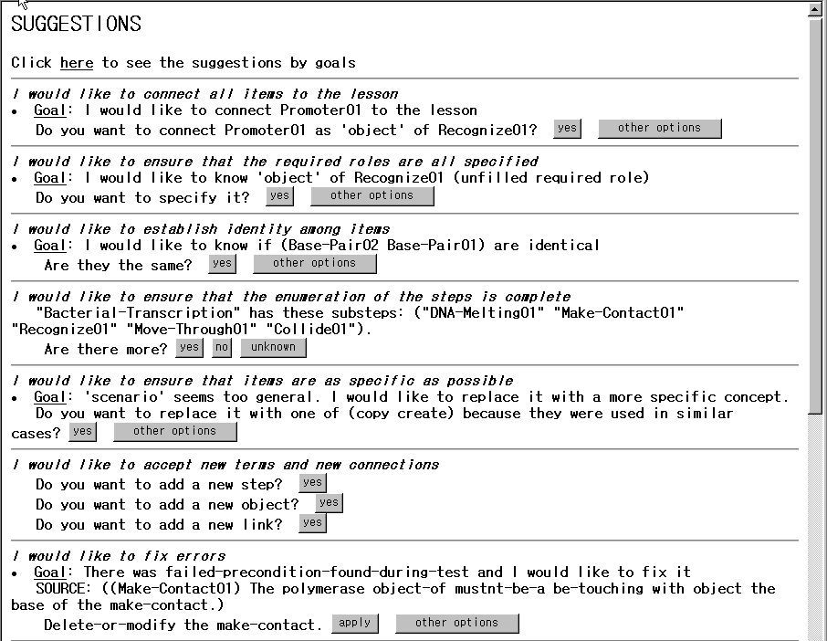
Gral acquisition principle
Specific acquisition goal
Educated guesses

Slide 4
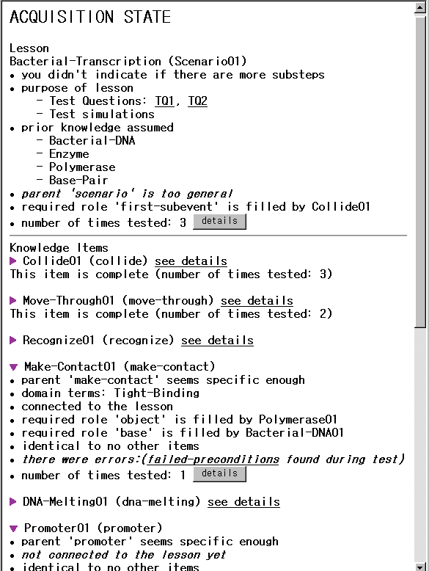
Awareness
Annotations:
1) State
Confidence
Competence
New acquisition goals
activated by the state

Slide 5
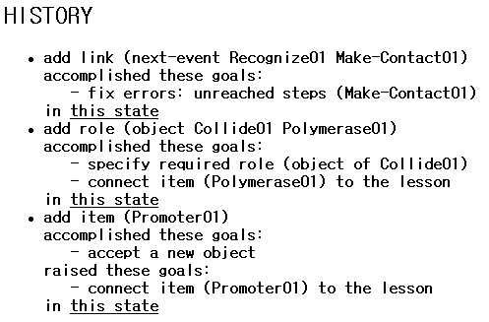
Awareness Annotations:
2) History
Shows user’s actions
and their effects in
accomplishing
acquisition goals
or raising new ones
User can view progress as
changes to the state

Slide 6
SLICK for
Supporting the Acquisition of
COA (Courses of Action)

Slide 7
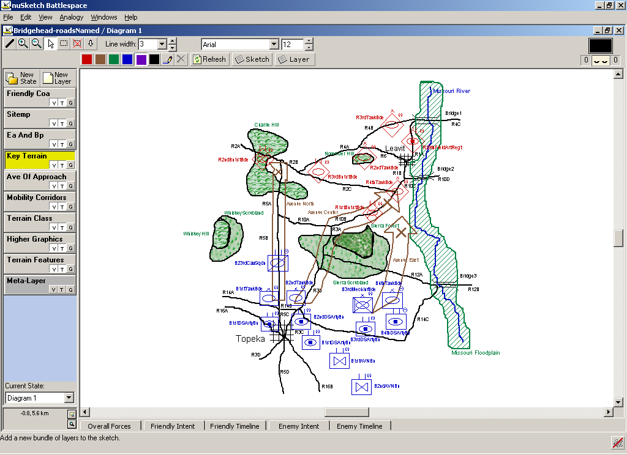
COA Sketch
(courtesy of DARPA Rapid Knowledge Formation program)

Slide 8
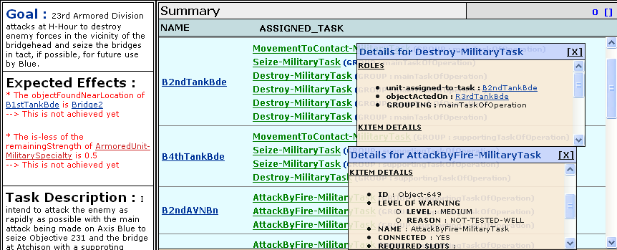


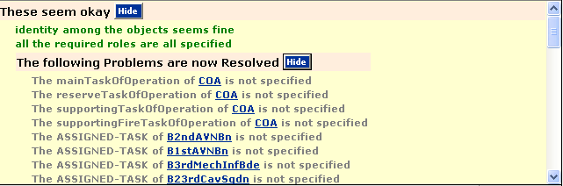


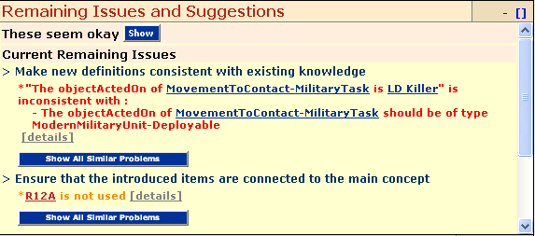


  Goal provides the purpose of the lesson
  User specified objects and steps
  Expected effects can be extracted from user’s intent and tested for validation
  confidence
  User can inspect what system is understanding about the new knowledge
  Issues now resolved: User can view progress over time
  Tasks organized in terms of high-level acquisition goals
  User sees remaining entry tasks
  User sees reason for suggested entry task in terms of acquisition goals

Slide 9
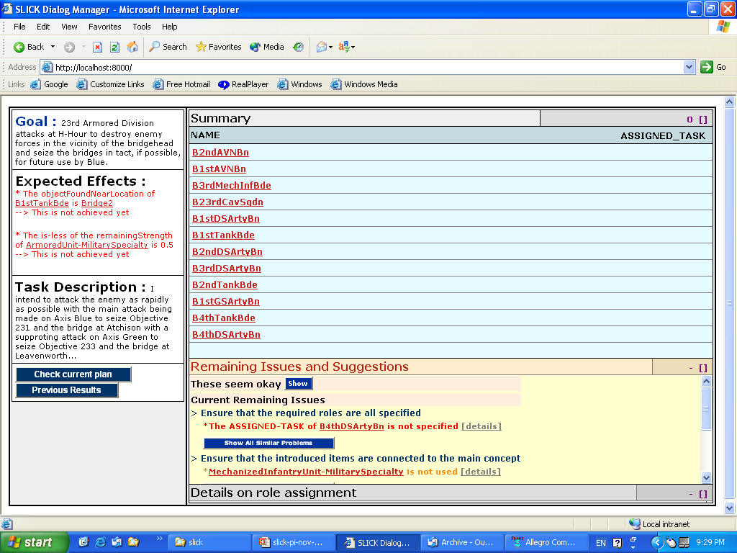
SLICK window when user starts a COA sketch
  Goal provides the purpose of the lesson
  Agents are not assigned to any tasks
  Expected effects can be extracted from user’s intent and tested for validation

Slide 10
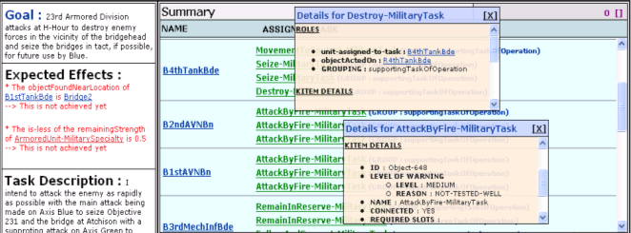
Lesson Overview
  User specified objects and steps
  confidence

Slide 11
Showing progress over time
  User can inspect what system is understanding about the new knowledge
  Issues now resolved: User can view progress over time

Slide 12
Showing remaining issues
  Tasks organized in terms of high-level acquisition goals
  User sees reason for suggested entry task in terms of acquisition goals
  User sees remaining entry tasks

Slide 13
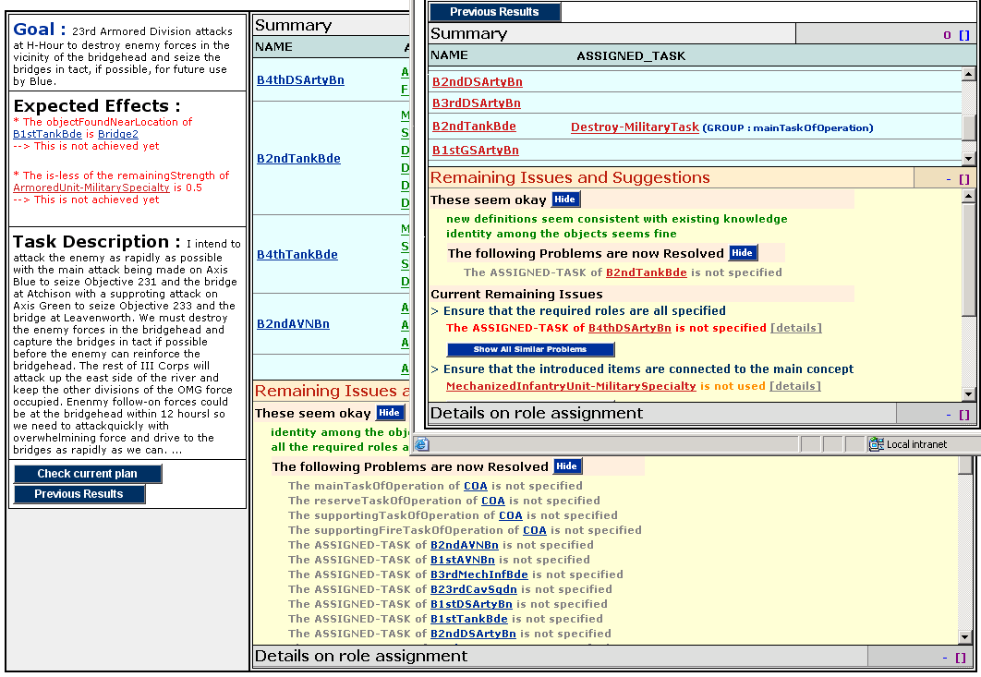
History: Progress Over Time

