Slide 1
Acquiring advice (that may use complex expressions) and action specifications
Acquiring planning advice, and boosting advice with problem-solving knowledge that can be represented in functions
Acquiring and modifying knowledge about actions
  planning knowledge about how to accomplish a task given by the user

Slide 2
Acquiring advice
Many of the constraints we can acquire with existing tools, e.g. Constable, can be framed as AP-style advice
  E.g. Flight time must be less than 3 hours: role advice or evaluation advice.
Advice may be simple or complex, independent of the role it plays in the planner’s decision cycle
  E.g. Drive if the time is short enough - compute the driving time by finding the distance from mapquest and dividing by 55: method advice

Slide 3
Observations
We can use dialog planning strategies, as we have done previously, based on knowledge of how to acquire different kinds of advice, to help users add new knowledge and to index it. [Blythe et al. IUI 01, Blythe IJCAI 01]
In some cases we will need procedural knowledge to represent complex advice expressions,
  E.g. “compute the driving time by finding the distance from mapquest and dividing by 55”
  Functions in Spark will be the target representation for this knowledge

Slide 4
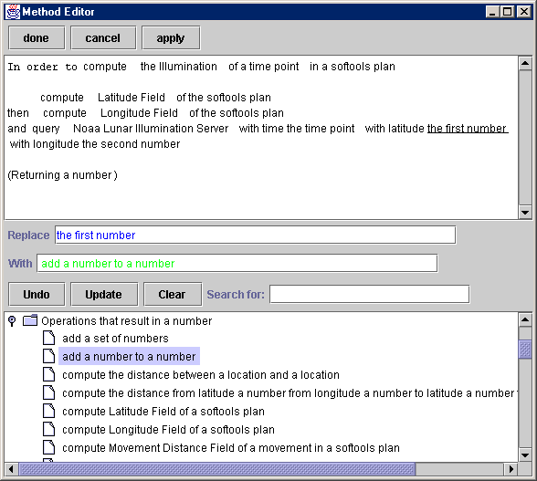
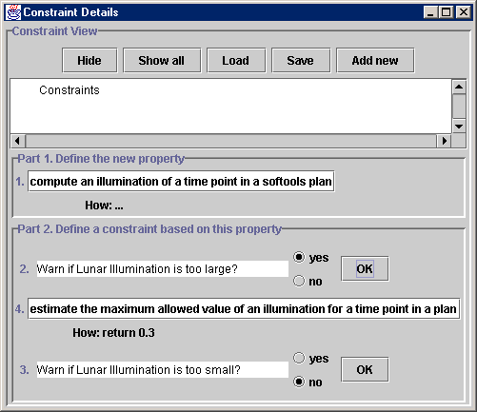
Dialog plans guide integration of information about the advice
[Blythe et al., IUI 01], & AcT Temple project
bounds check
upper bound
lower bound
“Warn if the value is too large?”

Slide 5
Some interesting research issues
Integrating Myers’ advice framework with our ontologies of norms and constraints, and dialog templates
How best to make use of and extend domain models
Integrating wizards for advice with dialog planners from U Rochester
How best to isolate the user from the system details
Flexible dialog techniques, allowing users to start acquisition at one time, leave and complete it at another time

Slide 6
Adding and modifying actions
We can use scripts and interdependency reasoning to help acquire and maintain sets of actions related to a task
  E.g. When a new action is added, check whether existing actions can complement it to achieve some goal, or whether more task information is required.
We will also carry forward our experience under RKF helping users create special cases of actions based on different goals or role types. [Kim & Blythe, IUI 03]
  People tend to think in terms of general cases and exceptions. Action special cases exploit this.

Slide 7
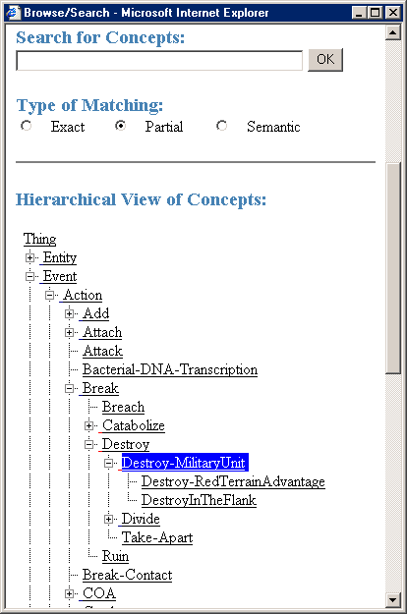
[Blythe & Kim IUI 03], & RKF Kanal project
trigger: agent is militaryUnit and object is militaryUnit
if: force ratio >= 3:1
and object does not have terrain advantage
  object attrition is 50%
  agent attrition is 10%
trigger: red has medium terrain advantage
  object attrition is 35%

Slide 8
Observations
Users will want to modify conditions under which actions are applicable. The line between advice and action preconditions can become blurred
  advice wizards can help with these decisions
We will investigate using Spark:
  To support interdependency reasoning
  To support action special cases

Slide 9
Some interesting research issues
A general model of action representations that supports their evolution over time
  supporting levels of relaxable preconditions,
  maintaining desired behavior through changes,
  maintaining existing advice as actions change
  …
Integrating planner-initiated and user-initiated KA episodes.
  The planner may detect it cannot complete a plan, or choose between alternatives.
  The user may decide the plan needs to be improved.

Slide 10
Possible architecture
User interaction
dialog
plans
ontology
of advice
templates
Advice/action
wizard
domain
model
ontology
of advice
types
Spark
Actions
Advice

Slide 11
Possible milestones
Early fall:
  Demonstrate acquiring advice for Spark, including complex expressions, using dialog plans.
  Determine how to use action special cases and functions and support interdependency reasoning in Spark
By summer:
  Demonstrate adding new actions through special cases, and using interdependency reasoning to prompt for further required information.
  Broader support for advice templates, including help categorizing new knowledge as advice.
  Planner-driven feedback on what knowledge needs to be acquired.

Slide 12
References
[Blythe et al. IUI 01] Blythe, Kim, Ramachandran and Gil, “An integrated environment for knowledge acquisition”, Intelligent User Interfaces 2001
[Blythe IJCAI 01] “Integrating expectations to support end users to acquire procedural knowledge”, IJCAI 2001
[Kim & Blythe IUI 03] “Supporting plan authoring and analysis”, Intelligent User Interfaces 2003

