Slide 1
A Typical AI Agent
Service Description :
This agent monitors airfare for a set of start_time/origin
and return_time/dest., and notifies the user when the airfare changes.
Request
Monitor Airfare Agent
Wrapper for airlines website
Problems :
  Each agent needs to maintain data for each request.
  If machine crashes, requests could be lost, and the current airfare for existing requests could be lost
  DB could fill up.
  The airlines website could be down.
  If web site is changed, the wrapper needs to change, so the agent needs to be changed
  Can Grid Services address some of these problems ?
Response
Database
R1
Current fare
R2
Current fare
R3
Current fare
R4
Current fare

Slide 2
Grid Service
Web Service Client
Web Service
[AirfareClient] (3)
- getAirFareQuotes()
Input to fn :
- 4 strings.
- converts the dates
into dateTime format
to correspond with
the wsdl description
Persistent
Properties
Service Instance 3
Schema for
Service Data
[FlightStatus.xsd] (5)
Airfare Quote Svc
Running at
wavendon.co.uk
Service Instance 2
Service Instance 1
Imports
WSDL (1)
Description
- getAirFareQuote(x)
WSDL
Stubs generated
from the Service Data
Schema
[MyAirFareQuoteType]
Grid Service
Implementation
[FlightImpl] (6)
Imports
Interface
(4)
Imports
Stubs
generated
from the wsdl
description
(2)
MonitorAirfare
Service Data 3
Imports
Service Data 2
Grid
Factory
Service
Data 1
CreateService
Java client
[FlightClient] (7)
Notification Listener
[FlightStatusListener]
( 8)
Grid Service Client

Slide 3
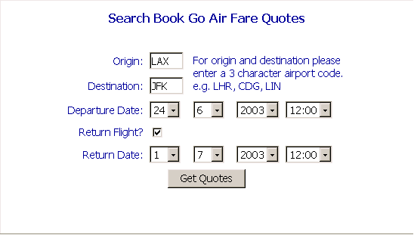
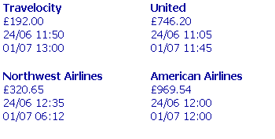
AirFareQuote service
[http://wavendon.dsdata.co.uk/DSUKWebsite/services/Demos/SBGAirFareQuotes/SBGAirFareQuotes.jsp]

Slide 4
Problems raised earlier :
  Each agent needs to maintain data for each request.
    Each request starts a separate grid service instance, each with its own service data.
  If machine crashes, requests could be lost, and the current airfare for existing requests could be lost
    The grid service instances could be made persistent, and could use persistent properties to restore request data and the current airfare data on restart.
  DB could fill up. (?)
    Use a “Load Sharing Facility” to schedule service instances on different machines according to load.
  If the airlines website is down or changed, the wrapper needs to change, so the agent needs to be changed (?)
    We could detect when the web-service is down in the Grid service implementation and thereby reduce service guarantees

