Slide 1

Modeling and Using
Simulation Code for SCEC/IT
Yolanda Gil
Jihie Kim
Varun Ratnakar
Marc Spraragen
USC/Information Sciences Institute
Thanks to Ned Field, Tom Jordan, hans Chalupsky, Tom Russ, Stefan Decker

Slide 2
SCEC/IT Architecture for a
Community Modeling Environment

Slide 3
Publishing and Using Simulation Models
Problem: bringing sophisticated models to a wide range of users (civil engineers, city planners, disaster resp. teams)
  Choosing appropriate models for site and eqk. forecast
  Parameter value constraints (e.g., magnitude)
  Parameter approximations and settings (e.g., shear-wave velocity)
  Interacting constraints
Approach: expressive declarative constraint representation and reasoning
  Ties model descriptions to overarching SCEC ontologies
  Exploits state-of-the-art KR&R to check model use
  Uses constraint-based reasoning to guide users:
    To make appropriate use of models
    To suggest alternative models more appropriate for user’s analysis
  Just-in-time documentation helps user view model constraints in context

Slide 4
DOCKER: Single-point entry to repository of simulation models
Model developers can:
  Publish the code for their models
  Specify I/O parameter types in terms of SCEC ontologies
  Specify and document constraints of model use
End users can:
  Invoke models from a uniform interface
  Invoke model correctly by enforcing constraints
  Find appropriate simulation models for their requirements
How it works:
  Code can be easily added to repository
  Documents the source of constraints for model use and I/O types
  Generates user interface & spec for each model automatically
  Translates code specs into KR language
  Uses KR&R to check constraints during code invocation

Slide 5
Modeling and Using Simulation Code: Relevant Research
Problem solving methods and task models
  UPML (EU)
  EXPECT - HPKB PSMs (ISI)
Process description languages
  PSL (NIST)
Task/action representation languages (PDDL, ACT, PRS)
Agents
  Phosphorus - E-Elves (ISI)
  Retsina (CMU)
Web services
  DAML-S
  Many emerging standards (WSDL, WSFL)
Grid computing
  OGSA
Software specification and reuse

Slide 6
Modeling and Using Simulation Code:
Research Challenges
Accessibility to end users
  Appropriate descriptions, handling errors
Accuracy of models
  Model is an approximation of code
  Truth in advertising
Composition of models
  Contingency and resource-based planning
Robust execution
  Exploit capabilities of distributed computing environments

Slide 7
Current Focus: Seismic Hazard Analysis
Site Info
List of Potential EQKs
SA from
AWM
IMR
Forecast
Model
Forecast
Model
Forecast
Model
Forecast
Model
IMR
Timespan
IMR
Forecast
Model
CFM
Map Creation
USGS
Fault Model
FAD
Map

Slide 8
Focus to Date: Seismic Hazard Analysis Using IMRs
User’s goal:
  Given: a site S, a structure ST
  Determine: P of > 1g acc in 50 yrs, P > 1/10g in 10 yrs
User interaction:
  User picks IMT (based on ST)
  System lists IMRs, user selects a subset
  User fills site info of IMR based on S
    Site type, Vs30, basin depth, location
  User specifies earthquake forecast
    Fault type, source, magnitude
  System runs models
  User may explore variations on IMT and forecast

Slide 9
Helping the User through Constraint Reasoning
User’s goal:
  Given: a site S, a structure ST
  Determine: P of > 1g acc in 50 yrs, P > 1/10g in 10 yrs
User interaction:
  User picks IMT (based on ST)
  System lists IMRs, user selects a subset
  User fills site info of IMR based on S
    Site type, Vs30, basin depth, location
  User specifies earthquake forecast
    Fault type, source, magnitude
  System runs models
  User may explore variations on IMT and forecast
Did you know that [A2000]
takes into account
directivity effects?
Did you know that
[Sadigh97] is a good
model for dist >80 miles?

Slide 10
DOCKER: Using SHA Code
User can:
Browse through SHA models
Invoke SHA models
Get help in selecting appropriate model
Web Browser
AS97
DOCKER
AS97
User
Interface
Model
Reasoning
docs
constrs
types
msg
AS97
ontology
Pathway
Elicitation
Constraint
Reasoning
KR&R
(Powerloom)
SCEC
ontologies

Slide 11
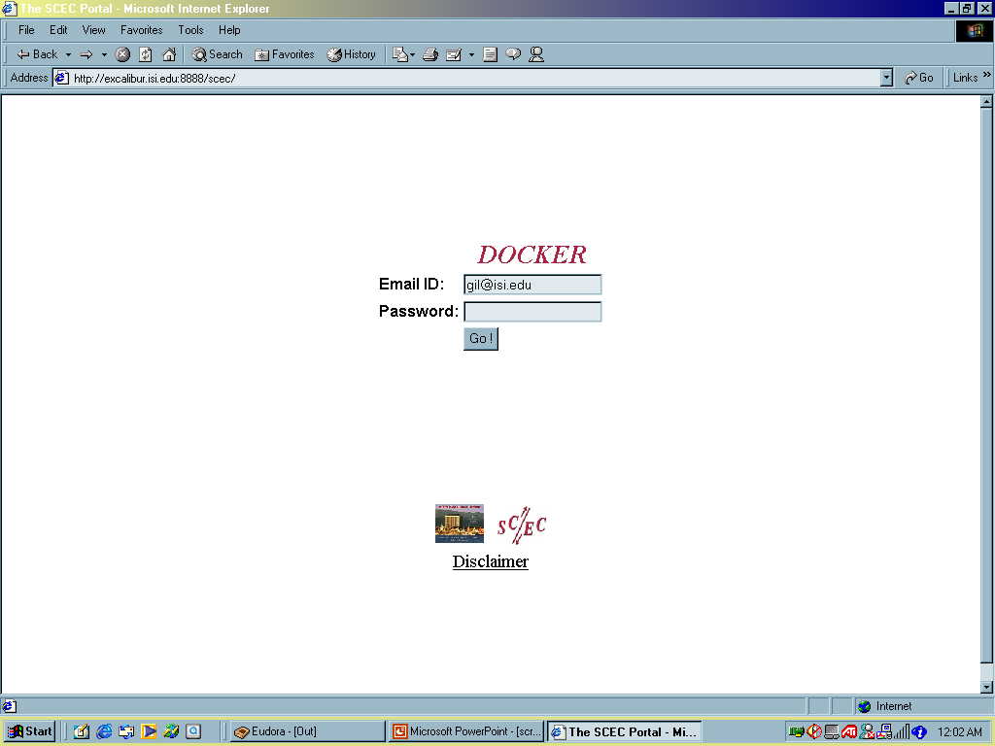
A Brief Demonstration of DOCKER

Slide 12
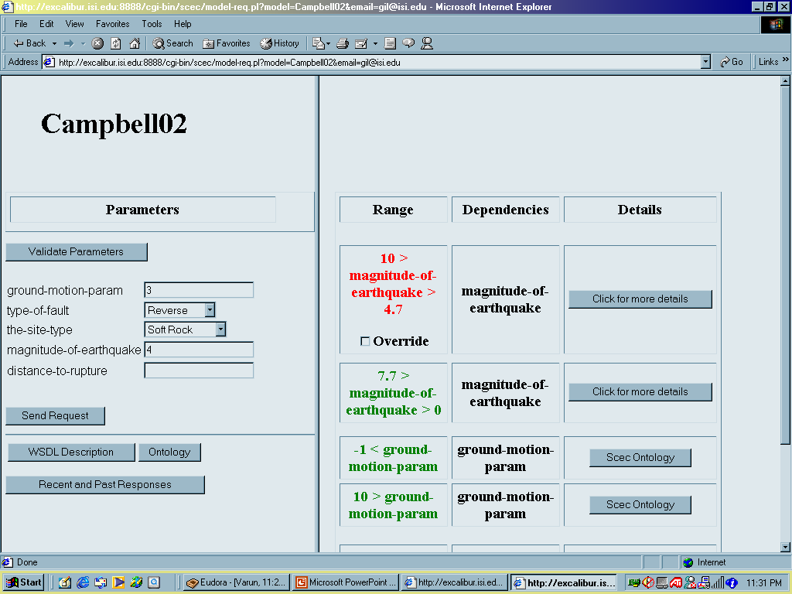
Detecting Constraint Violations

Slide 13
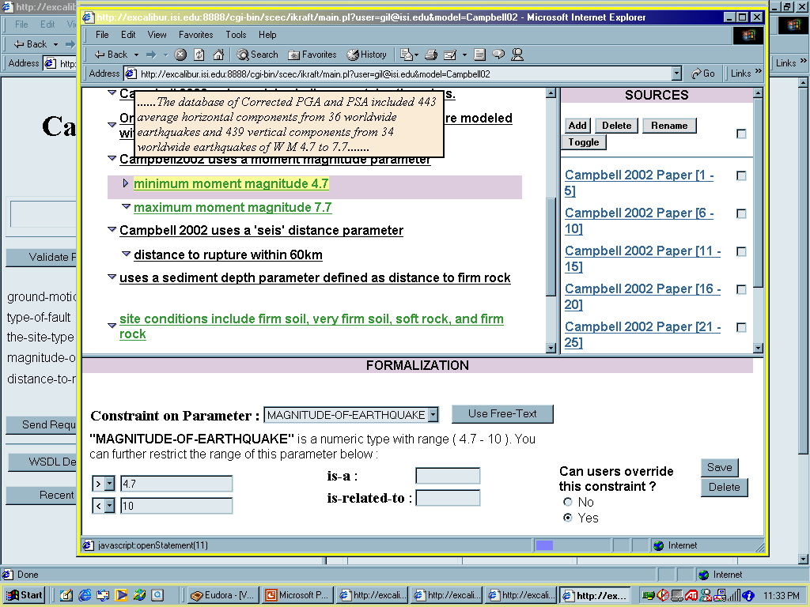
Looking Up Reasons for Constraint with IKRAFT [Gil and Ratnakar 2002]

Slide 14
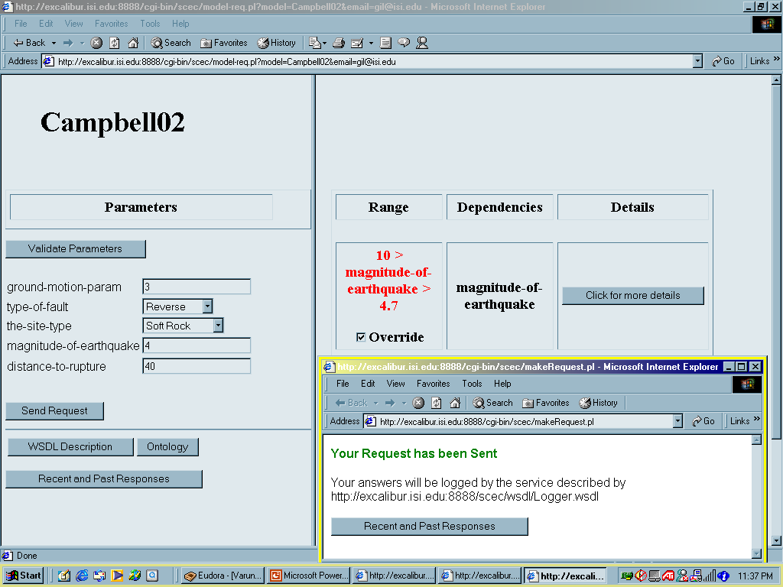
User Can Override (Soft) Constraints

Slide 15
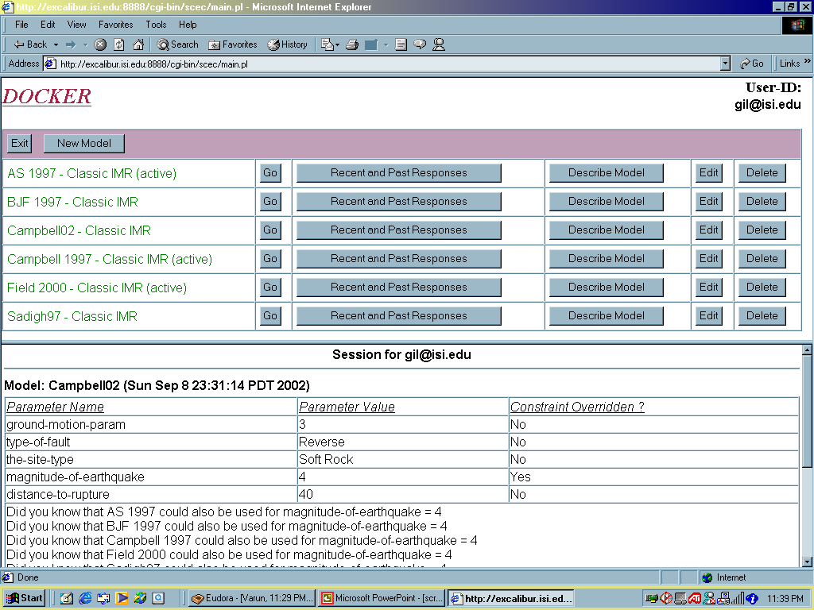
System recommends using other models for those parameter values
Yes
Did you know that [Sadigh97] is a good model for dist >80 miles?

Slide 16
DOCKER: Publishing SHA Code
User specifies:
Types of model parameters
Format of input messages
Documentation
Constraints
Web
Browser
DOCKER
AS97
User
Interface
Model
Specification
AS97
docs
types
msg
constrs
Wrapper
Generation
(WSDL, PWL)
Constraint
Acquisition
AS97
ontology
SCEC
ontologies

Slide 17
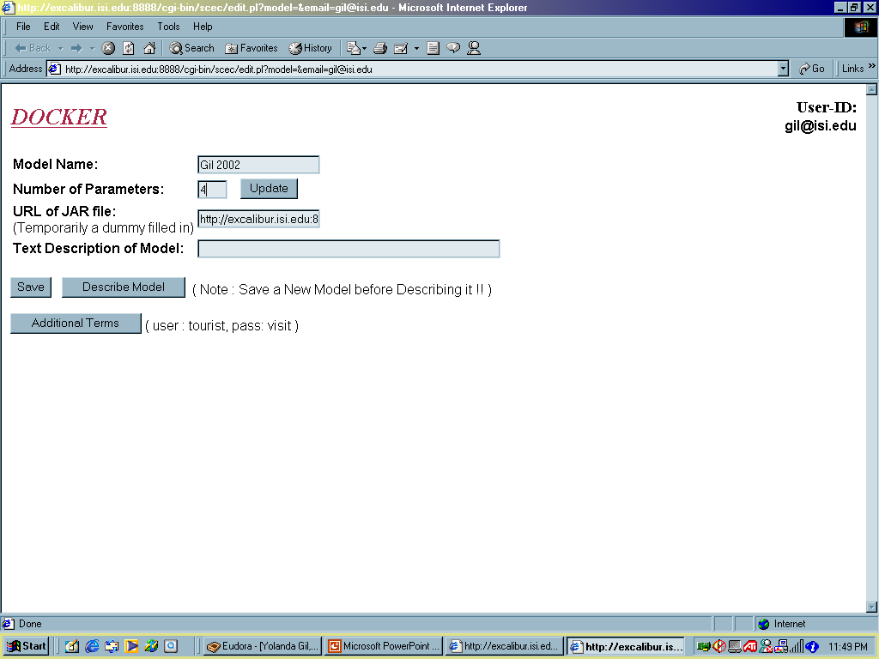
Publishing a Model

Slide 18
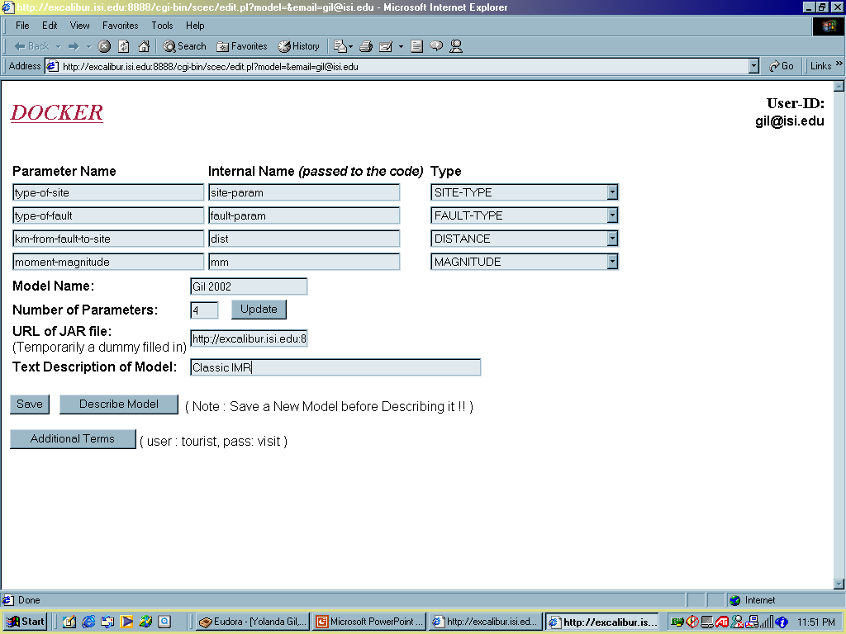
Defining Parameters

Slide 19
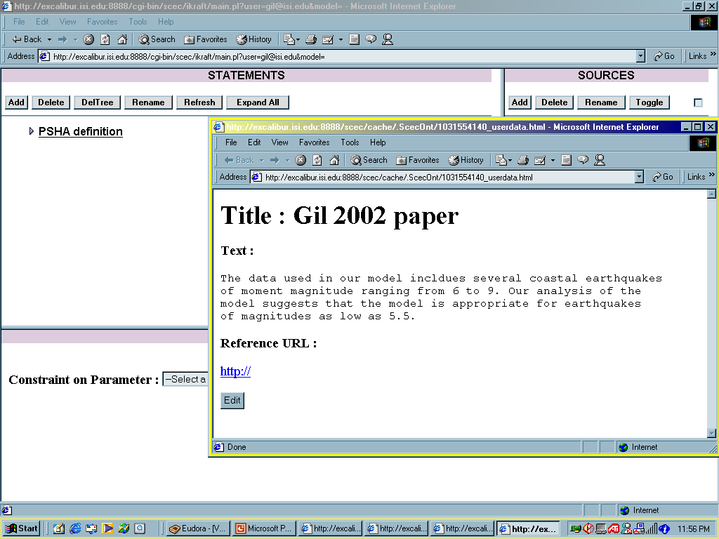
Documenting the Model

Slide 20
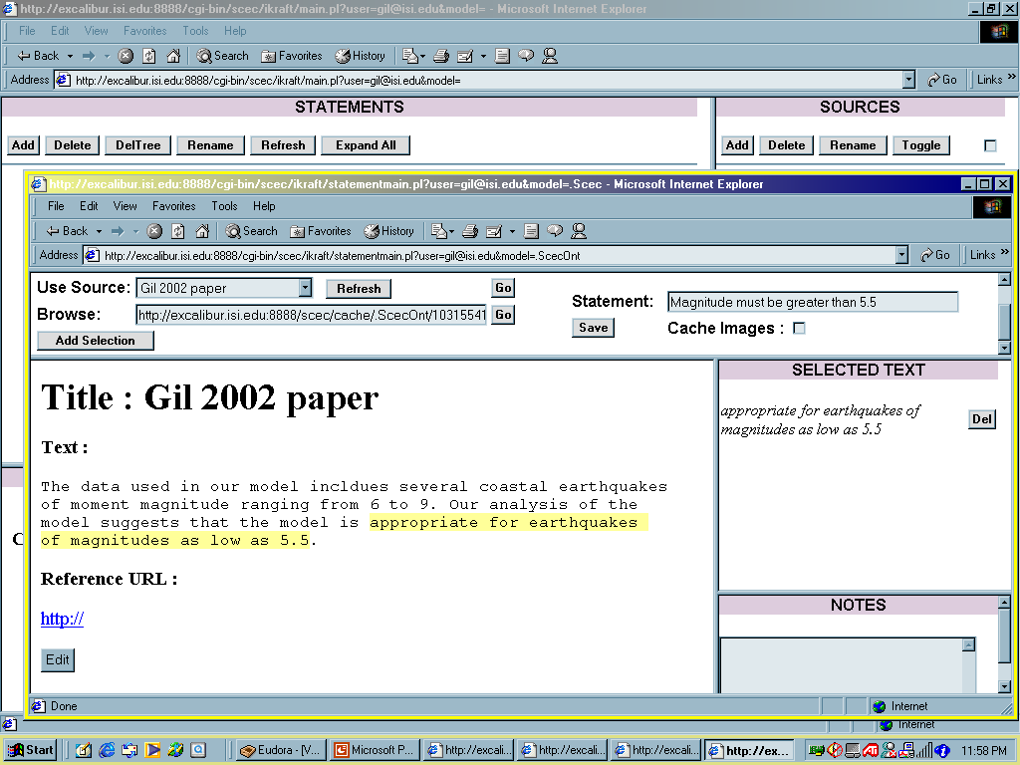
Documenting Each Constraint

Slide 21
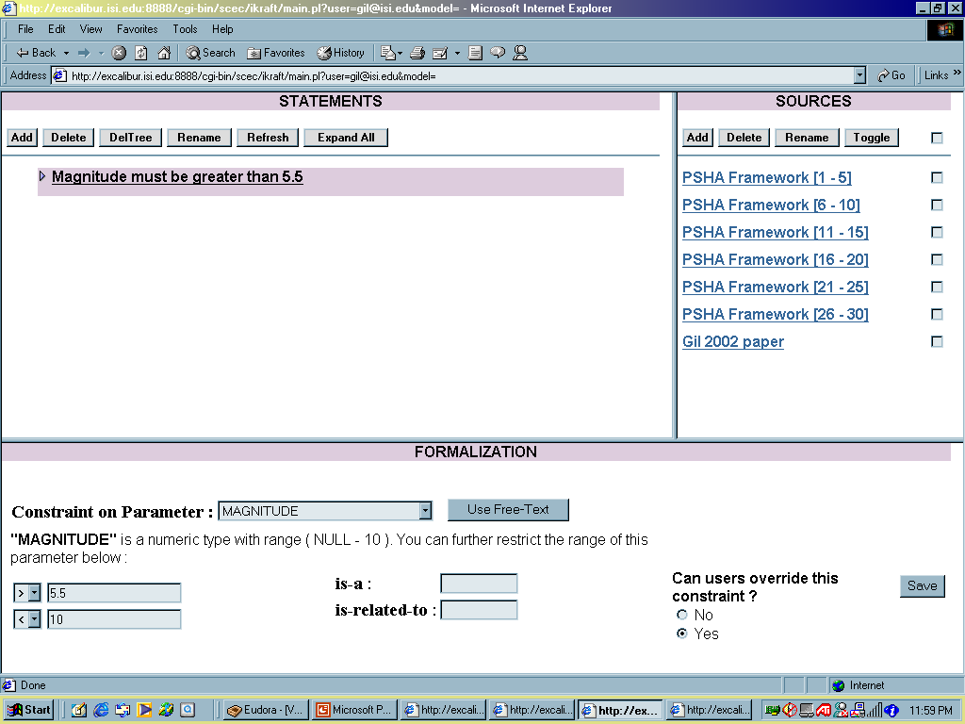
Formalizing Constraints

Slide 22
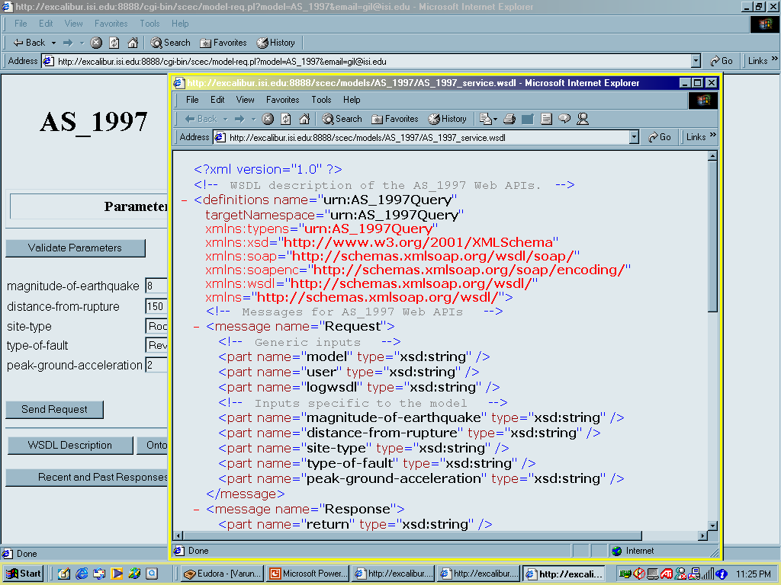
Automatically Generates Underlying Message Transport (WSDL description)

Slide 23
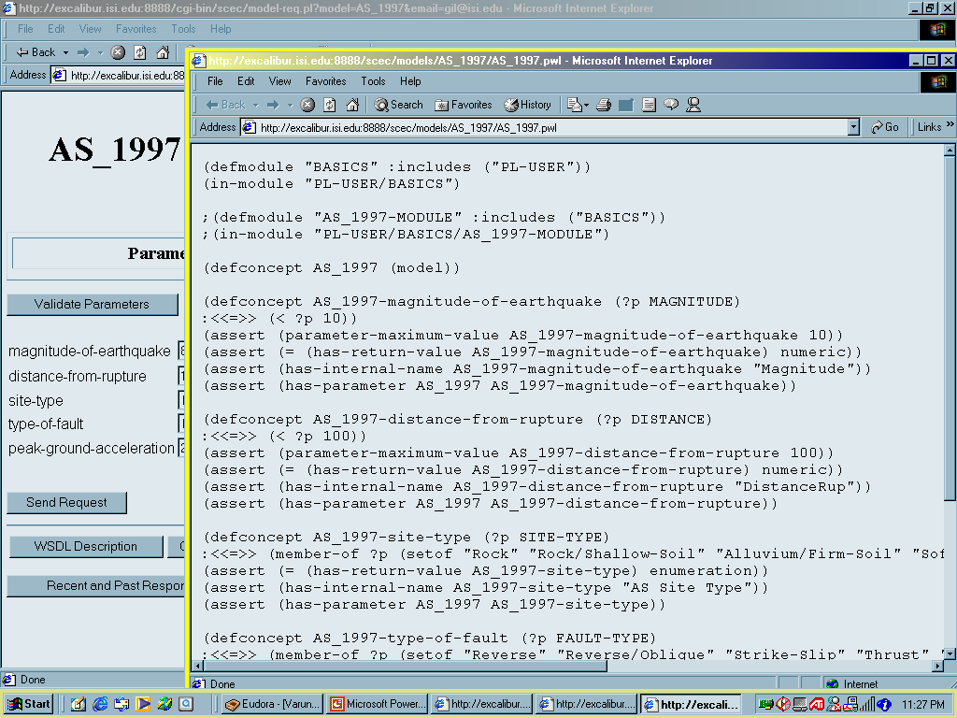
Automatically Generates Description in KR Language (PowerLoom)

Slide 24
Summary
DOCKER facilitates publishing and using simulation code
  Assists end users in selecting appropriate codes and parameters
  Provides baseline system to specify simple constraints
  Declarative descriptions of code are easy to provide
    Markup language mapped to KR (Powerloom) done by system
  Initial focus: empirical attenuation relationships for SHA
Future work:
  Computational pathway elicitation: composing several codes
  More expressive language to describe simulation code
  Incorporation of physics-based models
  Simulation code distributed over the Globus grid

