Slide 1
DOCKER - Summer internship summary 2003
Edward Kim
Information Sciences Institute
University of Southern California

Slide 2
Objectives
Improve and add to DOCKER system
  Add constraints and research information into knowledge base through IKRAFT interface
  Expand uses/functionalities of DOCKER system through web services available in the internet

Slide 3
IKRAFT
Set up statements and constraints for current models in DOCKER
  Retrieve constraints from powerloom file
  Write statements that support powerloom constraints
  Set user constraints through statements

Slide 4
IKRAFT - Documentation
Statements are linked to online html documents
Utilized OCR [optical character recognition] software to create “soft” documents of earthquake research papers for online referencing
  Scanning in physical documents to create ‘soft’ documents online

Slide 5
IKRAFT - Obstacles
Image to text conversion tool not sufficiently accurate
  Used Adobe ‘paper capture’ software
    Freeware
    http://www.adobe.com/support/downloads/detail.jsp?ftpID=1907
  Quality of document plays role
  Roughly 50% of text recognized by software

Slide 6
IKRAFT - Obstacles
PDF to HTML conversion software insufficient
  Used Adobe’s online pdf-to-html conversion tool
    http://www.adobe.com/products/acrobat/access_simple_form.html
  Often converts PDF into pure image files
  Cannot read any text from image files

Slide 7
IKRAFT – Alternatives
Manually type out MS word document
  Copy and paste available text in pdf file
Create an abridged version for each research paper
  For papers that are too long
Provide full documentation in original PDF format

Slide 8
IKRAFT - Notes
Deleting constraints
  Constraint must be deleted separate from statement
Restricted to capturing text from html only
Approximately ¼ to 1/3 of model constraints not documented in the documents
  Undocumented constraint are from powerloom file
    Example: how the results are to be graphed
Location of documents:
  http://www.isi.edu/ikcap/docker/scec-papers

Slide 9
Web Services – Conversion Services
Adding math services onto DOCKER
  Scientific Calculator
  Unit conversion calculator [ex. feet -> meters]
Provide users/researchers the means to manipulate numeric data to conform to model’s parameter constraints

Slide 10
Conversion Services - Implementation
Access to xml/wsdl file
  Retrieve data types, operations and endpoint
Client [perl or java] to handle user input/requests and response from service provider

Slide 11
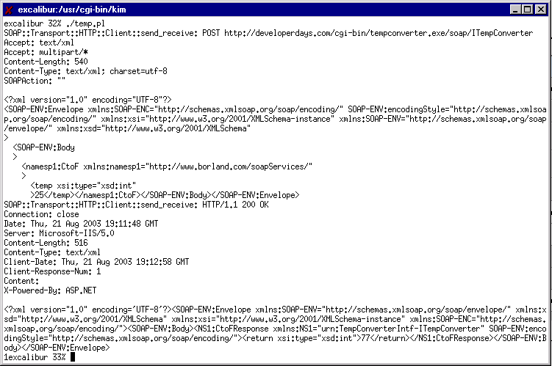

Slide 12
Conversion Services -Limitations
Sources of math web services sources limited
  Basic unit conversion and calculators
  Services for special algorithms scarce
  Some web services that used to work are no longer available, or are not working anymore
Alternatives
  Create non-web service programs embedded into DOCKER
  Create own web services

Slide 13
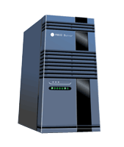
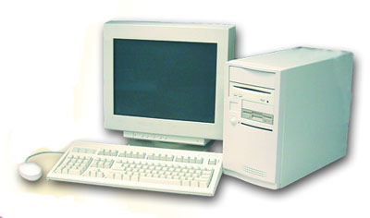
Web Services – Expanding beyond SCEC
Conversion Services
DOCKER
Earthquake Services
???

Slide 14
Web Services – Expanding beyond SCEC
Further use besides earthquake research
  Travel services on the web
  Search engine
Using multiple web services through one interface to cater to broader user needs

Slide 15
Example – Travel services
Grouping travel related services together
  Hotel reservations
  Air fare quote and flight time
  Car rental or taxi services
  Map services

Slide 16
Web Services – conclusion
Various web services possible through DOCKER
Limited number of services on the web and they are always changing
Ongoing search for other available web services
Location of xml/perl files:
  http://www.isi.edu/ikcap/docker/xml

