Slide 1
Deriving Expectations to Guide KB Creation
Jihie Kim
Yolanda Gil
Information Sciences Institute
University of Southern California
http://www.isi.edu/expect

Slide 2
Motivation
Today’s KA tools (such as EXPECT & Protégé) guide users effectively by having expectations that are derived from dependencies among components in KBS
  example: dependencies between factual knowledge and problem-solving methods
    User: Add Havana as a new seaport
    System: You need to tell me about the berths of Havana because I need to know how to dock ships
Factual Knowledge
Problem Solving Knowledge
Problem: During initial KB creation when there is a smaller body of knowledge in the KB, where can we get expectations to guide users?

Slide 3
EMeD: EXPECT Method Developer
What it does: Acquire problem-solving methods from users
  “In order to estimate the duration of an earthmoving operation, compute the volume of earth to be moved and the bulldozing rate based on soil type”
Expectations come from
  Dependencies among problem-solving methods
  Relationship between capability(I.e., purposes or goals) of methods
  Dependencies between factual knowledge and methods
  Dependency between components within a method based on representation language
  User-specified dependencies

Slide 4
Current Functionality
Method Editor/Organizer
  Create, modify, delete, copy & edit methods
  Organize methods into groups
Method Sub-method Relation hierarchy
  Compute potential subgoals created from methods and link subgoals to other method that achieve them
Method Capability (purposes or goal) hierarchy
  Hierarchy of method capabilities based on their subsumption relation (Method1 is more specific than Method2)
    Example: “estimate average speed of aircraft” is more specific than “estimate average speed of vehicle”

Slide 5
Functionality (cont)
Undefined methods
  List subgoals referred fom a method but not achieved by any existing methods
    Example: no method to find bulldozing rate for soil type
Method Search based on subsumption relation
  Find methods who refer to subsumer/subsumee of given term (concept, relation, instance)
    Example: find all methods related to bulldozer
Error messages
  Separate errors of each method from global errors

Slide 6
EMeD Architecture
Server (Lisp)
Client (Java)
Method Editor/Organizer
Expect
Methods
Method Sub-method hierarchy
Dependency
Manager
Interface
Manager
Capability hierarchy
Undefined Methods
Loom
KB
API
API
Subsumtion-based Search
XML
Encoder
HTTP
XML
_x0004__x0004_Decoder
Error Messages

Slide 7
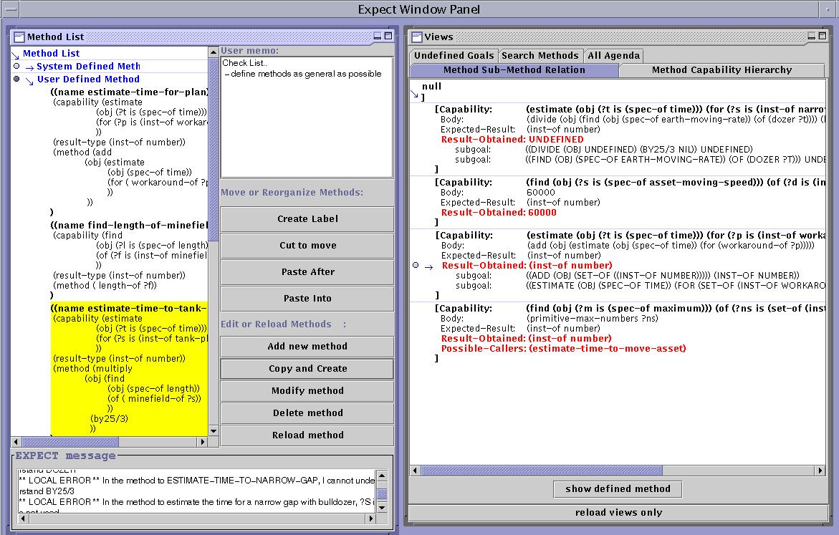
EMeD User Interface

Slide 8
Expectation-Based Method Development: Preliminary Evaluation Results
Total Time
(minutes)
Number of
methods added
Method creation rate
(min/method)
EMeD
153
24
6.4
Without EMeD
218
25
8.7
Method development time reduced by 30%
Now collecting metrics on the use of different types of expectations

Slide 9
Benefits
Provide guidance during initial KB creation
  Guide users to fill missing knowledge
  Guide users to find errors earlier
  Help users understand the KB during its initial development

