Slide 1
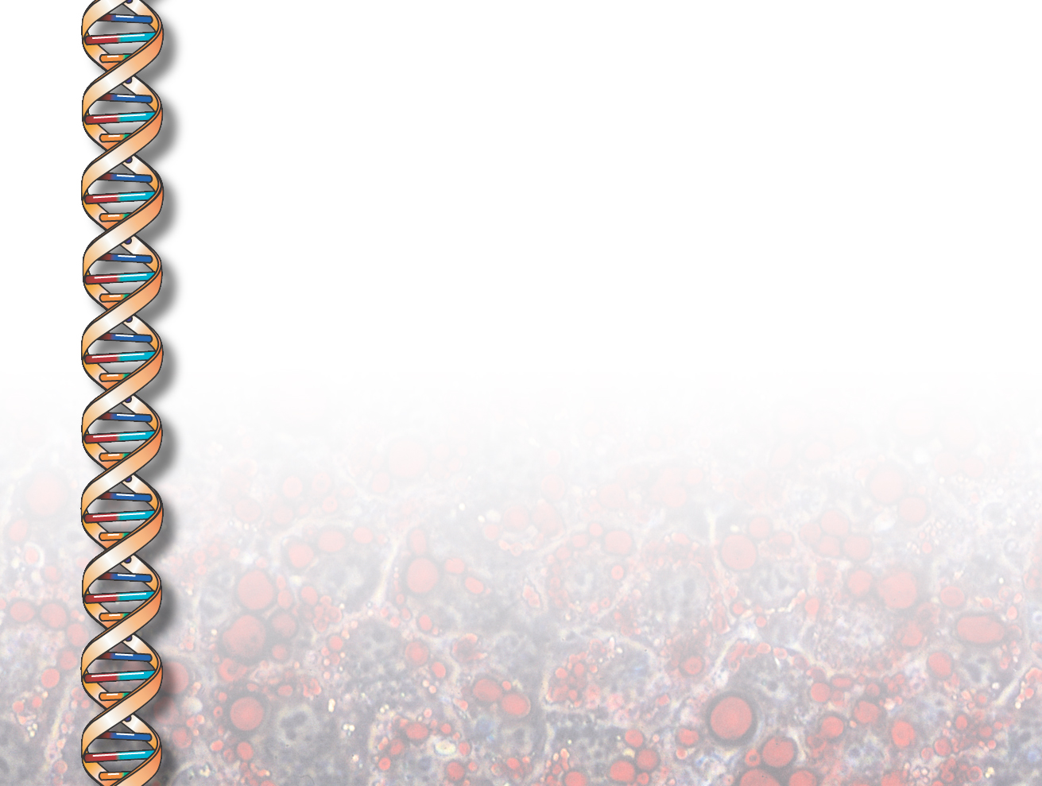
KANAL
(Knowledge ANALysis)
Jihie Kim
Jim Blythe
Yolanda Gil
www.isi.edu/expect/projects/KANAL/

Slide 2
Problem Addressed: Helping users specify complete and consistent process models
Models need to contain detailed information:
  Substeps of a given step, temporal and causal links between substeps
  Each step modeled as an event type in the component lib
  Each event type defines roles that are filled by
  objects (e.g., agent, destination, etc.)
Users need help in defining process models:
  May forget important details
  May define inconsistent steps or links among steps
  Even when an inconsistency or gap is detected, user may not know how to fix it

Slide 3
Approach: Interdependency Models
Interdependency Models relate different pieces of Knowledge among themselves and to the existing KB [Swartout & Gil 95; Kim and Gil 99]
  1) Derive interdependencies by analyzing how knowledge is used
  2) Use the interdependencies to detect inconsistencies and missing knowledge
  3) Based on the context provided by the models, guide users in fixing the inconsistencies and gaps
Successfully used in acquiring and checking problem-solving K in EMeD/EXPECT from end users [Kim & Gil 00]

Slide 4
KANAL: Helping Users through
Interdependency Models (IMs)
KANAL derives IMs through the dynamic analysis (simulation) of steps and static analysis of the event ontology
  Starting with initial state, iterate through steps (and alt. paths):
    Check preconditions in current state
    Apply step by asserting effects
    Check effects
KANAL uses the resulting IMs to check if:
  All steps are properly linked, all step preconditions are satisfied, all expected effects are achieved, etc.
  User sees a report of serious errors (to be fixed) as well as warnings for potential problems (can be fixed or dismissed by user)
KANAL exploits the IMs to suggest fixes for these problems
  Finding steps that can assert unachieved effects, adding missing links, changing ordering constraints to reinstate conditions, etc.

Slide 5
KANAL’s Checks on Process Models
  Unachieved preconditions
  Expected effects
  Enabling relationships
  Unnecessary or missing links
  Undoable step/ useless step
  Disjunctive branches
  Loops

Slide 6
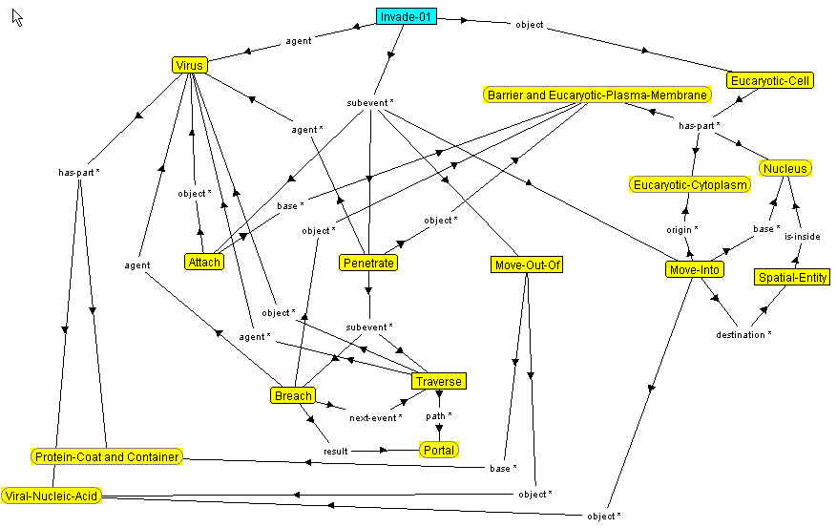
User’s mistake: Missing ordering links between steps

Slide 7
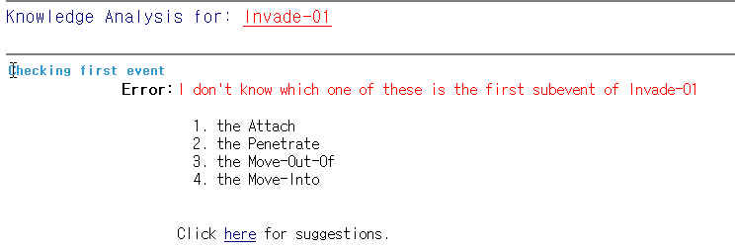
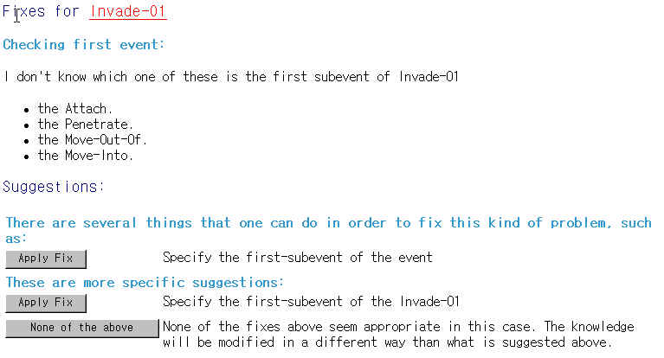
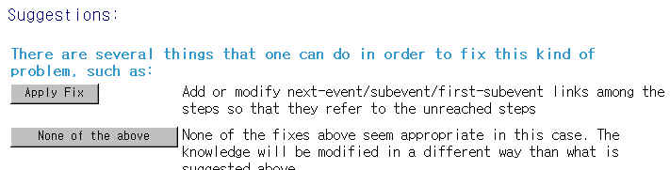
Test Output

Slide 8
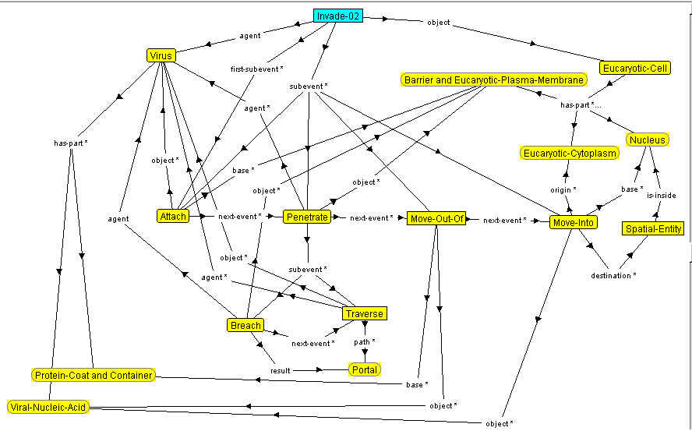
User’s mistake: destination of Move-Out-Of (Eucaryotic-Cytoplasm) is missing

Slide 9
Missing Role Assignment
→ Failed Precondition of Move-Into
Cytoplasm
destination
origin
Move-Out-Of
next-event
Move-Into
object
object
Viral-nucleic-acid
Viral-Nucleic-Acid is not located at the
Cytoplasm (origin of Move-Into) !

Slide 10
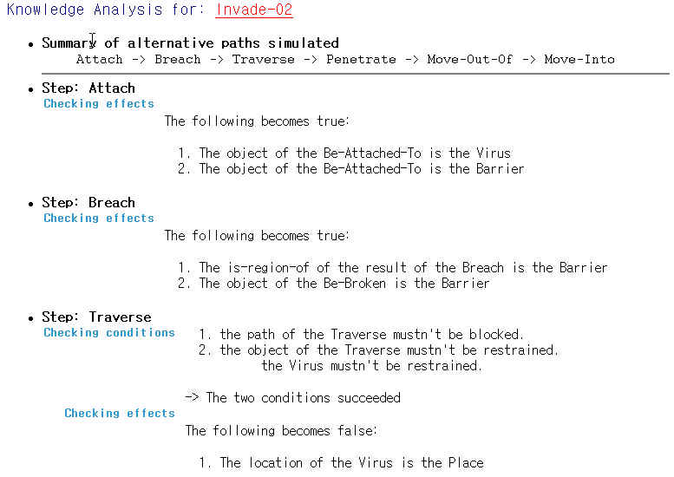
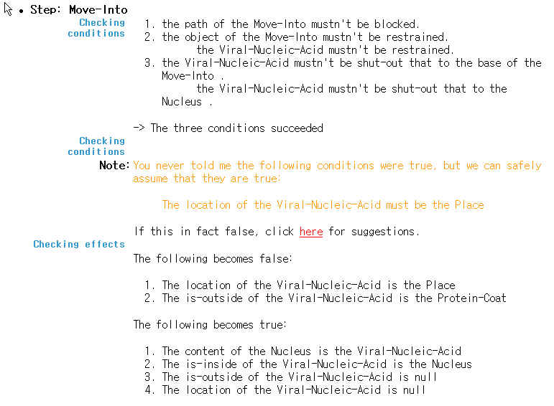
Test Output

Slide 11
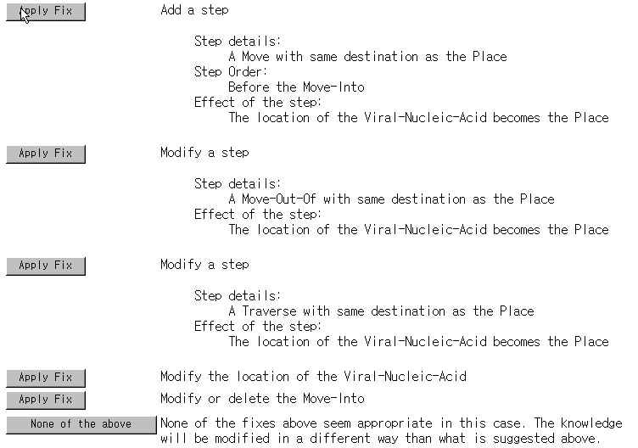
Proposed Fixes

Slide 12
Suggesting good fixes is challenging
When user forgets to assign destination of the Move-Out-Of step
  KANAL proposes two kinds of fixes:
  Direct fixes: e.g., Change the destination of Move-Out-Of step
  Indirect fixes: e.g., Add a Move step to assert the condition
Direct fixes point to the source of the problem: much more useful!
Single user mistake is detected in multiple ways
Different mistakes may lead to the same error
Selectively presenting related errors
  Missing link →unreached steps → unachieved effects

Slide 13
Errors & Warnings shown during TKCP
Error type
# errors/
warnings
Missing first-event, subevent, next-event
37
Unreached events
55
Unnecessary ordering
105
Loop
1
Failed conditions
133
Failed execution of step
30
Effectless step
139
Failed expected effect
7
Total invocations of KANAL: 144

