Slide 1
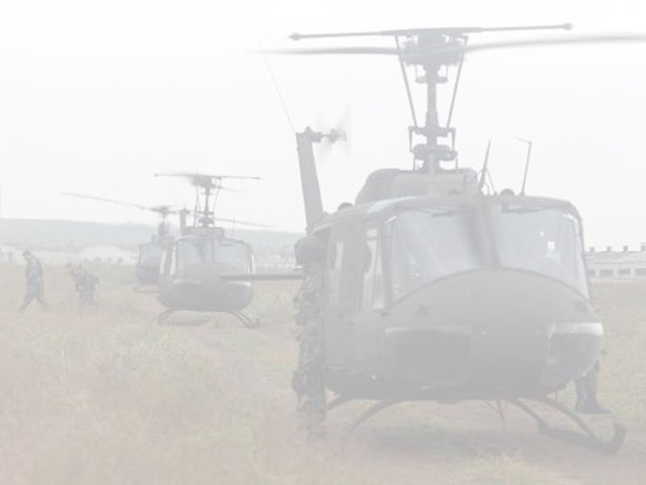
COA critiquing through normative simulation
Jihie Kim
Jim Blythe
Yolanda Gil
Varun Ratnakar

Slide 2
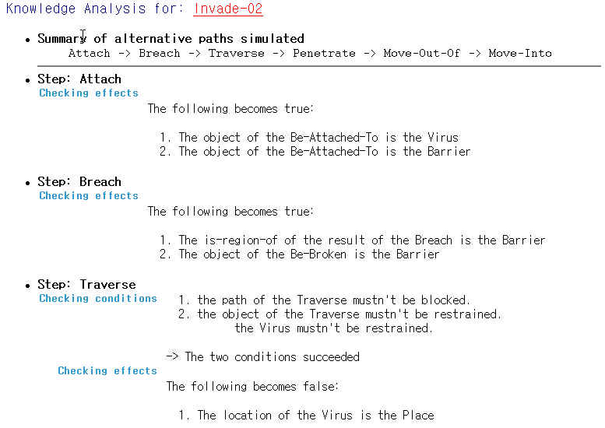
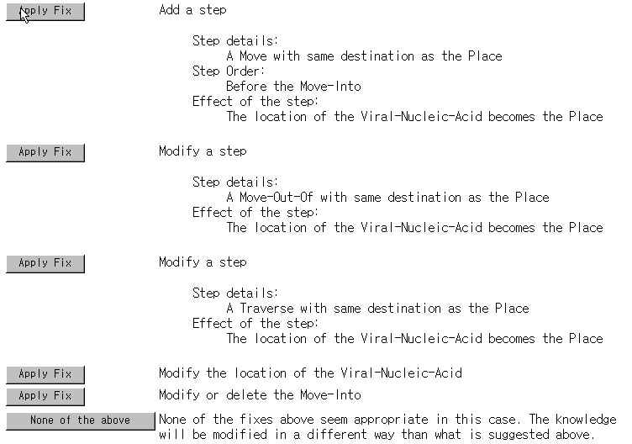
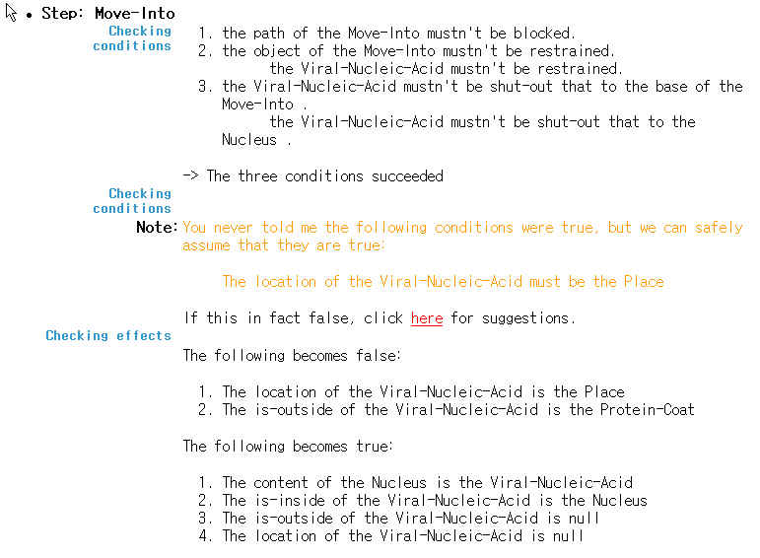
Our Previous Work on KANAL
Checking process models through normative simulation

Slide 3
KANAL: Critiques through normative simulation
Critiques are generated by a normative simulation that uses knowledge about actions
Simulation checks what happens before and after each step based on its background knowledge of conditions and effects of each action
  Examples:
    Precondition on required force-ratio: an attack-to-destroy step has force-ratio value 2.5 but 3:1 is required
    Precondition on appropriate terrain type: tank units cannot move on Forest or Lake
    Effect on remaining strength: Remaining strength of Blue3 is still greater than 85% after the attack-to-destroy step
    Effect on location: After a move, the location of the unit changes to the destination
    Effect on time: after a step, the time changes based on its duration
    . . .
event1
event2
event3
event4

Slide 4
Outline
Action editor: user defines special cases of Clib actions
  KANAL uses the newly defined knowledge to improve its critiques
Improvements to KANAL
  Critiques from normative simulation of actions alert user of unusual situations
  Critiques from checking expected effects based on commander’s intent
  User defines new special cases if simulation disagrees with user’s knowledge

Slide 5
Action Editor: Adding New Knowledge to Shaken
The component library contains general knowledge about actions
General descriptions need to be extended with variations that account for action behavior in different situations: special cases of the actions
User adds this knowledge by specializing concepts from the component library
KANAL uses knowledge about actions – preconditions and effects. It will use newly defined situation-dependent specializations of the actions.
  This does not modify the component library, but extends it

Slide 6
Extending SHAKEN’s Action Representation
Actions have a general structure with preconditions and effects that limits expressivity
  Soft conditions
    It is possible to attack even if required force ratio (precondition) is not satisfied
  Triggers for special cases
    When the trigger is satisfied, a different kind of model is used for the action

Slide 7
Example: a specialized version of ‘attack-by-fire’ when the object is artillery
We assume the action ‘attack-by-fire’ has a domain-independent definition in the component library
Initially, (through pump-priming) the KB has a definition of ‘attack-by-fire’ for military units in which the agent needs a 1:1 force ratio to be successful
However, in a SME-generated COA, a 0.5:1 ratio is sufficient because the attack is done to artillery.
The SME will create a new special case of the ‘destroy’ action
  With a trigger: the object is artillery
  With a different precondition: required force ratio 0.5:1
KANAL uses the new knowledge in the simulation
Notes:
To check mission accomplishment, a normative simulation would check that all the actions are possible and that they combine to achieve the plan’s desired effects. Here we consider an example where the tool believes the action is not possible because it has an over-constrained model of the preconditions.

Slide 8
Action Editor: Creating special cases of the actions tailored to the situation
Special cases are represented as subclasses of the Action
Special cases capture situations where actions behave differently
  A trigger represents the defining criteria of the subclass (with a group node converted to a trigger)
  Preconditions and effects are modified based on what property values are different in the subclass

Slide 9
Action Editor and KANAL
  KANAL critiques a COA based on what it knows about actions
  Action special cases can be added in order to modify how KANAL makes a critique
  KANAL will apply the new values whenever an action matches the special case in a new COA

Slide 10
Example: combat power critiques
Default values can be estimated based on units and equipment
  Default required force ratio for attack-to-seize is 3:1
  Default combat power of M1A2 battalion is 1.2 when baseline is M2 battalion
Defaults need to be adjusted/tuned to account for various situations by defining special cases
  Examples from the SMEs
    Seizing inanimate objects such as bridge requires minimum required force ratio (0.2)
    When aviation attacks artillery, attrition is even lower (0.97)
    Typically require ratio of 3:1 for attack, but only 2.5:1 for attack on units in a ‘hasty defense’.

Slide 11
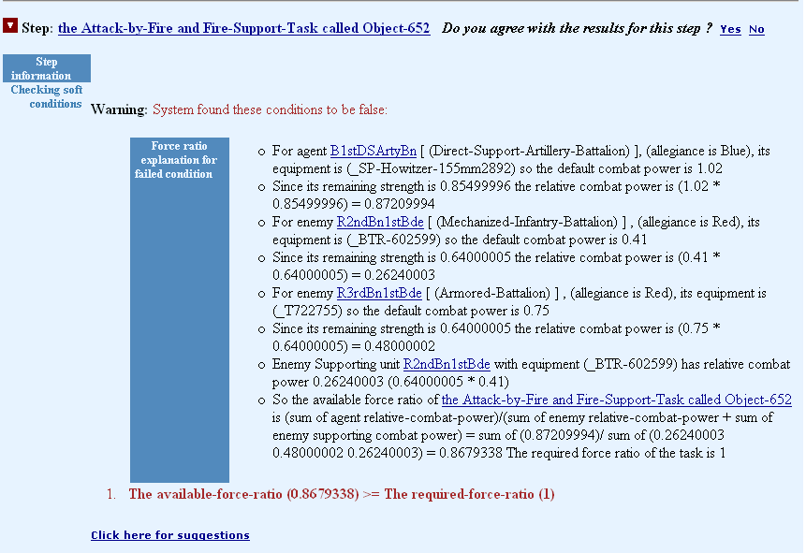
KANAL Results: failed condition of Attack-by-Fire

Slide 12
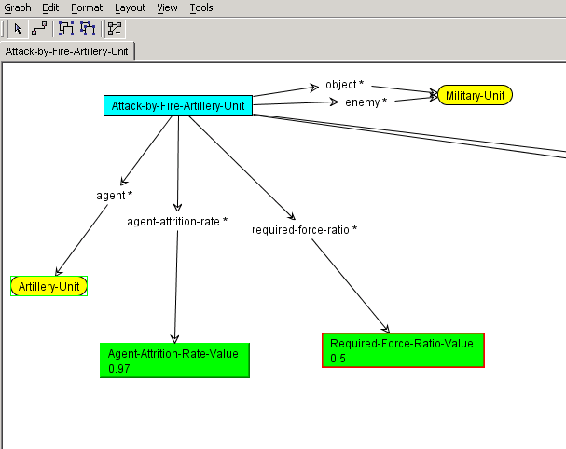
Creating special case through CMap
a special case of Attack-by-Fire that requires less force ratio and less agent attrition rate
Trigger: the agent is Artillery-Unit
New values: the required force ratio is lower and the agent attrition is lower
Trigger
New values

Slide 13
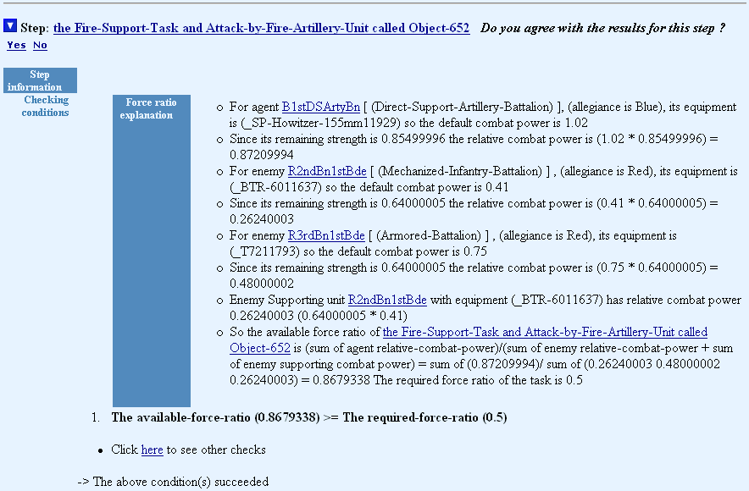
New report where the special case is applied

Slide 14
Special cases created
SME1
  Aviation-Destroy-Arty (T3)
  TigAtk-by-fire-Avn-on-Arty (T3)
  AvnDestroyArty (final training)
  Avn-atck-Art (final training)
  Atk-by-Fire-on-MechInf (final eval)
  Seize-Inanimate_object (final eval)
  Atk-by-Fire-on-LtInf (final eval)
SME2
  Weakened-Military-Unit (T3)
  Destroy-Unit-Using_Aviation (T3)
  Attack-by-Fire-Hasty-Def (final training)
  Destroy-Unit-Armor-on-Mech (final training)
  Destroy-Unit-Avn-on-Arty (final training)
  Attack-by-Fire-Arty-on-Mvr-Unit (final eval)
  Attack-by-Fire-Avn-on-Armor (final eval)
  Attack-by-Fire-Avn-Bn-on-Armor (final eval)
  Attack-by-Fire-Avn-Bn-on-Arty (final eval)
  Seize-Terrain-Feature (final eval)

Slide 15
Action Editor /KANAL usage
Results | T3 | Final eval
Number of special cases created | 4 | 13
Average number of times applied | 1 | 5.4
Average time to create a special case | N/A | 420 seconds
Number of times KANAL was run | 32(16+16) | 42(22 +20)
Number of concepts tested | 9(5+4) | 8(4+4)
Total number of warnings/errors | 85(38+47) | 345(131+214)
Number of times agreed | N/A | 29(7+22)
Number of times disagreed | N/A | 43(7+36)

Slide 16
Unexpected uses
Create a special case to turn off some of the checks
  E.g. Seizing bridge doesn’t need force ratio check
Create a special military unit
  E.g. weakened military unit (75% strength)

Slide 17
User Feedback
“It is interesting how it interprets this.”
“surprisingly good” when special actions were applied

Slide 18
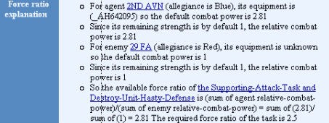
Improvements of KANAL based on SME’s wish list (T1-T3)
Template based approach to provide an explanation of the analysis
  E.g. combat power ratio checks
  Future extension: support a more general approach such as using EXPECT
Providing focused report
  Hiding generic component library conditions and effects
    E.g. Objects not restrained
    the agent should be known
  Future extension: make use of the context and the user’s interests to filter out unnecessary details.

Slide 19
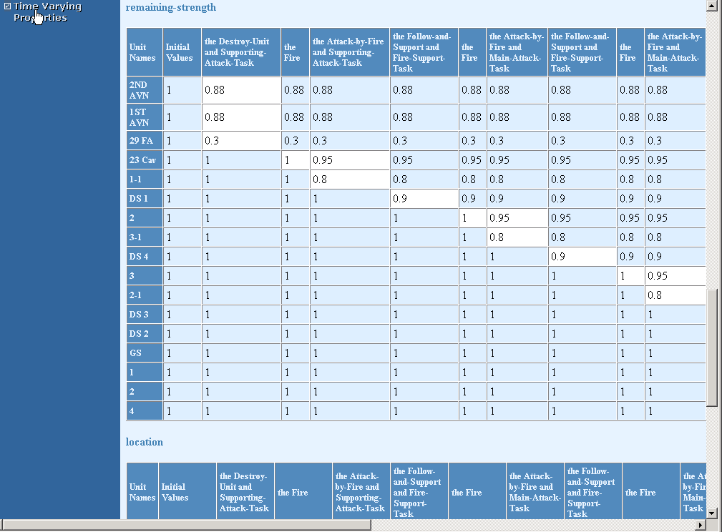
KANAL Improvements (cont)
Summary of state transition
  generating a table for each property that changes over time in order to visualize changes made to objects in a plan
Thorough instrumentation
New form for expected effects (like Q/A techniques)

Slide 20
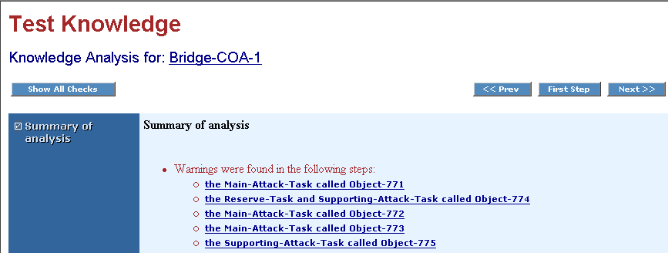
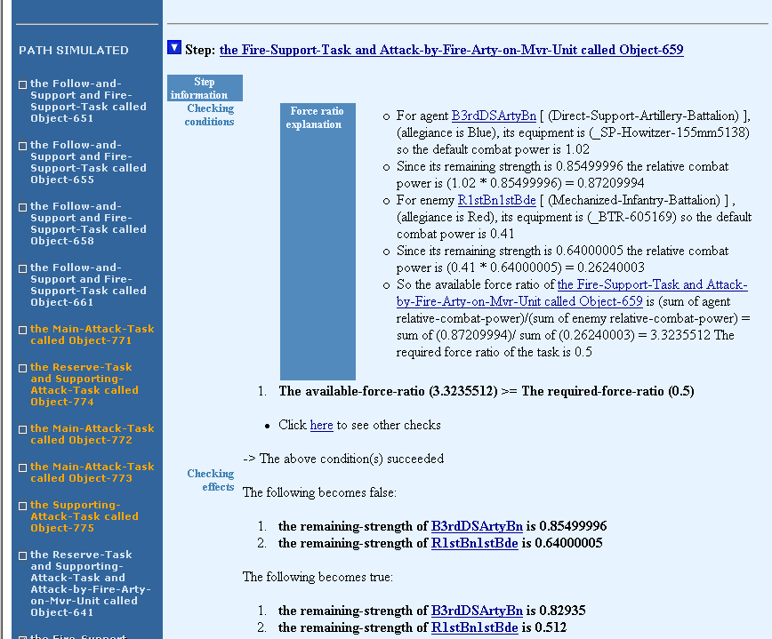
KANAL Improvements (cont): New Look
new interface
old interface

Slide 21
Critiquing based on Expected Effects
Related to commander’s intent, desired end state, mission accomplishment
Two kinds:
  To check whether some actions achieve effects needed to reach the Desired End State and whether the overall plan (COA) achieves the mission.
  To check if intermediate steps achieve intended effects
example expected effects used by SMEs
  The remaining strength of Blue 1st tank brigade > 0.7
  The remaining strength of Blue 2nd tank brigade > 0.8
  The location of Blue 1st tank brigade is at Bridge #1
  …
Total number of Expected Effects used during the final eval: 23

Slide 22
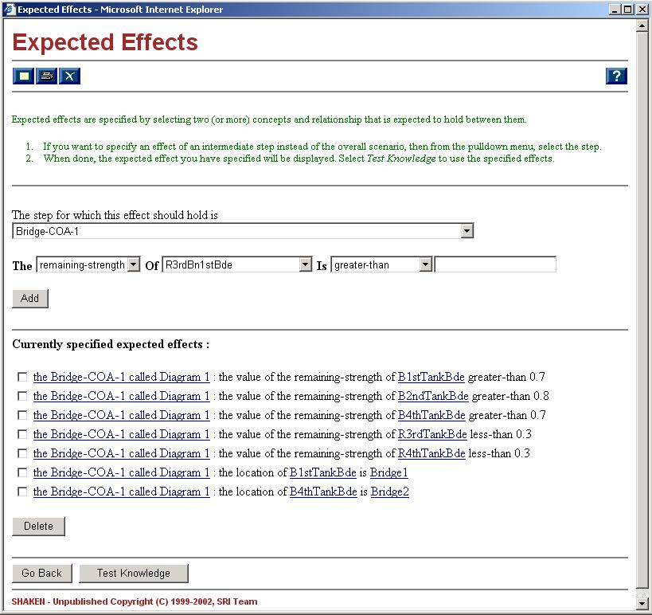
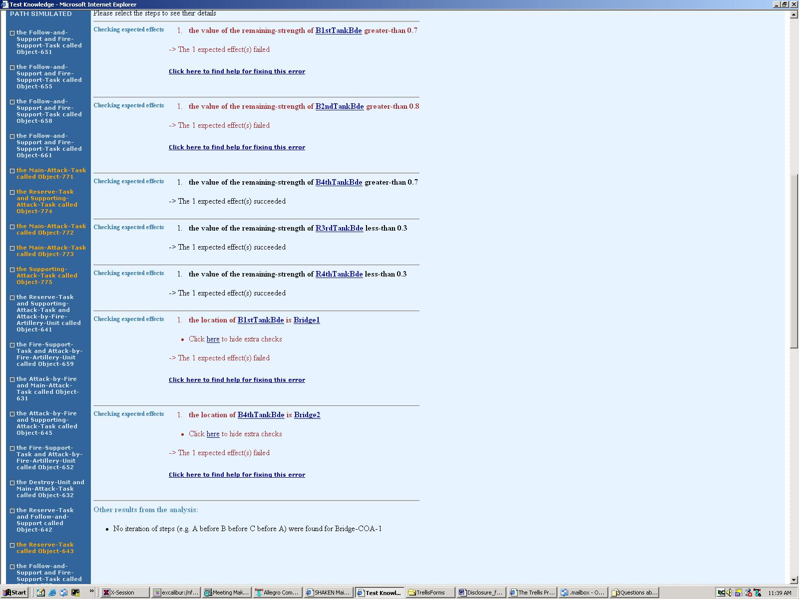

Slide 23
Other contributions
Designing a new format for action descriptions
  Use of soft conditions
  Triggers for exceptions
Assist pumppriming
  examples
    Required force ratios,
    combining combat power of supporting tasks
KANAL used in debugging SHAKEN
  Aligning translation output with Clib
  Missing knowledge
    defaults: default combat power
  Efficiency problems in some KM calls
  English generation

Slide 24
Current Limitations
Testing with KANAL
  Simulation functions are built to execute steps linearly
→ hard to address simultaneous/parallel events
“Disagree with results of _Destroy-Unit17391 because …This attack occurs simultaneously with the attack by the 1st Arm Bde and the Atk Avn Bns”
  Limited reasoning on how the steps are related each other
→ Hard to check supporting relations (e.g. supporting attack)
“the calculation should sum all of the contributions of combat power before calculating the resulting Combat Power Ratio”
Action editor
  User can only modified property values
    → User cannot modify condition expressions or effects

Slide 25
Future work
Support more extensive modifications to action knowledge in creating special cases
  E.g. Modifying condition expressions and effects
Analyzing other types of plans and process models in addition to biology processes and COAs
  use KANAL in checking earthquake simulations
  Other simulation environments

Slide 26
END of presentation

Slide 27
Other improvements made
  New API between KANAL and SHAKEN
    Earlier API
    New API

Slide 28
Example: a specialized version of ‘destroy’ when the attack is on the flank
We assume the action ‘destroy’ has a domain-independent definition in the component library
Initially, (through pump-priming) the KB has a definition of ‘destroy’ for military units in which the agent needs a 3:1 force ratio to be successful
However, in a SME-generated COA, a 2.5:1 ratio is sufficient because the attack is in the Red flank.
The SME will create a new special case of the ‘destroy’ action
  With a trigger condition: attack in the Red flank
  With a different precondition: required force ratio 2.5:1
KANAL uses the new knowledge in the simulation
Notes:
To check mission accomplishment, a normative simulation would check that all the actions are possible and that they combine to achieve the plan’s desired effects. Here we consider an example where the tool believes the action is not possible because it has an over-constrained model of the preconditions.

Slide 29
User Feedback
Disagree with results of _Destroy-Unit7602 because … In reality, there are several other units attacking this same enemy Tank Brigade simultaneously, and the calculation should sum all of the contributions of combat power before calculating the resulting Combat Power Ratio.
Disagree with results of _Destroy-Unit17391 because …This attack occurs simultaneously with the attack by the 1st Arm Bde and the Atk Avn Bns
“It is interesting how it interprets this.”
“surprisingly good” when special actions were applied

