Slide 1

KANAL (Knowledge ANALysis)
Status
Jihie Kim
Yolanda Gil
Jim Blythe
Varun Ratnakar
www.isi.edu/expect/projects/KANAL/

Slide 2
Problem Addressed: Helping users specify complete and consistent process models
Models need to contain detailed information:
  Substeps of a given step, temporal and causal links between substeps
  Each step modeled as an event type in the component lib
  Each event type defines roles that are filled by
  objects (e.g., agent, destination, etc.)
Users need help in defining process models:
  May forget important details
  May define inconsistent steps or links among steps
  Even when an inconsistency or gap is detected, user may not know how to fix it

Slide 3
KANAL: Helping Users through
Interdependency Models (IMs)
[Kim & Gil, IJCAI-01]
KANAL derives IMs through static analysis of the event ontology (comp. lib) and dynamic analysis (simulation) of steps
  Starting with initial state, iterate through steps:
    Check preconditions in current state
    Apply step
    Check effects
KANAL uses the resulting IMs to check if:
  All steps are properly ordered, all step preconditions are satisfied, all expected effects are achieved, etc.
  User sees a report of serious errors (to be fixed) as well as warnings for potential problems (can be fixed or dismissed by user)
KANAL exploits the IMs to suggest fixes for these problems
  Finding steps that can assert unachieved effects, adding missing links, changing ordering constraints to reinstate conditions, etc.

Slide 4
KANAL’s Checks on Process Models
  Missing ordering (first-event, subevent, next-event)
  Unreached events
  Unnecessary ordering
  Failed conditions
  Failed execution of step
  Effectless step
  Failed expected effect
  Loops

Slide 5
Uses of KANAL
 | Summer 2001 | January 2002
Total number of concepts built | 449 | 157
KANAL invocations | 144 | 71
Invocations per concept | 0.32 | 0.45

Slide 6
Errors and warnings reported to users
Error/warning Type | Summer 2001 |  | January 2002
 | Total # | ratio | Total # | ratio
Missing first-event, subevent, next-event | 37 | 0.26 | 8 | 0.11
Unreached events | 55 | 0.38 | 16 | 0.23
Unnecessary ordering | 105 | 0.73 | 52 | 0.73
Failed conditions | 133 | 0.92 | 111 | 1.56
Failed execution of step | 30 | 0.21 | 24 | 0.34
Effectless step | 139 | 0.97 | 6 | 0.08
Failed expected effect | 7 | 0.05 | 10 | 0.14
Loop | 1 | 0.01 | 0 | 0
ratio: # of errors or notes / # of KANAL invocations

Slide 7
Errors and warnings reported to users
Error/warning Type | Summer 2001 | January 2002
Missing first-event, subevent, next-event | 0.26 | 0.11
Unreached events | 0.38 | 0.23
Unnecessary ordering | 0.73 | 0.73
Failed conditions | 0.92 | 1.56
Failed execution of step | 0.21 | 0.34
Effectless step | 0.97 | 0.08
Failed expected effect | 0.05 | 0.14
Loop | 0.01 | 0
User
Improved
Comp Lib
Improved

Slide 8
Supporting SMEs and KEs Collaboration
KANAL’s interface collects user feedback in the context of analyzing errors in a scenario
Users can provide feedback for an error/warning
Users can describe details of feedback
User’s comments help improve KB & SHAKEN

Slide 9
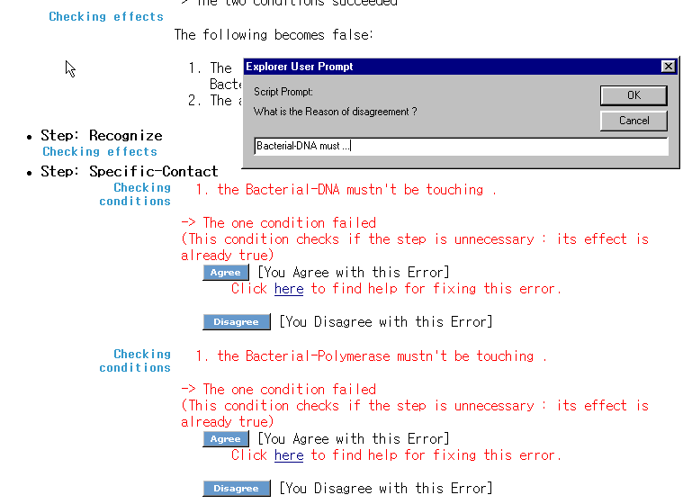
Getting User Feedback

Slide 10
User Feedback (Jan 2002)
Type | Number of notes | details
Agree | 19 | 4 expected effect 2 unnecessary ordering 5 missing event links 5 inexplicit precondition 2 unnecessary ordering 1 effectless event
Dismiss warning | 37 | 37 inexplicit precondition
Disagree | 14 | 4 inexplicit precondition 1 missing event link 9 unnecessary ordering

Slide 11
A user’s note suggests extension to SADL
"RNA capping is a process that takes place during Transcription but is not a first subevent in it. It is also a RNA processing step hence it becomes part of 2 processes but is the first subevent of only RNA processing.“

Slide 12
A user’s note suggests improvements to component library
"1.DNA transcription produces Capped Primary RNA transcript which is used by a sub sub event of RNA Processing.(2)Result of RNA capping is Capped Primary RNA transcript which is a subevent of Poly Adenylation-1.(3)Remove produces Excised-Primary-RNA-Transcript which is used by Add.(4)Result of RNA processing,Processed RNA transcript is the object of Move Through. (5)Movement of Processed RNA transcript to Cytoplasm is necessary for Translation to take place.“

Slide 13
A user’s note suggests improvements to explanation system
SHAKEN Report: the RNA-Polymerase must not be a broken Entity that plays an instrument role
User feedback: "The wording of the warning is not clear .. it may say .. The RNA Polymerase is playing the instrument role and it should not be broken"
SHAKEN Report: the Enzyme must not be a broken Entity that plays an instrument role
User feedback: "same comment ... Enzyme playing the instrument role and is not broken"

Slide 14
Summary
KANAL Interface has been improved a lot
KANAL collects user feedback in the context of analyzing errors in a scenario
KANAL was more heavily used
KANAL reports all the answers for process type questions upfront
  useful for checking/removing errors

