Slide 1

Interactive Composition of Computational Pathways
Yolanda Gil
Jihie Kim
Varun Ratnakar
Students:
  Marc Spraragen (USC)
  Sid Shaw (USC)
  Dan Wu (U Maryland)
  Ronggang Yu (UT)
  Edward Kim (USC)

Slide 2
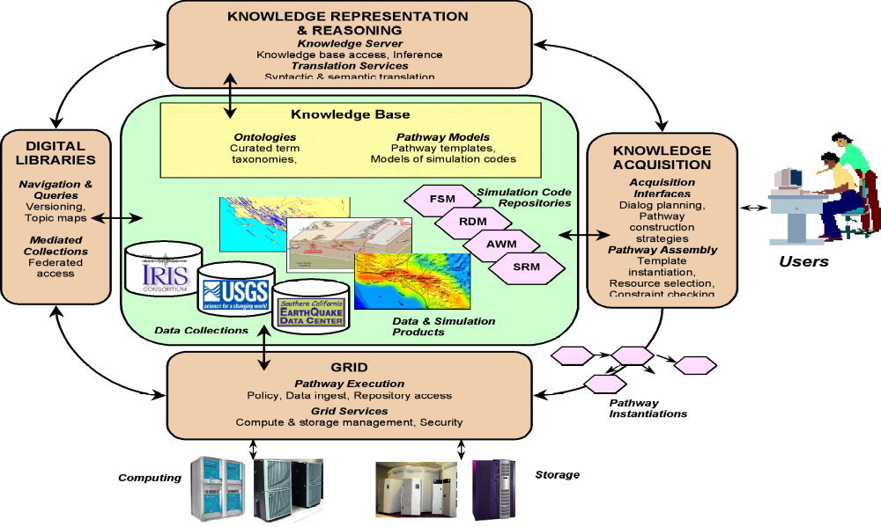
SCEC/IT Architecture for a
Community Modeling Environment

Slide 3
Publishing and Using Simulation Models
Problem: bringing sophisticated models to a wide range of users (civil engineers, city planners, disaster resp. teams)
  Choosing appropriate models for given site and eqk. forecast
  Setting parameters through approximations (e.g., shear-wave velocity)
  Complying with parameter value constraints (e.g., magnitude)
  Detecting and resolving interacting constraints
  Composing end-to-end pathways from individual models
  Execution on grid resources
Approach: expressive declarative constraint representation and reasoning
  Ties model descriptions to definitions (ontologies)
  Uses constraint-based reasoning to guide users to make appropriate use of models
  Ensure correctness of pathways by analyzing semantic constraints of individual models

Slide 4
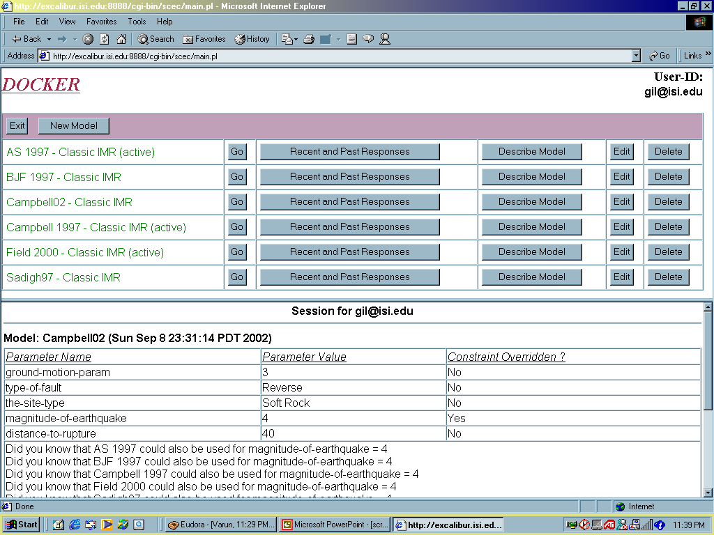
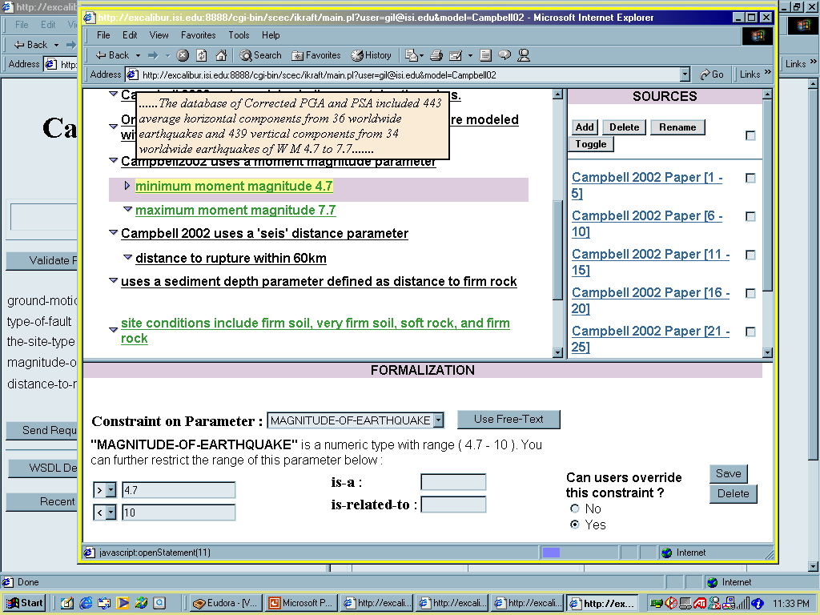
Year l: Modeling and Using Simulation Code for Seismic Hazard Analysis with DOCKER [Gil & Ratnakar 02]
Declarative descriptions of models are linked to ontologies and KR tools
Model developers can easily add simple constraints to model description and document their sources and criticality
System generates formal representations of model constraints in PowerLoom as well as XSD and WSDL
User is allowed to override model constraints to accommodate analysis
System reasons about model representation and suggests alternative models

Slide 5
End Result: An Executable Computational Pathway
Task Result: Hazard curve: SA vs. prob. exc.
UTM
Converter
(get-Lat-Long-
given-UTM)
Lat.
long
UTM
(, , , )
PEER-Fault
Gaussian Dist
No Truncation
Total Moment
Rate
Duration-Year
Fault-Grid-Spacing
Ruptures
Rupture Offset
Hazard curve: SA vs. prob. exc.
Mag-Length-sigma
Dip
Rake
Ruptures
Hazard Curve
Calculator: SA
vs. prob. exc.
Magnitude (min)
rfml
Magnitude (max)
Magnitude (mean)
Rupture
Lat
Long.
CVM-get-
Velocity-
at-point
Velocity
Field
(2000)
IMR: SA
exc. prob.
Lat
Long.
Site VS30
SA exc.
probs.
Site Basin-Depth-2.5
Lat
Long.
Basin-Depth
Calculator
Basin-Depth
rfml
SA Period
Gaussian
Truncation
SA exc.
prob.
Std. Dev. Type

Slide 6
Interactive Composition of Computational Pathways
Goal: support users in creating a specification of a pathway
  Automatic tracking of pathway constraints
    System ensures consistency and completeness of pathway so user does not have to keep track of many computational details
  Provide flexible interaction
    User can start from initial data, from data products, or steps
    User can specify abstract descriptions of steps and later specialize them
  Intelligent assistance
    System should not just point out problems but help user by suggesting fixes

Slide 7
Our Approach
Cast pathway composition as plan synthesis
  Initial state + desired goals + available steps + constraints (e.g., robot planning, mission planning, etc
Advantages:
  Many algorithms and techniques available for searching the space of combinations of steps and detect solutions [Nilsson 71, McDermott 86, Hendler 9l, Weld 95, etc]
  Clearly defined semantics and desirable properties
  Used in the past to model software composition and service composition [Lansky 94, Stickel 96, McDermott 01, etc]
Consistent with our approach to generate executable pathways on grids (more in a moment)
Interactive composition is a novel research area

Slide 8
Pathway Composition as Plan Synthesis
Initial state: user-provided input or available data
Desired goals: data products requested by user
Available steps: simulation models, conversion routines, data transformations, web services, etc
Constraints: defined in ontologies and formal descriptions of steps

Slide 9
Formalizing Pathway Composition
Pathway: {Steps}, {Links}
  Link: [OP(S1), IP(S2)]
  Step: [{IP}, {OP}, Exec]
Links can be consistent, partially consistent, inconsistent, well-formed, dangling, redundant, …
Steps can be satisfied, partially satisfied, unsatisfied, justified, …
What are desirable properties of pathways?

Slide 10
Desirable Properties of Pathways
Satisfied: all steps have linked inputs
Tasked: has end result specified
Complete: satisfied and tasked
Consistent: all links are well-formed and consistent
Grounded: all steps are executable
Justified: all steps contribute to results
Correct: complete, consistent, grounded, and justified

Slide 11
Assisting Users in Pathway Composition
User interaction results in modifications to pathways
  Add/remove step, add/remove link
  Specialize step
  Desired result, external/user provided input
As users create a pathway, intermediate stages result in possibly incorrect, unjustified, or incomplete pathways
ErrorScan algorithm [Spraragen 03] detects errors and generates appropriate fixes
  Given any intermediate pathway it is guaranteed to suggest fixes that lead to solution
  If no errors detected, pathway is guaranteed to be correct

Slide 12
Task Ontology
Domain Ontology
. . .
. . .
Compute-Hazard-Level-
given-IMR-input-parameters
Hazard-Level
Parameter
probability-function
Compute-Hazard-Level-
with-SA-
given-IMR-input-parameters
IMT
Compute-Hazard-Level-
with-PGV-
given-IMR-input-parameters
Hazard-Level-with-SA
Hazard-Level-with-PGV
Compute-Hazard-Level-with-PGA-
given-IMR-input-parameters
IMR-Input-Parameter
Hazard-Level-with-PGA
. . .
probability-function
Compute-Hazard-Level-with-SA-Median-
given-IMR-input-parameters
Field-2000-Input-Parameter
Hazard-Level-with-Median
Hazard-Level-with-Std-Dev
Compute-Hazard-Level-with-SA-Std-Dev-
given-IMR-input-parameters
Hazard-Level-with-Median
Fault-Type
Hazard-Level-with-SA-Median
Compute-Hazard-Level-with-SA-Prob-Exc-
given-IMR-input-parameters
IMR
Basin-Depth
Hazard-Level-with-SA-Std-Dev
F2-Hazard-Level
Compute-F2-Hazard-Level-
given-Field-2000-input-parameters
. . .
Distance
Hazard-Level-with-SA-Prob-Exc
. . .
Compute-F2-SA-Median-
given-Field-2000-input-parameters
. . .
Compute-F2-SA-Median-wrt-Distance-JB-
given-Fault-Type-&-Basin-Depth-&-…
Compute-F2-SA-MEDIAN-wrt-VS30-
given-Fault-Type-&-Basin-Depth-&-…
. . .
F2-SA-Median-wrt-VS30
F2-operation-SA-Median-Distance-JB
F2-operation-SA-Median-VS30
. . .

Slide 13
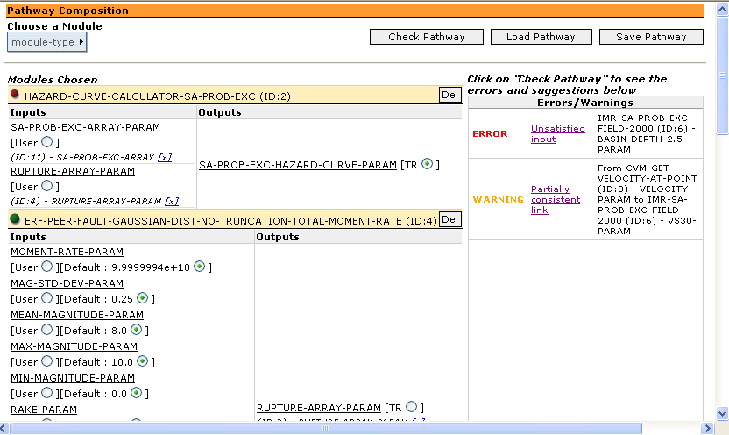
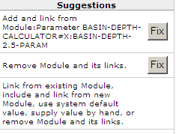
CAT: Composition Analysis Tool
User building a pathway specification from library of models
Errors and fixes generated by ErrorScan algorithm

Slide 14
SCEC/IT Architecture for a
Community Modeling Environment

Slide 15
Pegasus: Workflow Generation for Computational Grids [Deelman et al 03; Blythe et al 03]
Given: desired result and constraints
  A desired result (high-level, metadata description)
  A set of application components described in the Grid
  A set of resources in the Grid (dynamic, distributed)
  A set of constraints and preferences on solution quality
Find: an executable job workflow
  A configuration of components that generates the desired result
  A specification of resources where components can be executed and data can be stored
Approach: Use AI planning techniques to search the solution space and evaluate tradeoffs
  Exploit heuristics to direct the search for solutions and represent optimality and policy criteria

Slide 16
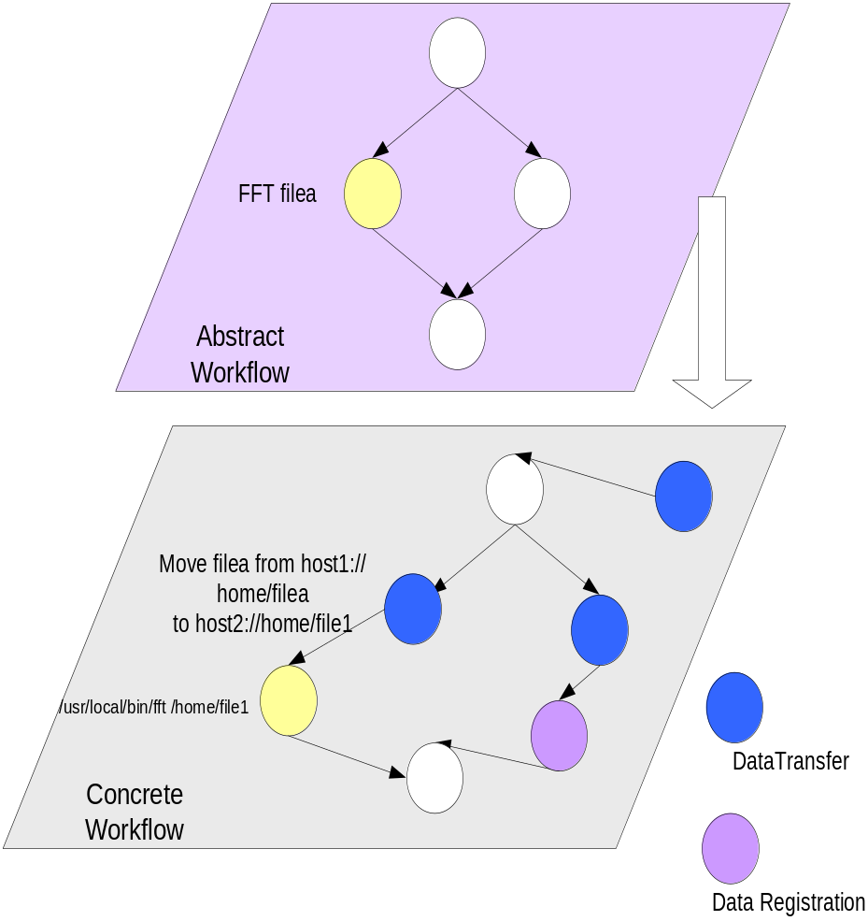
Generating an Executable Workflow
Need to consider:
  Information about location of data files and components
  Reuse of existing data files
  State of the Grid resources
Selecting specific:
  Resources
  Files
  Adding jobs required to form a concrete workflow that can be executed in the Grid environment
    Data movement
    Data registration
  Each component in the abstract workflow is turned into an executable job

Slide 17
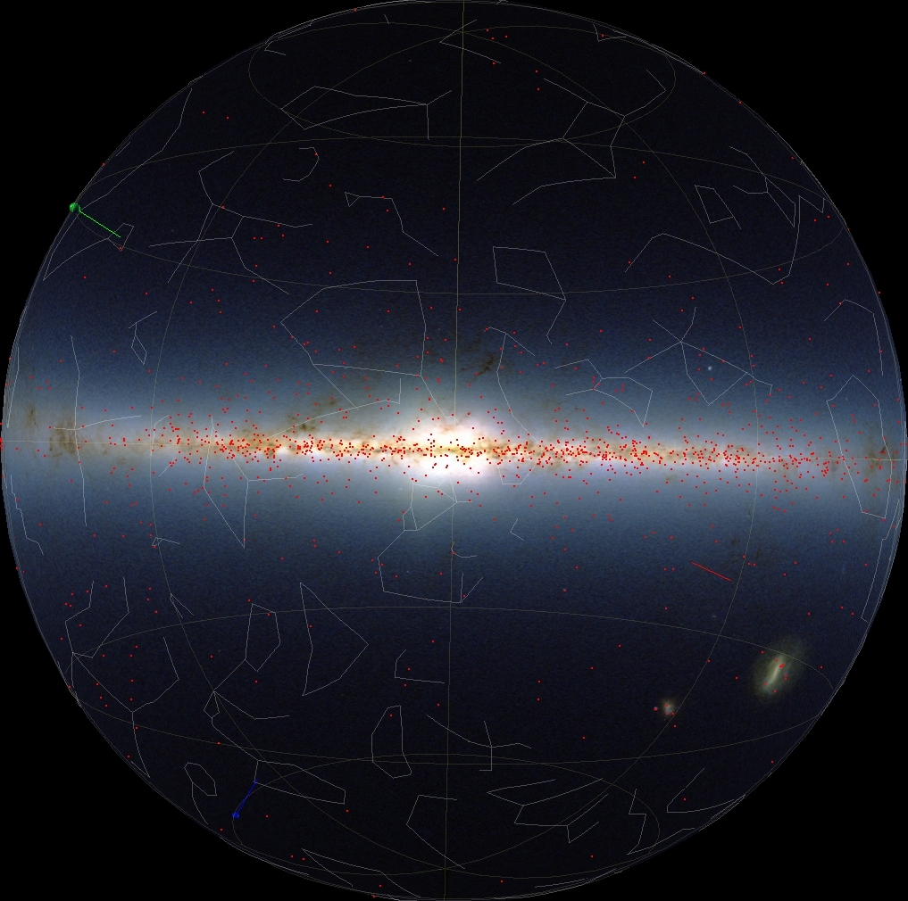
Pegasus Applied to LIGO’s pulsar search [Deelman et al 03]
Used LIGO’s data collected during the first scientific run of the instrument
Targeted a set of 1000 locations of known pulsar as well as random locations in the sky
Performed using compute and storage resources at Caltech, University of Southern California, University of Wisconsin Milwaukee.
Used AI planning techniques to generate workflows with hundreds of steps sent to grid for execution

Slide 18
Interactive Knowledge Acquisition:
Summary of Activities
Accessibility of complex models to end users (DOCKER)
  Showing appropriate descriptions of models and constraints
  Handling errors due to complex constraint violations
Assisting model developers to publish code (DOCKER)
  Describing code behavior is not sufficient
  Documenting appropriate use of model formally and informally
Interactive composition of computational pathways (CAT)
  User selects and connects models to create a sketch of pathway
  Automatic error checking and completion support
Execution on the Grid environment (Pegasus)
  Isolate unsophisticated user from complexity of distributed computing environments
Extend and integrate DOCKER, CAT, and Pegasus
Year l
Year 2
Y3

