Slide 1

Interactive Composition of Computational Pathways
Students:
  Marc Spraragen (USC)
  Sid Shaw (USC)
  Dan Wu (U Maryland)
  Ronggang Yu (UT)
  Edward Kim (USC)
Yolanda Gil
Jihie Kim
Varun Ratnakar

Slide 2
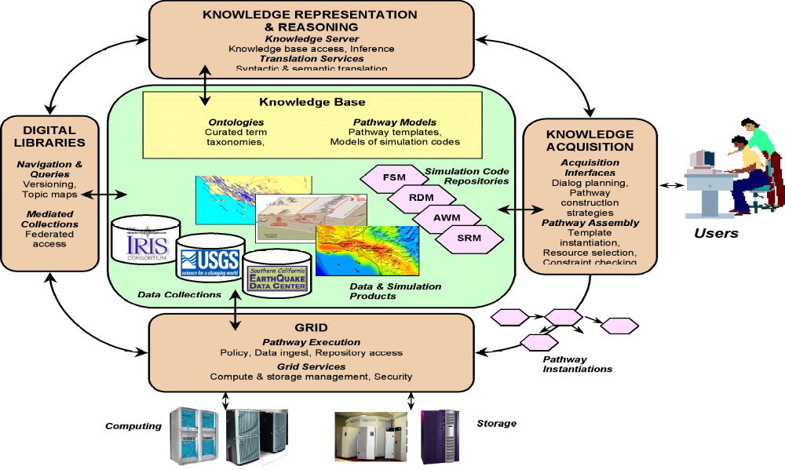
SCEC/IT Architecture for a
Community Modeling Environment

Slide 3
Interactive Knowledge Acquisition:
Summary of Activities
Accessibility of complex models to end users (DOCKER)
  Showing appropriate descriptions of models and constraints
  Handling errors due to complex constraint violations
Assisting model developers to publish code (DOCKER)
  Describing code behavior is not sufficient
  Documenting appropriate use of model formally and informally
Interactive composition of computational pathways (CAT)
  User selects and connects models to create a sketch of pathway
  Automatic error checking and completion support
  (details in a minute)
Execution on the Grid environment (Pegasus)
  Isolate unsophisticated user from complexity of distributed computing environments
Year l
Year 2

Slide 4
A Computational Pathway Specification
Task Result: Hazard curve: SA vs. prob. exc.
UTM
Converter
(get-Lat-Long-
given-UTM)
Lat.
long
UTM
(, , , )
PEER-Fault
Gaussian Dist
No Truncation
Total Moment
Rate
Duration-Year
Fault-Grid-Spacing
Ruptures
Rupture Offset
Hazard curve: SA vs. prob. exc.
Mag-Length-sigma
Dip
Rake
Ruptures
Hazard Curve
Calculator: SA
vs. prob. exc.
Magnitude (min)
Magnitude (max)
Magnitude (mean)
Rupture
Lat
Long.
CVM-get-
Velocity-
at-point
Velocity
Field
(2000)
IMR: SA
exc. prob.
Lat
Long.
Site VS30
SA exc.
probs.
Site Basin-Depth-2.5
Lat
Long.
Basin-Depth
Calculator
Basin-Depth
SA Period
Gaussian
Truncation
SA exc.
prob.
Std. Dev. Type

Slide 5
Interactive Composition of Computational Pathways
Goal: support users in creating a specification of a pathway
  Automatic tracking of pathway constraints
    System ensures consistency and completeness of pathway so user does not have to keep track of many computational details
  Provide flexible interaction
    User can start from initial data, from data products, or steps
    User can specify abstract descriptions of steps and later specialize them
  Intelligent assistance
    System should not just point out problems but help user by suggesting fixes

Slide 6
Approach
Mixed-initiative system that helps users create, reuse, and combine workflows by exploiting:
Knowledge-based descriptions of components
  Ontology of components and component types based on common features and parameter constraints
Analysis of (partially constructed) pathways based on AI planning techniques
  Relate steps to goals and initial states, and interpret user actions in terms of incremental plan generation
  Exploit existing techniques and algorithms
[Kim et al, IUI 04] [Kim & Gil AAAI SSS 04] [Kim & Gil ISWC 03]
[Kim et al, submitted] [Spraragen, submitted]

Slide 7
Supporting Knowledge Base
Component ontology: hierarchies of components that describe abstract-level components as well as specific executable components
  e.g. IMR → Field-2000 → Field-2000-SA-Prob-Exc
Domain ontology: data types for representing input and output parameters and the constraints associated with them
  e.g. Field-2000 needs VS30, Basin-Depth, Fault-type, etc.

Slide 8
Component Ontology
Domain Ontology
. . .
. . .
Compute-Hazard-Level-
given-IMR-input-parameters
Hazard-Level
Parameter
probability-function
Compute-Hazard-Level-
with-SA-
given-IMR-input-parameters
IMT
Compute-Hazard-Level-
with-PGV-
given-IMR-input-parameters
Hazard-Level-with-SA
Hazard-Level-with-PGV
Compute-Hazard-Level-with-PGA-
given-IMR-input-parameters
IMR-Input-Parameter
Hazard-Level-with-PGA
. . .
probability-function
Compute-Hazard-Level-with-SA-Median-
given-IMR-input-parameters
Field-2000-Input-Parameter
Hazard-Level-with-Median
Hazard-Level-with-Std-Dev
Compute-Hazard-Level-with-SA-Std-Dev-
given-IMR-input-parameters
Hazard-Level-with-Median
Fault-Type
Hazard-Level-with-SA-Median
Compute-Hazard-Level-with-SA-Prob-Exc-
given-IMR-input-parameters
IMR
Basin-Depth
Hazard-Level-with-SA-Std-Dev
F2-Hazard-Level
Compute-F2-Hazard-Level-
given-Field-2000-input-parameters
. . .
Distance
Hazard-Level-with-SA-Prob-Exc
. . .
Compute-F2-SA-Median-
given-Field-2000-input-parameters
. . .
Compute-F2-SA-Median-wrt-Distance-JB-
given-Fault-Type-&-Basin-Depth-&-…
Compute-F2-SA-MEDIAN-wrt-VS30-
given-Fault-Type-&-Basin-Depth-&-…
. . .
F2-SA-Median-wrt-VS30
F2-operation-SA-Median-Distance-JB
F2-operation-SA-Median-VS30
. . .

Slide 9
Pathway analysis based on
AI planning framework
ErrorScan
Input: pathway W <C,L,I,G>
Output: list of errors and corresponding fix suggestions
I. If W is not purposeful, return Error.
Suggestions: define end result e using types from the KB, AddEndResult (e).
.
II. For each Component C in W:
a. If C is not Justified, return Error.
Suggestions ∀p that is output-parameter (c), find components cj in the pathway or the KB that have pj as input- parameter(cj), and subsumes(pj,p), AddLink(c,p,cj,pj)
b. If C is not Executable, return Error.
Suggestions: (∀ Cj ∈ FindDirectSubtypes(c),
SpecializeComponent(C, Cj).
c. For each i in input-parameter(c):
1. If i is not Satisfied, return Error.
Suggestions: ∀ cj ∈ C with output parameter pj such that
subsumes(range(c,i),range(cj,pj))
AddLink(cj,pj,c,i).
Suggestions: ∀ cj ∈ FindMatchingOutput (i)),
AddLink(cj,pj,c,i).
Suggestion:AddAndLinkComponent
(W, AddInitialInput(i),range( i), c, i)
III. For each Link L in W:
a.If L is not Consistent, return Error.
Suggestions: ∀ Ci ∈ FindInterPosingComponent(L),
InterposeComponent (Ci, L).
Suggestion: RemoveLink(L).
b. If L is Redundant, return Error.
Suggestion: RemoveLink (L).
Formalize pathway features
Define desirable properties
ErrorScan Algorithm
  Purposeful (pathway)
  For each step S in pathway:
    Satisfied (S)
    Justified (S)
    Executable (S)
  For each link L in pathway:
    Consistent (L)
    Unique (L)
If ErrorScan does not generate any error messages for a given pathway, the pathway is purposeful, executable, satisfied, justified, unique, and consistent
→ Correct pathway specification

Slide 10
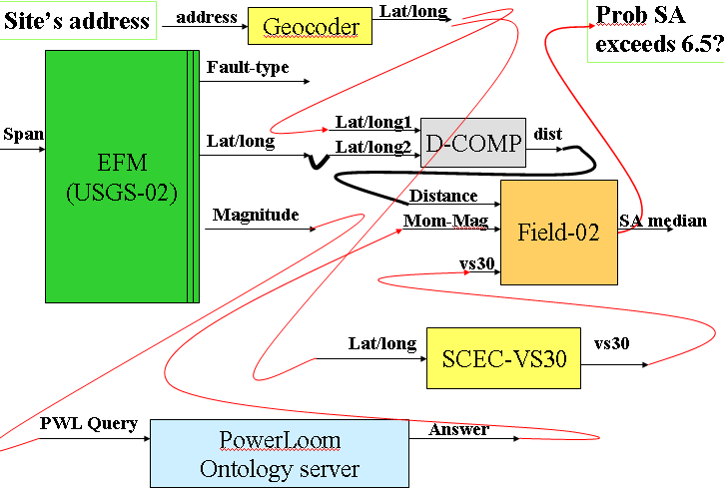
CAT (Composition Analysis Tool) architecture
User Interface
Web
Services
CAT
Interaction
Manager
ErrorScan
Component Ontology
Domain Ontology
Pathway
Reasoning
Constraint
Reasoning

Slide 11
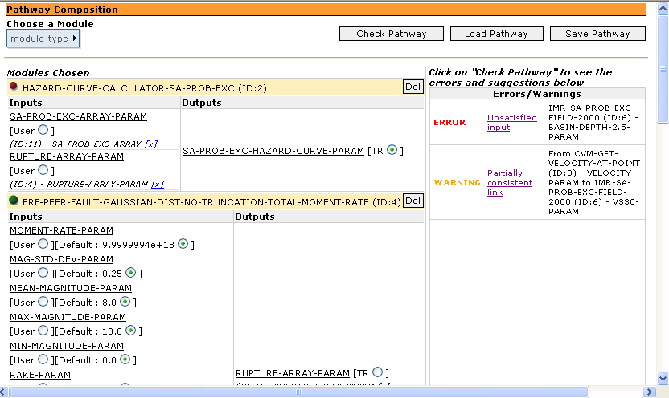
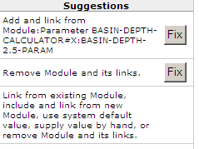
CAT Interface
User building a pathway specification from library of components
Errors and fixes generated by ErrorScan algorithm

Slide 12
User Studies
Preliminary study of system’s capabilities
4 subjects
2 pathways with 7 steps and 20 links each
Users composed complete workflows in a short amount of time (avg. 13 min)
CAT’s error messages were routinely used by the users (4.2/5)
Mixed-initiative interaction seems useful

Slide 13
Evaluating CAT with Synthetic Scenarios: Results with “artificial user mistakes”
How well can CAT detect mistakes given uncertainty of user actions and interactions between mistakes?
→ CAT virtually always detected artificial user mistakes and made suggestions to user (238/240 cases)
Can CAT propose useful fixes?
→ For 87% of the mistakes detected, CAT’s fixes would correct the mistakes directly (direct fixes)
Results with 1 mistake | SHA | TRIP | Total
# mistakes | 20 | 20 | 40
# of mistakes detected (# of error msgs for detection) | 20 (195) | 20 (63) | 40 (258)
# of mistakes with direct fixes (# of direct fixes) | 15 (44) | 19 (38) | 34 (82)
Total # of error msgs Total # of fixes | 314 762 | 75 283 | 389 1045
Avg # of fixes per error msg | 2.43 | 3.77 | 3.10 (avg)
Results with 2 mistakes | SHA | TRIP | Total
# of mistakes | 40 | 40 | 80
# of mistakes detected (# of error msgs for detection) | 39 (184) | 40 (140) | 79 (324)
# of mistakes with direct fixes (# of direct fixes) | 35 (92) | 37 (56) | 72 (148)
Total # of error msgs Total # of fixes | 296 744 | 191 627 | 487 1371
Avg # of fixes per error msg | 2.51 | 3.28 | 2.89 (avg)
Results with 3 mistakes | SHA | TRIP | Total
# of mistakes | 60 | 60 | 120
# of mistakes detected (# of error msgs for detection) | 59 (335) | 60 (185) | 119 (520)
# of mistakes with direct fixes (# of direct fixes) | 49 (133) | 52 (98) | 101 (231)
Total # of error msgs Total # of fixes | 488 1243 | 212 755 | 700 1998
Avg # of fixes per error msg | 2.54 | 3.56 | 3.05 (avg)

Slide 14
Year 3 work: Automatic Completion of Partial Workflows
Goal: User specifies a sketch of the workflow at a high level, system fills out details
Approach:
User creates partial workflow with CAT
Use AI planning techniques to complete partial workflow
  AutoCAT system to complete workflow spec
  Pegasus to add grid-related execution details

Slide 15
Pegasus: Workflow Generation for Computational Grids [Deelman et al 03; Blythe et al 03; Gil et al 04]
Given: desired result and constraints
  A desired result
  A set of application components described in the Grid
  A set of resources in the Grid (dynamic, distributed)
  A set of constraints and preferences on solution quality
Find: an executable job workflow
  A configuration of components that generates the desired result
  A specification of resources where components can be executed and data can be stored
Approach: Use AI planning techniques to search the solution space and evaluate tradeoffs
  Exploit heuristics to direct the search for solutions and represent optimality and policy criteria

Slide 16
Future Work
Integration with execution environment (ongoing)
  use Pegasus planner and SCEC Grid testbed
Ontology creation from component descriptions
  Design integrated approach by extending MCS
Release CAT to SCEC community

