Slide 1
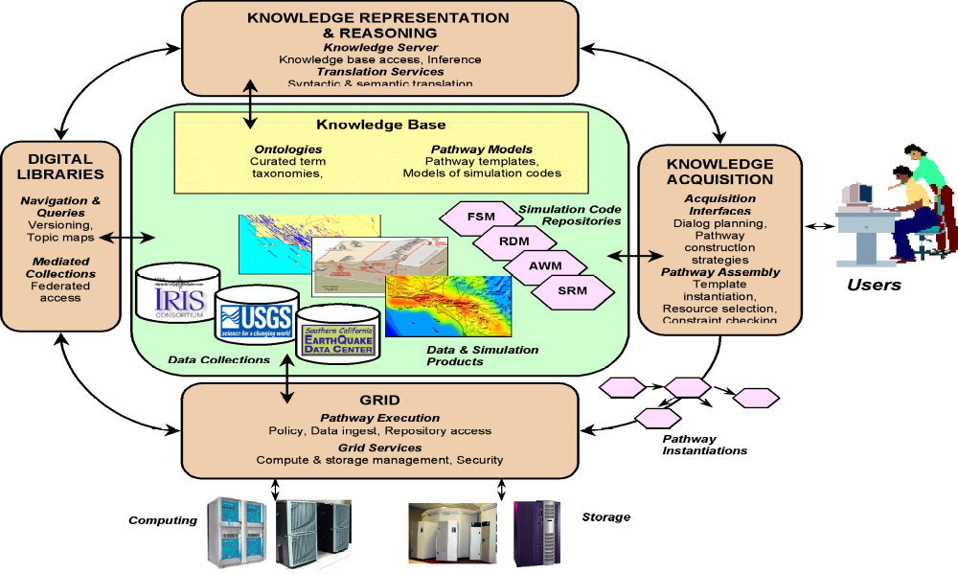
SCEC/IT Architecture for a
Community Modeling Environment

Slide 2
Publishing and Using Simulation Models
Problem: bringing sophisticated models to a wide range of users (civil engineers, city planners, disaster resp. teams)
  Choosing appropriate models for site and eqk. forecast
  Setting parameters through approximations (e.g., shear-wave velocity)
  Complying with parameter value constraints (e.g., magnitude)
  Detecting and resolving interacting constraints
Approach: expressive declarative constraint representation and reasoning
  Ties model descriptions to overarching SCEC ontologies
  Exploits state-of-the-art KR&R to check model use
  Uses constraint-based reasoning to guide users:
    To make appropriate use of models
    To suggest alternative models more adequate for user’s analysis
  Documents constraints to help end users understand model

Slide 3
Interactive Knowledge Acquisition:
Overview of Activities
Accessibility to end users
  Showing appropriate descriptions of models and constraints
  Handling errors due to complex constraint violations
Assisting model developers to publish code
  Describing code behavior is not sufficient
  Documenting appropriate use of model formally and informally
Elicitation of computational pathways
  Interactive composition of models creates sketch of pathway
  Automatic checking and completion of pathway
Execution on the Grid environment
  Isolate unsophisticated user from complexity of distributed computing environments

Slide 4
DOCKER: Single-point entry to repository of simulation models
Model developers can:
  Publish the code for their models
  Specify I/O parameter types in terms of SCEC ontologies
  Specify and document constraints of model use
End users can:
  Invoke models from a uniform interface
  Invoke model correctly by enforcing constraints
  Find appropriate simulation models for their requirements
How it works:
  Code can be easily added to repository
  Documents the source of constraints for model use and I/O types
  Generates user interface & spec for each model automatically
  Translates code specs into KR language
  Uses KR&R to check constraints during code invocation

Slide 5
DOCKER: Using SHA Code
End user can:
Browse through SHA models
Invoke SHA models
Get help in selecting appropriate model
Web Browser
AS97
DOCKER
AS97
User
Interface
Model
Reasoning
docs
constrs
types
msg
AS97
ontology
Pathway
Elicitation
Constraint
Reasoning
KR&R
(Powerloom)
SCEC
ontologies

Slide 6

DOCKER: Publishing SHA Code
User specifies:
Types of model parameters
Format of input messages
Documentation
Constraints
Web
Browser
DOCKER
AS97
User
Interface
Model
Specification
AS97
docs
types
msg
constrs
Wrapper
Generation
(WSDL, PWL)
Constraint
Acquisition
AS97
ontology
SCEC
ontologies

Slide 7
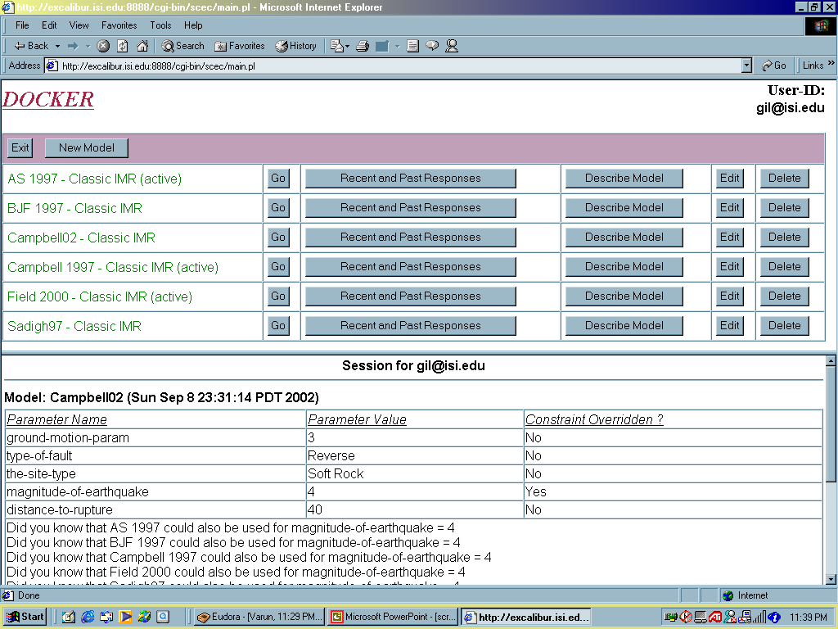
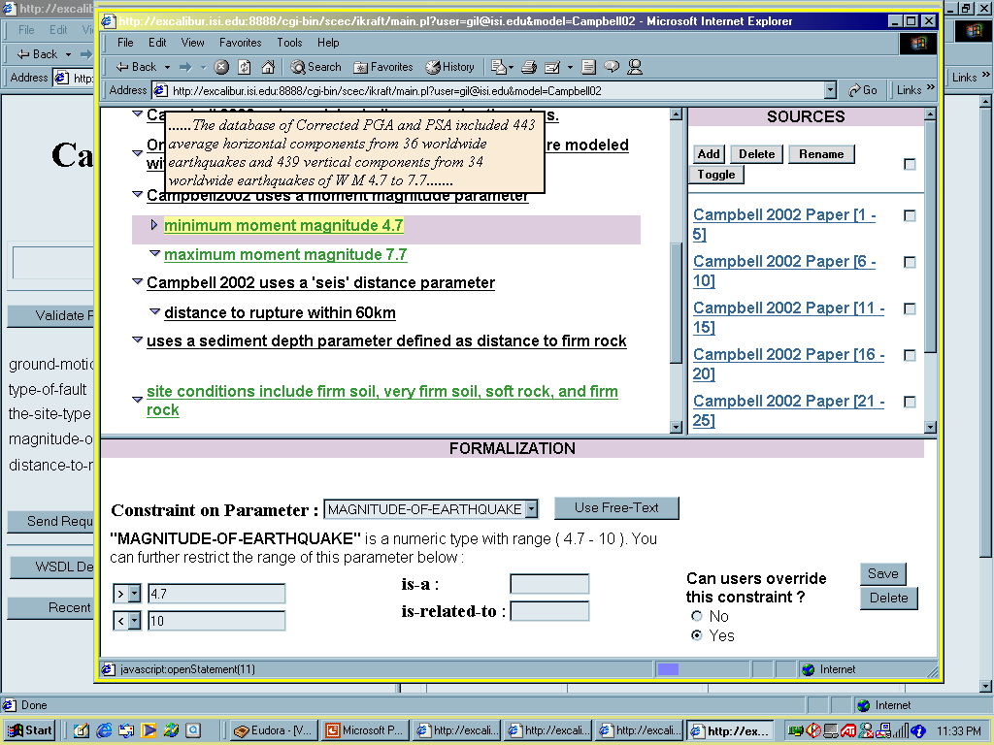
DOCKER: Modeling and Using Simulation Code for Seismic Hazard Analysis in SCEC
Declarative descriptions of models are linked to SCEC ontologies and KR tools
Model developers can easily add simple constraints to model description and document their sources and criticality
System generates formal representations of model constraints as well as XSD and WSDL
User is allowed to override model constraints to accommodate analysis
System reasons about model representation and suggests alternative models

Slide 8
SCEC/IT Architecture for a
Community Modeling Environment

Slide 9
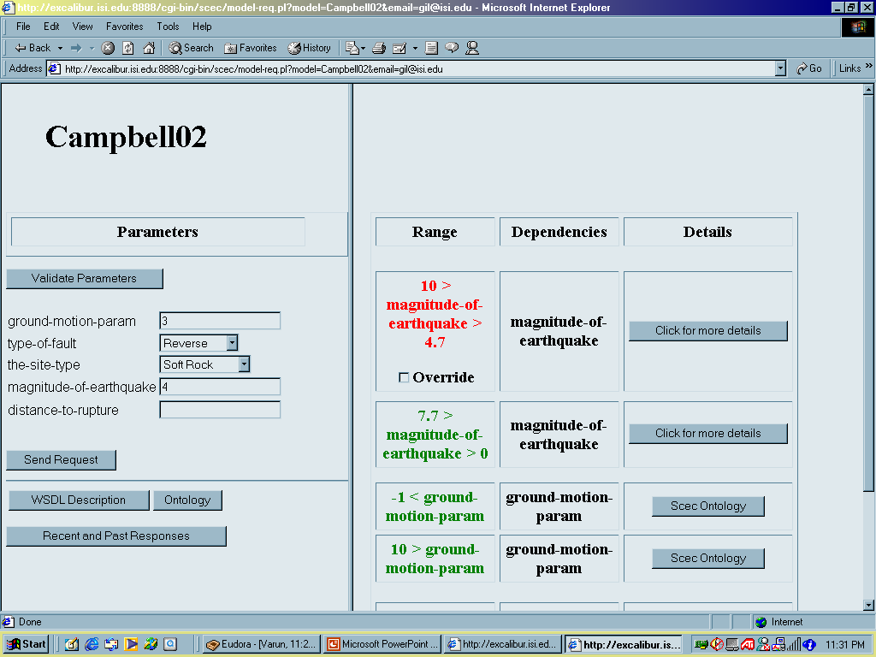
Constraints on Individual Parameters

Slide 10
Representing and Documenting Constraints

Slide 11
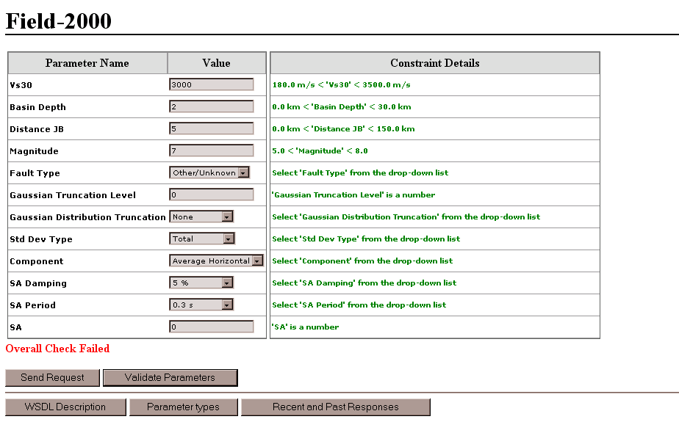
More Challenging: Constraints Among Parameters
Some constraints between parameters failed

Slide 12
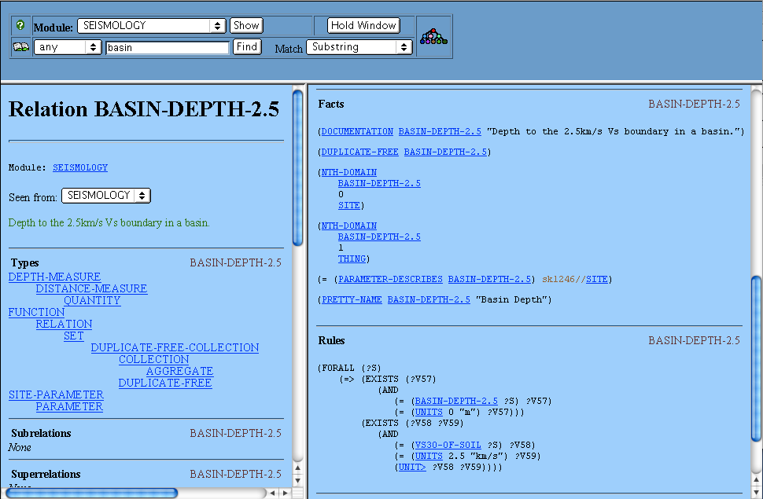
Basin Depth and Vs30 Constraint
Textual Definition
Formal logical encoding of one constraint implied by the textual definition
Structured Description
(Basin-depth = 0m) ⇔ (Vs30 > 2.5km/s)

Slide 13
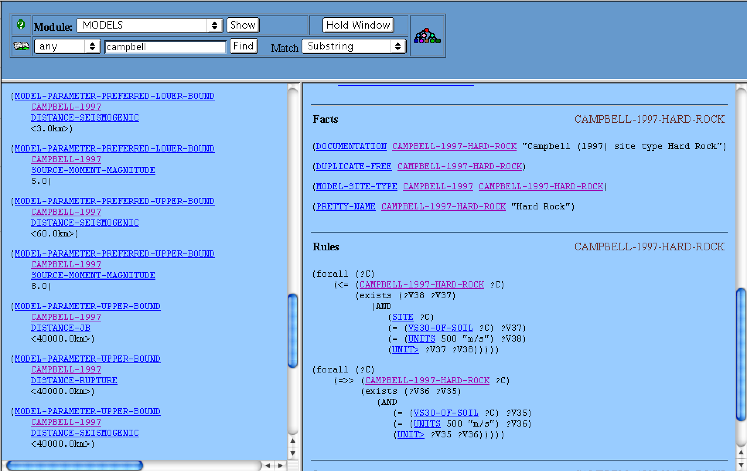
Campbell Hard Rock Site Type
Documentation String
PowerLoom internal annotation
Link from Model to this site type description
Rules provide definition of site type
Names used by parameter in Java code
Hard Rock has a Vs30 > 500m/s

Slide 14
Summary
DOCKER facilitates publishing and using simulation code
  Assists end users in selecting appropriate codes and parameters
  Provides baseline system to specify simple constraints
  Declarative descriptions of code are easy to provide
    Markup language mapped to KR (Powerloom) done by system
  Initial focus: empirical attenuation relationships for SHA
Future work:
  Computational pathway elicitation: composing several codes
  More expressive language to describe simulation code
  Incorporation of physics-based models (Pathway 2)
  Simulation code distributed over the Globus grid

Slide 16
Current Focus: Seismic Hazard Analysis
Site Info
List of Potential EQKs
SA from
AWM
IMR
Forecast
Model
Forecast
Model
Forecast
Model
Forecast
Model
IMR
Timespan
IMR
Forecast
Model
CFM
Map Creation
USGS
Fault Model
FAD
Map

Slide 17
Focus to Date: Seismic Hazard Analysis Using IMRs
User’s goal:
  Given: a site S, a structure ST
  Determine: P of > 1g acc in 50 yrs, P > 1/10g in 10 yrs
User interaction:
  User picks IMT (based on ST)
  System lists IMRs, user selects a subset
  User fills site info of IMR based on S
    Site type, Vs30, basin depth, location
  User specifies earthquake forecast
    Fault type, source, magnitude
  System runs models
  User may explore variations on IMT and forecast

Slide 18
Helping the User through Constraint Reasoning
User’s goal:
  Given: a site S, a structure ST
  Determine: P of > 1g acc in 50 yrs, P > 1/10g in 10 yrs
User interaction:
  User picks IMT (based on ST)
  System lists IMRs, user selects a subset
  User fills site info of IMR based on S
    Site type, Vs30, basin depth, location
  User specifies earthquake forecast
    Fault type, source, magnitude
  System runs models
  User may explore variations on IMT and forecast
Did you know that [A2000]
takes into account
directivity effects?
Did you know that
[Sadigh97] is a good
model for dist >80 miles?

Slide 19
DOCKER: Using SHA Code
End user can:
Browse through SHA models
Invoke SHA models
Get help in selecting appropriate model
Web Browser
AS97
DOCKER
AS97
User
Interface
Model
Reasoning
docs
constrs
types
msg
AS97
ontology
Pathway
Elicitation
Constraint
Reasoning
KR&R
(Powerloom)
SCEC
ontologies

Slide 20
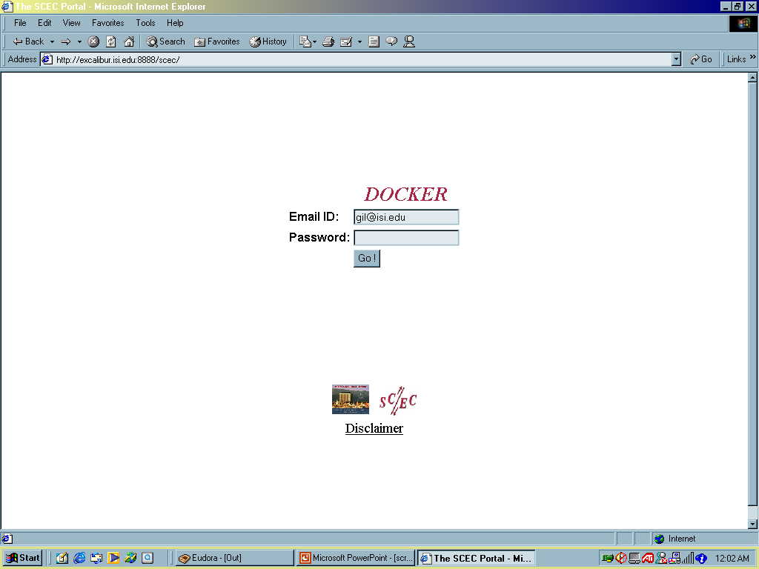
DOCKER (Ask me for a demo!)

Slide 21
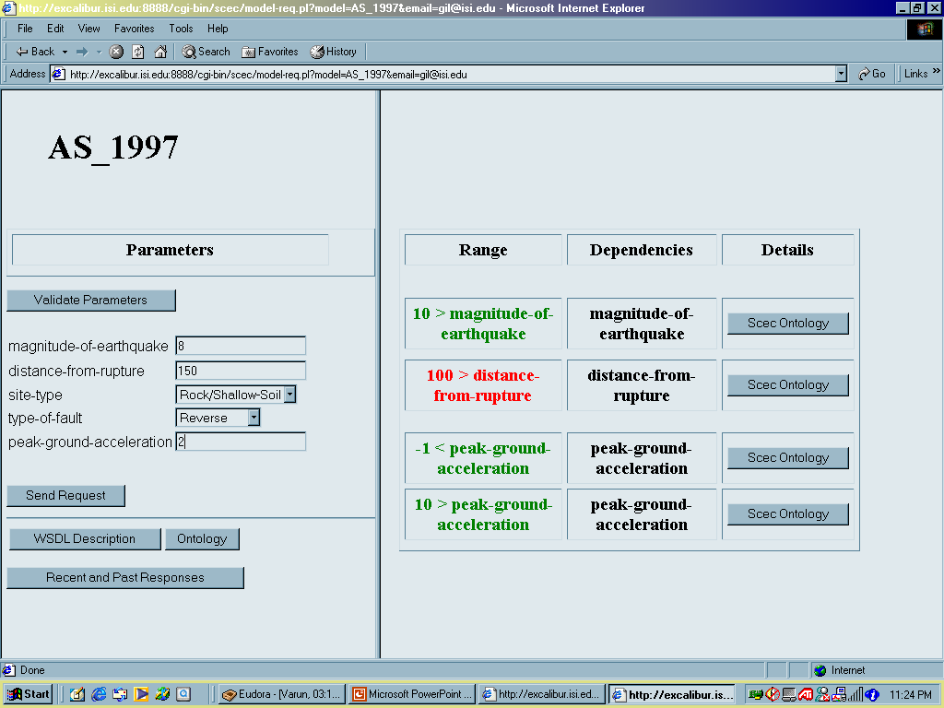
Detecting Constraint Violations

Slide 22
Managing Constraint Violations

Slide 23
Looking Up Reasons for Constraint

Slide 24
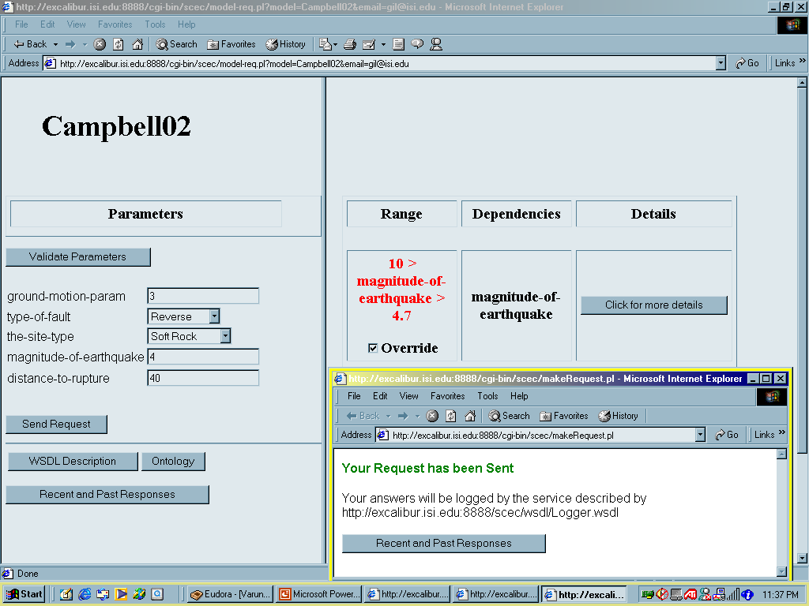
User Can Override (Soft) Constraints

Slide 25
System recommends using other models for those parameter values
Yes
Did you know that [Sadigh97] is a good model for dist >80 miles?

Slide 26
DOCKER: Publishing SHA Code
User specifies:
Types of model parameters
Format of input messages
Documentation
Constraints
Web
Browser
DOCKER
AS97
User
Interface
Model
Specification
AS97
docs
types
msg
constrs
Wrapper
Generation
(WSDL, PWL)
Constraint
Acquisition
AS97
ontology
SCEC
ontologies

Slide 27
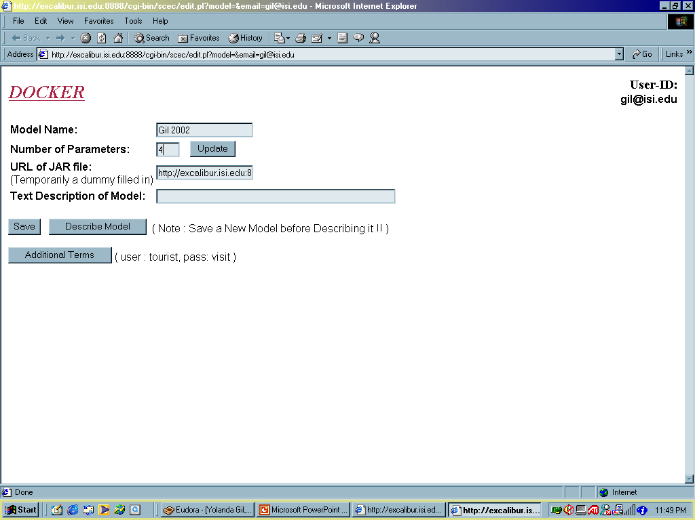
Publishing a Model

Slide 28
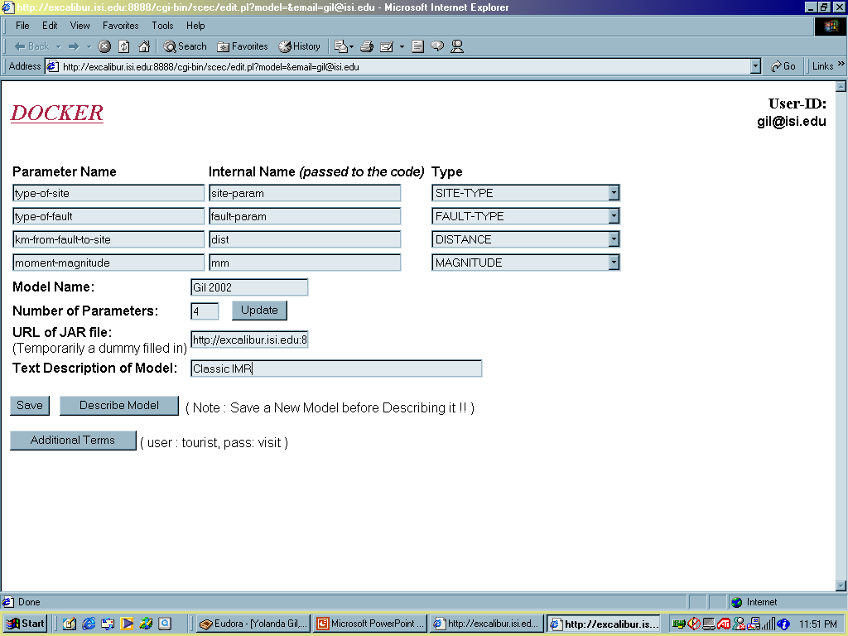
Defining Parameters

Slide 29
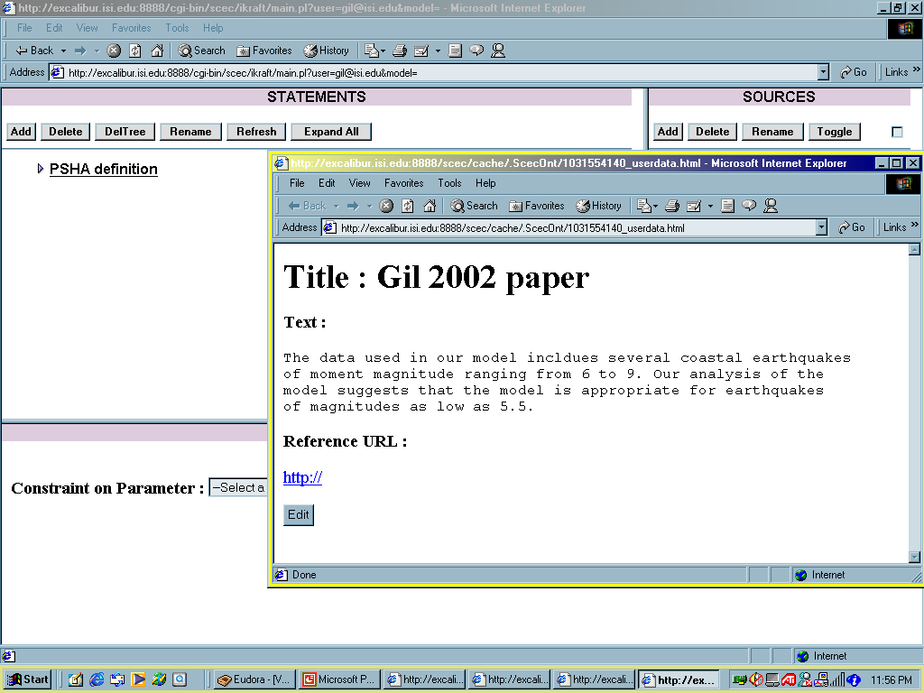
Documenting the Model

Slide 30
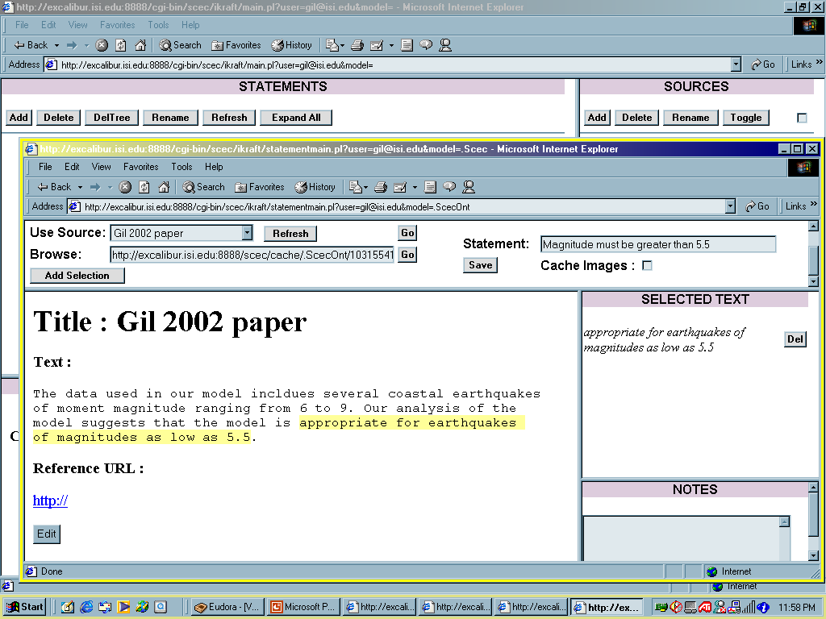
Documenting Each Constraint

Slide 31
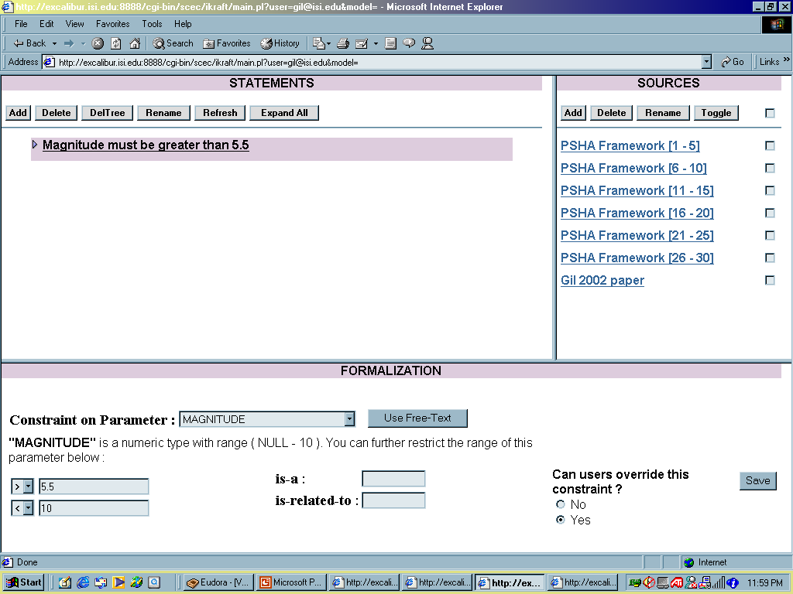
Formalizing Constraints

Slide 32
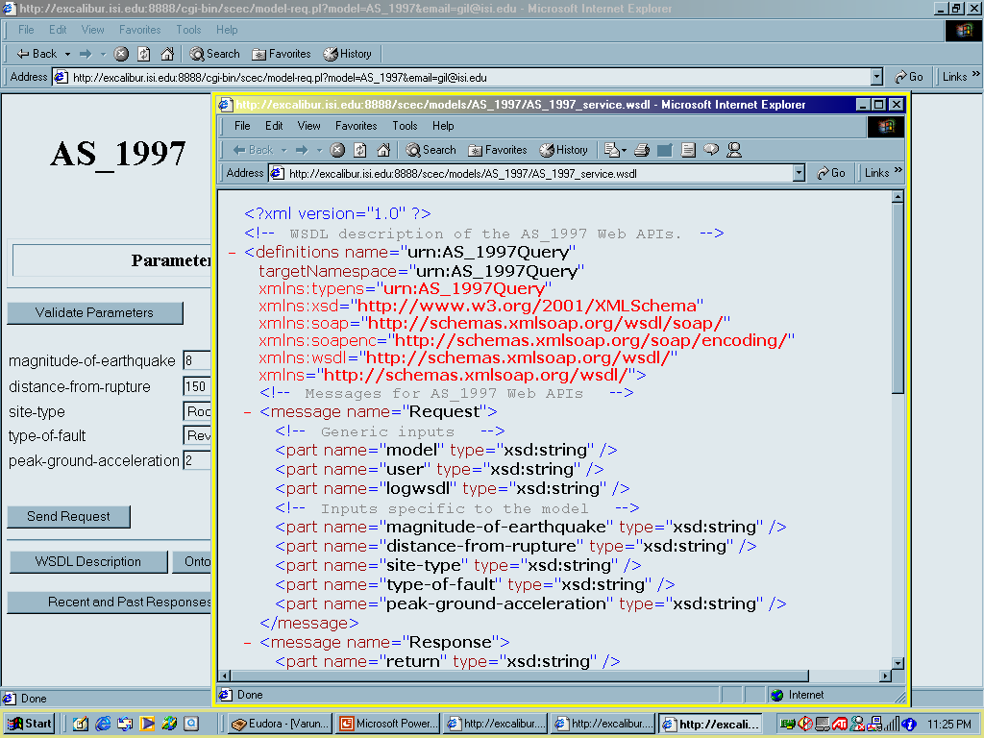
Automatically Generates Underlying Message Transport (WSDL description)

Slide 33
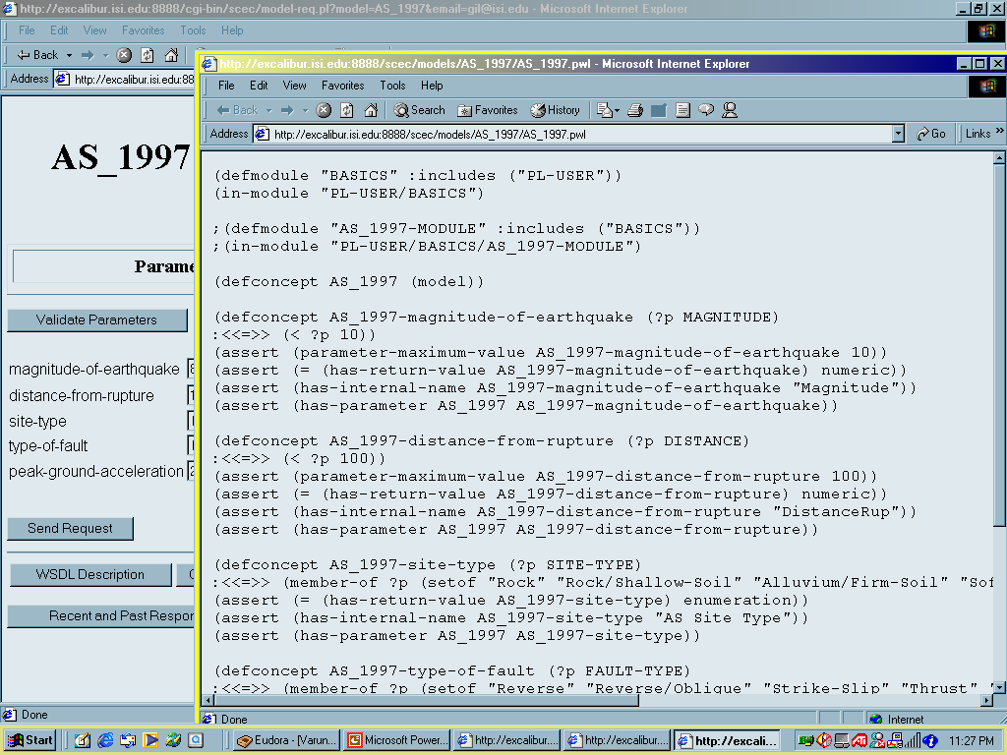
Automatically Generates Description in KR Language (PowerLoom) (or XMLS, etc)

Slide 34
Modeling and Using Simulation Code: Relevant Research
Problem solving methods and task models
  UPML (EU)
  EXPECT - HPKB PSMs (ISI)
Process description languages
  PSL (NIST)
Task/action representation languages (PDDL, ACT, PRS)
Agents
  Phosphorus - E-Elves (ISI)
  Retsina (CMU)
Web services
  DAML-S
  Many emerging standards (WSDL, WSFL)
Grid computing
  OGSA
Software specification and reuse

