Slide 1

Proactive Acquisition Dialogues
Jihie Kim
Yolanda Gil
www.isi.edu/expect/projects/rkf/

Slide 2
Feedback from Summer-01 Evaluations
User’s comments on SHAKEN:
    “The system had to be taken by the hand”
    "I do not really know whether there is a possibility of standardizing the entire [KA] process. But it would be better to document some of the [KA] processes which you think are standardized".
Proposed solution: Extend SHAKEN with proactive dialogue capabilities

Slide 3
Research Issues
How to turn a KA tool into a good student, how to help a user be a good teacher
  Tutoring & educational literature
Assess competence and confidence in the new body of knowledge
Dialogue planning
  Meta-level knowledge about KA tasks
Collaborative dialogue
User modeling
Utility of system’s interventions

Slide 4




Deriving Acquisition Principles from Tutoring Principles
SOFTWARE
USER
?
Instructional
System
Good
Tutoring
Principles
teaches
Acquisition
Tool
Good
Learning
Principles
teaches
?

Slide 5
Deriving Acquisition Principles from Tutoring Principles (II)
SOFTWARE
USER
?
Instructional
System
Good
Tutoring
Principles
teaches
Acquisition
Tool
Good
Learning
Principles
teaches
?

Slide 6
14 Tutoring and Learning Principles [Kim & Gil 02]
Teaching/Learning principle | Tutoring literature
Start by introducing lesson topics and goals | Atlas-Andes, Meno-Tutor, Human tutorial dialog
Use topics of the lesson as a guide | BE&E, UMFE
Subsumption to existing cognitive structure | Human learning, WHY, Atlas-Andes
Immediate Feedback | SOPHIE, Auto-Tutor, Lisp tutor, Human tutorial dialog, human learning
Generate educated guesses | Human tutorial dialog, QUADRATIC, PACT
Keep on track | GUIDON, SHOLAR, TRAIN-Tutor
Indicate lack of understanding | Human tutorial dialog, WHY

Slide 7
Tutoring and Learning Principles
(cont)
Teaching/Learning principle | Tutoring literature
Detect and fix “buggy” knowledge | SCHOLAR, Meno-Tutor, WHY, Buggy, CIRCSIM
Learn deep model | PACT, Atlas-Andes
Learn domain language | Atlas-Andes, Meno-Tutor
Keep track of correct answers | Atlas-Andes
Prioritize learning tasks | WHY
Summarize what was learned | EXCHECK, TRAIN-Tutor, Meno-Tutor
Provide overall assessment of learning knowledge | WEST, Human tutorial dialog

Slide 8
Competence and Confidence: Learning Awareness
Capable of assessing:
  Competence: What is known, what is unknown
  Confidence: What has been tested, what has been checked by the user
Steer the dialogue to improve KB in both counts

Slide 9
Awareness Annotations
1) Annotations to the new body of knowledge:
  For each lesson: purpose, assumed background, sub-lessons, overall competence and confidence
  For each k item: connection to lesson, relation to other items, identity wrt other items, possible analogies and generalizations, domain terminology details, competence, confidence
  For each axiom of a k item: required information, generality, completeness, confidence
2) Annotations to the dialogue history:
  For each user action: changes to the annotations to the new knowledge, acquisition goals achieved and/or activated, possible future KA strategies

Slide 10
Dialogue Planning:
Viewing KA Activities as Lessons
1) SET UP LESSON AND CHECK BACKGROUND
2) ACCEPT AND RELATE NEW DEFINITIONS
3) TEST AND FIX
4) FIT WITH EXISTING KNOWLEDGE STRUCTURES:
5) ACHIEVE PROFICIENCY
6) REACH CLOSURE

Slide 11
Dialogue Planning that Exploits Acquisition Principles
SET UP LESSON AND CHECK BACKGROUND:
  Get the overall topic and purpose of the lesson.
  Acquire any assumed prior knowledge before pursuing the lesson.
ACCEPT AND RELATE NEW DEFINITIONS:
  Accept new definitions
  Ensure that new knowledge is specific as possible.
  Ask the user to be complete when enumerating items in terms of the elements and in terms of the significance of the order given.
  Get all the information required when existing knowledge indicates it must be provided.
  Make all new definitions consistent with existing knowledge.
  Connect all new items with the topic of the lesson.
TEST AND FIX:
  Test the new body of knowledge and generate tests for the aspects that have not been thoroughly tested.
  Fix problems that result from self-checks or from user's indications.
  Ensure user checks the reason for the answers, not just the answers themselves.
  Confirm new answers that change in light of new knowledge over what the user had seen the answer to be earlier.

Slide 12
Acquisition Principles (cont)
FIT WITH EXISTING KNOWLEDGE STRUCTURES:
  Establish identity of new objects by checking if existing objects appear to be the same.
  Generalize definitions if analogous things exist and there could be plausible generalizations.
ACHIEVE PROFICIENCY:
  Acquire domain terms to describe new knowledge.
  Learn to reason/generate answers efficiently and with shorter explanations.
REACH CLOSURE:
  Ensure that the purpose/topics of the lesson were covered and the test questions appropriately answered.

Slide 13
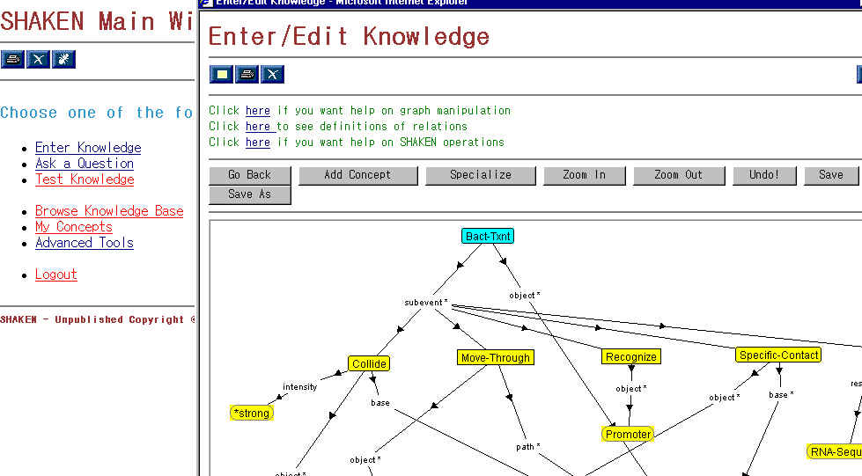
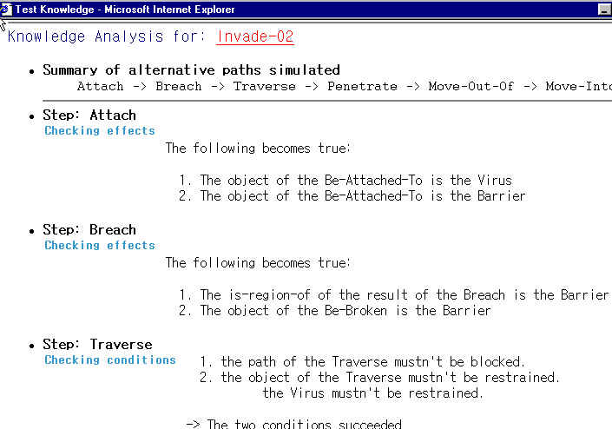
SHAKEN’01
UI (SHAKEN client)
SHAKEN server
KB
KANAL
Q/A
User command logs

Slide 14
Acquisition Dialogues in SHAKEN’02
SHAKEN server
UI (SHAKEN client)
Dialogue Manager
KB
Active Acquisition strategy
KANAL
Acquisition
Strategies
KA dialog
Window
…
Q/A
…
…
State & History
User command logs

Slide 15
Bacterial Transcription: A process model in biology
Scenario called Bact-Txn1
subevent
first-subevent
Collide
next
Move-Through
next
Recognize
next
Make-Contact
next
DNA-Melting
path
object
base
object
object
base
object
object
Tangible-Entity
Base-Pair
Base-Pair
Bacterial-Polymerase
structural-part-of
Bacterial-DNA
Promoter

Slide 16
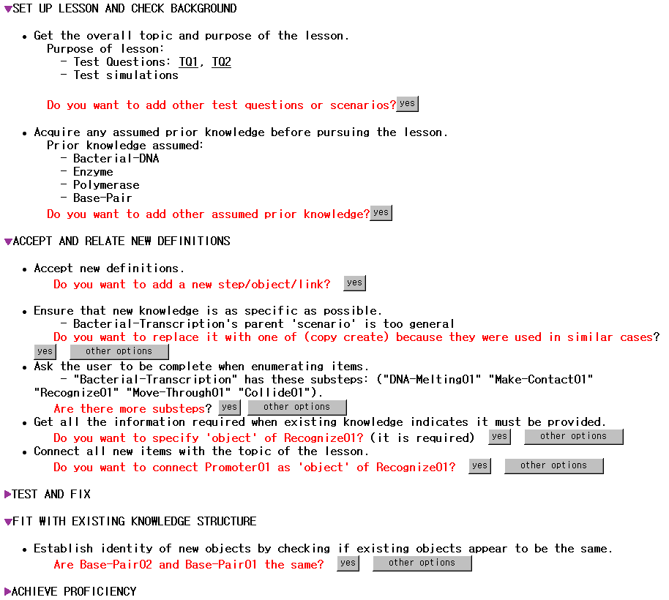

Slide 17
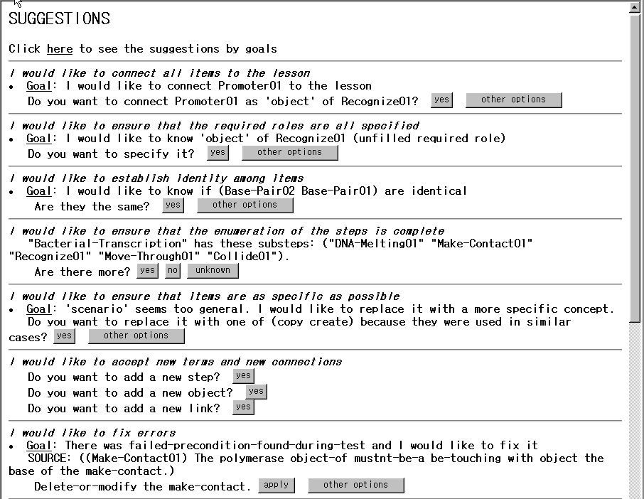
Gral acquisition principle
Specific acquisition goal
Educated guesses

Slide 18
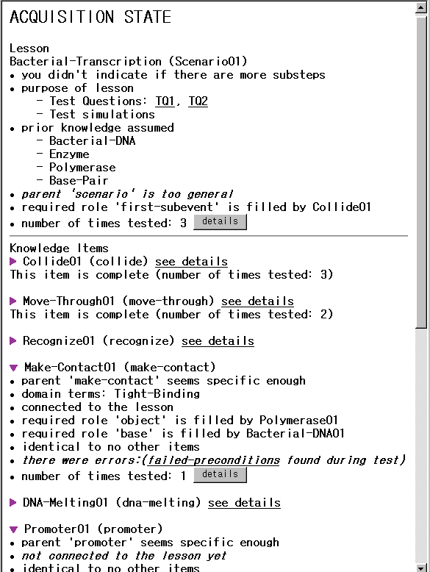
Awareness
Annotations:
1) State

Slide 19
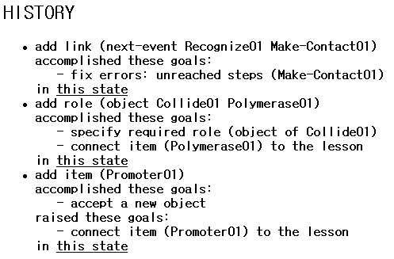
Awareness Annotations:
2) History
Shows user’s actions
and their effects in
accomplishing
acquisition goals
or raising new ones
User can view changes
to the state

Slide 20
Five Main Functions of KA Tools
Input command
INSTRUCTION
ASSIMILATION
Operational
Principles
STATUS
KA
Tool
GUI
Acqu. goals
History
TRIGGER
GOALS &
STRATEGIES
Acqu. strats
Awareness
Annotations
General
Tutoring
&
Learning
Principles
Dialogue GUI
Goals & Strats
State
Suggestions
History
PROPOSE
STRATEGIES
Guess
Generators
Active goals
& candidate
strategies
PRIORITIZE
GOALS &
STRATEGIES
Priority
Schemes
Immediate
goals &
strategies
PRESENTATION
DESIGN
Interaction
Guidelines
Knowledge Base

Slide 21
Tutoring and Learning principles used in KA tools [Gil & Kim 02]
Tutoring/Learning principle
Assimilate
Instruction
Trigger
Goals
Propose
Strategies
Prioritize
Goals & Strats
Design
Presentation
Introduce topics & goals
EXPECT, SEEK2
Use topics of the lesson as a guide
SALT
SEEK2
EXPECT
SALT
Subsumption to existing cog. structure
PROTOS
TEIREISIAS
PROTOS, SALT
Immediate feedback
PROTOS
INSTRUCTO-SOAR
TEIREISIAS
EXPECT
Generate educated guesses
TEIREISIAS
EXPECT
Keep on track
Indicate lack of understanding
INSTRUCTO-SOAR
INSTRUCTO-SOAR
Detect and fix “buggy” K
TAQL
EXPECT,CHIMERA
Learn deep models
Learn domain language
Keep track of answers
SEEK2
Prioritize learned tasks
EXPECT
Summarize what is learned
Assess learned knowledge
KSSn

Slide 22
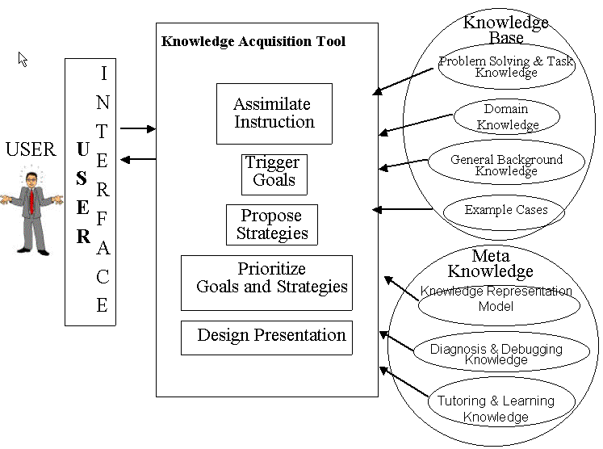

Slide 23
Future Work
Dialogue Planning
  Designing a library of dialogue plans for KA tasks
  Focus and attention (track subdialogues, detect thrashing)
Collaborative dialogue techniques
Integration with SHAKEN
  Longer term: redesign overall user interaction
Integration of other modules to operationalize more principles (CHIMAERA, Analogy, etc.)

