Slide 1
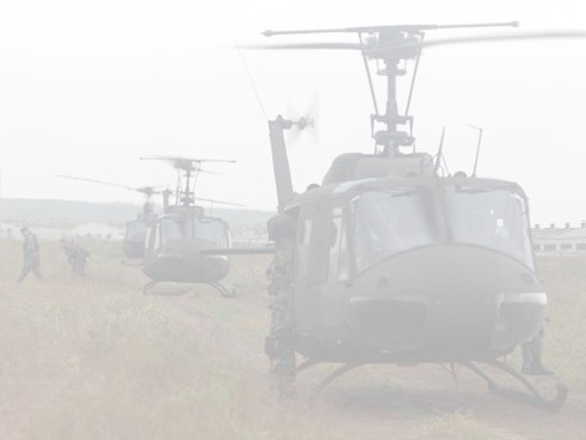
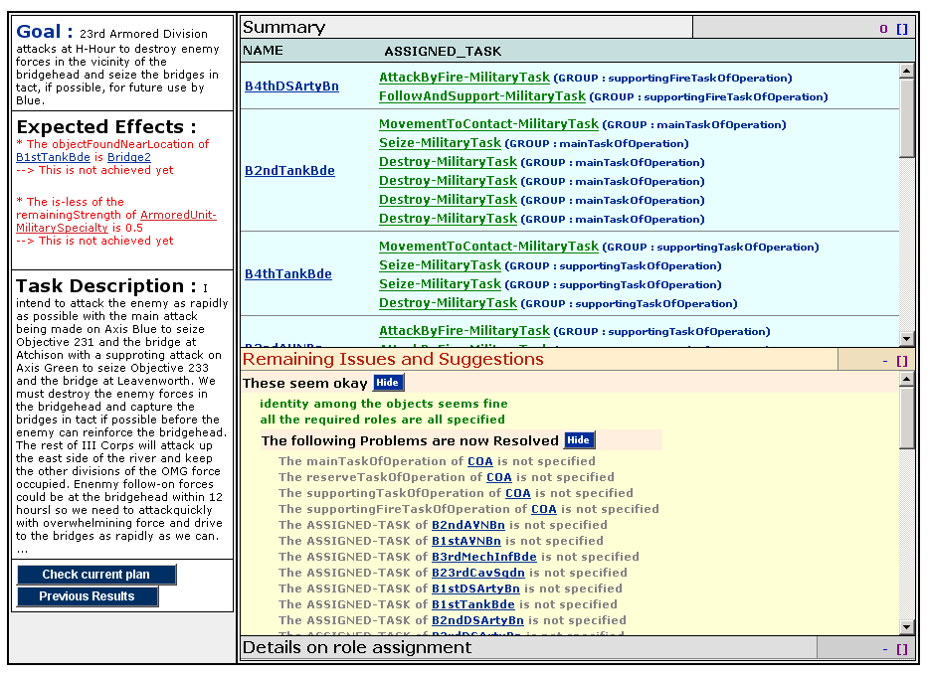
Dialog Window for Bridgehead COA
(from the final evalulation)
  Goal provides the purpose of the lesson
  User specified military tasks
  Expected effects can be extracted from commander’s intent and tested by KANAL
  User can inspect what system is understanding about the new knowledge
  User can view progress over time

Slide 2
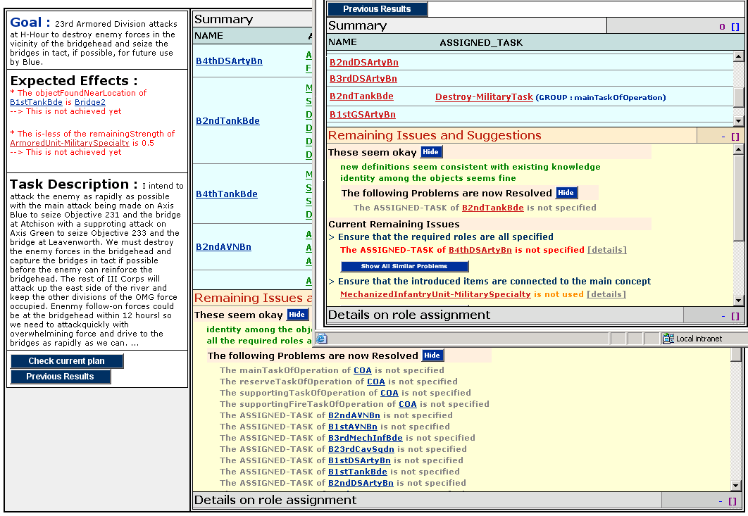
History: Progress Over Time

Slide 3
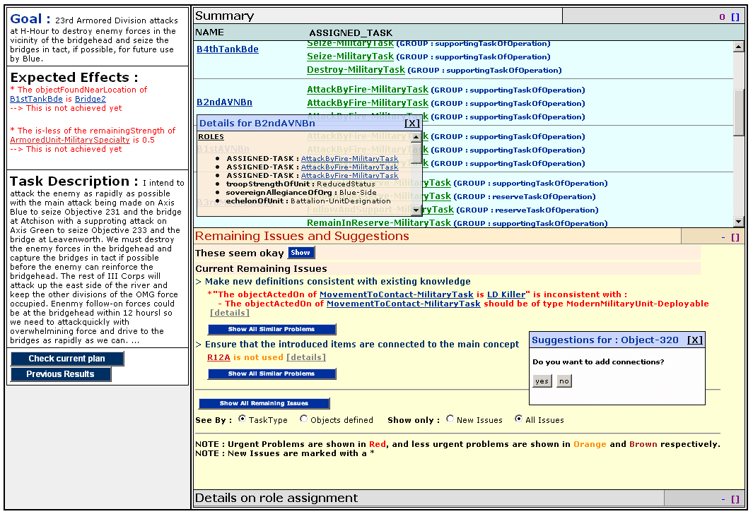
Remaining tasks
  User sees remaining entry tasks

