Slide 1
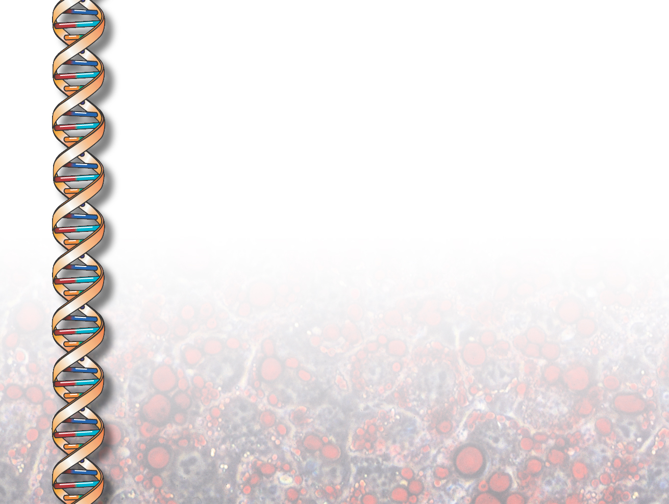
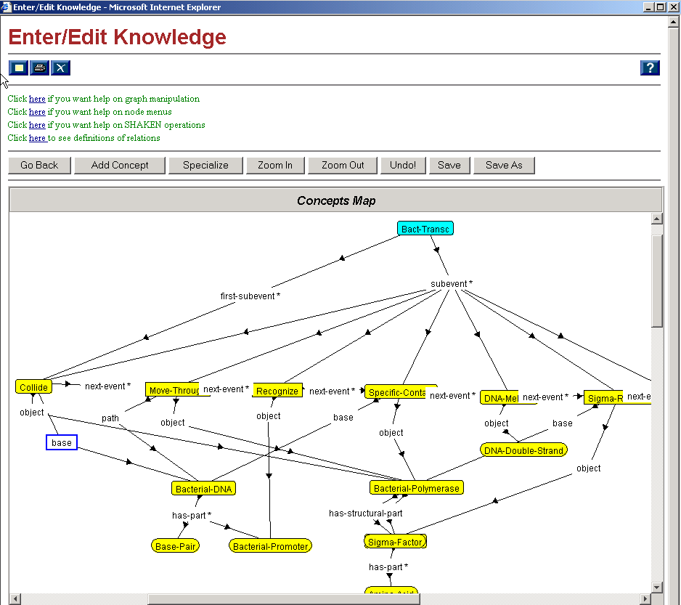
Entering biological process model

Slide 2
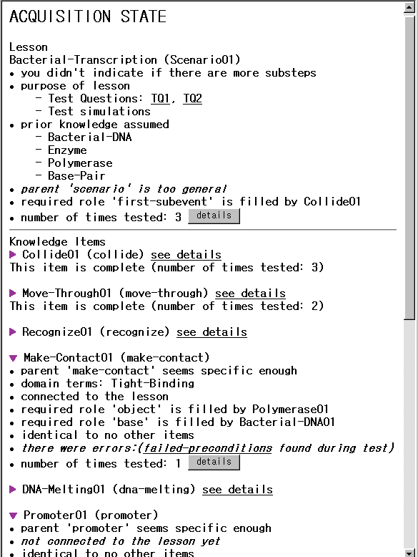
SLICK:
Annotated
Acquisition
State
Confidence
Competence
New acquisition goals
activated by the state

Slide 3
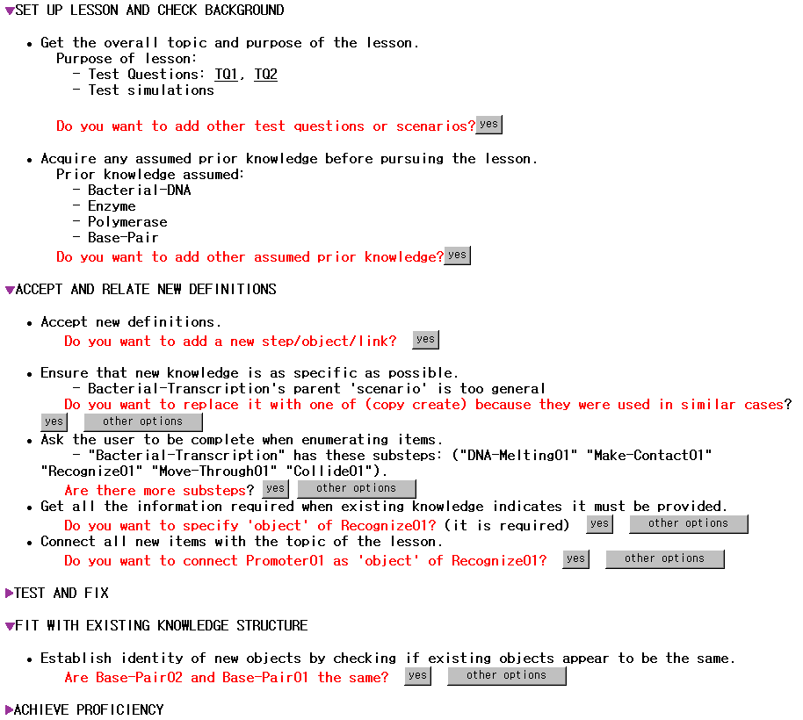
Dialogue is structured
as a thematic lesson
Gral acquisition principle
Specific acquisition goal
Educated guesses

Slide 4
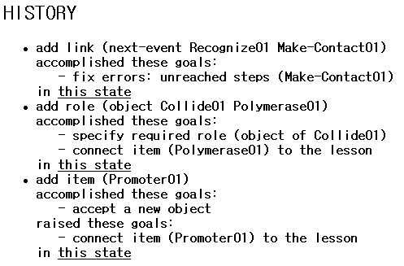
Awareness Annotations:
History
Shows user’s actions
and their effects in
accomplishing
acquisition goals
or raising new ones
User can view progress as
changes to the state

