Slide 1

SLICK:
Proactive Acquisition Dialog
Jihie Kim
Yolanda Gil
Varun Ratnakar

Slide 2
A Key Challenges in KA
Users remain largely responsible for the acquisition process
  Decide where, what, when, how, why to enter knowledge
  System checks errors, may have some short-term acquisition goals
Ideally, KA tools should have student-like skills:
  Formulate and pursue learning goals
  Keep track of lessons and progress
  Self-assessment of competence and confidence
  Supplement the user’s lack of teaching skills

Slide 3
Approach
KA tool should reason about tutoring and learning goals
KA tool should have awareness of
  Competence: What is known, what is unknown
  Confidence: What has been tested, what has been checked by the user

Slide 4




Deriving Acquisition Principles from Tutoring and Learning Principles
SYSTEM
USER
?
Instructional
Software
Good
Tutoring
Principles
teaches
Acquisition
Tool
Good
Learning
Principles
teaches
?

Slide 5
Tutoring and learning principles [Kim&Gil ITS-02]
Teaching/Learning principle | Tutoring literature
Start by introducing lesson topics and goals | Atlas-Andes, Meno-Tutor, Human tutorial dialog
Use topics of the lesson as a guide | BE&E, UMFE
Subsumption to existing cognitive structure | Human learning, WHY, Atlas-Andes
Immediate Feedback | SOPHIE, Auto-Tutor, Lisp tutor, Human tutorial dialog, human learning
Generate educated guesses | Human tutorial dialog, QUADRATIC, PACT
Keep on track | GUIDON, SHOLAR, TRAIN-Tutor
Detect and fix “buggy” knowledge | SCHOLAR, Meno-Tutor, WHY, Buggy, CIRCSIM
Learn deep model | PACT, Atlas-Andes
Learn domain language | Atlas-Andes, Meno-Tutor
Keep track of correct answers | Atlas-Andes
Prioritize learning tasks | WHY
Limit the nesting of the lesson to a handful | Atlas
Summarize what was learned | EXCHECK, TRAIN-Tutor, Meno-Tutor
Provide overall assessment of learned knowledge | WEST, Human tutorial dialog
Indicate lack of understanding | Human tutorial dialog, WHY

Slide 6
Tutoring and Learning Principles in existing KA Tools
Observation: Some learning and tutoring principles are used in some aspects of the dialogue by some tools
  Opportunity: Incorporate principles more thoroughly in all aspects of the dialogue
Observation: These principles are implicit in the tool’s code and thus are limited
  Opportunity: Exploit declarative representations of learning state, goals, and strategies

Slide 7
Tutoring and Learning Principles Implicit in KA tools [Kim & Gil CogSci-02]
Tutoring/Learning principle
Assimilate
Instruction
Trigger
Goals
Propose
Strategies
Prioritize
Goals & Strats
Design
Presentation
Introduce topics & goals
EXPECT, SEEK2
Use topics of the lesson as a guide
SALT
SEEK2
EXPECT
SALT
Subsumption to existing cog. structure
PROTOS
TEIREISIAS
PROTOS, SALT
Immediate feedback
PROTOS
INSTRUCTO-SOAR
TEIREISIAS
EXPECT
Generate educated guesses
TEIREISIAS
EXPECT
Keep on track
Indicate lack of understanding
INSTRUCTO-SOAR
INSTRUCTO-SOAR
Detect and fix “buggy” K
TAQL
EXPECT,CHIMERA
Learn deep models
Learn domain language
Keep track of answers
SEEK2
Prioritize learning tasks
EXPECT
Limit the nesting of lessons
Summarize what is learned
Assess learned knowledge
KSSn

Slide 8
Learning Awareness
KA tool should be capable of assessing:
  Competence: What is known, what is unknown
  Confidence: What has been tested, what has been checked by the user
System should steer the dialogue to improve KB in both counts

Slide 9
Competence and Confidence: Awareness Annotations
1) Annotations to the new body of knowledge:
  For each lesson: purpose, assumed background, sub-lessons, overall competence and confidence
  For each k item: connection to lesson, relation to other items, identity wrt other items, possible analogies and generalizations, domain terminology details, competence, confidence
  For each axiom of a k item: required information, generality, completeness, confidence
2) Annotations to the dialogue history:
  For each user action: changes to the annotations to the new knowledge, acquisition goals achieved and/or activated, possible future KA strategies

Slide 10
KA Dialogue Planning:
Viewing in a Lesson Structure
1) SET UP LESSON AND CHECK BACKGROUND
2) ACCEPT AND RELATE NEW DEFINITIONS
3) TEST AND FIX
4) FIT WITH EXISTING KNOWLEDGE STRUCTURES:
5) ACHIEVE PROFICIENCY
6) REACH CLOSURE ON LESSON

Slide 11
KA Dialogue Planning as Acquisition Goals
1) SET UP LESSON AND CHECK BACKGROUND:
  G1 : Get the overall topic and purpose of the lesson.
  G2: Acquire any assumed prior knowledge before pursuing the lesson.
2) ACCEPT AND RELATE NEW DEFINITIONS:
  G3: Accept new definitions
  G4: Ensure that new knowledge is specific as possible.
  G5: Ask the user to be complete when enumerating items in terms of the elements and in terms of the significance of the order given.
  G6: Get all the information required when existing knowledge indicates it must be provided.
  G7: Make all new definitions consistent with existing knowledge.
  G8: Connect all new items with the topic of the lesson.
3) TEST AND FIX:
  G9: Test the new body of knowledge and generate tests for the aspects that have not been thoroughly tested.
  G10: Fix problems that result from self-checks or from user's indications.
  G11: Ensure user checks the reason for the answers, not just the answers .
  G12: Confirm new answers that change in light of new knowledge over what the user had seen the answer to be earlier.

Slide 12
KA Dialogue Planning as Acquisition Goals (cont)
4) FIT WITH EXISTING KNOWLEDGE STRUCTURES:
  G13: Establish identity of new objects by checking if existing objects appear to be the same.
  G14: Generalize definitions if analogous things exist and there could be plausible generalizations.
5) ACHIEVE PROFICIENCY:
  G15: Acquire domain terms to describe new knowledge.
  G16: Learn to reason/generate answers efficiently and with shorter explanations.
6) REACH CLOSURE ON LESSON:
  G17: Ensure that the purpose/topics of the lesson were covered and the test questions appropriately answered.

Slide 13
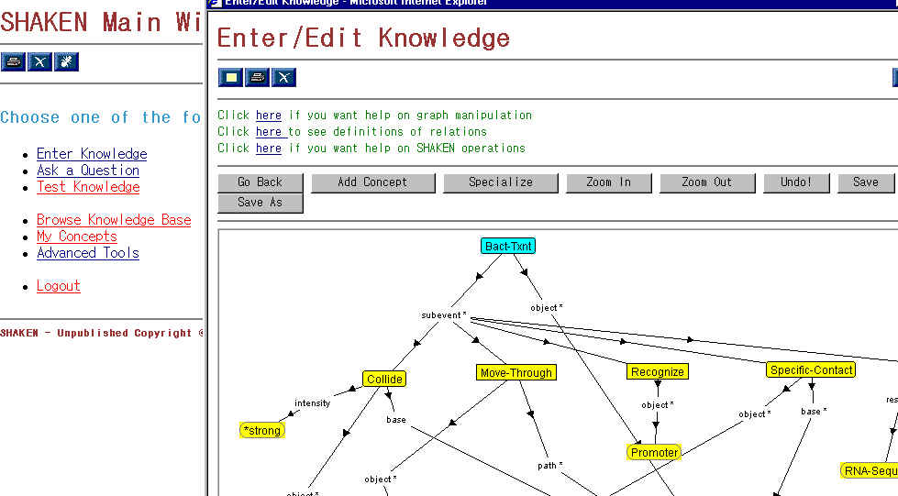
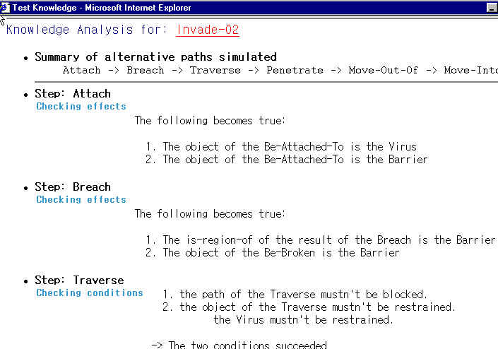
SLICK (Skills for Learning and Interactively Capture Knowledge)
Server
USER INTERFACE
KNOWLEDGE ACQUISITION BACKEND
KB
SLICK Dialogue Manager
Proactive
Dialogue
Window
Awareness
Annotations
Active Acquisition
Goals
&
Strategies
Tutoring
&
Learning
Principles
KB
State
Dial.
History

Slide 14
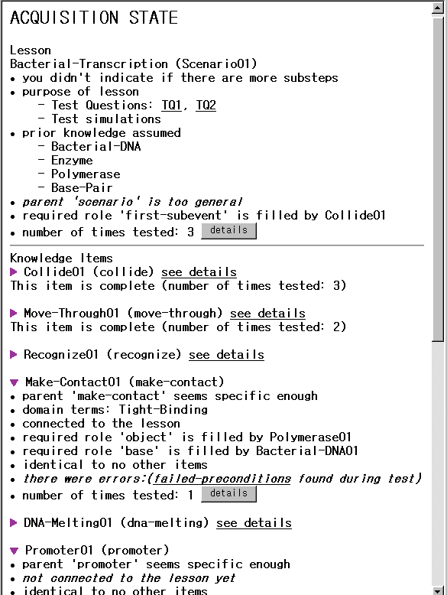
SLICK in SHAKEN:
Annotated
Acquisition
State
Confidence
Competence
New acquisition goals
activated by the state

Slide 15
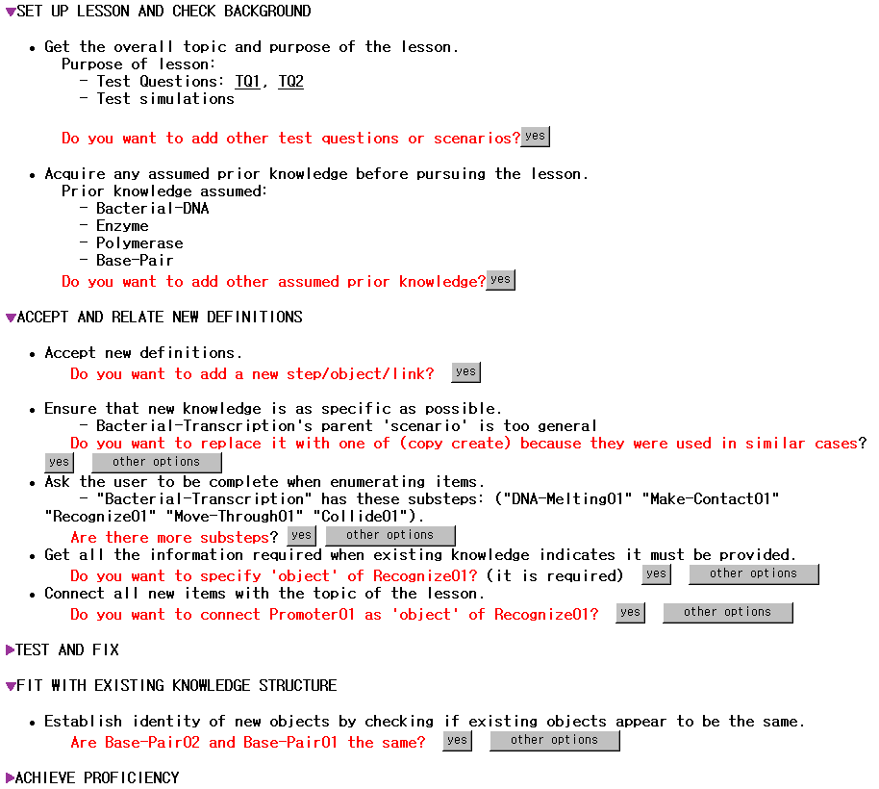
Dialogue is structured
as a thematic lesson
Gral acquisition principle
Specific acquisition goal
Educated guesses

Slide 16
Example:
Supporting the Acquisition of
COA (Courses of Action)

Slide 17
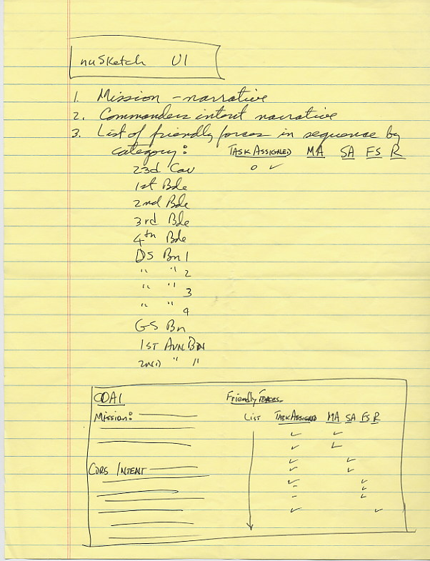
SME’s wishlist
See progress over time
plan summary table

Slide 18
COA entry with Acquisition Dialogue
Server
UI
nuSketch
translator
KB
KANAL
Q/A
SHAKEN
KA dialog
Window
NuSketch
Server
SLICK Dialogue Manager
Active Acquisition goals
Acquisition
principles
…
…
State & History
…

Slide 19
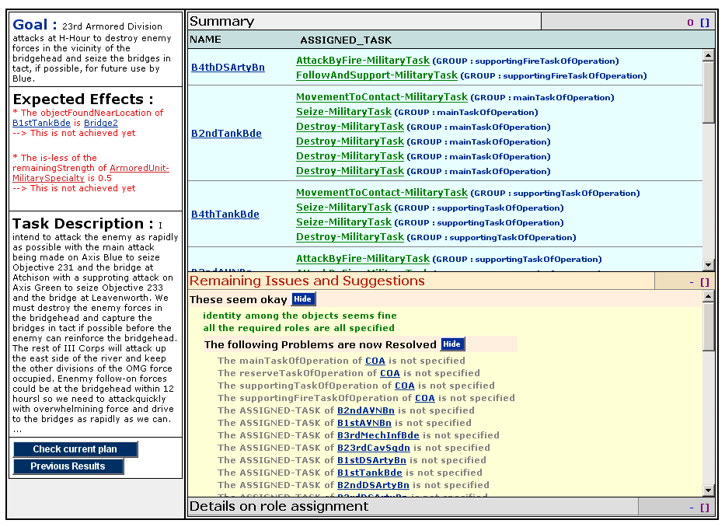
Dialog Window for Bridgehead COA
(from the final evalulation)
  Goal provides the purpose of the lesson
  User specified military tasks
  Expected effects can be extracted from commander’s intent and tested by KANAL
  User can inspect what system is understanding about the new knowledge
  User can view progress over time

Slide 20
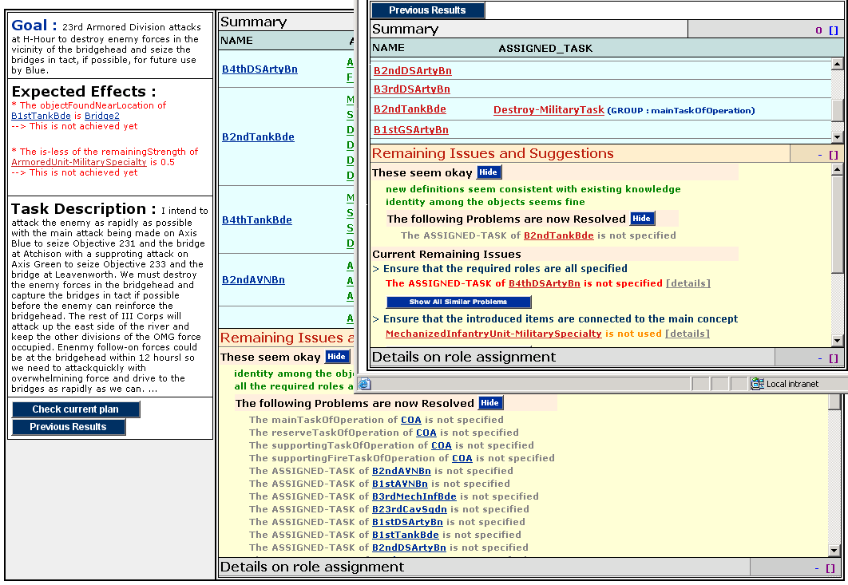
History: Progress Over Time

Slide 21
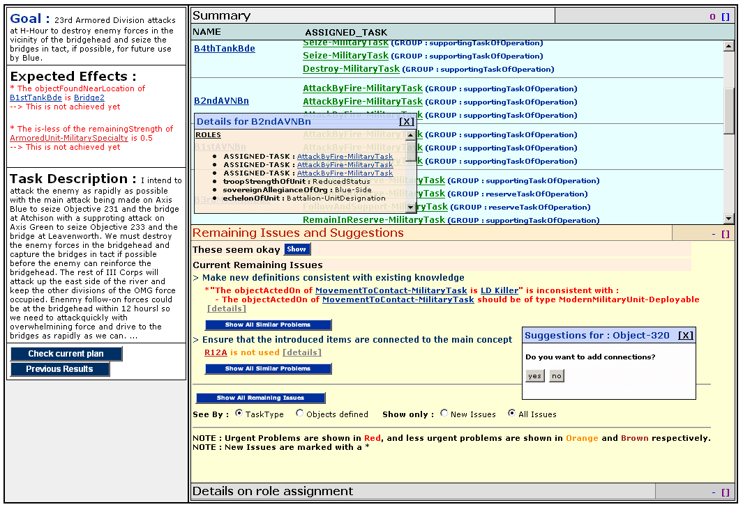
Remaining tasks
  User sees remaining entry tasks

Slide 22
Dialogue Items are derived from Acquisition Principles
SET UP LESSON AND CHECK BACKGROUND:
  G1: Get the overall topic goal (expected effects)
ACCEPT AND RELATE NEW DEFINITIONS:
  G4: Ensure that new knowledge is as specific as possible
  G5: Ask the user to be complete when enumerating items in terms of the elements and in terms of the significance of the order given.
  G6: Get all the information required when existing knowledge indicates it must be provided.
    Examples
    Every COA has mainTask, supportingTask, reserveTask, FireTask
    Each task has assigned units
  G7: Make all new definitions consistent with existing knowledge
    Examples
    For MovementToContact, the object should be militaryUnit
    For Follow-and-Support, the agent is military-unit and the base is Military-Unit whose allegiance is the same as the allegiance of the agent
  G8: Connect all new items with the topic of the lesson.
TEST AND FIX
  G9: Test the new body of knowledge and generate tests
FIT WITH EXISTING KNOWLEDGE STRUCTURE
  G13: Establish identity of new objects by checking existing objects
ACHIEVE PROFICIENCY
  G15: Acquire domain terms to describe new knowledge (using lexical entries)
REACH CLOSURE
  G17: Ensure that the purpose/topics of the lesson were covered
    check if all the expected effects are achieved

Slide 23
Future work
Full integration with Shaken
Ensure broad applicability
  COAs
  Biology concepts
  Modeling human behavior for military simulation
Improve current capabilities
  Exploiting additional KA strategies
  Handling subnesting of lessons

Slide 24
END

Slide 25
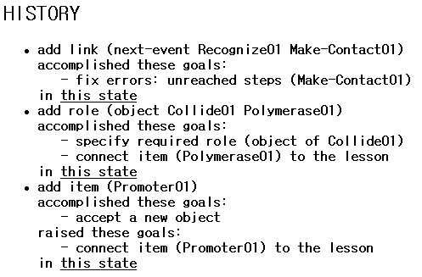
Awareness Annotations:
History
Shows user’s actions
and their effects in
accomplishing
acquisition goals
or raising new ones
User can view progress as
changes to the state

