Slide 1
TAILOR*:
Modifying Calo’s Procedure Knowledge through Instruction
Jim Blythe, Yolanda Gil, Jihie Kim
USC Information Sciences Institute
*Task Acquisition through Interaction in a Learning, Organizing assistant

Slide 2
Outline
Mapping user instruction to the procedure KB
Tailor Year 1 operational prototype in the Calo demo
Year 2: migrate to a robust system
  opportunities for group collaboration

Slide 3
Mapping user instruction to the procedure KB
User instructions may relate to several different kinds of knowledge:
  About objects, constraints, preferences, advice, procedures
Instructions about procedures must be aligned with existing procedure definitions
  Which procedure to modify, what predicates, variable bindings
  Follow-up questions to clarify or complete the instruction
A modification to a procedure will have ripple effects on other procedure definitions
Several possible modifications capture the same behavior

Slide 4
Different kinds of knowledge about procedures
Users need to update and customize the way tasks are accomplished by modifying:
  Object knowledge (Jim works at institution X on project Y)
  Preferences (normally prefer to purchase a ThinkPad)
  Constraints (the laptop cost must be below $3000)
  Procedure definitions
  purchase spare bulbs along with any projector
  get a visa when traveling out of the country
  you don’t need divisional authorization to purchase a PDA
  ask the user to make the choice when purchasing
  a laptop, but choose the cheapest option for pencils.
Procedure
knowledge

Slide 5
Must be able to modify procedure knowledge to handle all instruction
Some knowledge can be represented in separate advice structures, some needs to be encoded in the procedure definition
{defprocedure "Buy Laptop"
cue: [do: (purchase $item $criteria)]
precondition: (= laptop $item)
body:
[context: (and (User $user)
(Called $user $username))
seq: [do: (find_laptop $item $criteria $seln)]
[do: (complete_form req_form $this_form $seln)]
[do: (obtain_authorizations $this_form $seln)]
[do: (place_order $seln)]
[context: (= (list_index $seln 0) $pseln)
do: (print
" %s: *** Purchase of laptop %s completed "
[$username $pseln])]]}
{defprocedure "Buy Laptop“
….
body: [context: (and (User $user)
(Called $user $username))
seq: [do: (find_laptop $item $criteria $seln)]
[do: (complete_form req_form $this_form $seln)]
[select: (and (Computer_Total_Price $seln $val)
(< $val 2000))
do: (obtain_authorizations $this_form $seln)]
[do: (place_order $seln)] # Also modified by Tailor
[context: (= (list_index $seln 0) $pseln)
do: (print
" %s: *** Purchase of laptop %s completed "
[$username $pseln])]]}

Slide 6
TAILOR: Helping users modify procedure knowledge through instruction
Tailor takes user instructions and makes modifications to Spark’s procedure knowledge.
  Year 1 focus: modify existing procedures by adding conditions to subtasks.
Main challenges addressed:
  Maps user instruction to existing procedure knowledge based on the context (e.g. currently executing structures)
  Asks follow-up questions to help complete the instruction and resolve ambiguity

Slide 7
Overview of Tailor’s use in the Calo Year 1 demo
While purchasing a laptop, Calo warns the user of the approaching deadline for purchase authorization.
User: “You don’t need authorization, since the cost is less than $2000”
Tailor finds an interpretation based on the context and suggests it in user terms:
Tailor warns that more instruction may be needed: the subsequent ‘place order’ task has precondition ‘received authorization’ which may be false.
Tailor presents options complete the instruction, leading to a successful modification.
Candidate tasks/items:
Obtain all required authorizations
Get authorization from project manager
Conclude that authorization has been received
Modification:
make execution of <task>
depend on <condition>
Candidate conditions:
The cost of submitting the form < 2000,
The total price of the selected item < 2000,
The shipping cost < 2000, …

Slide 8
Key ideas in Tailor
Global Procedure Analysis (GPA):
  Captures the relationship between the procedures used.
  Provides context for mapping
  user instruction
  Detects side-effects of a modification
  indicating the instruction is incomplete
  Similar in spirit to Static [Etzioni 90]
  and Expect IMs [Kim & Gil 01]
Expression mapper:
Search for valid expressions that match the user’s instruction based on the current goals and activities (from the GPA), as well as domain objects and relations.
[Blythe, IJCAI 01; Blythe & Gil, WWW 04]
Purchase $item $criteria
$item = “laptop”
Find_laptop $item $criteria $selection
$selection has type Laptop
complete_form Requisition_form $form $selection
$form has type Form
obtain_authorizations $form $selection
Adds “received_authorization $selection”
get_authorization $manager1 $form
Stalling task
get_authorization $manager2 $form
place_order $selection
Requires “received_authorization $selection”

Slide 9
The GPA provides context for interpreting request based on Spark’s procedure knowledge
Spark sends Tailor the top-level goal, active tasks and information about the failure.
The GPA tracks how variables and stored predicates are formed and propagated as procedures are combined.
Purchase $item $criteria
Propagates variable types
$item = “laptop”
Find_laptop $item $criteria $selection
$selection has type Laptop
complete_form Requisition_form $form $selection
$form has type Form
obtain_authorizations $form $selection
Adds
“received_authorization $selection”
Models the subgoal/
subtask structure
Stalling task
get_authorization $manager1 $form
Represents information dependencies across tasks
get_authorization $manager2 $form
place_order $selection
Requires “received_authorization $selection”

Slide 10
The expression mapper finds valid, matching expressions based on the context and domain KB
User description: “you don’t need form B when the seller is in the US”
Tailor finds the matching expression: (and (vendor $selection $v) (location $v US))
Shown as: “when the location of the vendor of the selected laptop is the US”
Variable and description from GPA
Synonym
from
WordNet
laptop
Vendor
vendor (syn: seller)
0:$selection (GPA)
“the selected laptop”
0:
1:(Vendor $sel’n $v+)
Object from user instruction
HasDisplay
ComputerTotalPrice,
ShippingCost, RAM, …
Location
display
0:
1:(HasDisplay $sel’n $d+)
DialCode
place
Size
number
0:US (user)
1:
match
0:
1:(Price $sel’n $p+), ..
2: (and (HasDisplay $sel’n $d)
(Size $d $s)), ..
2:(and (Vendor $sel’n $v)
(Location $v US))
<, >,
…

Slide 11
The expression mapper: under the hood
Initially: Tailor builds a graph of concepts linked by relations.
  Concepts and relations found from Spark terms and related ontology
The GPA is used to determine the procedures to modify based on the user’s instruction and the problem-solving context.
Initial expressions are added from the GPA and the user’s instruction.
On each iteration: the mapper sweeps through the graph to form new expressions from existing ones by following links.
Expressions are matched to user instruction based on the relation names used, phrases for variables from the GPA and synonyms from WordNet. Plausible matches are ranked by:
  (1) number of terms matched (attempts to match all)
  (2) ordering of terms closest to that of the user instruction,
  (3) least use of synonyms.

Slide 12

Tailor Architecture
Procedure
KB
Task
models
Domain facts,
Relations,
concepts
SPARK
Year 1
additions
OAA
OAA
Tailor
Calo
GUI
OAA
Global
Procedure
Analysis (GPA)
Modification
analyser
MMD
User
Follow-up
questions
Expression
completion
and mapping
Parser
WordNet

Slide 13
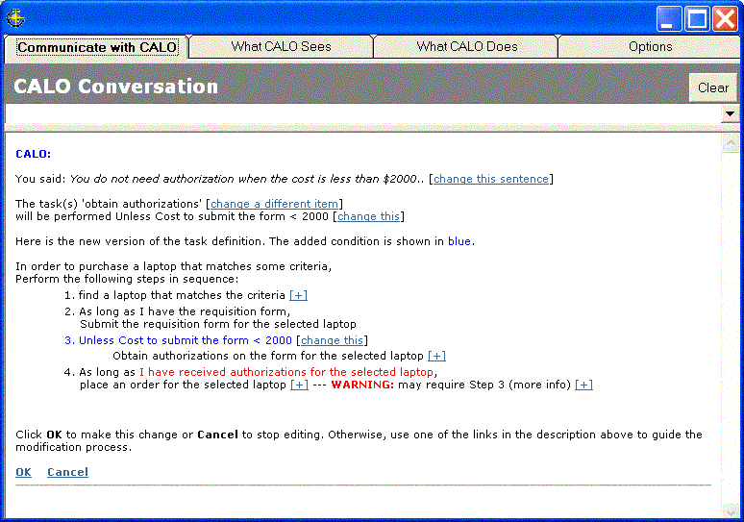
Ensuring Tailor’s interpretation of the user’s instruction is correct
User can choose among alternative tasks to change from the modification analyser
Summarizes the proposed change
User can choose among alternative interpretations from the expression mapper
Warns the user of unintended side-effects detected through the GPA
Shows the new procedure knowledge

Slide 14
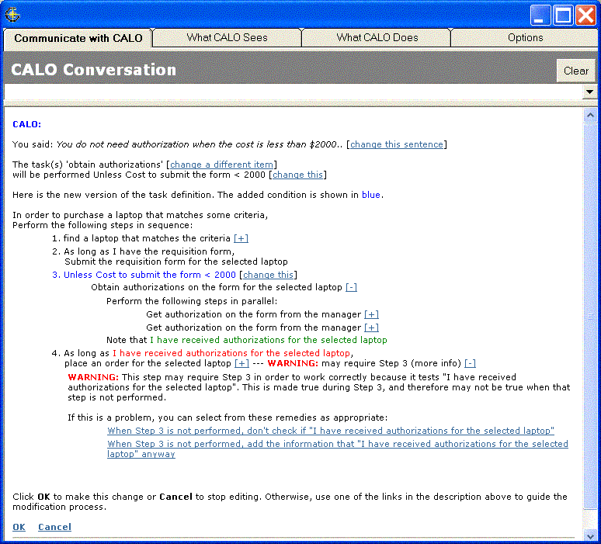
Helping the user complete the instruction
Describes the unintended side-effect
suggests potential fixes

Slide 15
Summary of year 1 system
Tailor helps users modify Spark’s procedure knowledge based on instruction.
  Modified procedures are executed on the fly by Spark.
Tailor combines analysis of procedures and domain knowledge
  to map user instruction to procedure knowledge modifications
  to resolve ambiguity
  to help the user complete the instruction
Interacts with the user when more knowledge is needed
  Generates text versions of procedure definitions, problems and fixes.

Slide 16
Plans for year 2
Broader range of simple modifications
  Adding a new, known subtask to a procedure body
  Alternatives for subtasks under certain conditions
More support for completing instructions
  Parameters missing for new subtask
  Weakened preconditions not matched by sub-procedures
Explicit reasoning about alternative modifications
  Modify a procedure? Clone a procedure? Add explicit advice?
  Which procedure to modify?

Slide 17
Areas of potential MMD impact
Recognize more sentences as instructions about procedure knowledge
Use context of overall dialog for mapping instructions
Integrate instruction and follow-up questions about modifications into the overall dialog
  Better rendering of feedback and follow-up questions
…

Slide 18
Beyond year 2
Defining new procedures with several subtasks
Complex procedures with many related changes
  E.g. change of representation requiring a global modification
Handling all of Spark’s language
  Try this first, then try an alternative if it fails
  Wait X minutes, if you don’t get a reply then call
Using previous experience
  Detect and resolve inconsistencies in advice
  Guidance from previous cases
  Induction bias, analogy, transfer, learning from few examples, ..

