Slide 1
Use Scenario of
JIST Version 3.0.2 Capabilities:
Storyboard for Dossier Building
Prepared by:
Jihie Kim
Yolanda Gil
Varun Ratnakar
Tim Chklovski
USC/Information Sciences Institute
jihie@isi.edu
October 09, 2005
NOTE: These slides focus on the current capabilities of JIST Version 3.0.2.

Slide 2
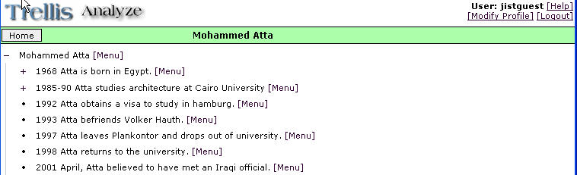
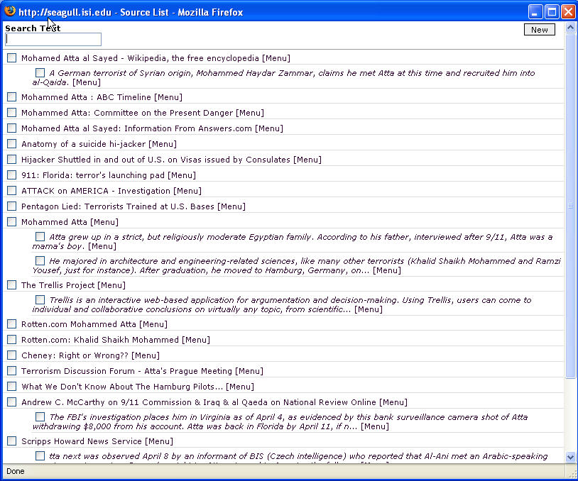
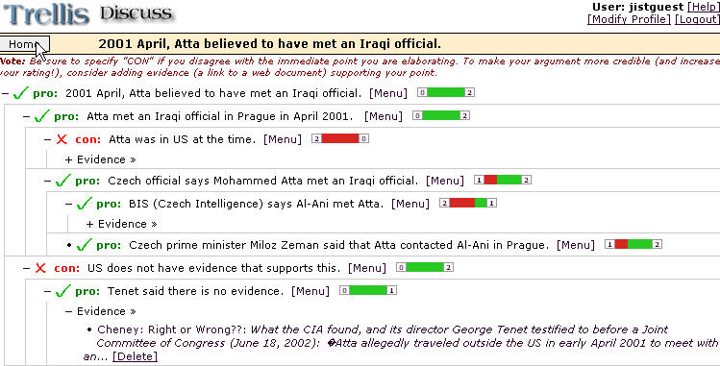
Example of a Final JIST Dossier
Dossier Subject
Dossier statements
Contradictory evidence analyzed in collaboration with other analysts
Source documents and their selected portions.

Slide 3
Storyboard Outline:
Main Steps in Creating a Dossier
1. Start a New Dossier
2. Create Dossier Statements
3. Add and Use Sources
4. Prompt Collaboration:
4-A. Assess Conflicting Evidence through Pro/Con Analysis
4-B. Compare Multiple Options/Scenarios through Table-Based Analysis
5. Self-Contained Portable Final Report
6. Detailed Metrics and Final Summary Generation

Slide 4
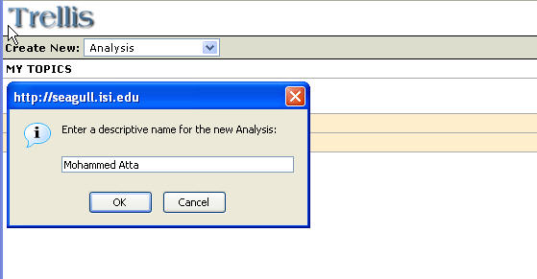
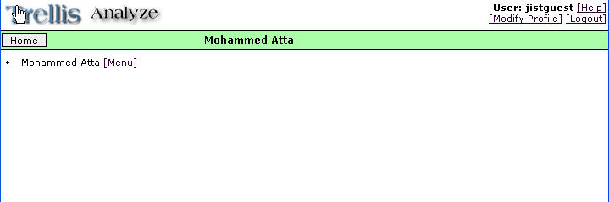
1. Start a New Dossier
Create a new
Analysis on
‘Mohammed Atta’

Slide 5
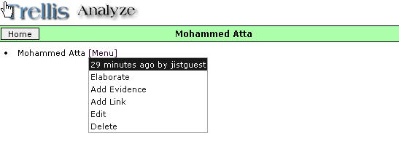
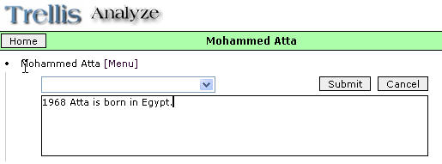
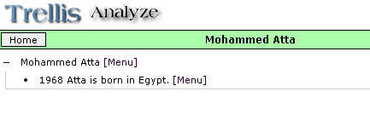
2.1 Create Dossier Statements
A statement created
for ‘Mohammed Atta’.

Slide 6
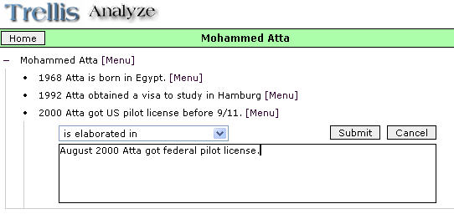
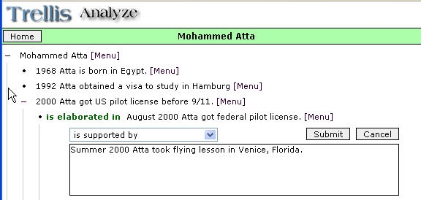
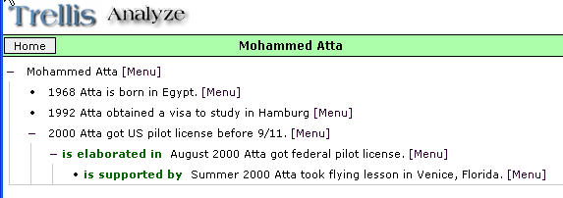
2.2 Create Composite Statements

Slide 7
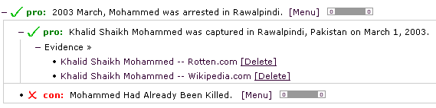
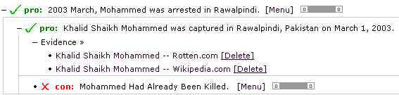
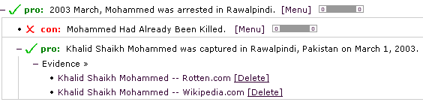
2.3 Drag and Drop Statements
Move before a statement
Move ‘into’ a statement: The statement has a new parent.
The ‘Help’ button has more details on copy/cut/drag and paste facilities.

Slide 8
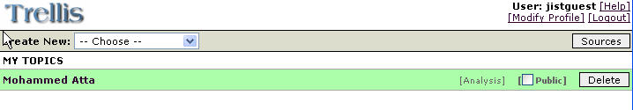
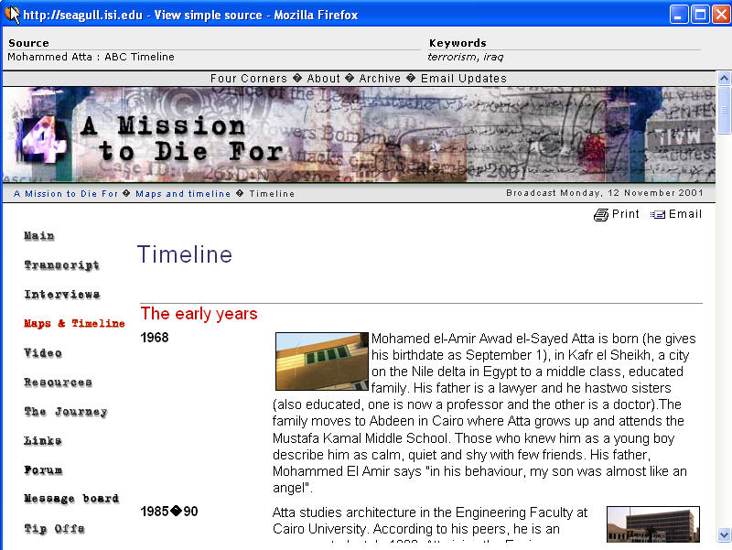
3. Add and Use Sources
3.1 Use of ‘Pre-Cashed’ Web Sources
Viewing the selected source document

Slide 9
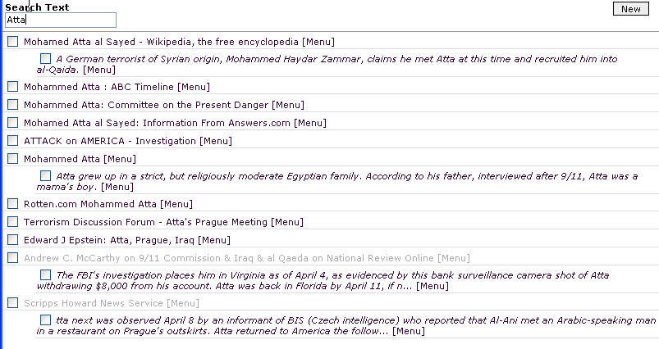
3.1.1 Search sources and source portions with a keyword

Slide 10
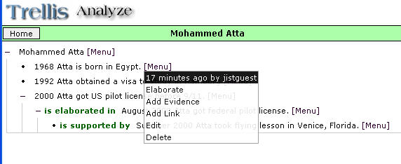
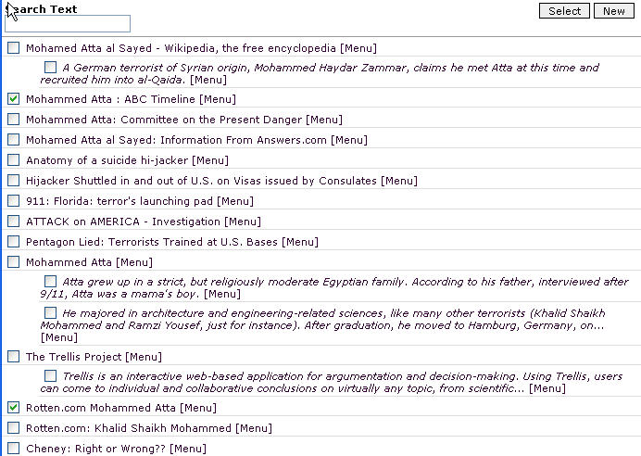
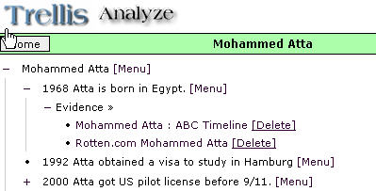
3.2 Specify Sources As Evidence
Sources are selected from the Source List.

Slide 11
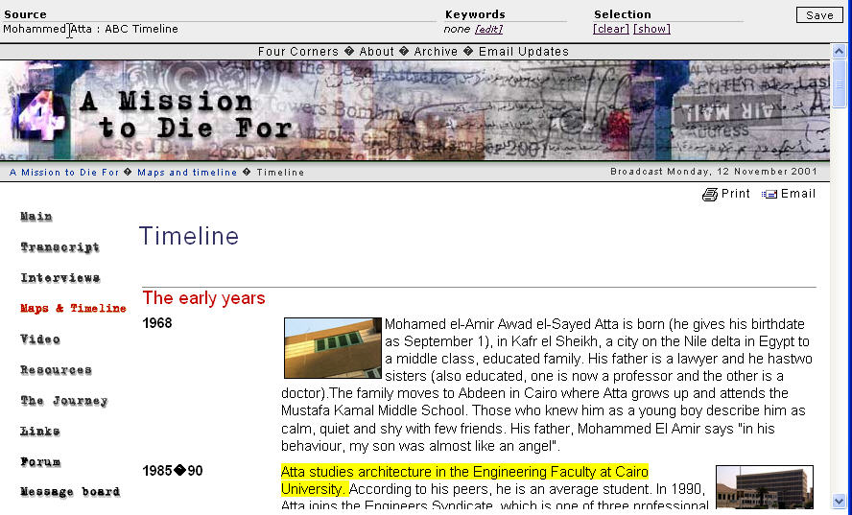
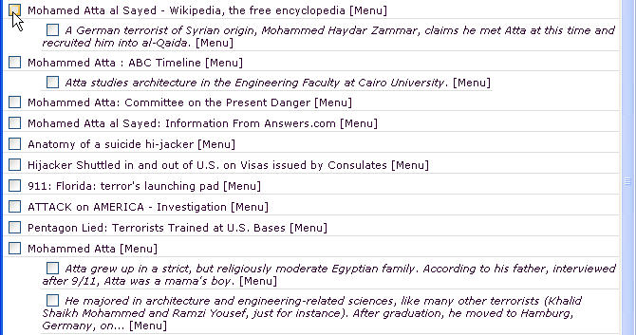
3.3 Select a portion of a source document
Select ‘Select Portion’
from the menu
Text selected from source document by highlighting portions of it

Slide 12
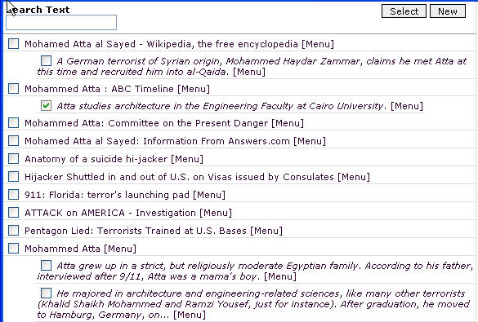
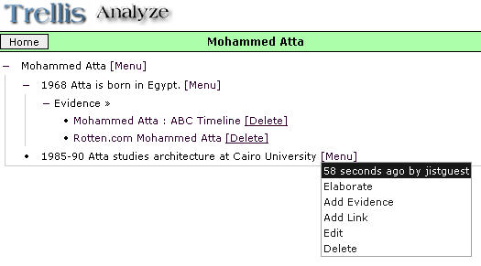
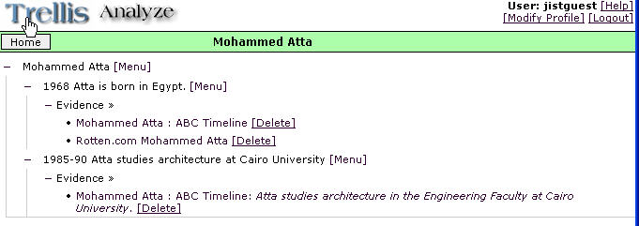
3.4 Specify a portion of a source document as evidence
A source portion can also be dynamically added to the source list during ‘Add evidence’.

Slide 13
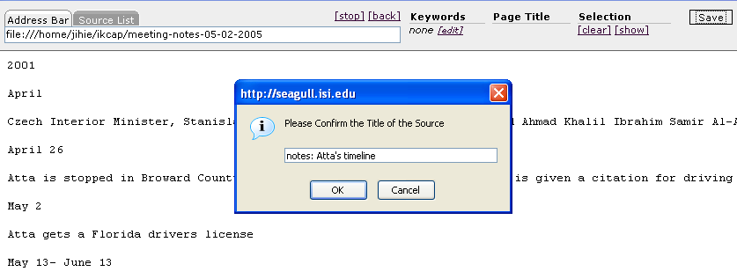
3.5 Add New Sources from Local Files
NOTE FROM DAVID FADO
The version for RDEC includes the capability to handle documents from a local file store
  This allows for an experiment that has a limited set of information with known issues and “ground truth”

Slide 14
3.6 Adding Source Ratings
Coming Soon…
NOTE FROM DAVID FADO
This feature will not be needed for this scenario, but it is a capability that JIST can provide, especially for a system that is used over a long period of time.

Slide 15
4. Provoke Collaboration
4-A. Assess conflicting evidence
through pro/con analysis
4-B. Compare multiple options/scenarios
through table-based analysis

Slide 16
4-A Provoke Collaboration:
Assess Conflicting Evidence
4-A.1. Marking Controversial Statements in a Dossier
4-A.2. Collaboration and Evidence Collection
4-A.2.1 Analyst Enters Initial Supporting/Contradicting Statements
4-A.2.2 Provoke Collaboration: Send Requests to Other Analysts’ Desktop
4-A.2.3 Other Analysts Enter Additional Statements and Sources as Evidence
4-A.2.4 Analysts Vote on Statements Using Color Bars
4-A.3. Review Contributions from Other Analysts
4-A.4. Check System’s Summary of Collaboration and Evidence Collection.

Slide 17
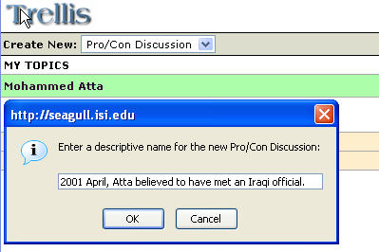
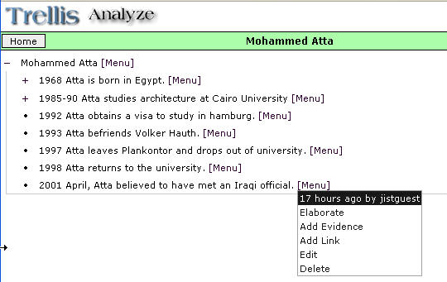
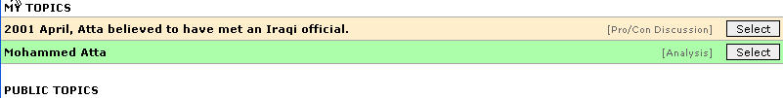
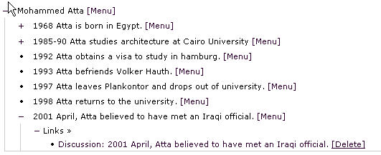
4-A.1 Marking Controversial Statements in a Dossier
Create a Pro/Con Discussion
Mark a controversial statement
or add a link to other analyses
The selected pro/con
discussion is linked to a
dossier statement

Slide 18
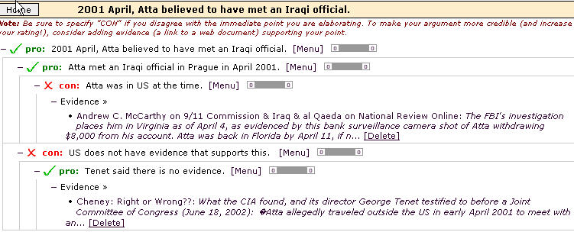
4-A.2.1 Analyst Enters Initial Supporting/Contradicting Statements
Analyst enters supporting and contradicting statements and evidence
Single seamless collection of sources are used across the main Analysis and Pro/Con Discussion

Slide 19
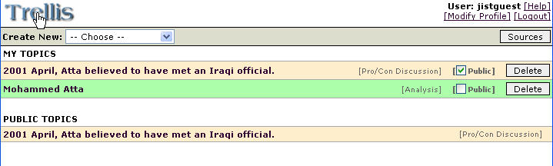
4-A.2.2 Provoke Collaboration: Send Requests to Other Analysts
Current implementation: Make the pro/con discussion public to other analysts
Private topics.
Topics for collaborative discussion.
The topic becomes public.

Slide 20
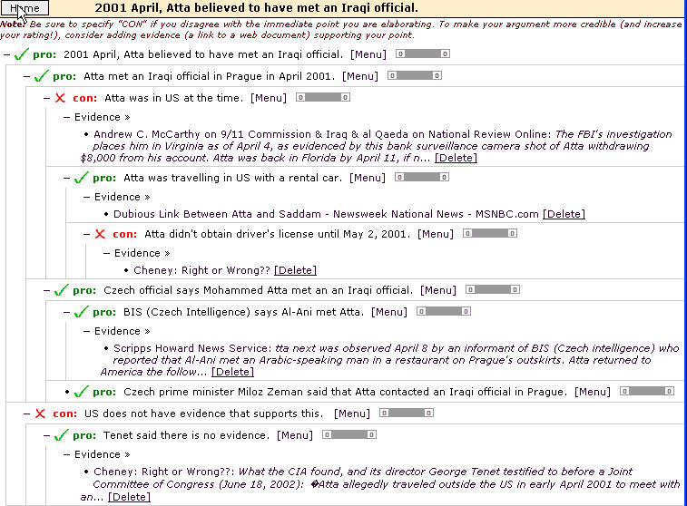
4-A.2.3 Other Analysts Enter Additional Statements and Sources as Evidence

Slide 21
4-A.2.4 Analysts Vote on Statements Using Color Bars
2 yes votes and 1 no

Slide 22
5. Self-Contained Portable Analysis
Coming soon…
NOTE FROM DAVID FADO
JIST stores all analysis in a form very friendly for sharing and collaboration. While this is not a feature exercised in this scenario, it is a capability that makes JIST a compelling general platform for polling in a distributed analytical environment.

Slide 23
6. Detailed Metrics
Event
  who: analyst
  when: time
  action: enter/modify/delete
  object: sources, statements, features, vote, …
Analysis Details
- statements entered
- sources used
details on assessment of controversial stmts
- depth & breadth of the trees
- number of sources for supporting/opposing stmts
- each vote
…
A summary generation capability is coming soon…

Slide 24
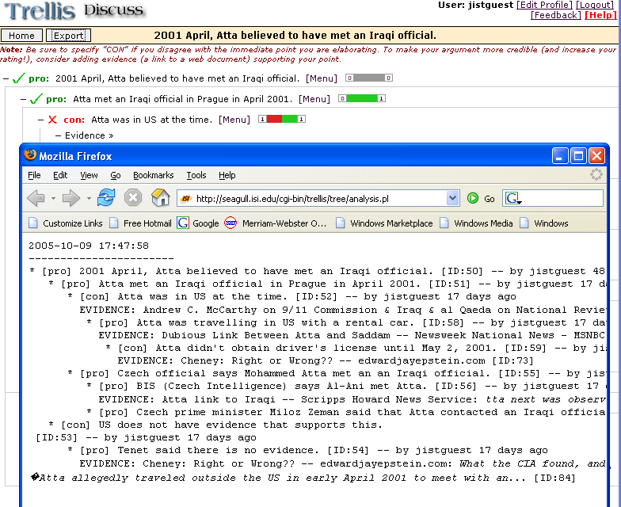
6.1 Record a Snapshot of an Analysis

Slide 25
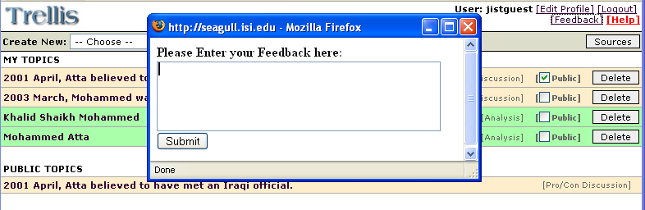
7. Get User Feedback
JIST records analyst comments and feedback.

Slide 26
Update from Version 3.0.1
2.3 Drag and drop statements
3.5 Add new sources from local files
6. Improved Instrumentation
6.1 Record a snapshot of an analysis
7. Get user feedback

Slide 27
Capabilities to be added
3.6 Add source ratings
4-A.4. Summary of Collaboration and Evidence Collection.
5. Self-Contained Portable Analysis
6. Generation of overall summary

