Slide 1
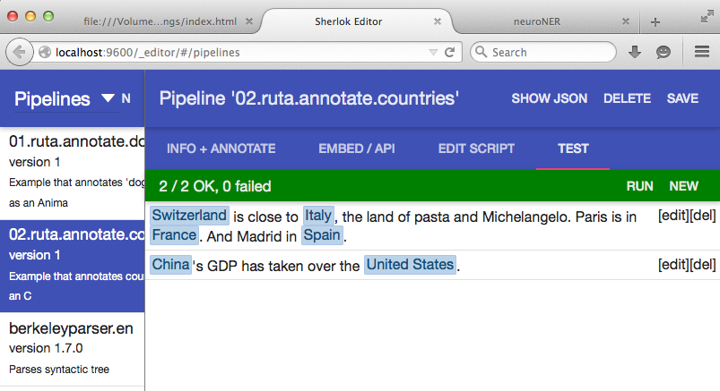
Sherlok: architecture
HTML5 editor
Sherlok manager
REST service
bundles (CRUD) (deps, engines)
pipelines: CRUD
Javascript client
UIMA
engine
annotate
Python client
Java client
rules,
resources,
models
…

Slide 2
Sherlok: deployment
Sherlok
master
instance
Sherlok
slave
instance
Sherlok
slave
instance
Sherlok
slave
instance
Sherlok
slave
instance
Sherlok
slave
instance
. . .
Load Balancer

