Slide 1
Malicious URL Detection System
Capstone Project | By Louis Knox
Date: July 2025

Slide 2
Project Overview
Objective: Use machine learning to automatically identify malicious URLs.
Assists users in avoiding phishing attempts, scams, and harmful websites.
The model was trained on approximately 1 million URLs using XGBoost.

Slide 3
Problem Statement
Cybersecurity threats often use deceptive URLs.
Manual checking is inefficient and error-prone.
We need an automated, reliable classification tool.

Slide 4

Dataset Description
Combined multiple datasets: OpenPhish, PhishTank, etc.
Balanced dataset of malicious and benign URLs.
Final cleaned dataset has ~1 million entries.

Slide 5

Feature Engineering
Extracted features from each URL such as:
- URL length
- Number of digits and special characters
- Presence of IP, '@' symbol, suspicious keywords
- Subdomain count, use of shortening services

Slide 6
Model Training
Chosen model: XGBoost – fast, accurate, handles tabular data well.
Trained using scikit-learn + joblib for saving.
Evaluated using accuracy, precision, recall, F1-score.

Slide 7
Model Results
Accuracy: ~76%
Precision and recall optimized to reduce false positives.
Visualized using confusion matrix and feature importance.

Slide 8
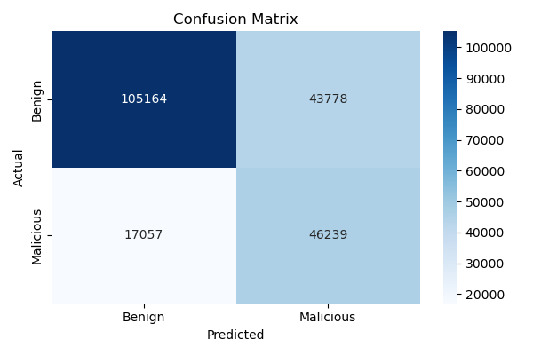
Model Results Cont.
The confusion matrix visualizes the performance of the XGBoost model in classifying benign and malicious URLs.
True Positives (Malicious correctly identified): 46,239
True Negatives (Benign correctly identified): 105,164
False Positives (Benign misclassified as malicious): 43,778
False Negatives (Malicious misclassified as benign): 17,057 This shows the model has strong recall for both classes but still faces some false positive/negative trade-offs.

Slide 9
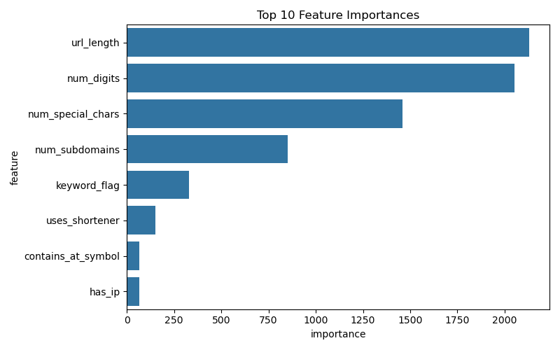
Model Results Cont.
The most influential factors are the length of the URL, the number of digits, and the number of special characters.
Other important indicators include num_subdomains, presence of suspicious keywords, and use of URL shorteners.

Slide 10
Deployment on AWS
Used Flask to create REST API with endpoints:
- /predict (single URL)
- /batch_predict (multiple URLs)
- /health, /model_info
Deployed to AWS EC2 (Free Tier).

Slide 11
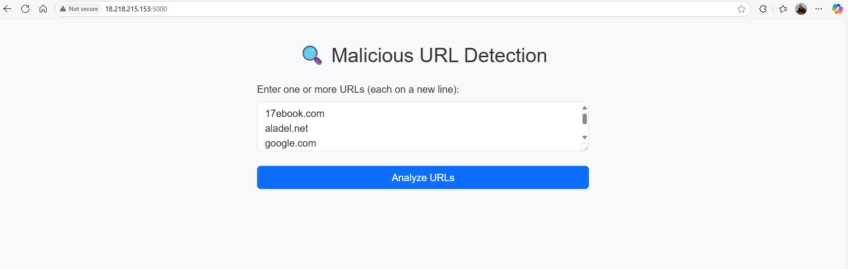
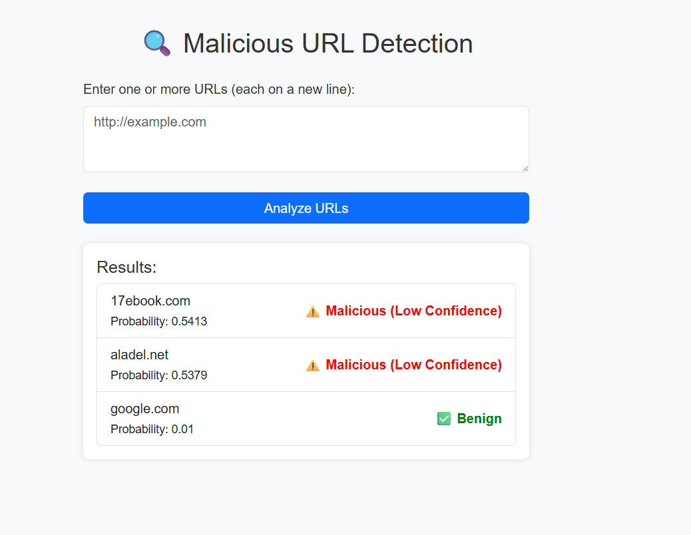
Web UI (Optional Frontend)
A user-friendly HTML interface for real-time testing.
Displays prediction results, labels, and probabilities.
Logs predictions and errors for further review.

Slide 12
Enhancements Added
Trusted domain whitelist (e.g., google.com)
Suspicious threshold range (0.4–0.7)
Logging to JSONL with error handling
Health check and model information routes

Slide 13
Challenges & Lessons
Dealing
Addressing issues related to unbalanced data and reducing false positives.
Tuning
Adjusting thresholds to achieve more reliable results.
Learning
Understanding the complete end-to-end pipeline: data collection → model development → API integration → user interface design.

Slide 14
Conclusion & Future Work
Developed a functional malicious URL detection system.
Deployed and tested through an API and web interface.
Future plans include enhancing accuracy with additional features such as domain age, language models, and WHOIS data.

