Slide 1
ARIMA Forecast for U.S. Construction Spending Construction Industry Research & Policy Center The University of Tennessee Edward L. Taylor February 2016

Slide 2
Introduction
Me - BZAN graduate student since 2010
Economics: Limdep, SAS, and Stata
Business Analytics: JMP, SAS, NCSS, and R
Stick with R – powerful and free
Notes:
Melvin Tobias

Slide 3
Agenda
Show the fundamentals of a time series forecast model in R
ARIMA(0,1,0)(0,1,0)[12]
Illustrate the functionality of the R commands decompose {stats}, auto.arima {stats}, & forecast.Arima {forecast}
Provide sources of free information about time series analysis in R

Slide 4
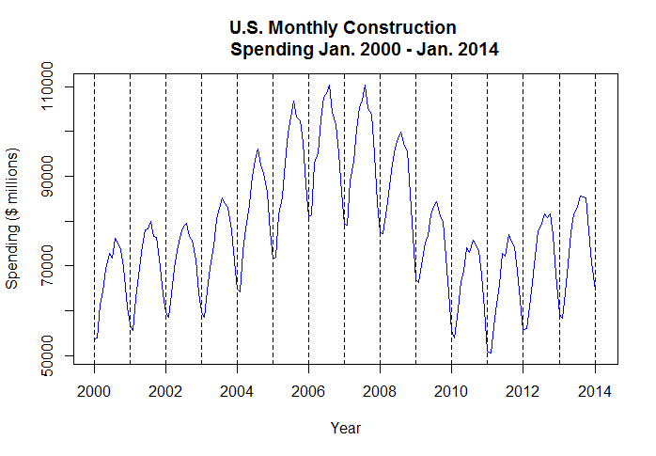
Monthly Time Series Federal Reserve Economic Data
Spend.ts <- ts(Spend$TTLCON, start = c(2000,1), end = c(2014,1), frequency = 12)
plot.ts(Spend.ts, ylab = "Spending ($ millions)", xlab = "Year", main = "U.S. Monthly Construction Spending Jan. 2000 - Jan. 2014", col="blue")

Slide 5

Forecast Result
Using the powerful open source package R and an
iterative fitting process, I fit a
parsimonious seasonal random walk mod model with residual white noise.
ARIMA (0, 1, 0) (0, 1, 0)[12]
The model was the best fit given the complex nature of the time series and the constraint of achieving residual
white noise.

Slide 6
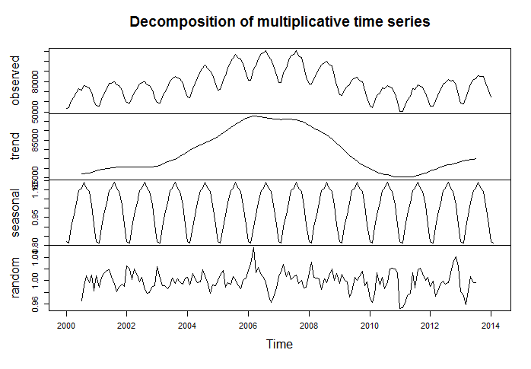
R Function – decompose{stats}
plot(decompose(Spend.ts, type="mult"))

Slide 7
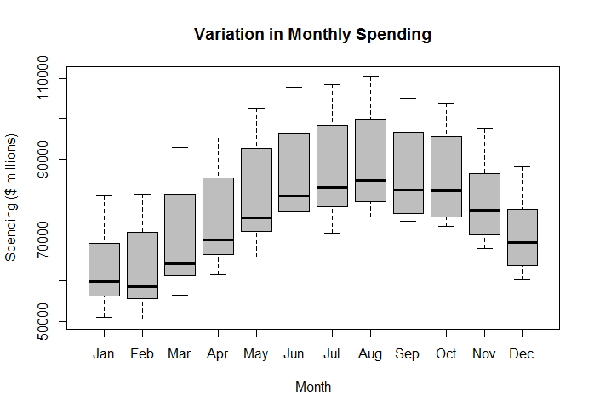
Seasonality Box Plot
boxplot(Spend.ts ~ cycle(Spend.ts), xlab = "Month", ylab = "Spending ($ millions)", xlab = "", main= "Variation in Monthly Spending", xaxt="n", col="gray")axis(1,at=1:12, labels=c("Jan","Feb","Mar","Apr","May","Jun","Jul","Aug","Sep","Oct","Nov","Dec"))

Slide 8
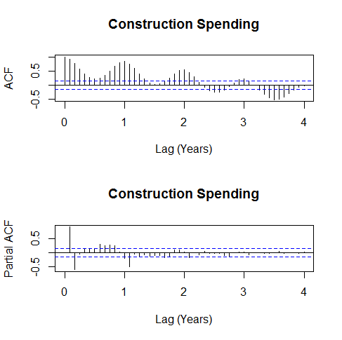
Acf / Pacf{stats}
acf(Spend.ts, cex =0.5, xlim = c(0,4), lag.max=48, xlab= "Lag (Years)", main = "Construction Spending")
pacf(Spend.ts, xlim = c(0,4), lag.max=48, xlab = "Lag (Years)", main = "Construction Spending")

Slide 9
Consistent AIC (AICc)
To avoid over-parameterization, the consistent Akaike Information Criteria (AICc)* can be used.
*Bozdogan, Psychometrika, 1987
OCCAM’S RAZOR
The goal in using consistent AIC is to choose the most parsimonious “true” model.

Slide 10
R Function - auto.arima{forecast} max: ARIMA(5,5,5)(5,5,5)
Using the R function, auto.arima, in the forecast library and AICc the selected model is:
ARIMA (0,1,0) (1,1,2)[12]
Note: the seasonal portion of the model two MA parameters and an AR(1) term - not parsimonious.
AICc = 2515
# Use auto.arima function in the forecast package
library(forecast)
library(ggplot2)
auto.arima(Spend.ts, ic=c("aicc","aic","bic"))

Slide 11
Another candidate
Using the log transformation, selection based on conditional sum of squares, and a constraint of maximum order 1; the model is:
ARIMA (0,1,0) (1,0,0)[12]
Note: the seasonal portion of the model is AR(1) w/ AICc = 2950. A parsimonious model.

Slide 12
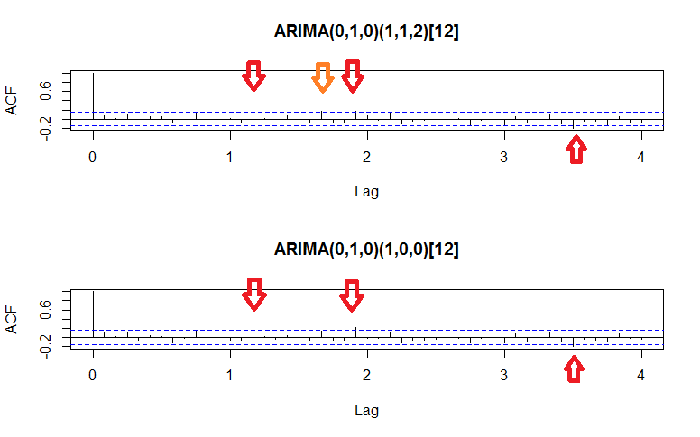
WHITE NOISE? ACF of Residuals For Both Candidates

Slide 13
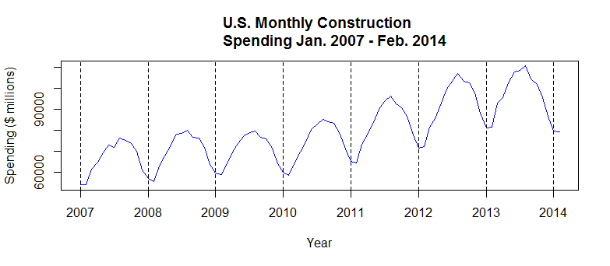
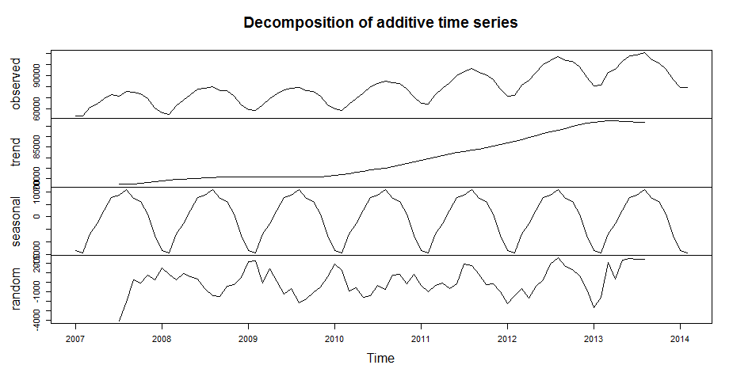
Monthly Time Series - Abbreviated

Slide 14
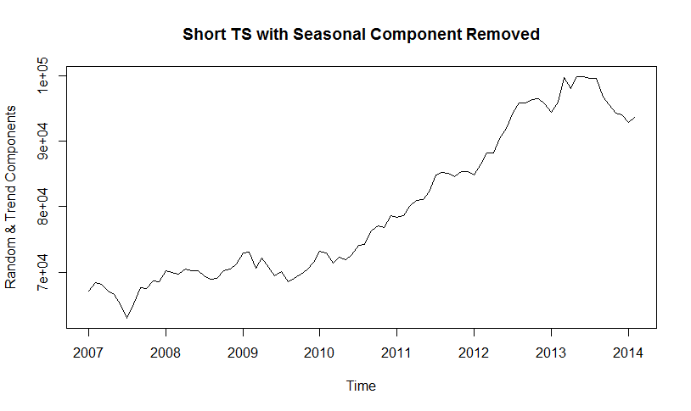
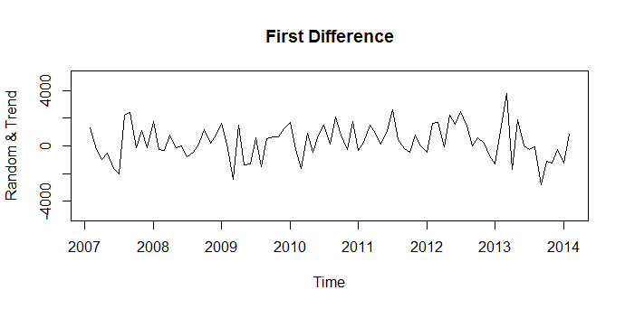
Abbreviated Series w/o Seasonality Non-Stationary

Slide 15
Begin Fit of Abbreviated Series
> Short.fit <- auto.arima (Short.Spend.ts)
> Short.fit
Series: Short.Spend.ts
ARIMA(0,1,0)(0,1,0)[12]
sigma^2 estimated as 1675734: log likelihood=-626.69
AIC=1255.38 AICc=1255.44 BIC=1257.67

Slide 16
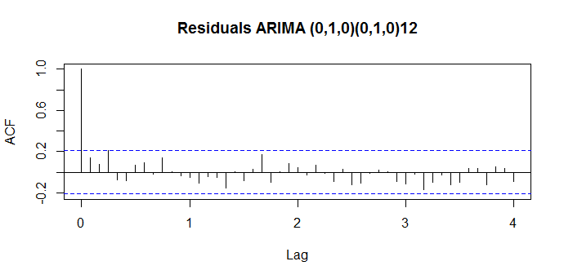
Abbreviated series White Noise ?
Box-Ljung test
data: Short.fit$residuals
X-squared = 1.7974, df = 1, p-value = 0.18

Slide 17
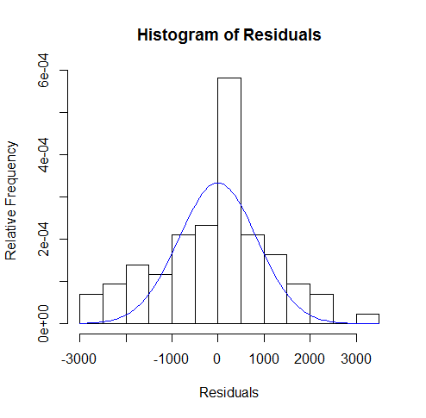
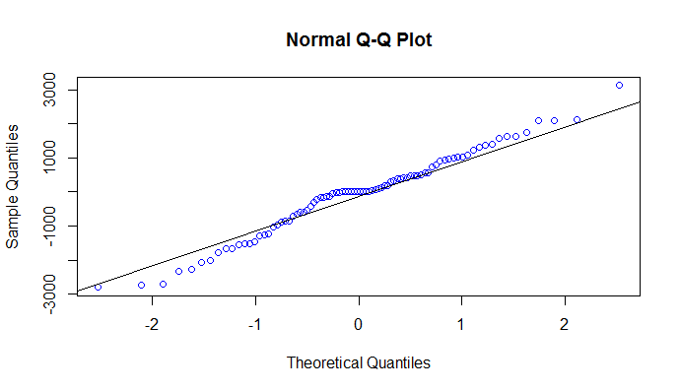
Normality of Residuals?

Slide 18
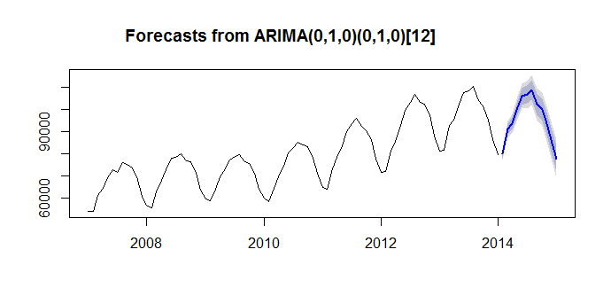
Summary – Random Walk Forecast ARIMA(0,1,0)(0,1,0)[12] (forecast.Arima) {forecast}
Notes:
Note 80 and 95 percent prediction intervals

Slide 19
References
A Little Book of R for Time Series, Coghlan, version 0.2,
https://media.readthedocs.org/pdf/a-little-book-of-r-for-time-series/latest/a-little-book-of-r-for-time-series.pdf
Introductory Time Series With R, Cowpertwait & Metclafe, Springer 2008
Time Series Analysis and Its Applications (with R Examples), Springer, 3rd Ed.

Slide 20
Bonus fact
Springer seems to be the favorite publisher for books on
Springer books may be downloaded freely by UTK students, staff, and faculty under the university’s institutional license.

Slide 21
The End
Thank you.
Questions?

