Slide 1
Analysis of finishing times for participants of the Knoxville marathon
Terry Higgins

Slide 2
Background
Masters in Statistics from UT in 2004.
Director of Research at the Construction Industry Research and Policy Center (CIRPC) at the University of Tennessee – Knoxville.
CIRPC has “Center status” under the Haslam College of Business and the majority of our funds come from a contract with the U.S. Department of Labor.
Our primary contractual obligation is to assist USDOL with support for surveys associated with the Davis-Bacon and Related Acts. Think: If a construction project has Federal Money in it, the General Contractor has certain legal obligations to fulfill in the rates they pay their employees.
We also do statistical analysis for the Wage & Hour Division on an as-needed basis.

Slide 3
My R experience
Before 2009, I was interested in R, to breakaway from SAS. I was 100% Excel.
In 2009 American Recovery and Reinvestment Act (ARRA) kept me very busy.
In late 2010, when ARRA was not as a hot topic for me, I started to look into R.
Since 2011, it has been a “learn when I can” experience.
In 2013, focused on converting data processing/reports from Excel/Access to R.
I have almost all of our contractual obligations converted over. I’m 85% R, 10% Excel, and 5% Access.

Slide 4

TODAY’s PRESENTATION
Finish Line results from the Covenant Health Knoxville Marathon (2005-2015)
Explain how this data was collected
Highlight some issues with the data
Show my approach to the problems

Slide 5


STATISTICS and RUNNING…
Usually falls into 1 of 2 categories:

Slide 6
A brief history of time(ing Chips)
Pheidippides inadvertent creates a historical footnote by dying at the end of a long run.
The modern Olympics created an event in 1896 to see who, in the world, is best at not dying.
1921 Olympic Committee officially set the distance to 42.195 km (26.195 miles).
Early 1990s, a company called Champion Chip produces passive Radio Frequency (RF) chip technology to track athletes.

Slide 7
HERDING CATTLE AT THE FINISH LINE
People directing runners to stay in line (of their order of finish) as they entered the finishing chutes.
Another group pulled off the tear away portion of their running bib and put them on a GIANT pin that kept them in order.
Another person was tasked to key into a recorder, Bib numbers, this would capture the time the runner crossed the finish line.
Then all the information would be put into a computer and eventually results would be ready.

Slide 8
NO more “paper”
The runner wears a “chip” (i.e. the transmitter) (though it might be a different configuration) and when they pass over a “mat” (i.e. the receiver) their information is recorded for that location.
At first, it was a luxury at some races. You would be charged $$$, if your chip was not returned.
Now, the timing chips are “disposable”. Many are part of the running bib, but some are still the shoe version, and you get to keep the chip as a souvenir.
Most races will have a Start Mat and a Finish Mat. Other Mats out on the course are referred to as “Splits” and are used to identify cheating, especially at races were real money is at stake.

Slide 9
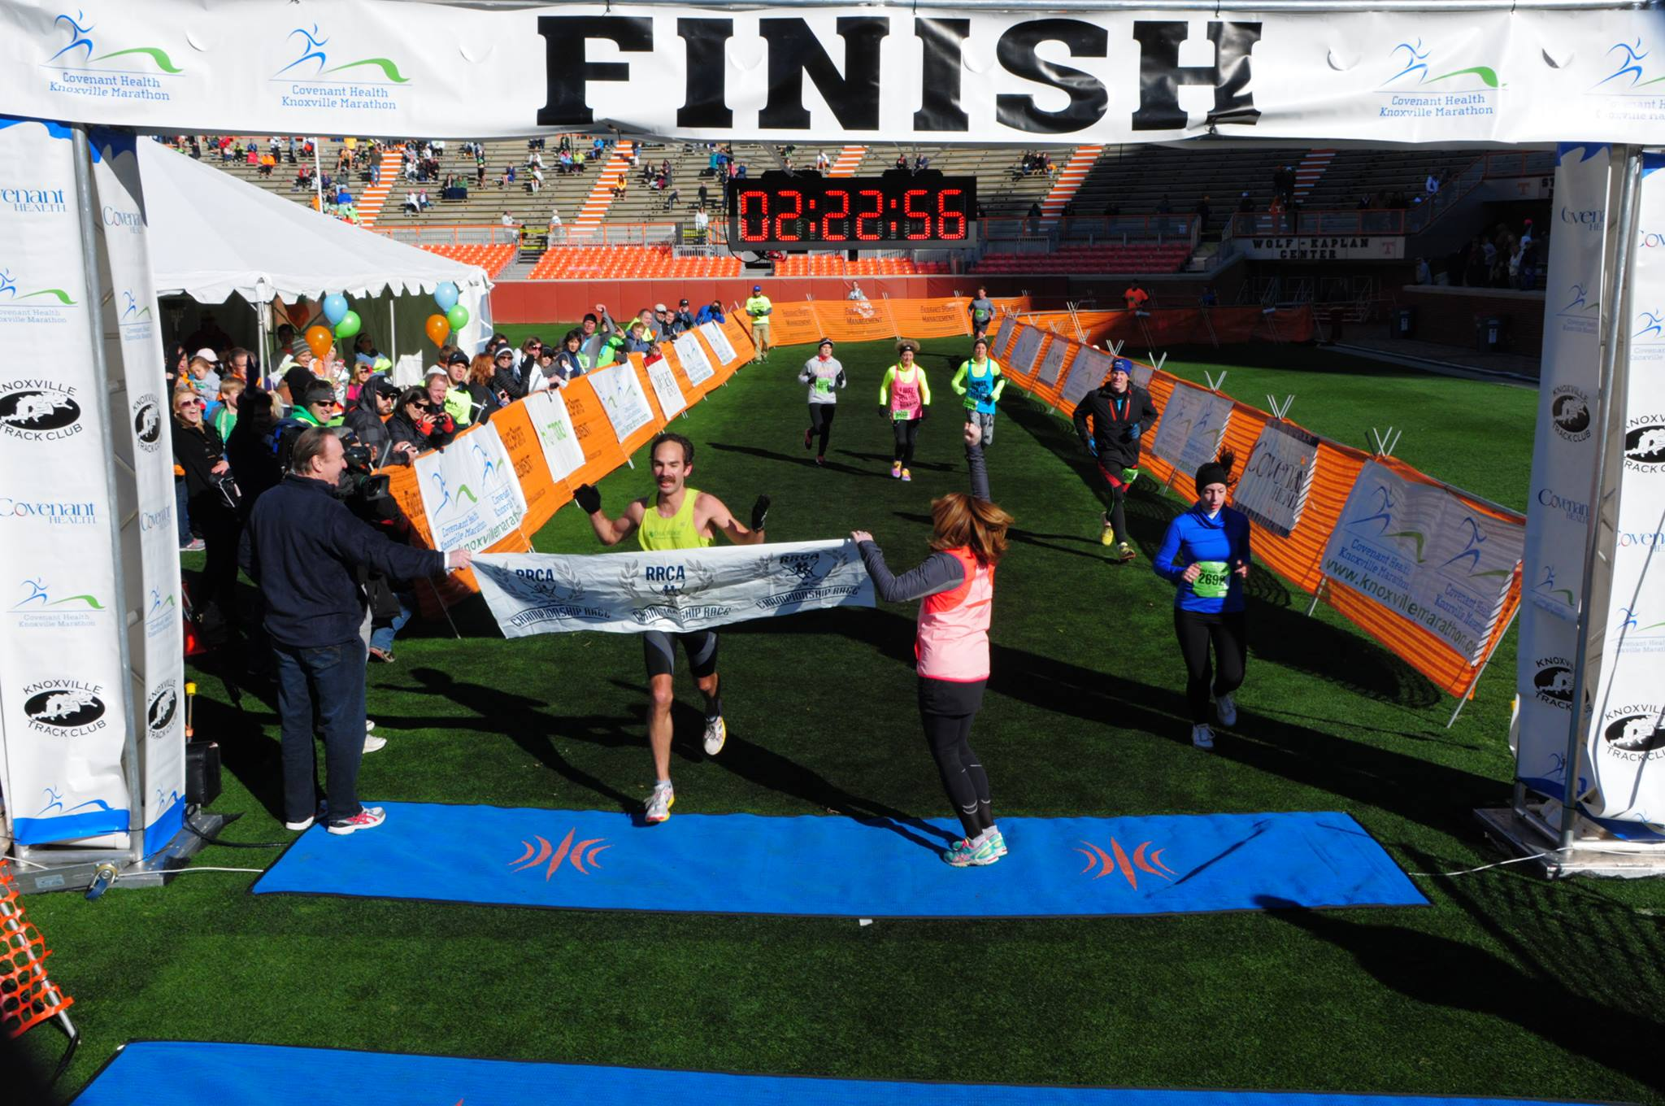

Slide 10
We have the technology
Results which used to take days, now only take hours.
Some races will even send out text messages when you pass certain parts of the course. This way friends and loved ones see how well you are destroying the course, or how well the course is destroying you.
Nowadays, apps to record performance can provide live information about your pace, distance ran, etc. using a GPS signal. Perhaps, this is the future.

Slide 11
To help the end, look at the beginning
Races have become extremely popular over the past 15 years. Especially 5ks and Half Marathons.
At large races, cattle runners are now seeded into corrals based on predicted time.
In “theory”, the faster runners are in the front and then each corral has slower runners
Some big races even have Corral Police, which look at your bib and make sure you aren’t jumping corrals.
For some runners, at very large races, it might be 20 minutes from the time the starting gun goes off until they cross the timing mat.

Slide 12
Wibbly wobbley Timey whimey
When looking at Race Results there are usually more than 1 time listed:
Gun or Clock Time – Time from when the starter’s gun is fired (i.e. recording started)
Chip Time – Elapsed Time from Start Line mat to Finish Line mat
Split Time – Sometimes elapsed time from mat to mat, some times not

Slide 13
DATE-TIME CONTINUUM
Dates – Time of Day already a data handling nightmare
Elapsed Time joins the fray
Excel wants to be your friend of best intentions
Goal is to get all of the time variables converted into minutes

Slide 14

CASE STUDY

Slide 15
History of the Knoxville Marathon
Almost all marathons have a set “date”, just like the “Third Saturday in October” means UT is playing Alabama
Knoxville marathon is held on the last Sunday in March, unless Easter falls on that day, like this year, which it pushed back a week.
First race was held on March 20th 2005; This year is April 3rd 2016
The website (www.knoxvillemarathon.com) has links to the results from 2005-2015.

Slide 16
MY VISION (in a perfect world)
I would extract each year’s data into a text file.
I would use 2005 data and create a boiler plate for processing the data.
I would create a loop, that would import the desired year(s) worth of data, process it, then export as a flat data file for future analysis.

Slide 17
Best laid plans… *sigh*
3 different entities have been used for timing.
Results provided have 6 different configurations, just on variables regarding times alone.
Results have to be extracted from the webpage, but these different configurations provide different obstacles
Easiest: Straight Text from HTML, fast and easy, paste into text editor (Notepad++), raw data is Tab delimited, ready to go.
Hardest: HTML table in a fixed sized frame made Copy & Paste very frustrating because you had to be precise. (View Page/Frame Source was not helpful)

Slide 18
AND we’re off to a great start
2005 result were very user friendly. Select, Copy & Paste right from race results page.
Pasted into text editor, Tab-Delimited format.
When I read the table into R, I had 920 Finishers and 11 variables

Slide 19
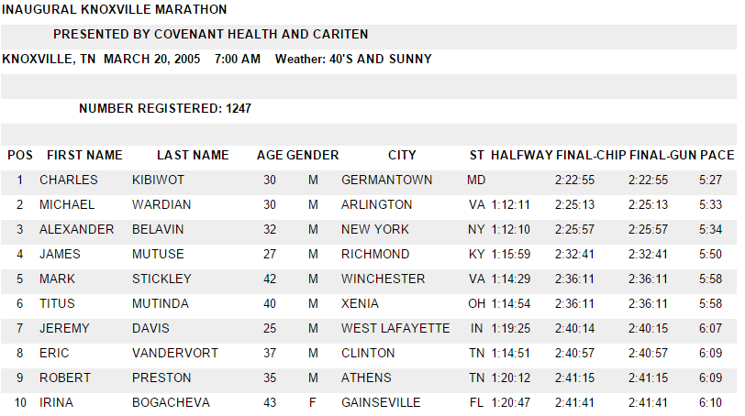

Slide 20
Code part 1
SourcePath<-c("C:/Users/TERRY_XPS/Dropbox/CloudDox/Running/")
SourceFolderName <- c("Race Results/")
Locale <- paste(SourcePath,SourceFolderName,sep="")
# Set Date Time Frame
# 2005 through 2015
StartYear<-2005
#EndYear <-2005 # Just to test
#TimeFrame <- seq(StartYear:EndYear)+(StartYear-1)
# Reads in the first data file to capture Column Names
myDR <- read.csv(paste(Locale,"CHKM-",StartYear,"results.csv",sep=""))

Slide 21
Obstacle Number NEXT
Convert HH:MM:SS to Minutes (Decimal)

Slide 22
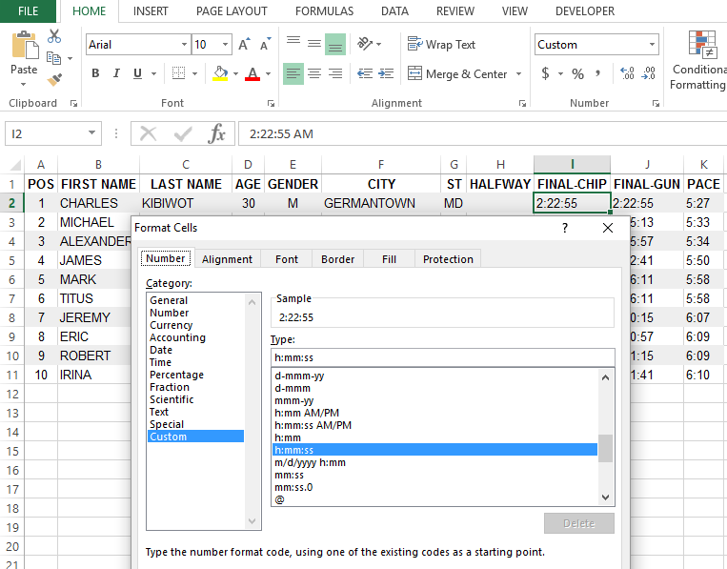

Slide 23
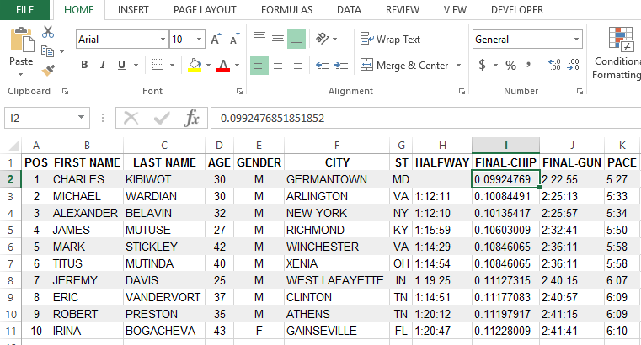

Slide 24
To make Excel “work”
Data from the website had to be pasted into Excel
Save As a CSV file, which Excel gives that extra “Are You Sure???” Dialog Box
Open CSV file in Text Editor
Paste Back into Excel
Text to Column on the comma
Then the Time components are broken out using Text to Column on the colon delimiter

Slide 25
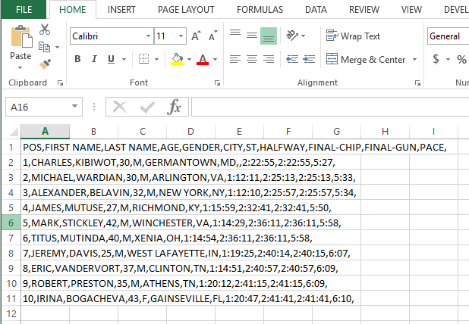
AND Then…

Slide 26
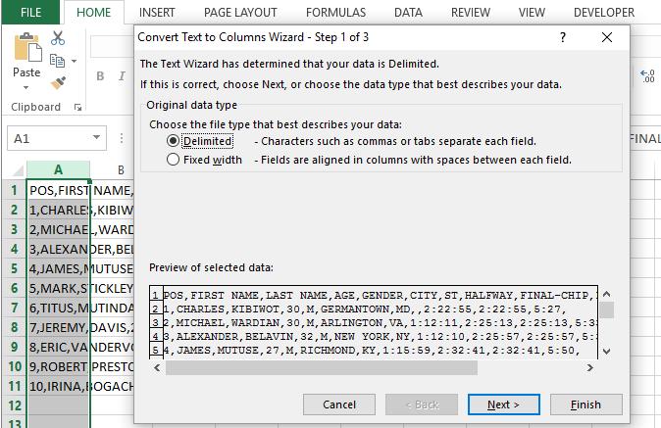
AND Then…

Slide 27
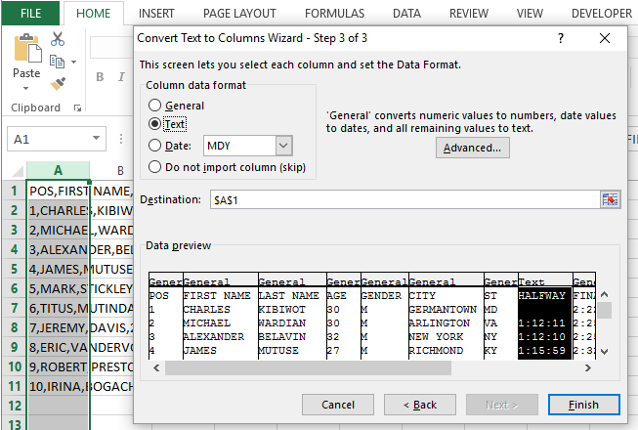
AND Then…

Slide 28
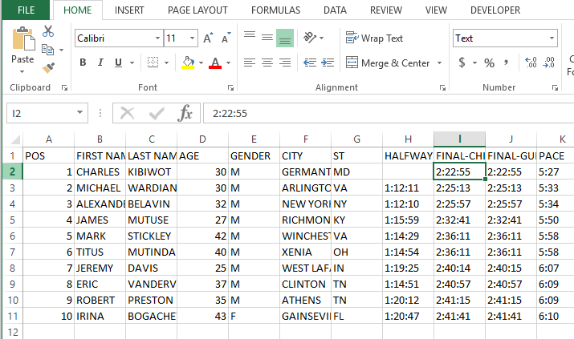
AND Then…

Slide 29
AND THEN….
Once you had the right format, you needed blank columns to the right of your data for each delimiter
Use the 3 step “Text to Columns” with delimiter of “:”
Write in the variable name for new columns
Repeat for each variable involving time

Slide 30
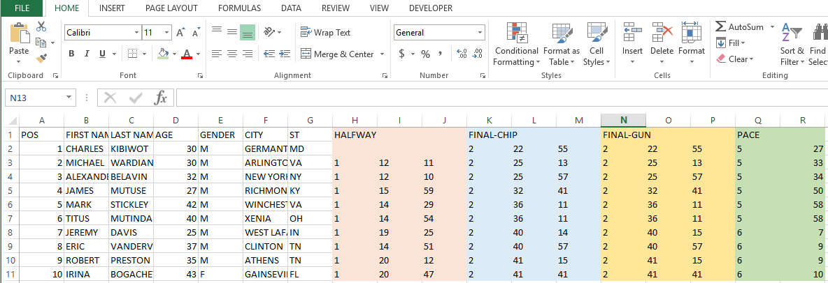
AND FINALLY

Slide 31
SKINNING A CAT METHOD #42 : tidyr
The code that I found was “separate” from the tidyr package
I used the first one to create a new working data frame (my$DR2), just in case when I messed up and needed to rerun from the beginning
# Split Time Variables into components of Hours, Minutes, Seconds
myDR2 <- separate(myDR, HALFWAY, into = c("HALF_H", "HALF_M","HALF_S"),sep = ":")
myDR2 <- separate(myDR2, FINAL.CHIP, into = c("CHIP_H", "CHIP_M","CHIP_S"),sep = ":")
myDR2 <- separate(myDR2, FINAL.GUN, into = c("GUN_H", "GUN_M","GUN_S"),sep = ":")
myDR2 <- separate(myDR2, PACE, into = c("PACE_M","PACE_S"),sep = ":")

Slide 32
BUT IT has to be the right time (FORMAT)
#Convert Time Variables from Factor to Character
myDR$HALFWAY<-as.character(myDR$HALFWAY)
myDR$FINAL.CHIP<-as.character(myDR$FINAL.CHIP)
myDR$FINAL.GUN<-as.character(myDR$FINAL.GUN)
myDR$PACE<-as.character(myDR$PACE)

Slide 33
M ssing d ta
Timing technology is not perfect and there are missing data in 2005 & 2006
This was a straightforward fix, which I didn’t have to edit the source file, but added it into the script for the 2005 data
# Sets Time as "0:0:0" format
myDR$HALFWAY[myDR$HALFWAY==""] <- "0:0:0“

Slide 34
Benchmarking
Terry using Excel for 4 variables - 1 minute 38 seconds
R for 4 variables – 0.02 seconds

Slide 35
CONVERT into minutes
The 2005 winner of the Knoxville Marathon finished in 2:22:55 or 142.9 minutes (2.38 hours)
# Converts the created Time related columns to numeric
z<-8:18
for (i in z){
myDR2[,i] <-as.numeric(myDR2[,i])}
# Creates a time in minutes for each of the Time Variable
myDR2$GUN_HALF <- (myDR2$HALF_H*60)+myDR2$HALF_M+(myDR2$HALF_S/60) # Half Way Elapsed Gun Time of Runner
myDR2$CHIP_FINAL <- (myDR2$CHIP_H*60)+myDR2$CHIP_M+(myDR2$CHIP_S/60) # Net Time of Runner
myDR2$GUN_FINAL <- (myDR2$GUN_H*60)+myDR2$GUN_M+(myDR2$GUN_S/60) # Total Elapsed Time of Runner
myDR2$GUN_PACE.FINAL <- myDR2$PACE_M+(myDR2$PACE_S/60) # Overall Average Pace (Gun)

Slide 36
The 2006 headache
Initially, I thought it was going to be fine because it there were no issues reading into R
There were a couple of runners that had data in an extra, untitled column
I didn’t recognize it at first, because the “problem children” weren’t at the very top

Slide 37
EXCEL SURGERY
Once I figured out that there was an extra column, which runner(s) were impacted, what time was being listed
I pulled the data into Excel, moved the data, then resaved
I went ahead and filled in all the missing time values with “0:0:0”

Slide 38
Variable NAMING and CONSISTENCY
Once the 2006 data was stitched back up, I was able to use the 2005 code as a template
The 2006 data had a 10k (6.2 mile) and a 20 mile split time
Had to decide how I was going to handle the variable names
Right now: MAKE_MODEL format (CHIP_FINAL or GUN_SPL.10k)

Slide 39
Winning
At almost all marathons, finishers receive some sort of commemorative medal. Medals are as unique as their location. Some places, like Knoxville, go above and beyond for their runners.
For Knoxville, which is typical, there are awards (usually $$) for the Top 3 Males and Top 3 Females
Masters (40 to 49), Grand Masters (50 to 59), and Veterans (60+)
Standard Age Group categories are by Gender in 5 year intervals. E.g. Males 40 to 44, Males 45 to 49, etc
As you can guess, listing Age/Gender is different as well between years

Slide 40
Age is (sometimes) just a number
2005
2 Variables: AGE, GENDER (“30”, “M”)
2006
1 Variable: AGE.DIVISION (“Marathon M Overall Winner” or “Marathon M 30 to 34”)

Slide 41
Living in data harmony
2005
Assign each Age into a Division and then paste() Gender (“M 30 to 34”)
2006
First had to remove the text “Marathon ”
If the runner was a winner of a Non Age Group award (Overall, Masters, Grandmasters, Vet), their age had to be lookup on website. About ~19 of them
Then, found out that 2006 reported the age group “24 and under” but in 2005 I had created: “15 to 19” and “20 to 24”

Slide 42
Mo’ splits, mo’ analysis
Even Splits – Time for the 2nd half of marathon is equal to 1st Half
Negative Splits – Runner is faster for the 2nd Half
Positive Splits – Runner is slower for the 2nd Half
myDR2$GUN_FIRST <- myDR2$GUN_SPL.10k+myDR2$GUN_SPL.HALF # Create First Half Split Time
myDR2$GUN_SECOND <- myDR2$GUN_FINAL-myDR2$GUN_FIRST # Create Second Half Split Time

Slide 43
graphS
I have not graphed any of the 2006 data information yet, it’s still in the data cleansing / variable harmonizing process
I do have a couple of graphs of the 2005 information

Slide 44
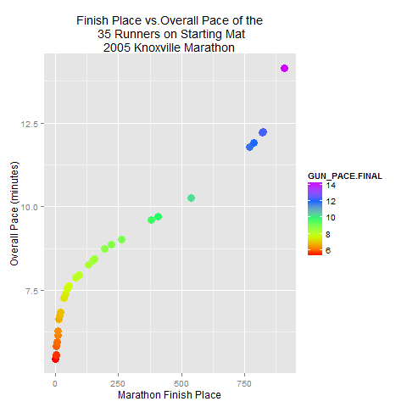

Slide 45
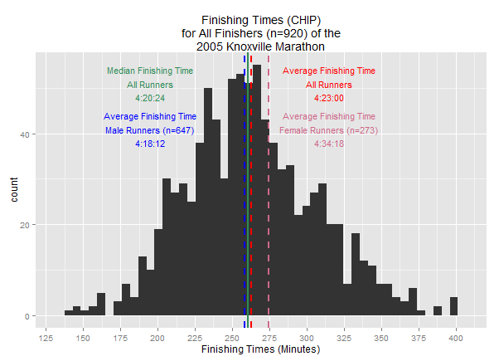

Slide 46
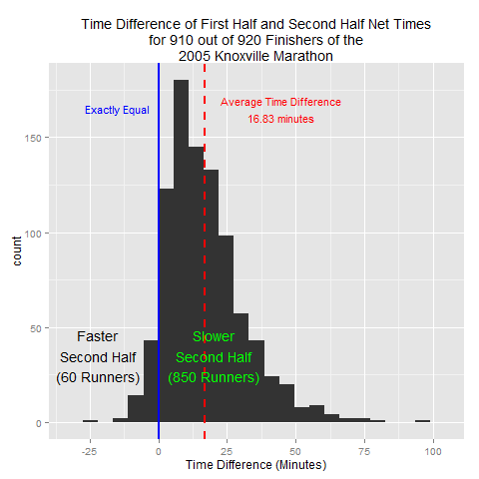

Slide 47
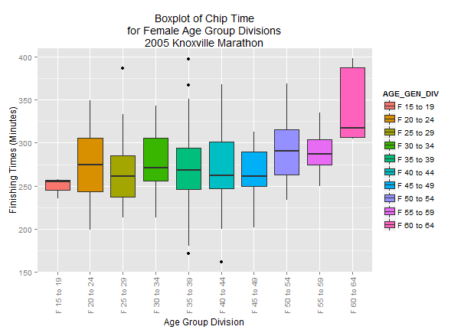

Slide 48
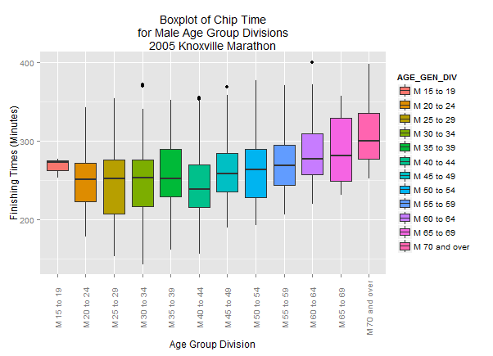

Slide 49
SO what next?
City, State is also another demographic that can be standardized and used as a comparison. I already know there’s a problem
Continue to cleanse the data from 2007 through 2015
In 2010, one of the split times is 20.5 miles (not 20 miles); in 2015, there’s a 30k (18.7 miles) split time
In 2012 and 2013, no split times are listed on the general results page

