Slide 1
Using R to Detect User Fraud
Elaine Crutchley

Slide 2

What is gapNsnap?
Out of stock reporting app
Users in all 50 states
Depending on location, users either get cash or points that they can redeem for a variety of prizes
gapNsnap compiles the information from snaps to build out of stock reports

Slide 3
What is User Fraud?
Two users taking pictures of the same out of stock commodities in the same store at the same time
One user repeatedly taking pictures of the same commodity
One user with two phones and two accounts double snapping the same commodities

Slide 4
Available User Information
Email address
Both personal and the email address and email address connected to their paypal account
State and Zip code
For both their home address and the address of the store where they were snapping
Store name where picture was taken
Exact time when picture was taken
Exact location (Latitude and Longitude) where picture was taken
Not available: Address of Store

Slide 5
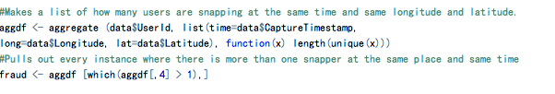
Aggregate Function
Aggregate function is the biggest part of the program, most of the process come from one line of code
After finding locations and times with more than one person are snapping it is easy to pull records at those locations and times out of the full data table.

Slide 6
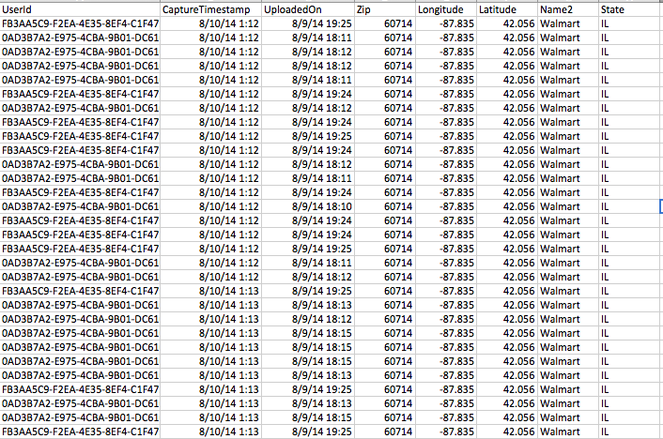
Output
Outputs a csv file with all of the records where more than one snapper is snapping at the same place at the same time
This csv is easy to load into visualization software.

