Slide 1
Exploring and Predicting Heart Disease Trends: An IR System Using Health Indicators
Link to repository: https://github.com/KnusprigeNuss/AIR24.git

Slide 2
Table of contents
Exploring and Predicting Heart Disease Trends
Introduction
Data
Models
Results
Conclusion

Slide 3
Introduction – Project scope
Exploring and Predicting Heart Disease Trends
User friendly tool that predicts heart disease risk based on given inputs and recommends a medication
Machine learning model for risk prediction and information retrieval for drug recommendation
Uses two datasets from Kaggle
Web interface where users can input their health details

Slide 4
Introduction – Motivation
Exploring and Predicting Heart Disease Trends
Early detection of heart disease risk could save lives
Many people lack easy access to tools that help evaluate their health risks and understand the effect possible treatments
Providing a technological solution to the problem of heart disease risk

Slide 5
Data
Exploring and Predicting Heart Disease Trends
For the MR model: „Indicators of Heart Disease“ dataset found on Kaggle
Has around 250.000 entries
Sex, Physical Health and Activities, Heart attack, ...
For the IR system: „Drug Dataset: Uses, Side Effects and User Reviews“ dataset found on Kaggle.
Covers around 11.500 different medications
Medicine Name, Composition, Uses, Side Effects, ...

Slide 6
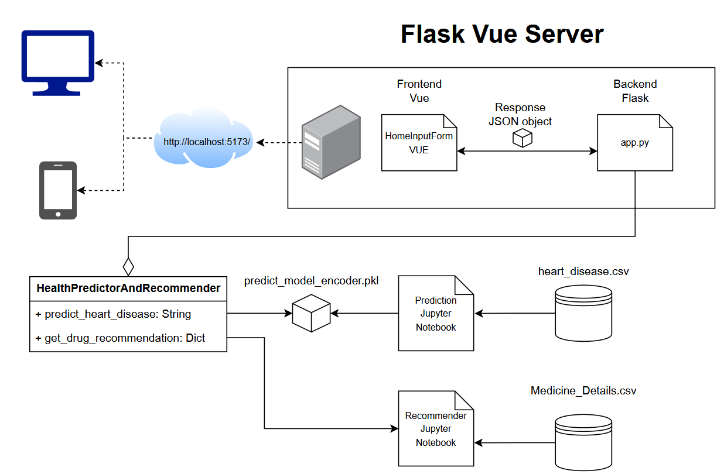
Workflow
Exploring and Predicting Heart Disease Trends

Slide 7
MR Model
Exploring and Predicting Heart Disease Trends

Slide 8
IR Model
Exploring and Predicting Heart Disease Trends
Objective: Identify and rank the top 5 medications
Extract user input features
Boolean information retrieval, check if documents contain query terms
Compare input features with dataset attributes using cosine similarity
Rank medications based on results

Slide 9
Results
Exploring and Predicting Heart Disease Trends

Slide 10
Conclusion
Exploring and Predicting Heart Disease Trends

