Slide 1
AI for societal challenges: A bibliometric analysis
Stefano Bianchini
BETA – Université de Strasbourg
A1 transitoire

Slide 2
Digital transformation vis-à-vis Sustainability
Unlike past technological revolutions, digital transformation comes at a time of profound interdependent changes including global warming, migration, an aging population, and new geopolitical tensions
It will cause great stress on our economic, social and political systems, creating some preconditions for sustainability, but undermining others
Sustainability can be understood as the result of a balanced articulation of the three pillars – social, economic, environmental – including good governance

Slide 3


Slide 4
AI for good?
Some Pros
Support green transition through smarter energy management
Virtual and augmented realities empowered by AI can enable transnational communication networks, thereby stimulating cultural diversity
Some Cons
Data processing requires (massive) computing centres, which are high energy intensive and thus responsible for a high carbon footprint
Digitally-driven configurations of the economic, social, political and cultural systems may disempower individuals and amplify disparities

Slide 5
The project
Mapping the inter-linkages between digital transformation and the Sustainable Development Goals (SDGs) in research and innovation
Assessing the contribution – i.e., enabling, neutral, or inhibiting – of digital transformation on the achievement of the SDGs and the targets therein

Slide 6
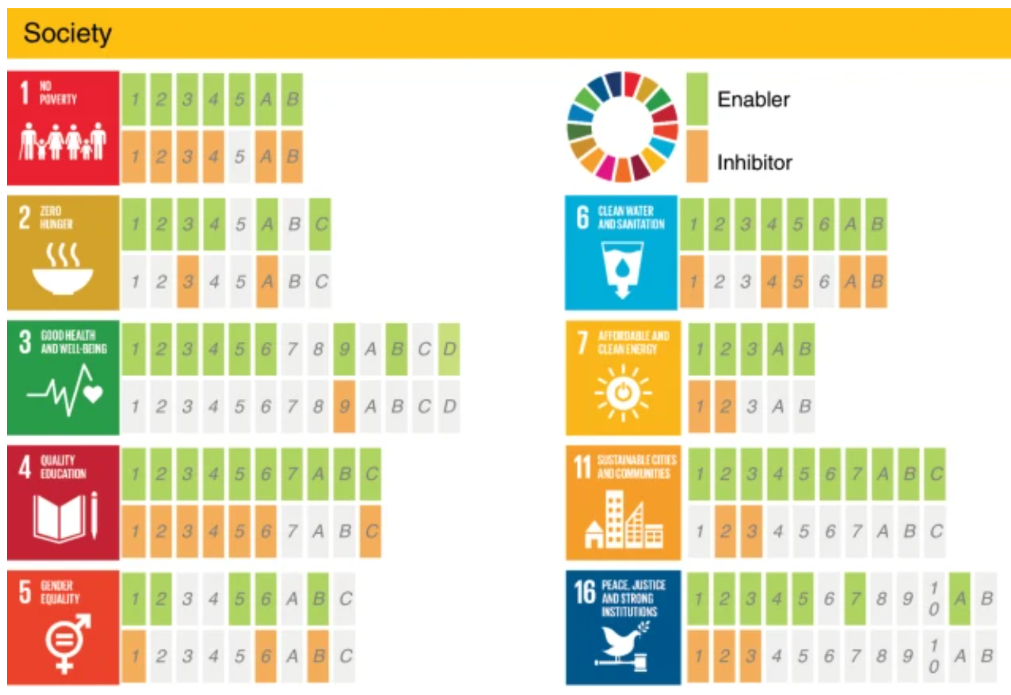
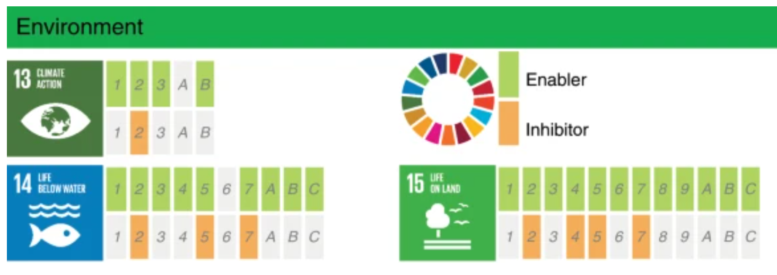
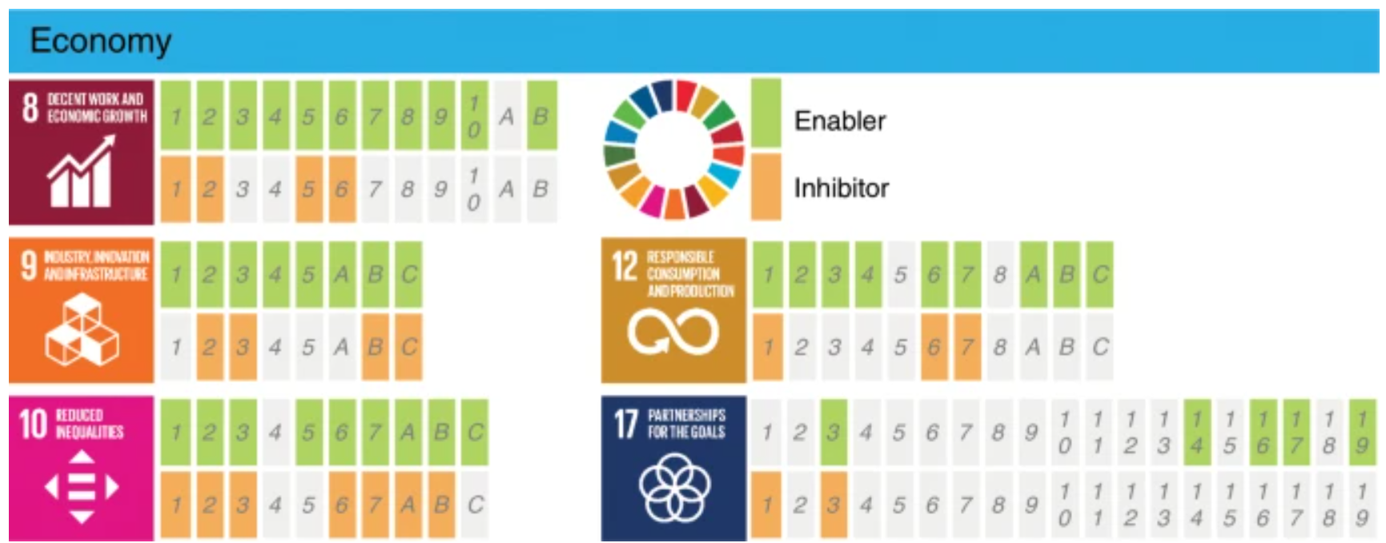
See Vinuesa et al. (2020 Nature)

Slide 7
How to map AI for SDGs?
Publication statistics (Web of Science – available through the ENT)
List of keywords in the title and abstract of scientific publication
https://sdgresources.relx.com/match-research-to-sdgs
https://aurora-network-global.github.io/sdg-queries/
First step:
Choose one or two SDGs, find the query, and retrieve publications from WoS
From that sample, identify publications that involve AI technologies [list of keywords]

Slide 8
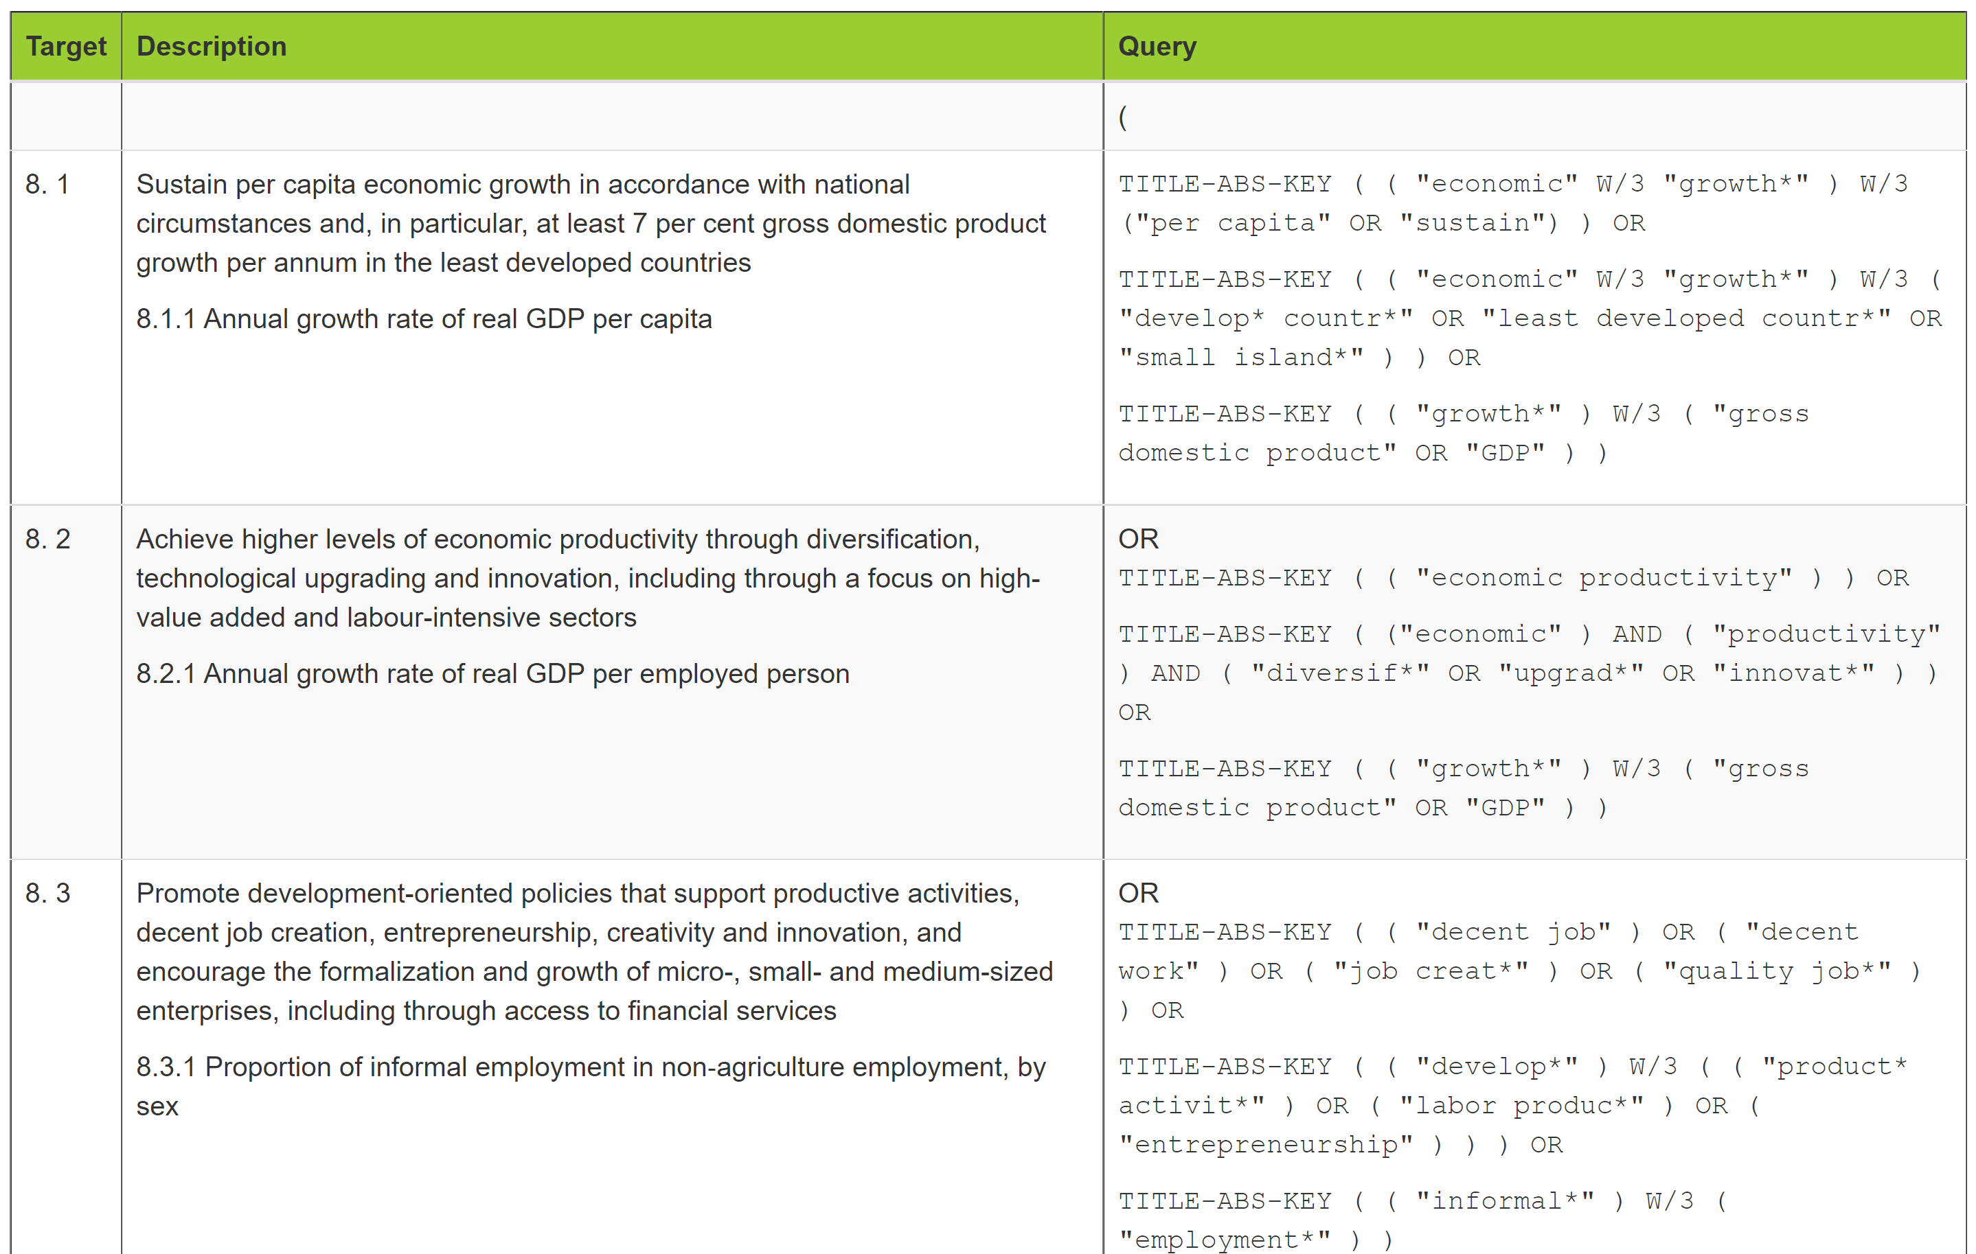

Slide 9
How to map AI for SDGs?
Provide descriptive evidence, ideally in the form of interactive dashboard. For example:
Time evolution
Countries involved and their collaboration (e.g. network analysis)
Main application areas (e.g. word clouds)
Sentiment analysis on the abstracts to detect the role of AI for achieving the SDG(s)

Slide 10
Some (must!) readings
del Río Castro, G., Fernández, M. C. G., & Colsa, Á. U. (2020). Unleashing the convergence amid digitalization and sustainability towards pursuing the Sustainable Development Goals (SDGs): A holistic review. Journal of Cleaner Production, 122204.
Elsevier (2019). https://www.elsevier.com/about/partnerships/sdg-research-mapping-initiative
Griggs, D., Stafford-Smith, M., Gaffney, O., Rockström, J., Öhman, M. C., Shyamsundar, P., ... & Noble, I. (2013). Sustainable development goals for people and planet. Nature, 495(7441), 305-307.
Vinuesa, R., Azizpour, H., Leite, I., Balaam, M., Dignum, V., Domisch, S., ... & Nerini, F. F. (2020). The role of artificial intelligence in achieving the Sustainable Development Goals. Nature communications, 11(1), 1-10.

