Slide 1
LAUNDARY MANAGEMENT SYSTEM By Kanav Khera

Slide 2

HELLO!
I am Kanav Khera
I am Software Developer Traniee at
iSchoolConnect

Slide 3
Practical Exposure
0

Slide 4
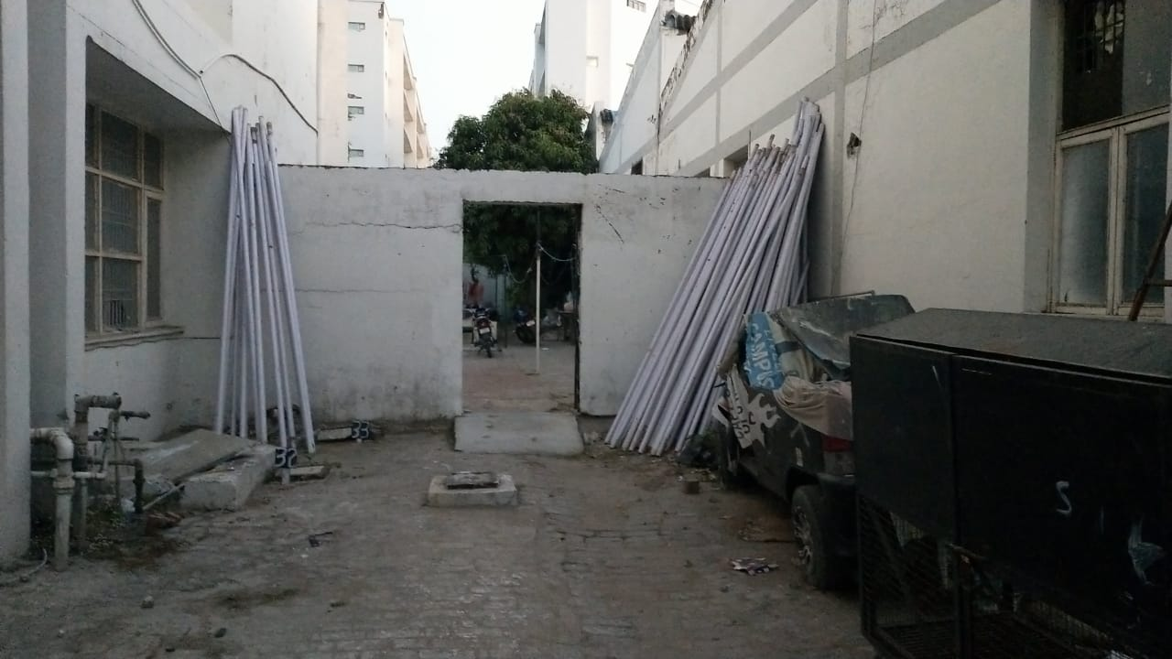
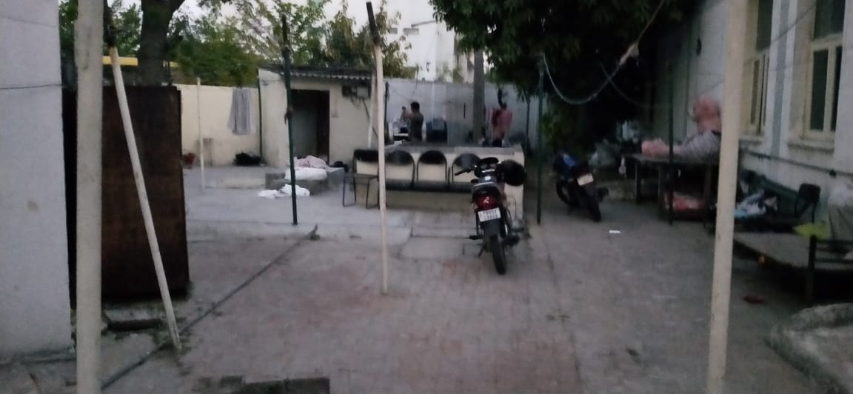

Slide 5
Goals
1
Let’s start with it

Slide 6
What To Make ?
A laundary management system that makes the laundary work easy and to make a system approach even in the laundary field

Slide 7
BIG CONCEPT
Everthing can be done online right?
Then why not Making laundary

Slide 8
Project Plan
2
Approach for making this application

Slide 9
TIMELINE
The Completion of UI part and what will be logics that makes the app work
One by One completion of the components
Finalizing the app and hosting it
Day 1
Day 2
Day 3
Day 4
Day 5
Trying to resolve the errors
All the planning and What approach should I follow

Slide 10
What I have used to make this app work
4

Slide 11
What was my approach ?
I want people to come to my application and start using it without any login or sign up because I think that it will be easy to operate an app then I used component to display the desired output

Slide 12
TECH STACK
HTML CSS
ANGULAR
MONGODB
1
3
5
2
4
6
TYPESCRIPT
NODE JS
FIREBASE

Slide 13
LET’S REVIEW STRUCTURE
APP COMPONENT
Parent Component from which other features of app work.
SERVICE COMPONENT
Ithis component is capable of taking Input from the user and save it to database.
ADMIN COMPONENT
This can control the databse and can append the information
BACKEND
In backend, nodejs provide connections with mongodb, which provides databse to tha app
SERVICES
It is type of a middle man between backend and the angular
FIREBASE
It is used to provide hosting to the app

Slide 14
How I manage the Errors?
4

Slide 15
What were the errors ?
From making the UI part till hosting I encountered many error and somehow I almost solve every one of them but ..

Slide 16
Submission https://laundry-system-1958d.web.app/
5

Slide 17
THANKS!
Email: kanavkhera30@gmail.com

