Slide 1
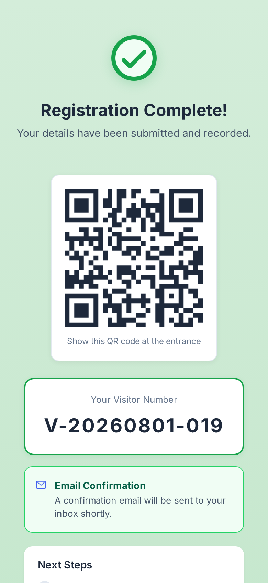
LITEVM
Visitor Management Reimagined
Mobile pre-registration · QR check-in · Photo verification · Real-time reporting — from Rp 50K/month
Prepared by Fenky Tjhang · August 2026

Slide 2
The Problem
Visitor management is still stuck in the paper age
📋
Paper logbooks
Lost records, illegible handwriting, zero audit trail, no identity proof
⏱
Slow queues
Manual lookup and phone calls at every entry — visitors and guards both wait
🔒
Privacy risk
Indonesia UU PDP (2024) effectively outlaws unmanaged paper visitor logs
💰
Enterprise pricing
Global SaaS starts at USD 29–362 per location/month — far beyond SME reach

Slide 3
Introducing LITEVM
A lightweight, mobile-first visitor management system built for SEA businesses
📱
🎫
📸
Visitor pre-registration
QR-based check-in
Photo verification
Visitors register from any phone — before they arrive
Show the QR at the gate; guard verifies identity in seconds
ID card + selfie captured at registration, compared at entry
📊
📧
🔑
Real-time reports
Email confirmations
ACT Pro integration
Auto-generated visitor logs, exportable to CSV / PDF
Visitor number and confirmations delivered to any inbox — zero training
Auto-grant / revoke door access rights on check-in and sign-out

Slide 4
How It Works
Three steps from visitor to verified entry
1
Pre-Register
Visitor scans the QR at the lobby or opens the link. Fills details, captures ID + selfie, selects destination. Receives a unique visitor number via email.
2
Arrive & Show QR
Visitor presents the QR code at the gate. The guard looks up the number instantly.
3
Verify & Check-In
Guard matches the ID photo and selfie against the person. One tap to check in; rights auto-granted if ACT Pro is connected. Auto sign-out at end of day.

Slide 5
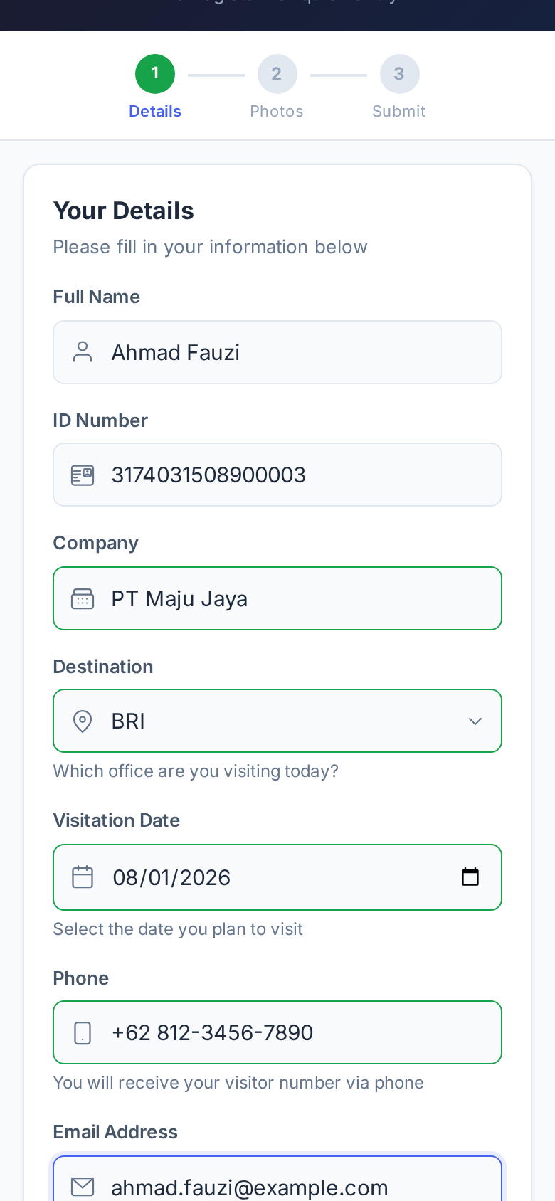
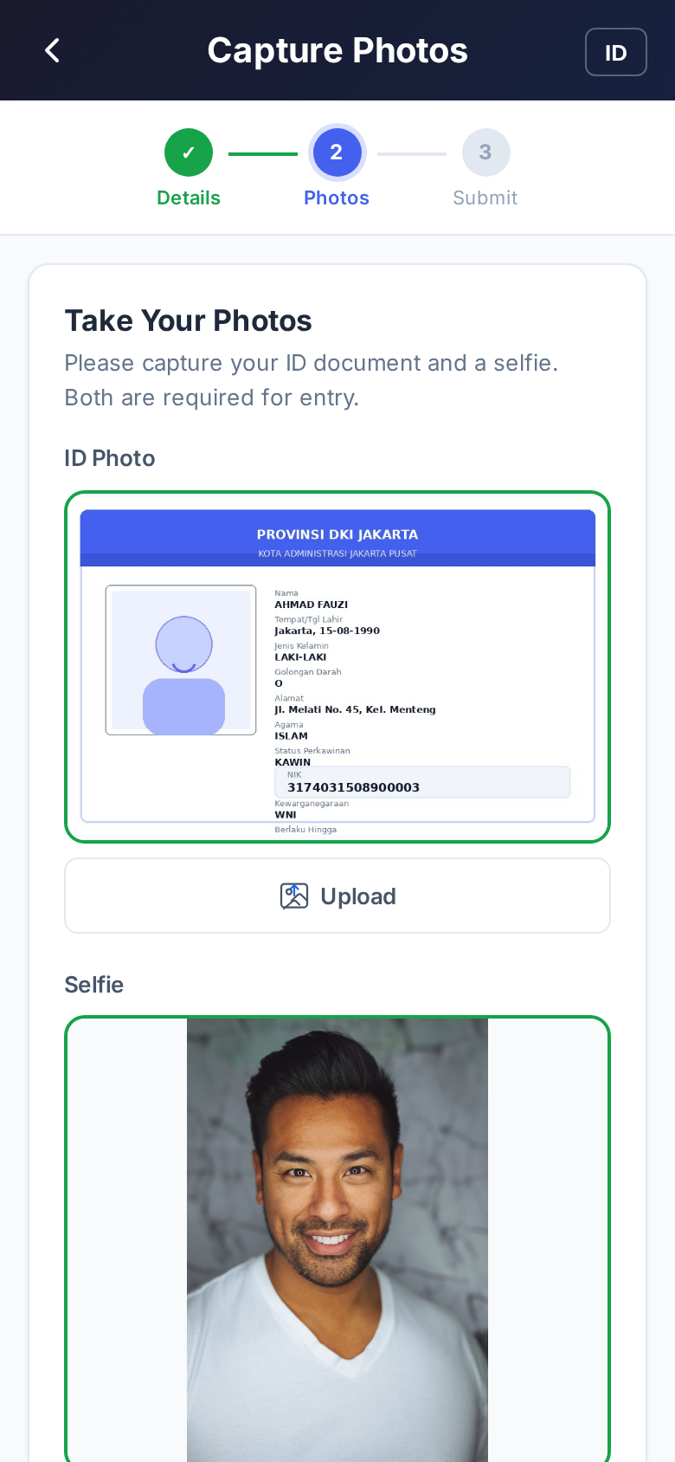
Visitors Register in Under a Minute
Details → Photos → QR

Slide 6
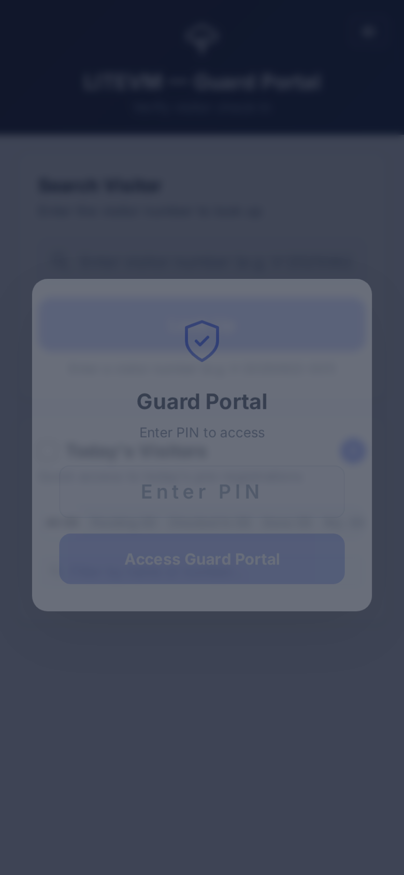
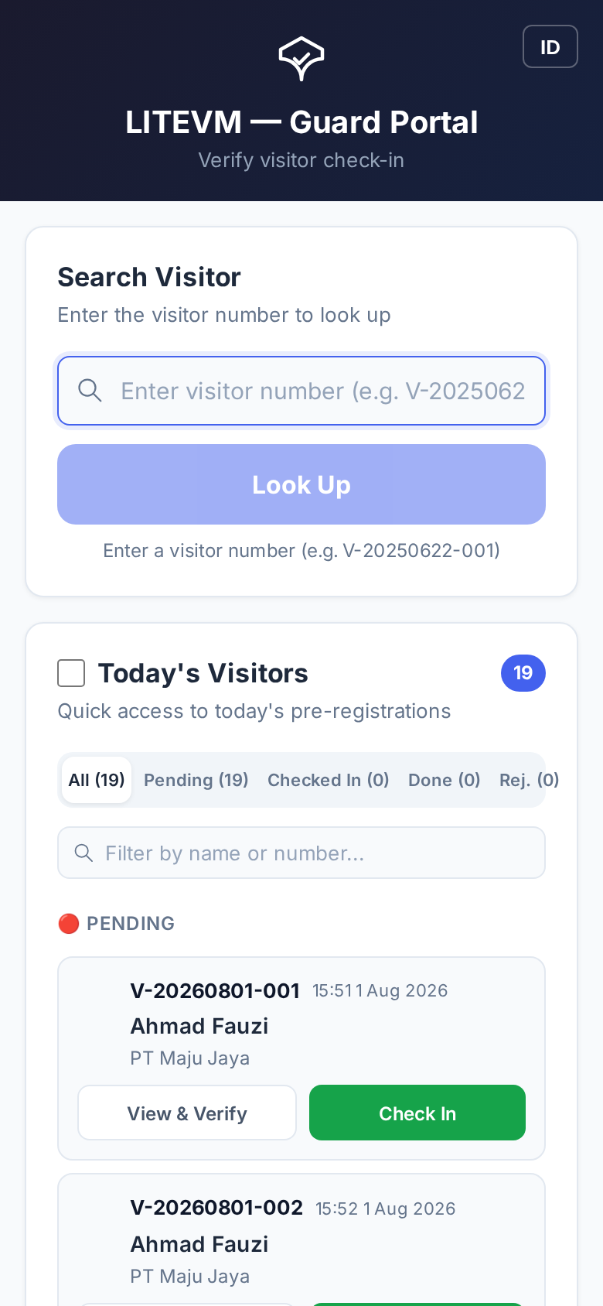
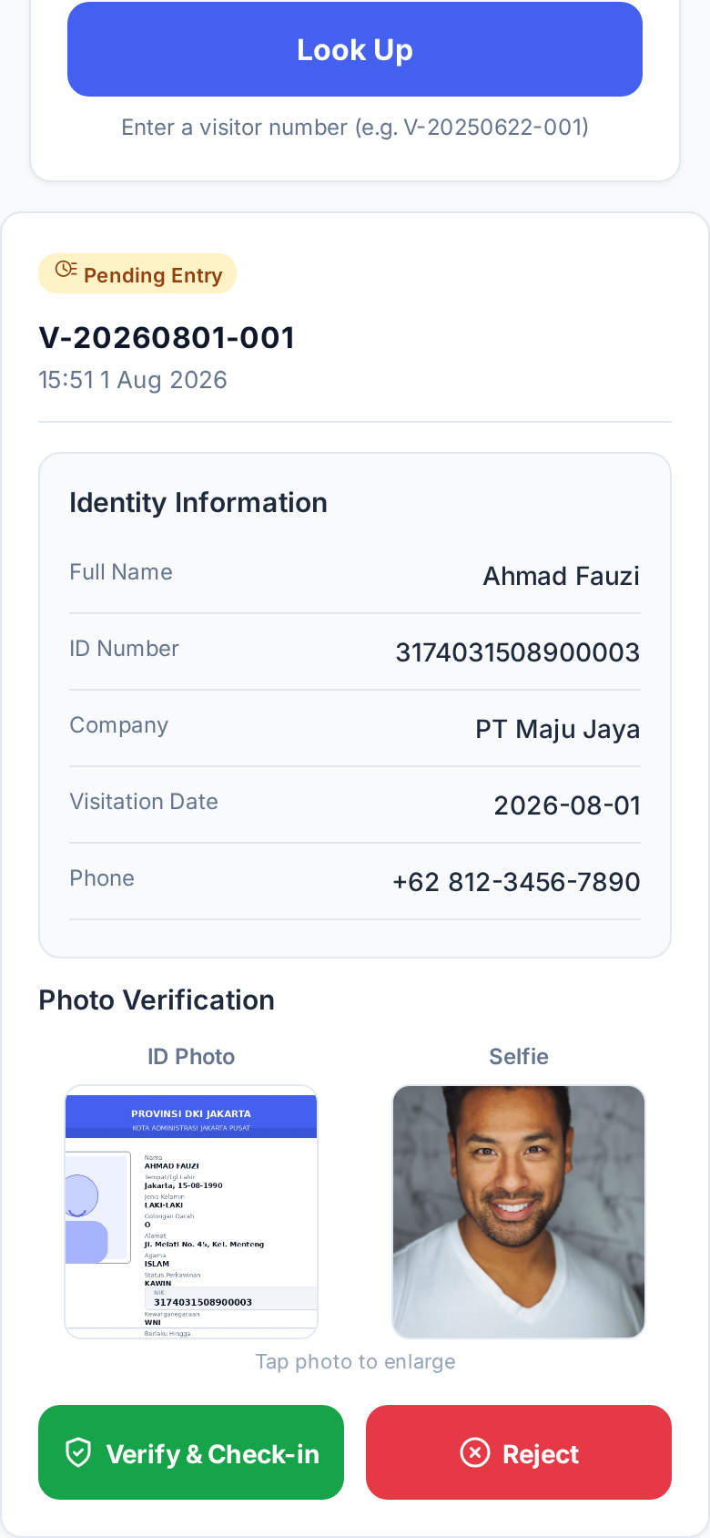
Guards Verify in Seconds
PIN-gated portal · Today's list · Photo verification · One-tap check-in / reject

Slide 7
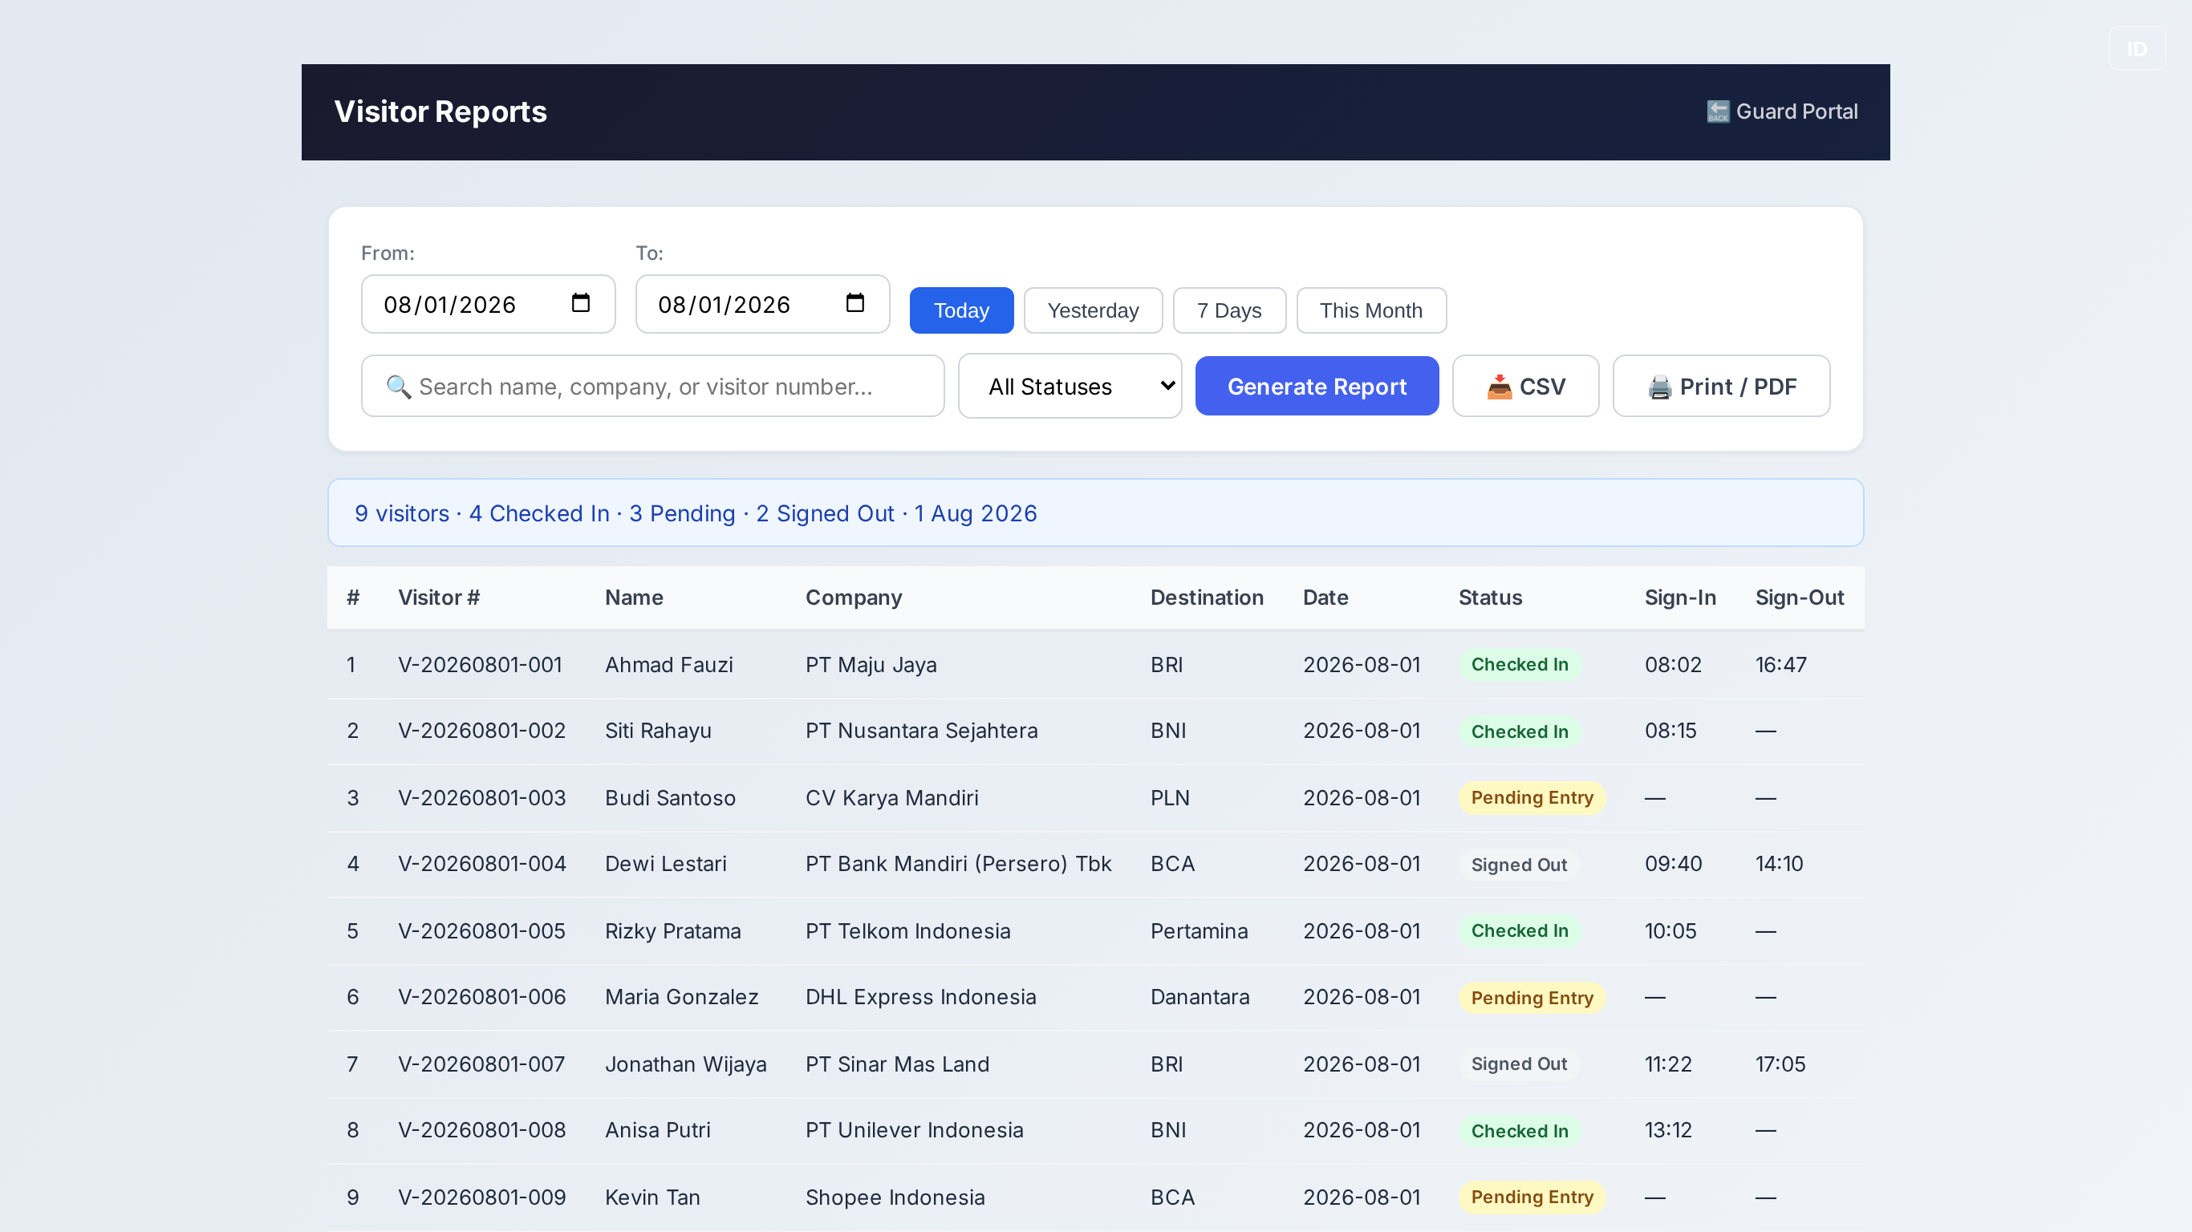
Reports & Audit Trail
Every visit logged, searchable, and exportable

Slide 8
Pricing That Any Business Can Afford
3–36× cheaper than the cheapest global competitor
Free
Starter
Pro
Multi-Site
Rp 0
Rp 50K/mo
Rp 150K/mo
Rp 100K/site/mo
1 location · 50 visitors/mo
1 location · 500 visitors
1 location · unlimited
3+ locations
Try it today
≈ USD 3.30
≈ USD 10
Volume pricing
vs Envoy USD 362 · Sine USD 69–199 · SwipedOn USD 29–99 per location/month

Slide 9
Market Opportunity — SEA
Regulatory tailwind meets massive under-served demand
Email
Email delivery — every visitor number and confirmation lands in the inbox
100M+
Visitors logged on paper daily across SEA apartments, offices, schools
2024
UU PDP passes — paper visitor logs become a legal liability
Rp 150K
≈ USD 10/month — less than a takeout meal for a full VMS

Slide 10
A Business Built to Scale
98–99%
~40
Gross margin
Customers to break even
Near-zero marginal cost per customer on Google infrastructure
Reached in month 4–5
Rp 30M
5
Y1 MRR target
ICP segments
≈ USD 2K/month at 300 customers
Apartments · SME offices · co-working · schools · ACT integrators

Slide 11
Why LITEVM Wins
Feature | LITEVM | Global SaaS
Price / location / mo | Rp 50–150K (USD 3–10) | USD 29–362
Setup | Template copy → live in a day | Onboarding, integrations, contracts
Channel | Email-based, zero training | Apps, hardware, dedicated staff
Integration | ACT Pro (dominant in Indonesia) | Enterprise access control brands
Language | EN / ID | EN first

Slide 12
Try LITEVM Today
Free plan available — live demo at knyf3.github.io/LITEVM
From Rp 50K/month · 3–36× cheaper than global competitors
Contact Fenky Tjhang
ft@structureresearch.io

