Slide 1

ASP NET MVC 5

Slide 2
Agenda
1. ASP NET MVC 5 Fundamentals
2. Building Forms
3. Implementing Validation
4. Web API

Slide 3
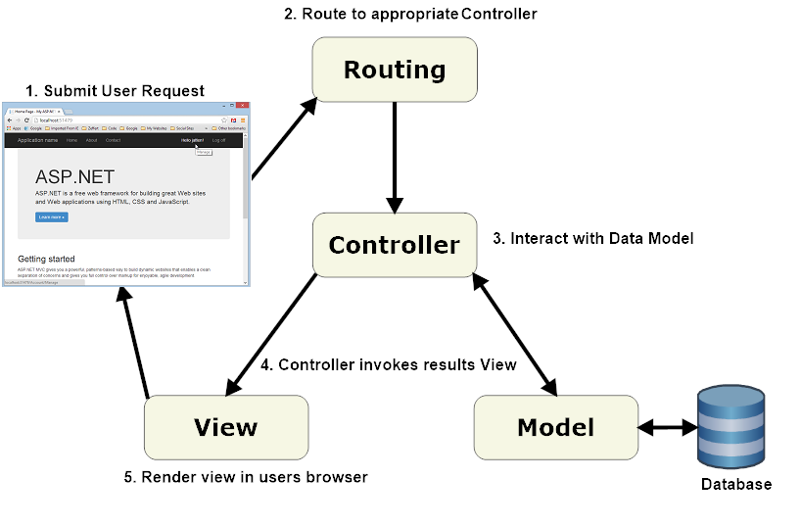
ASP NET MVC 5 Fundamentals

Slide 4
ASP NET MVC 5 Fundamentals
Key Concepts:
1. Razor Views
@if(…)
2. Partial Views
@Html.Partial(…)
3. View Models
4. Action Results
5. Action Parameters

Slide 5
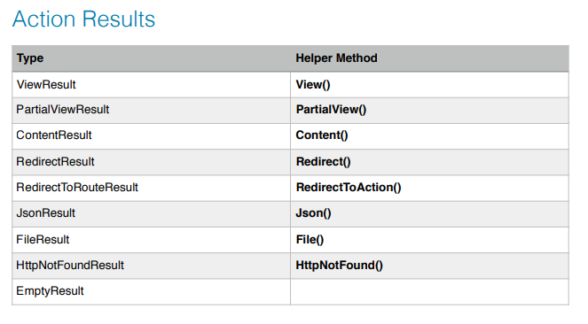
ASP NET MVC 5 Fundamentals

Slide 6
ASP NET MVC 5 Fundamentals
To feed data into your custom action
• Embedded in the URL: /controller/action/1
• In the query string: /controller/action?id=1

Slide 7

ASP NET MVC 5 Fundamentals

Slide 8
Building Forms
View
@using (Html.BeginForm(“action”, “controller”))
{
<div class=“form-group”>
@Html.LabelFor(m => m.Name)
</div>
<button type=“submit” class=“btn btn-primary”>Save</button>
}

Slide 9
Building Forms
[HttpPost]
public ActionResult Save(Param p)
{...}

Slide 10
Building Forms
1. @Html.CheckBoxFor(m => m.s)
2. @Html.DropDownListFor(m => m.t, new SelecList(Model.Types, ...)

Slide 11
Building Forms

Slide 12

Implementing Validation

Slide 13
Implementing Validation
[Required]
[StringLength(255)]
Public string Name {get;set;}

Slide 14
Implementing Validation
Data Annotations
• [Required]
• [StringLength(255)]
• [Range(1, 10)]
• [Compare(“OtherProperty”)]
• [Phone]
• [EmailAddress]
• [Url]
• [RegularExpression(“…”)]

Slide 15
Implementing Validation
To prevent CSRF
@Html.AntiForgeryToken()
[ValidateAntiForgeryToken]
Public ActionResult Save (Param p);

Slide 16
Implementing Validation

Slide 17
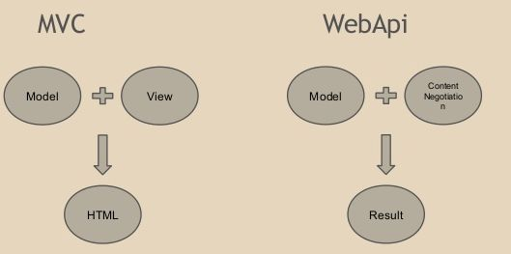
Web API

Slide 18
Web API
public class EmployeeController: ApiController
{
// GET: /Api/Employees/
public List < Employee > Get()
{
return EmployeeMaster.GetEmployees();
}
}

Slide 19
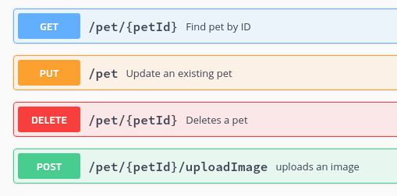
Web API
There are 7 HTTP methods, but only four are often used.

Slide 20
Web API
public IHttpActionResult GetCustomers() {}
[HttpPost]
public IHttpActionResult CreateCustomer(CustomerDto customer) {}
[HttpPut]
public IHttpActionResult UpdateCustomer(int id, CustomerDto
customer) {}
[HttpDelete]
public IHttpActionResult DeleteCustomer(int id) {}

Slide 21
Web API

