Slide 1
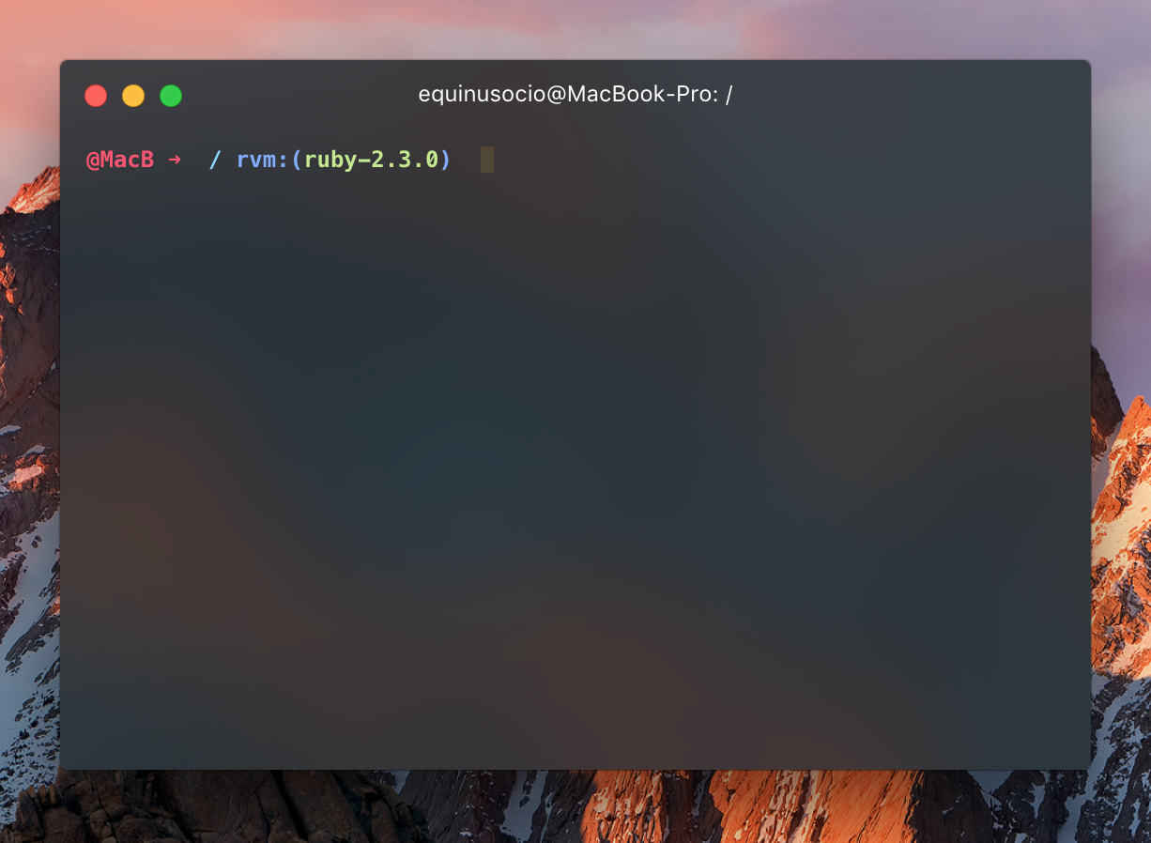
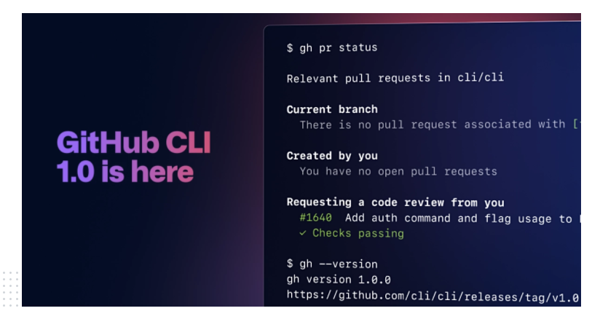
How To Use
Github CIL
~/repo$ gh pr status
Current branch
#12 Remove the test feature [user:patch-2]
- All checks failing - Review required
Created by you
You have no open pull requests
Requesting a code review from you
#13 Fix tests [branch]
- 3/4 checks failing - Review required
#15 New feature [branch]
- Checks passing - Approved

Slide 2
